Slide 1

QA – Questions & Answers
Mar 4, 2018
Taner Eşme

Slide 2

Agenda
Mockups
System Design
Software Components
Workflows
Sequence Diagrams
DB Diagrams

Slide 3
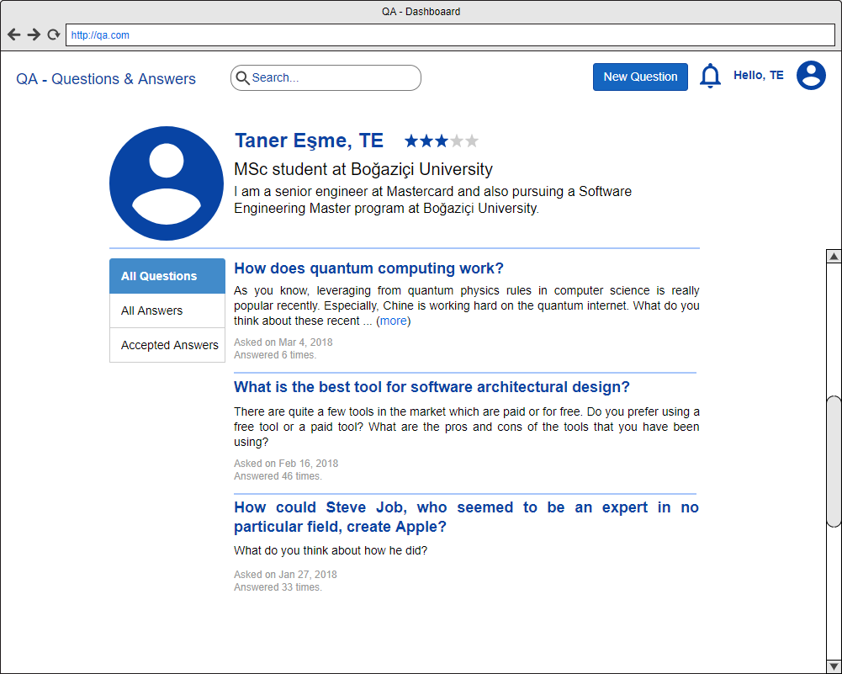
Mockups - Dashboard

Slide 4
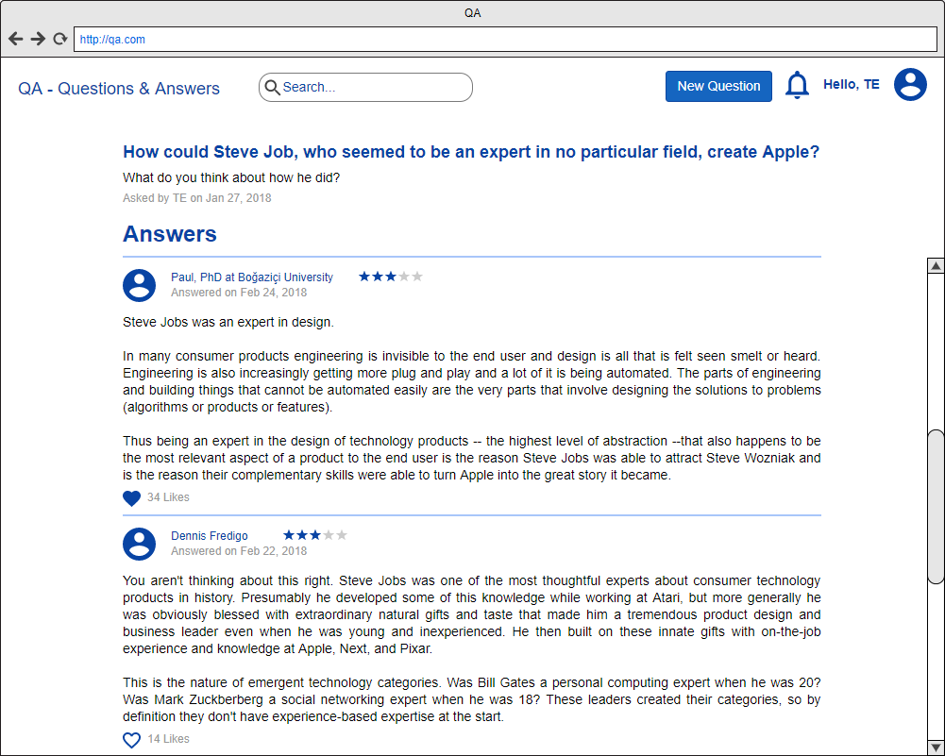
Mockups - Answers

Slide 5
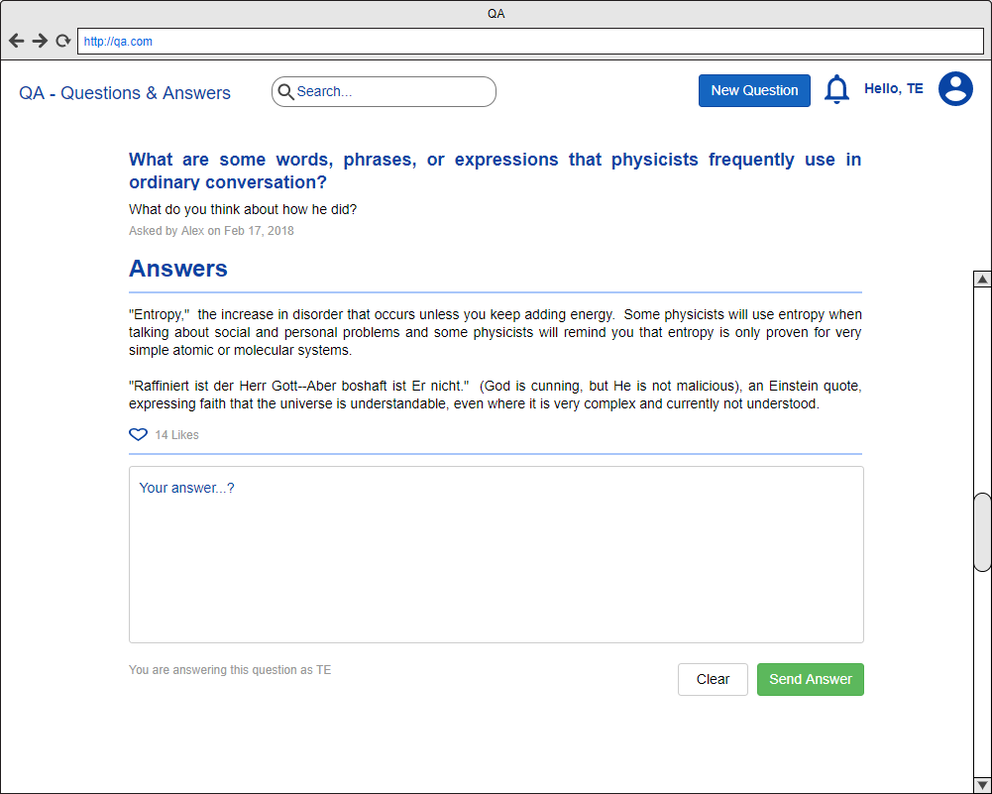
Mockups – Answer a Question

Slide 6
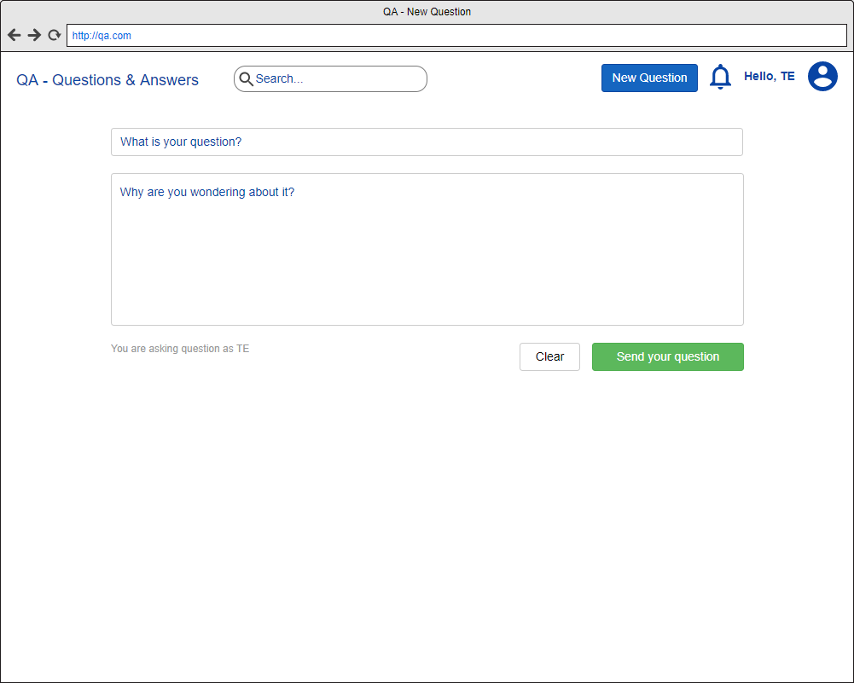
Mockups – Ask a Question

Slide 7
System Logical Design

Slide 8
Software Components

Slide 9
Workflows – New Question

Slide 10
Sequence Diagrams – New Question

Slide 11
DB Diagrams

Slide 12
Thank you!

