Slide 1

New Horizons for Requirements Engineering
December 16, 2017
Taner Eşme, Software Requirements Engineering

Slide 2

INTRODUCTION
In this presentation we will preview how RE evolved and we will discuss an alternative perspective on the discipline of RE. We will also advocate the evolution of RE toward a discipline that is applicable to any domain.

Slide 3
REQUIREMENTS ENGINEERING (RE)
RE practices and researches were affected by the incredible diversity of the domains besides software development. But the vast majority of requirements engineering application remains focused on Software-Intensive-System (SIS), which is the systems that software plays a significant role.

Slide 4
WHAT IS RE
Engineering
The historical record demonstrates that we learned everything that we need to know about engineering a very long time ago; consider what it took to build the Great Wall of China or the pyramids in Egypt and in many locations in South America. Since then, all we have done is become better at every aspect.
Requirements Engineering
Requirements engineering is the branch of software engineering concerned with the real-world goals for, functions of, and constraints on software systems. It is also concerned with the relationship of these factors to precise specifications of software behavior, and to their evolution over time and across software families.
RE Core Activities
-Elicitation
-Modelling and analysis
-Communication
-Agreeing (negotiation)
-Evolving (maintenance and management)

Slide 5
ANOTHER PERSPECTIVE ON RE
Engineering
Engineering is a body of practice that, when applied to the creation of a solution to a problem, ensures that the resulting solution artifacts will function as intended, with high probability, while meeting the constraints imposed by the problem stakeholders and the society within which the solution is initially deployed.
Requirements Engineering
Requirements Engineering is a body of practice that, when applied to the identification and definition of a problem, its stakeholders and their constraints, improves the probability that the results accurately represent the problem and the solution constraints and that the results are presented in a manner that facilitates communication between stakeholders.
Requirements
A requirement is a stakeholder constraint upon the problem space and/or the solution space.

Slide 6
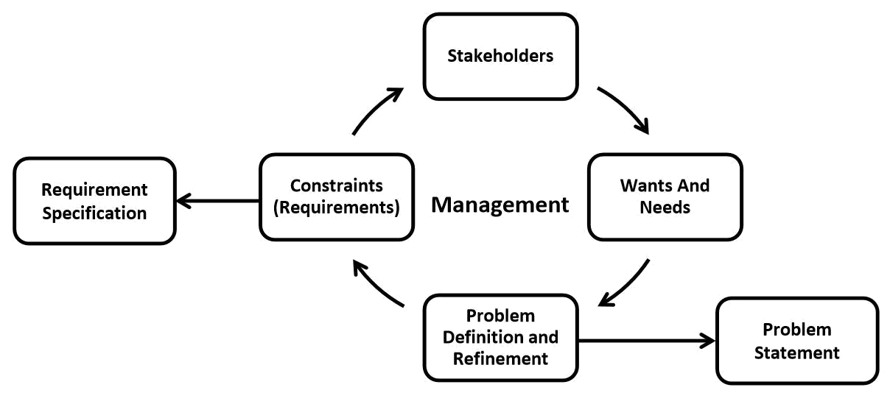
RE FOR SIS AND NON-SIS DOMAINS
Generic Requirements Engineering Process
Stakeholders: the people affected by the problem
Wants and needs: elicitation, exploration and identifying the core needs
Problem definition and refinement: the practical aspects of wants and needs, analysing the stakeholder expressions and leading to the later definition of functional and non-functional requirements
Constraints (Requirements): the necessary constraints upon the problem space and upon the solution space
Management: making the requirements engineering process work as needed, ensuring that the result is as close as possible to what was intended

Slide 7
CROSSING DOMAINS
When software aspects began to dominate system development and maintenance costs, the need to study the sociological and human aspects of system development became dramatically important. These trends helped requirements engineering better understand how to support the early phases of system development. Phases:
-Problem identification and definition
-Refinement
-Maintenance
-System phase-out or decommissioning
RELaw – Requirement Engineering and Law: The interactions of laws, policies and standards with software and system requirements to understand better ways to manage compliance, accountability, and traceability
RE Interactive, Creative Collisions: This initiative focused on interactions wherein the participants were randomly paired with the other participants for a 15-minute working session. Here the participants are from different domains and in the working sessions they mixed their knowledge and expertise to produce some results for creating a research problem statement and research mission statement.

Slide 8
NEW FRONTIERS FOR RE
Throughout this work, we advocated that RE should expand its frontiers beyond SIS and RE practice and research should embrace new horizons. We have discussed alternative perspectives on requirements engineering and on requirements. These alternative perspectives support the expansion of RE beyond SIS.

Slide 9
CONCLUSION
Expanding the frontiers of requirements engineering beyond the development of SIS can only make RE a more effective practice with the potential for delivering significant benefits to other domains.

Slide 10
THANK YOU

