Slide 1
KAIZEN
Taner Eşme, 2018

Slide 2
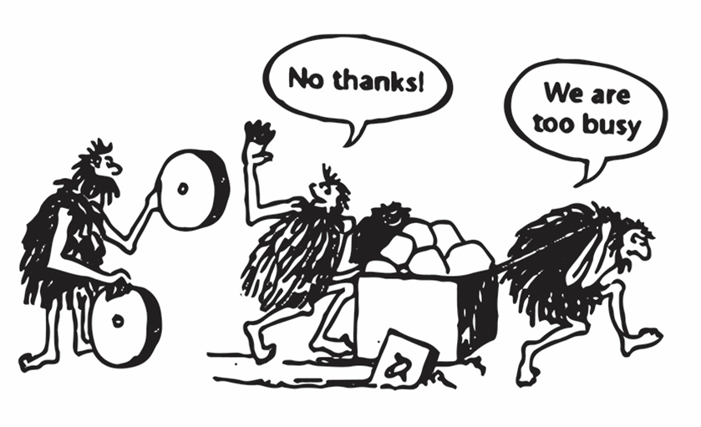
What is Kaizen?
If you are not getting better, you are getting worse!, Rat Riley

Slide 3

Kaizen Principles
Big Picture
Look for opportunity to improve
Teamwork
Focus on progress not perfection
Debottleneck

Slide 4

Types of Waste
Transportation
Inventory
Motion
Waiting
Overproduction
Over Processing
Defects

Slide 5
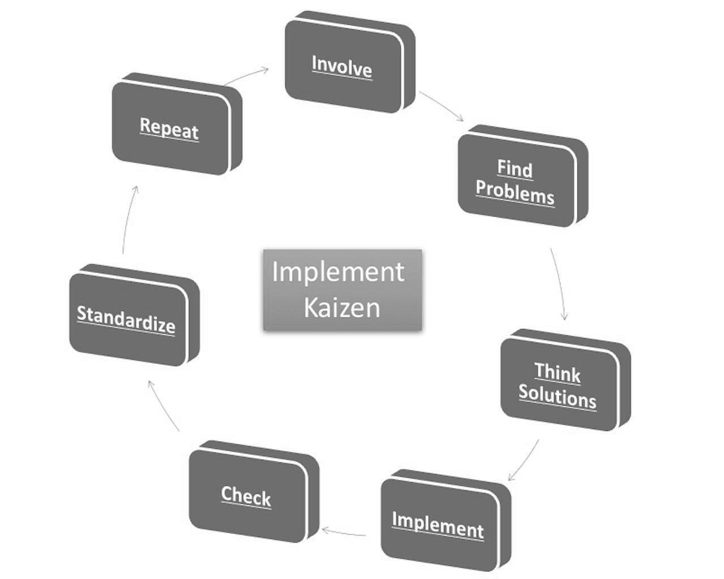
How to Implement Kaizen

Slide 6
Involve
Involve your employees because it will later help you to empower your employees as well.
To implement Kaizen, you need your employees motivated and involved.

Slide 7
Find Problems
Accept and find problems in your organization.
List out all the processes within the organization which needs improvements.
List out the problems and issues in a “To Do” Place.

Slide 8
Think Solutions
Dedicate specific time of the employees to find solutions to the problem.
Do not shoot down any suggestion because it might come in later.
Write down the solutions, and by using your own experience and the experience of the team, shortlist the suggestions which make the most sense.

Slide 9
Implement
Small-scale implementation is the best way to test out.
The implementation must be done in a planned manner.

Slide 10
Check
Ensure that implementation is done to the ground level so that the results are proper.

Slide 11
Standardize
If the results were positive and you find the process improving, then, by all means, standardize the process across all departments and across all locations.

Slide 12
Repeat
Repeat the complete procedure so that further tasks can be optimized.
Over a period of time, it becomes a culture in the organization to eliminate waste and to improve processes.

Slide 13
Start small, and take small steps!

