Slide 1
Professional Documentation Presentation – ISK1001
Group – Taner, Stephen and Jack

Slide 2
Project Purpose Explanation
The chosen project was the Cocktail Reference Application created by Taner Maddocks for the Custom Software Application assessment in the DEV1001 class.
The program’s purpose is to track the menu of a bar or other similar establishment’s menus and create mix items out of the bar’s menu items.
The stock items and mix items all have an array of data attached to them, such as price, name, and alcohol content.
Other functions of the app include adding new items, search and deleting items and showing filtered item lists.

Slide 3
Ethical Review
Due mostly to the simplicity of the project, no ethical concerns were raised.

Slide 4

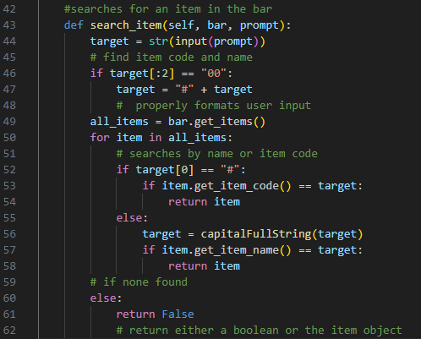
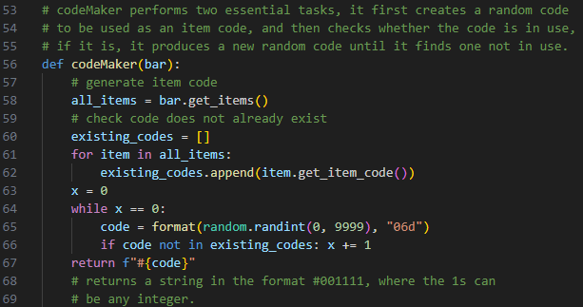
Method/Function Examples
codeMaker function:
Checks for and creates item codes when new stock items or mixes are created by a users.
search_item method:
Takes a user’s input, which will be an item number or an item name when using the searchItem() function.

Slide 5
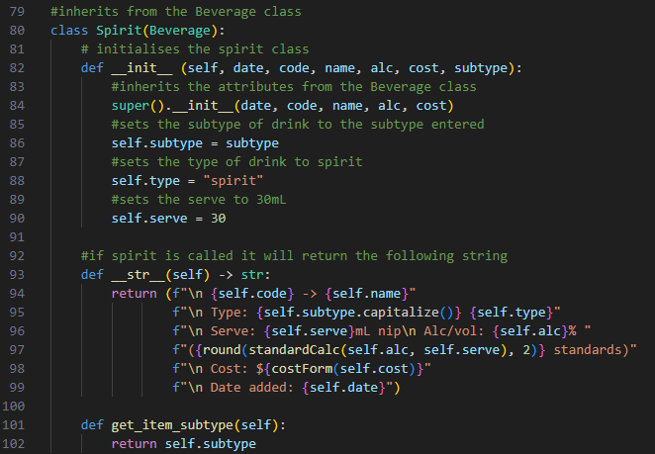
Class Explanation
The Spirit class, much like the Beer, Wine and Mix classes, inherits from the Beverage class.
The difference between the classes is primarily the data which they collect, as an example, unlike the Beer and Wine classes, the Spirit class has the subtype object, and as such it needs additional getters and setters for that object.
Each of the classes also has a different __str__ method, so that they can display the appropriate information when called.

Slide 6
Feedback Review

