Slide 1
Professional Documentation Presentation – ISK1001
Group – Taner, Stephen and Jack

Slide 2
Project Purpose Explanation
The chosen project was the Cocktail Reference Application created by Taner Maddocks for the Custom Software Application assessment in the DEV1001 class.
The program’s purpose is to track the menu of a bar or other similar establishment’s menus and create mix items out of the bar’s menu items.
The stock items and mix items all have an array of data attached to them, such as price, name, and alcohol content.
Other functions of the app include adding new items, search and deleting items and showing filtered item lists.

Slide 3
Ethical Review
Because the application specifically refers to alcoholic beverages, there is the necessity to ensure that the application is used only by parties that bear in mind the consequences that alcohol can have on different groups.
As an addon to concerns about alcohol, the app provides information relevant to Australian standard drinks, the information is provided to assist in managing alcohol consumption, but there exists the concern that is could result in the opposite.
While the application does not actively track stock (though that could be a future feature), the application does concern itself with pricing. The use of the application in a setting where money is exchanged is cause for care to be taken in its use.

Slide 4

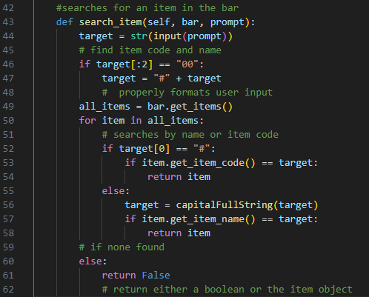
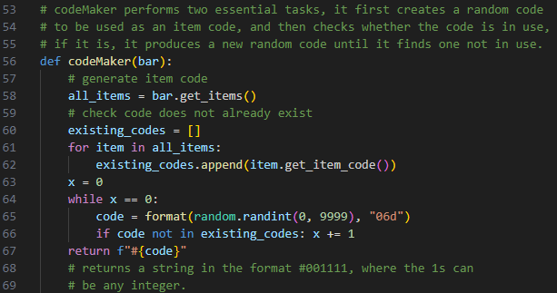
Method/Function Examples
codeMaker function:
Checks for and creates item codes when new stock items or mixes are created by a users. Makes use of the inbuilt python module ‘random’.
search_item method:
Takes a user’s input, which will be an item number or an item name when using the searchItem function.
The random module was used so that each code would be unique, as the randint method specifically, will produce an integer value that is distinct to any code used before it.

Slide 5
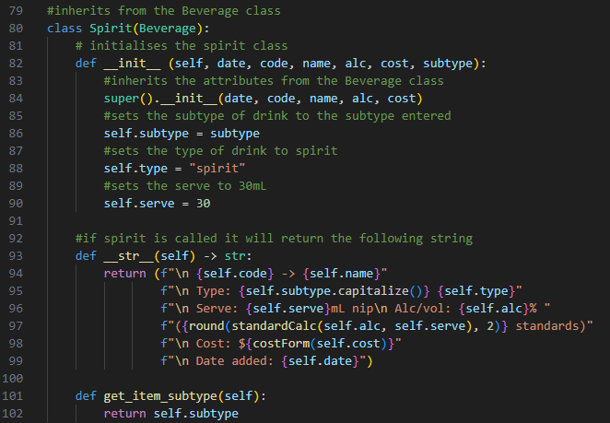
Class Explanation
The Spirit class, much like the Beer, Wine and Mix classes, inherits from the Beverage class.
The difference between the classes is primarily the data which they collect, as an example, unlike the Beer and Wine classes, the Spirit class has the subtype object, and as such it needs additional getters and setters for that object.
Each of the classes also has a different __str__ method, so that they can display the appropriate information when called.

Slide 6
Feedback Review

