Slide 1
Mean-Reversion Swing Strategy on the Magnificent Seven
Presented by Tanesh Singhal for FIN 7053 Final Project.

Slide 2
Why Mean Reversion?
Stocks often overshoot on extreme moves
Capturing “oversold” dips can deliver positive returns
Focus on the Magnificent Seven mega-caps

Slide 3
Data Source & Universe
AAPL
Apple Inc.
MSFT
Microsoft Corp.
Data feed: Alpaca Data API (EOD bars)
Date range: January 2021 to today
GOOGL
Alphabet Inc.
Universe: AAPL, MSFT, GOOGL, AMZN, NVDA, META, TSLA
AMZN
Amazon.com Inc.
NVDA
NVIDIA Corp.
META
Meta Platforms Inc.
TSLA
Tesla Inc.

Slide 4
Entry: Bollinger Bands (20, 2)
Calculation
Entry Signal
Purpose
20-day SMA ± 2×STD defines bands
Buy when price falls below lower band
Identifies statistically “oversold” conditions

Slide 5
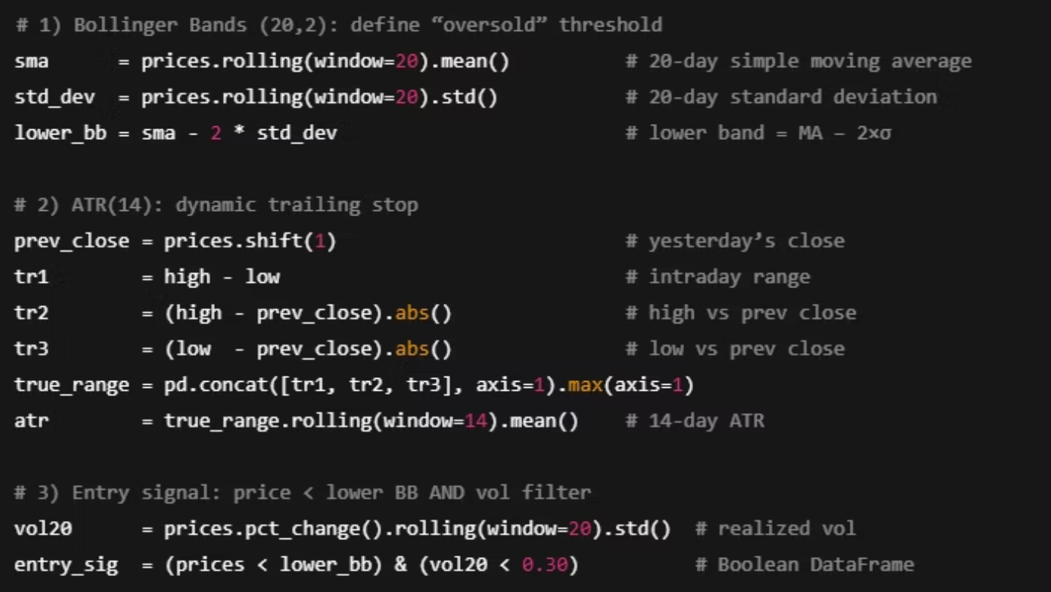
Implementation: Key Code Snippet

Slide 6
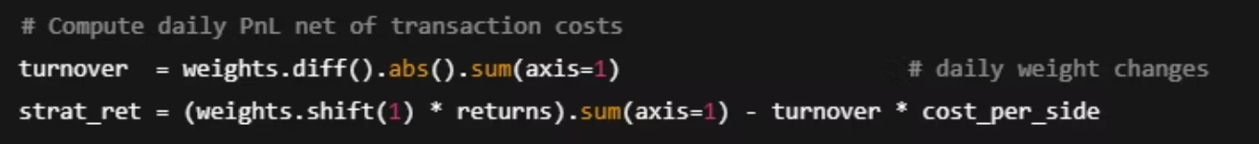
Implementation: Execution & Sizing
Next-day execution via signal.shift(1) avoids look-ahead bias
Position sizing: equal-weight → cap at 30% per stock → redistribute excess
Transaction costs: modeled at 2 bps default, varied in sensitivity tests
Capacity constraint: max 1% ADV per stock

Slide 7
Backtest Integrity & Caveats
Survivorship bias: universe is fixed (no delistings)
Look-ahead bias: signals all lagged by one day (.shift(1))
Transaction cost realism: modeled, but slippage not simulated
Over-fitting guardrails: parameter sweep & walk-forward validation

Slide 8
Volatility Filter & ATR Stop
Volatility Filter
ATR Stop
Risk Control
Exclude days with 20-day volatility over 30%
Trailing stop set at price minus ATR(14)
Protects against prolonged adverse moves

Slide 9
Exit Rules & Risk Management
Exit Rules
Risk Controls
Exit if price ≤ trailing stop (stop-loss)
Max 30% weight per stock
Exit if price ≥ 20-day SMA (mean reversion)
Kill-switch: cash out if drawdown > 10% for 10 days

Slide 10
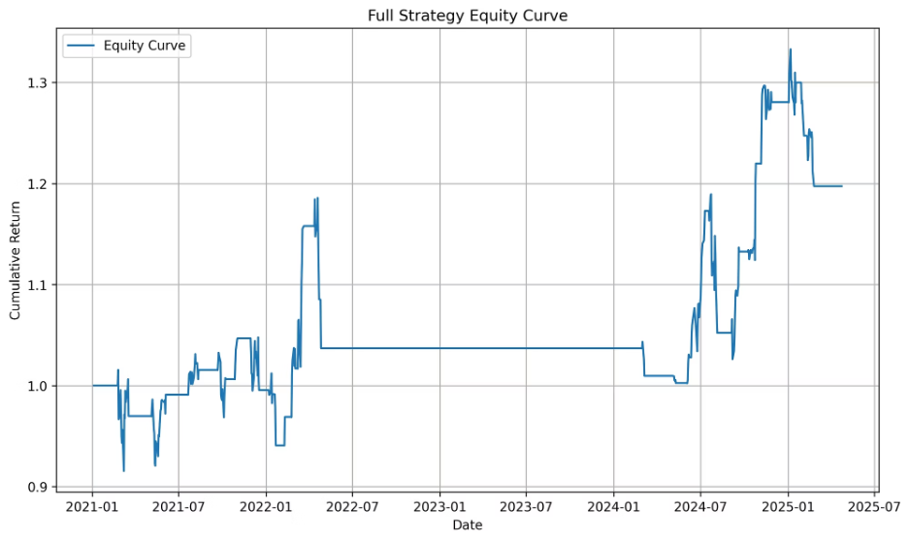
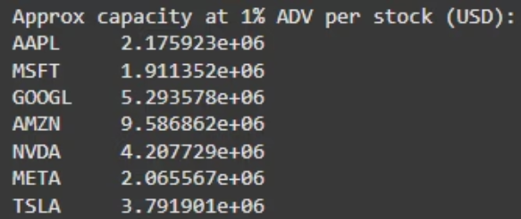
Liquidity, Capacity & Performance
Liquidity & Capacity
Backtest Results
Trade size capped at 1% average daily volume per stock
Annualized Return: 4.29%
Example: NVDA ≈ $4.21 million daily volume
Annualized Volatility: 13.76%
Sharpe Ratio: 0.31
Max Drawdown: 15.49%

Slide 11
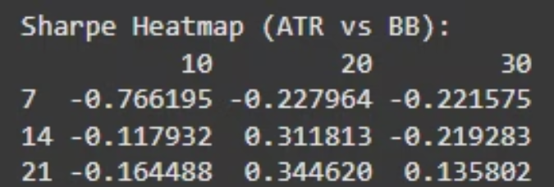
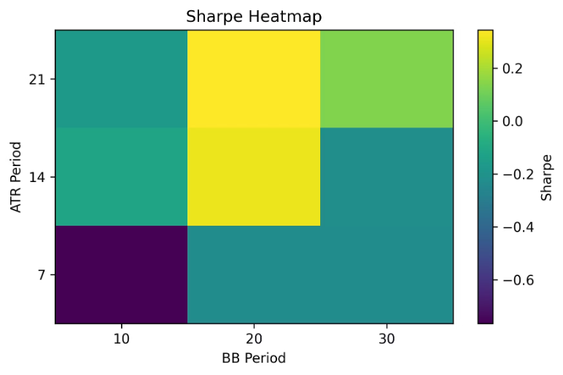
Trading Costs & Parameter Sensitivity
Cost (bps)
Return
Sharpe
Max DD
2
4.29%
0.31
15.49%
5
4.60%
0.34
13.85%
10
0.78%
0.06
17.16%
20
-4.73%
-0.40
24.91%
Strategy holds edge up to 5 bps costs; robust across parameters.

Slide 12
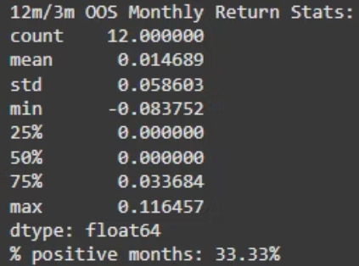
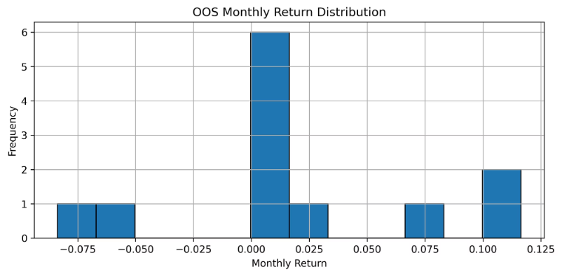
Walk-Forward Validation
12 months calibration, 3 months out-of-sample test
33.33% of months show positive returns
Mean return 1.47%, std 5.86%, min -8.38%, max 11.65%
Forward testing confirms repeatable performance beyond backtest.

Slide 13




Conclusions & Next Steps
Key Takeaways
Mean-reversion works on mega-caps with risk controls and filters.
Future Enhancements
Expand universe to mid-caps and sectors
Add macro filters like SPY 200-day SMA
Monte Carlo and bootstrap analysis
Live execution with slippage and latency modeling
Thank You!
GitHub: github.com/taneshsin/FIN7053-final-project

