Slide 1
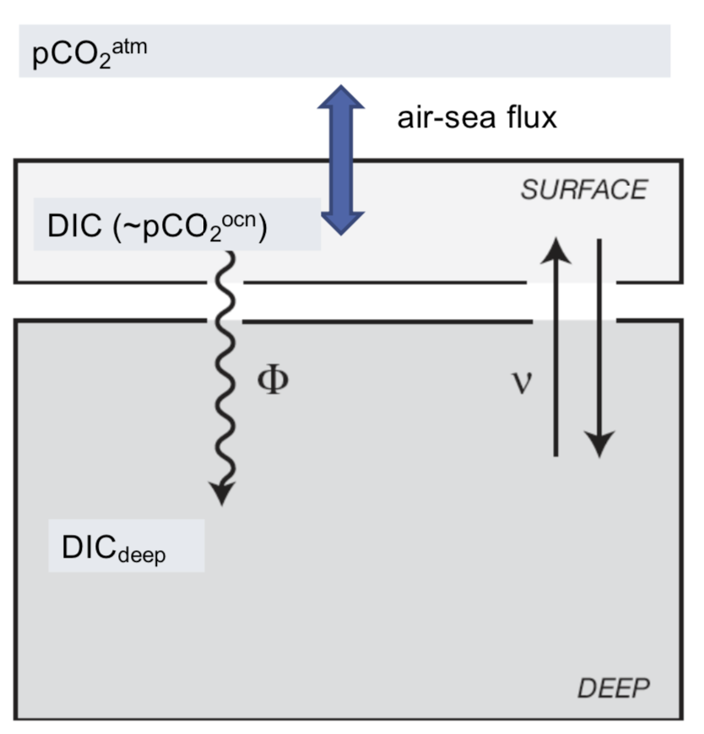
Ice cover

Slide 2
Ice cover

Slide 3
Ice cover

Slide 4
Ice cover

