Slide 1
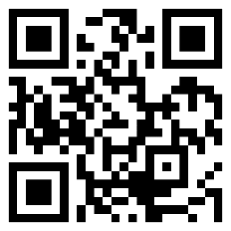

Find me @
Find me @
Find me @
FIONA ANTING TAN
FIONA ANTING TAN
FIONA ANTING TAN
FIONA ANTING TAN
FIONA ANTING TAN
PHD STUDENT, Data science/ NLP
PHD STUDENT, Data science/ NLP
PHD STUDENT, Data science/ NLP
PHD STUDENT, Data science/ NLP
PHD STUDENT, Data science/ NLP
tan.f@u.nus.edu
tan.f@u.nus.edu
tan.f@u.nus.edu
tan.f@u.nus.edu
tan.f@u.nus.edu
Institute of Data Science
Institute of Data Science
Institute of Data Science
Institute of Data Science
Institute of Data Science
National University of Singapore
National University of Singapore
National University of Singapore
National University of Singapore
National University of Singapore
FIONA ANTING TAN
FIONA ANTING TAN
FIONA ANTING TAN
FIONA ANTING TAN
FIONA ANTING TAN
PHD STUDENT, Data science/ NLP
PHD STUDENT, Data science/ NLP
PHD STUDENT, Data science/ NLP
PHD STUDENT, Data science/ NLP
PHD STUDENT, Data science/ NLP
tan.f@u.nus.edu
tan.f@u.nus.edu
tan.f@u.nus.edu
tan.f@u.nus.edu
tan.f@u.nus.edu
Institute of Data Science
Institute of Data Science
Institute of Data Science
Institute of Data Science
Institute of Data Science
National University of Singapore
National University of Singapore
National University of Singapore
National University of Singapore
National University of Singapore
Notes:
To change the first sample business card, replace the content with your own. To change the logo, select the picture “replace with LOGO” and choose Change Picture on the Picture Tools Format tab. Or, if you’d rather start from a clean slate, press the New Slide button on the Home tab to insert a new page. Now enter your text in the empty placeholders and add your logo using Insert Picture.

