Slide 1
DaTA SCIENCE Modeling
Xin Tang

Slide 2


What is modeling in Data Science
The modeling is the primary place where the data mining techniques are applied to the data.
Through supervised learning, modeling builds a simplified representation of reality created to serve a purpose
If the target attribute is a category, we call it classification
If the target attribute is a number, we call it regression
Prepared Data
Modeling

Slide 3
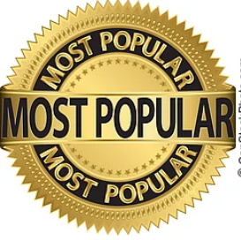
The types of modeling in Data Science
The predictive modeling is to estimate the unknown value of interest, the target by some known data features.
i.e.: Amazon predict what merchandise you like.
Judged by its predictive performance
The descriptive modeling is to gain insight into the underlying process or phenomenon.
i.e.: What cell phone customers who churn typically look like.
Judged by its intelligibility. (how easy to understand)
The Optimization modeling seeks to assess and determine the optimal variable values given an equation.
Best dimension to build a fence to improve livestock yield

Slide 4
Build the model, avoid overfitting and under fitting
Data need to prepared and evaluated.
Duplicate? missing data?
Data had information interested?
Data will be split into training and test data set, first set will be used build a model, then the model will be applied to test data to make prediction.
Many methods can be used to build the model.
Decision Tree
Linear regression
Logic regression
Others
Necessary steps need to taken to avoid overfitting and underfitting
Underfitting refers to a model that can neither model the training data
Overfitting happens when a model fit the the training data so well that it negatively impacts the performance of the model on test data

Slide 5
What’s a good model?
A good model can generalize well to new unseen data based on what it has learned from the training data.
i.e.: Amazon predicted and recommend merchandised to your based on your browsing history.
Do you think Amazon makes recommendations fit your need?
A data scientist will use different metrics to evaluate, visualize various models and compare their performance.
Accuracy and Precision
Mean Squared Error
ROC and AUC: Receiver Operating Characteristic (ROC) curve and Area Under the ROC Curve (AUC)
Expected value

Slide 6
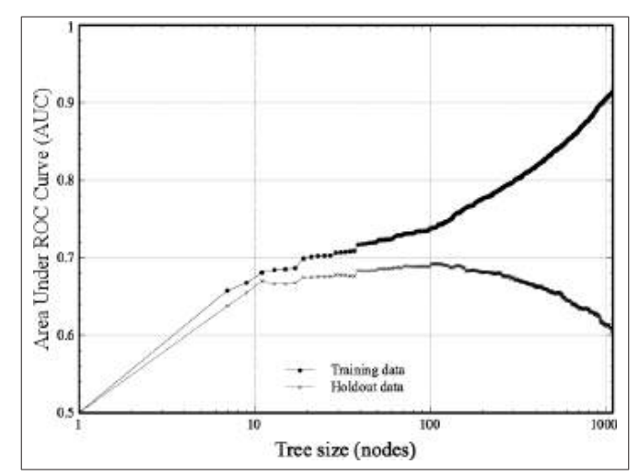
Visualization
A chart worthy a thousand words.
Data is too much and too complex to understand directly, same as model.
A good visualizations helps in comprehension, communication, and decision making
Sweet spot when increasing complexity of the tree
Circled area are tree nodes needed to build model to make best predictions on hold out data.

Slide 7
Acknowledgement and Credits
Majority statements are quoted from book “Data-Science-for-Business” by Foster provost and Tom Fawcett
Many Thanks to my classmate of DSC500 Winter 2022, they contributed many knowledges through weeks team post/discussion.
Thanks to Professor Matthew Metzger, his design of course provided many interesting discussion topics, which contribute many contents to this topic.

