Slide 1
DaTA VISULIZATION basketball game sale
Xin Tang

Slide 2
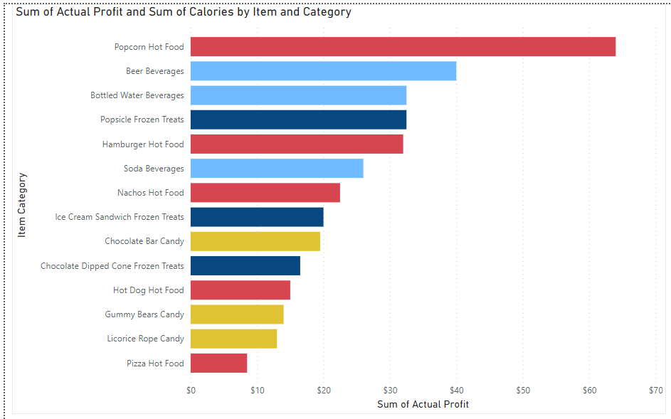
Clustered Bar Chart
This chart give a visual on which item yield most profit.
Different categories are represented by different colors. I.e.: hot food are red bars, frozen treats are dark blue bars.
It is shown that hot food and beverage are making most money, candy is not very profitable.
University did not provide the capability to install power BI add in into power point, so all charts are screen shot only.​

Slide 3
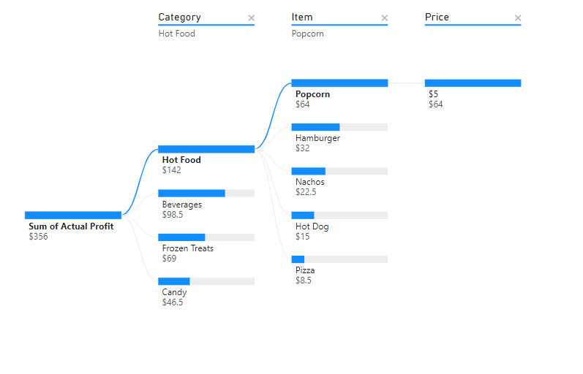
Tree Chart
This chart give a dynamic drill own visual on information wanted.
If in power BI, or properly inserted into PowerPoint, A click on any branches will drill into next level of information.
From this chart, we can see that popcorn is a good game watch merchandise, while pizza may not be a good item to make money.

Slide 4
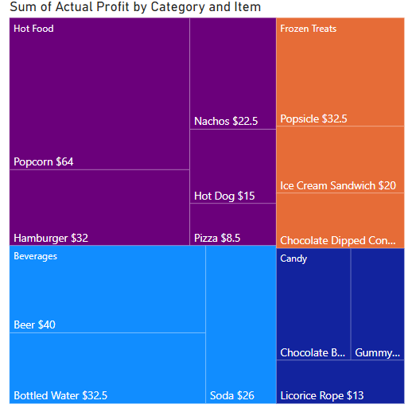
Matrix Chart
This chart give a visual on the profit made by each categories as well as each items.
It is very clear that hot food type made most profit. The popcorn is the most profitable in that category.
Matrix chart gives a direct visual comparison among each group and items, the different colors also help to differentiate each group from another.

Slide 5
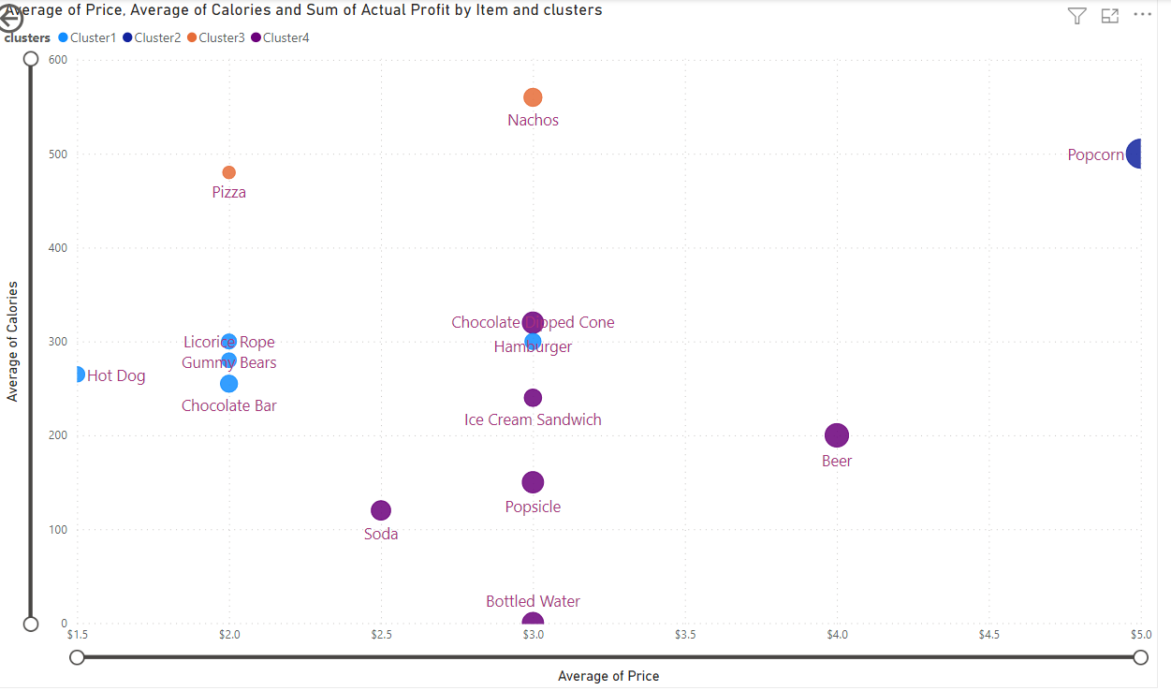
Scatter Chart
This scatter chart try to do an unsupervised clustering of the items, based on price and calories.
By requesting 4 clusters. The items are clustered based on similarities.
Popcorn stand as its own due to high calories and with a most pricy tag
This chart may help game watchers to pick items based on their need. For example, pizza is a good choice if you want something cheap but can fill you up.

