Slide 1
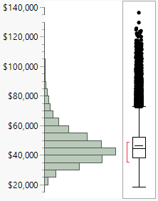
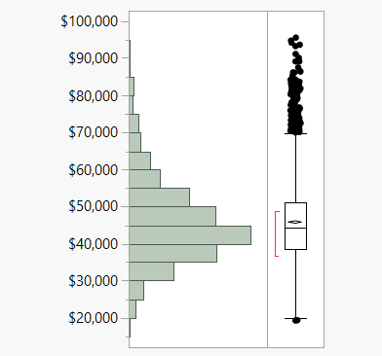
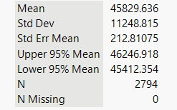
Median household income (all states)
Median household income (Texas only)
Mean 46432.003
Std Dev 12457.049
Std Err Mean 67.001472
Upper 95% Mean 46563.328
Lower 95% Mean 46300.678
N 34567
N Missing 0

Slide 2
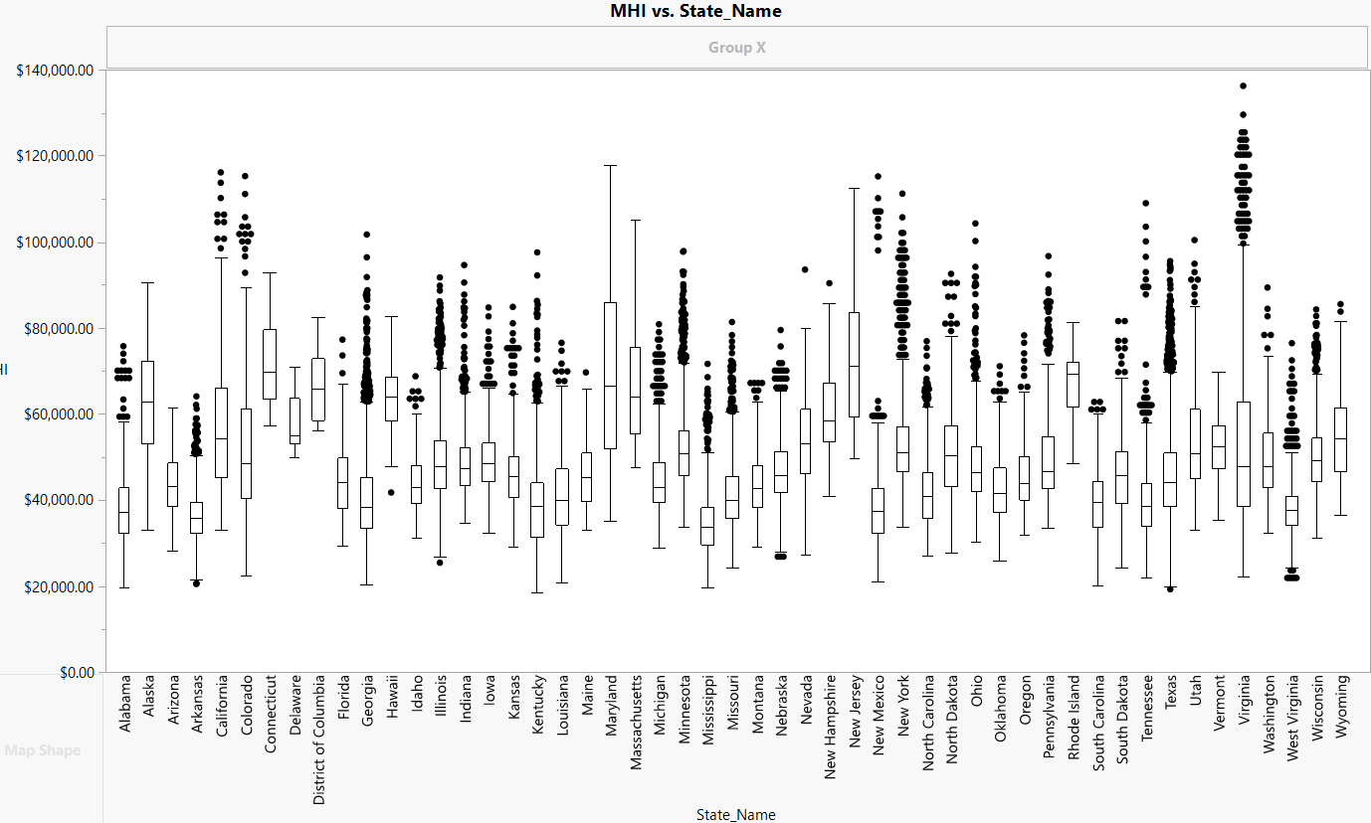

Slide 3
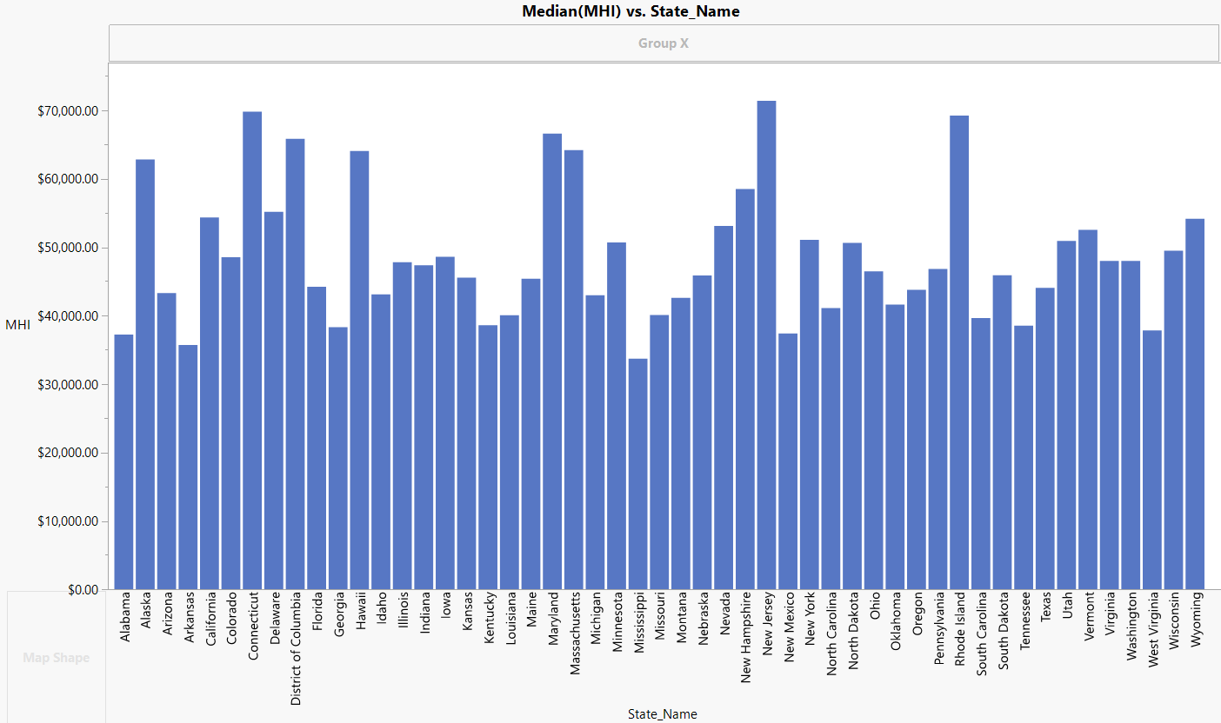

Slide 4
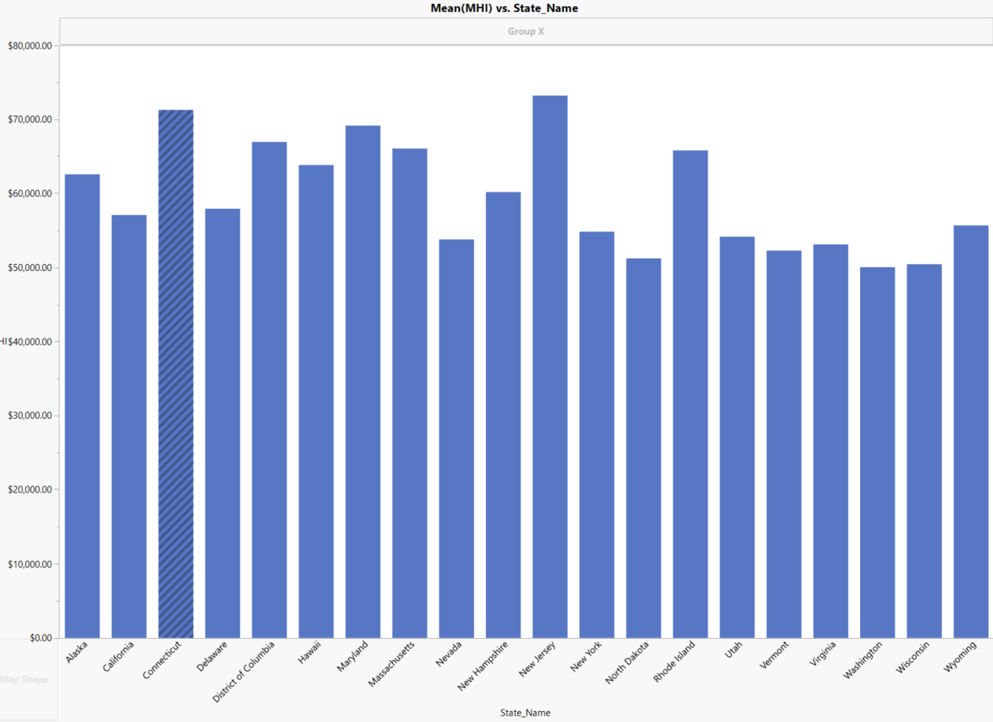
Above median household income state

Slide 5
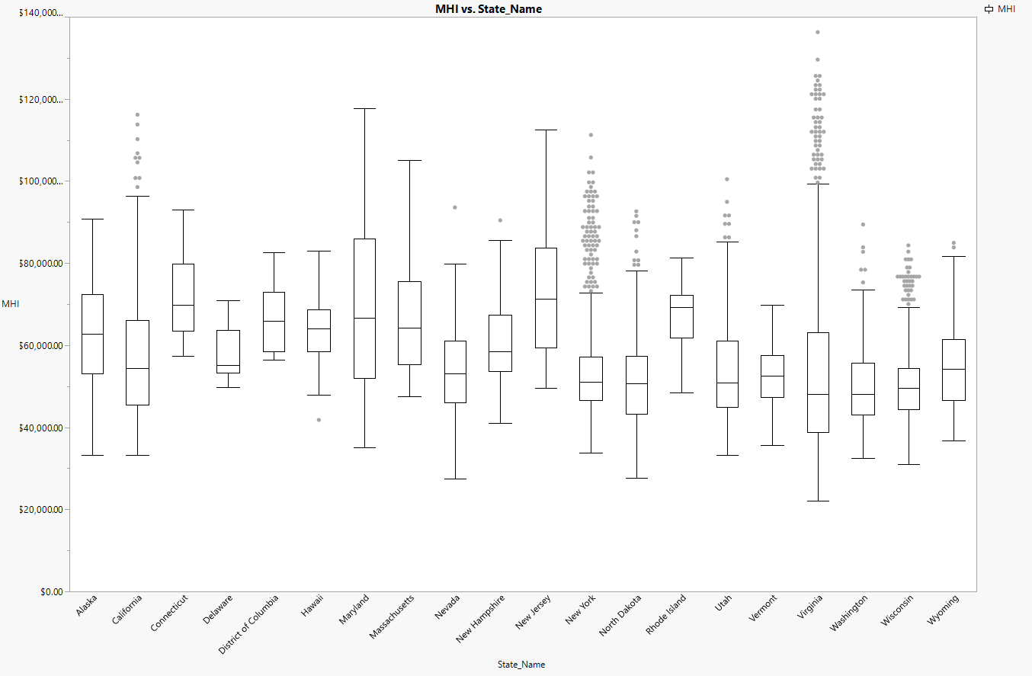
Above median household income from ‘rich’ state

Slide 6
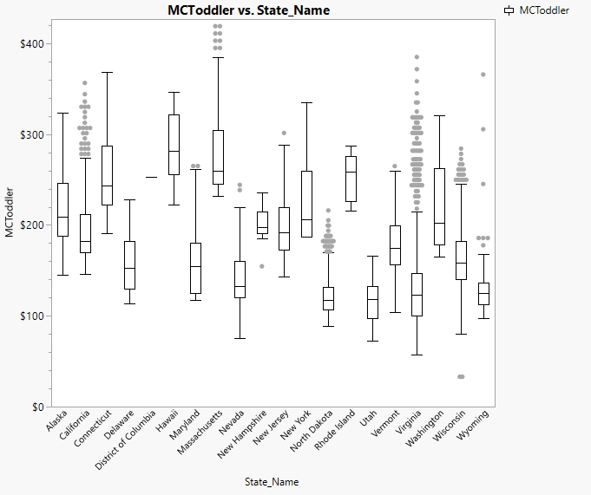
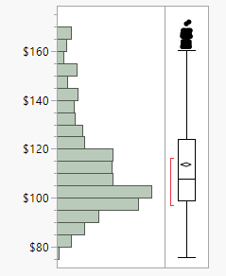
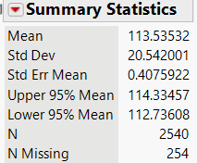
Median center care price for toddler (all > avg household income states)
MCToddler (Texas)
Median=$108
Median =$155

Slide 7
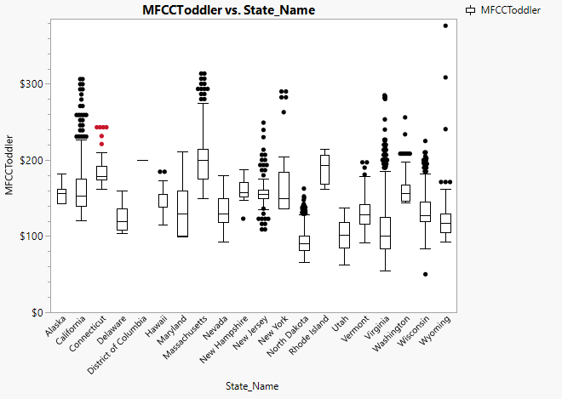
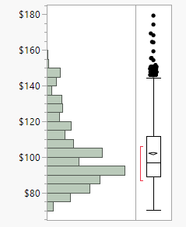
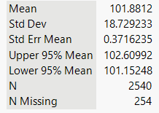
Median family care price for toddler (all > avg household income states)
MFCCToddler Texas
Median=$108
Median =$125

