Slide 1
Movie or TV?
Xin Tang

Slide 2
Background:
Netflix signed a contract to produce a potential top seller title, which potentially become 1 top 10 seller.
As an independent producer, a question arise:
Movie or TV ?
Which format can attract more viewer time?
Longer view time can have more opportunities for advertisement.
Does top 10 matters?
Do we want to make it fit for no-English market?

Slide 3
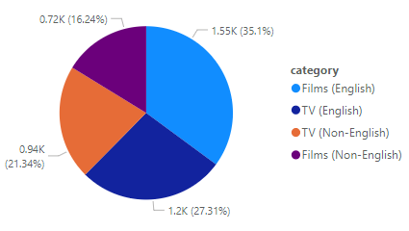

English film and English TV consume 62% of view time

Slide 4
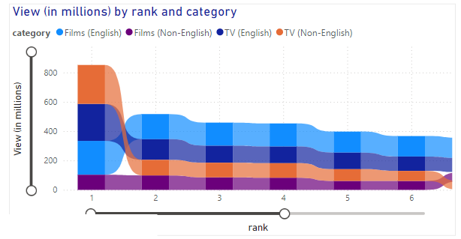
Non-English TVs also tank except No.1 title
Non-English films are not very popular

Slide 5
Top 5 ranked English film: Average weekly view time is ~ 50M hour Top 10 average English film weekly view time: 12M hour

Slide 6
Top 5 ranked English TV: Average weekly view time is > 70M hour Top 10 average English TV weekly view time: 22.1 M hour

Slide 7
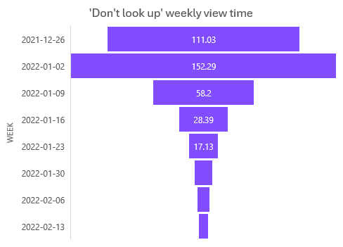
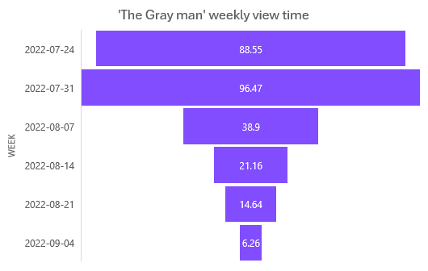
Top 2 English movie weekly view time trend
Unit in million hours
The view time start high but shrink quick after first 3 weeks

Slide 8
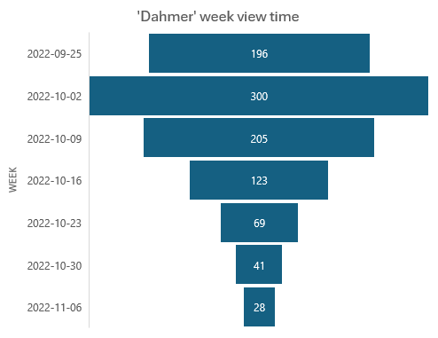
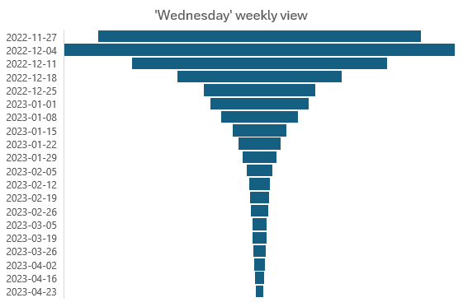
Top 2 English TV weekly view time trend
Unit in million hours
441
Still have 28M hour view at week 7
Stay on top10 for 20 weeks

Slide 9
Weekly average base:
Top 5 English TV average view time is 40% more than top 5 English movie (70 M vs 50M)
Top 10 English TV viewed 80% more than top 10 English movie (22.1M vs 12 M)
Top English TVs stays on top 10 list longer.
Let’s make an English TV series!

Slide 10
Data analysis
Power BI analysis
Excel file analysis

