Slide 1

Lab 2

Slide 2
What We Want to Do

Slide 3
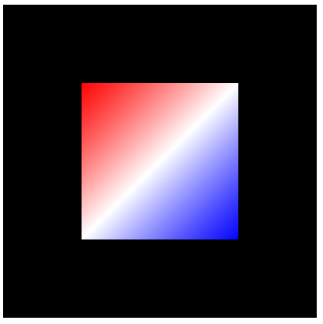
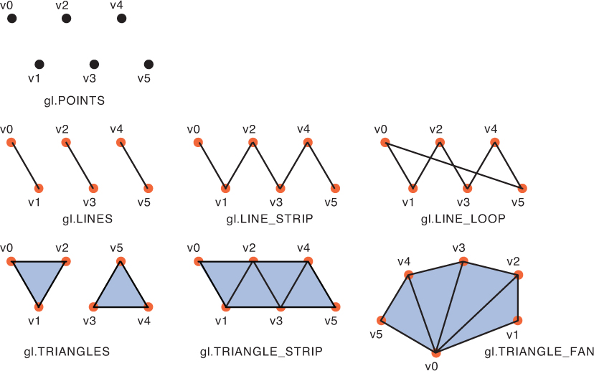
Draw a rectangle
Why is this hard? Any difference to draw a triangle or line?
Review gl.drawArrays()
There is no “gl.Quad” or “gl.rectangle”

Slide 4
Draw a rectangle
Why is this hard? Any difference to draw a triangle or line?
Review gl.drawArrays()
There is no “gl.Quad” or “gl.rectangle”
We have to use multiple triangles to draw a rectangle

Slide 5
What You Should Do Step by Step

Slide 6
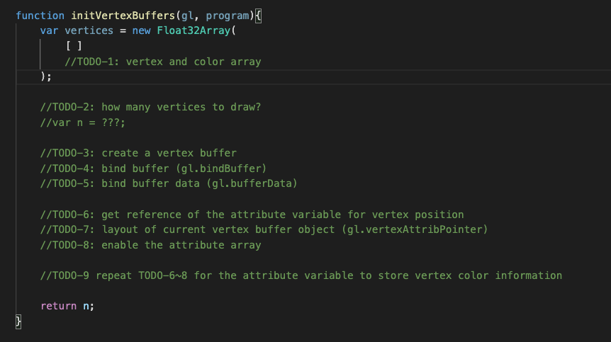
Check ”TODOs”
Check Line68 first
I use “gl.TRIANGLE_STRIP” in gl.drawArray()
Check TODO comments
They are all in initVertexBuffers()

Slide 7
Position: (-0.5, 0.5)
Color: (1.0, 0.0, 0.0)
Position: (0.5, 0.5)
Color:(1.0, 1.0,1.0)
Position: (-0.5, -0.5)
Color:(1.0, 1.0,1.0)
Position: (0.5, -0.5)
Color:(0.0, 0.0, 1.0)

Slide 8
What You Should Do for “Submission”

Slide 9
Submission Instruction
Create a folder
Put the html and js files in the folder
Zip the folder
Rename the zip file to your student ID
For example, if your student ID is “40312345s”, rename the zip file to “40312345s.zip”
Submit the renamed zip file to Moodle
Make sure
you put all files in the folder to zip
You submit the zip file with correct name
You won’t get any point if
the submitted file does not follow the naming rule,
TA cannot run your code,
or cannot unzip your zip file.

