Slide 1

Lab 10

Slide 2
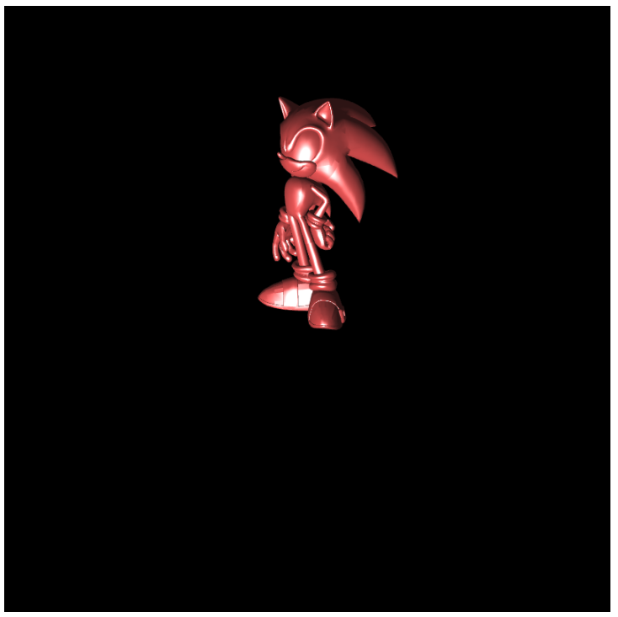
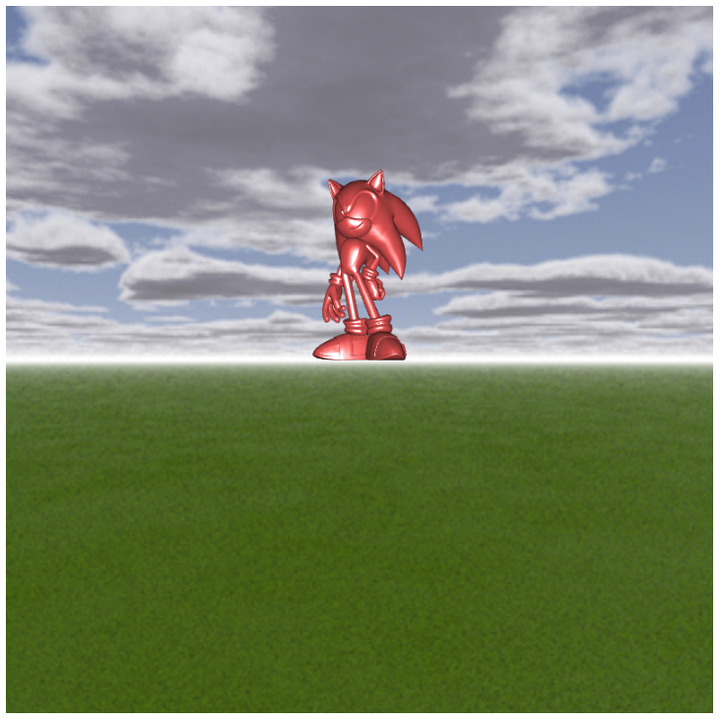
Download the lab10 template
This template is similar to Ex07-3
It gives you a sonic with nice illumination, but this is all it has
Also, it uses the model matrix to rotate the sonic instead of changing the view matrix
Goal:
Add environment map (use quad and cubemap) to this scene
When users press “w” or “s”, let the camera move forward or backward
When users use mouse to click and drag, rotate the camera view direction
Check comments, TODO-1, 2, and 3
I suggest that you can set the initial camera position to (0, 0, 5) and the initial camera direction to (0, 0, -1)
After you implement the environment cubemap, move the mouse cursor on the canvas if you do not see the environment cubemap
Essentially, this lab is to combine Ex07-3 and Ex 10-3
https://www.youtube.com/watch?v=P2lNiWHc-XY&list=PLsId7efYPyAah0Z64j9DpedSVAcvzOSKb&index=12&ab_channel=Ko-ChihWang

Slide 3
What You Should Do for “Submission”

Slide 4
Submission Instruction
Create a folder
Put the html and js files in the folder
Zip the folder
Rename the zip file to your student ID
For example, if your student ID is “40312345s”, rename the zip file to “40312345s.zip”
Submit the renamed zip file to Moodle
Make sure
you put all files in the folder to zip
You submit the zip file with correct name
You won’t get any point if
the submitted file does not follow the naming rule,
TA cannot run your code,
or cannot unzip your zip file.

