Slide 1

Lab 12

Slide 2
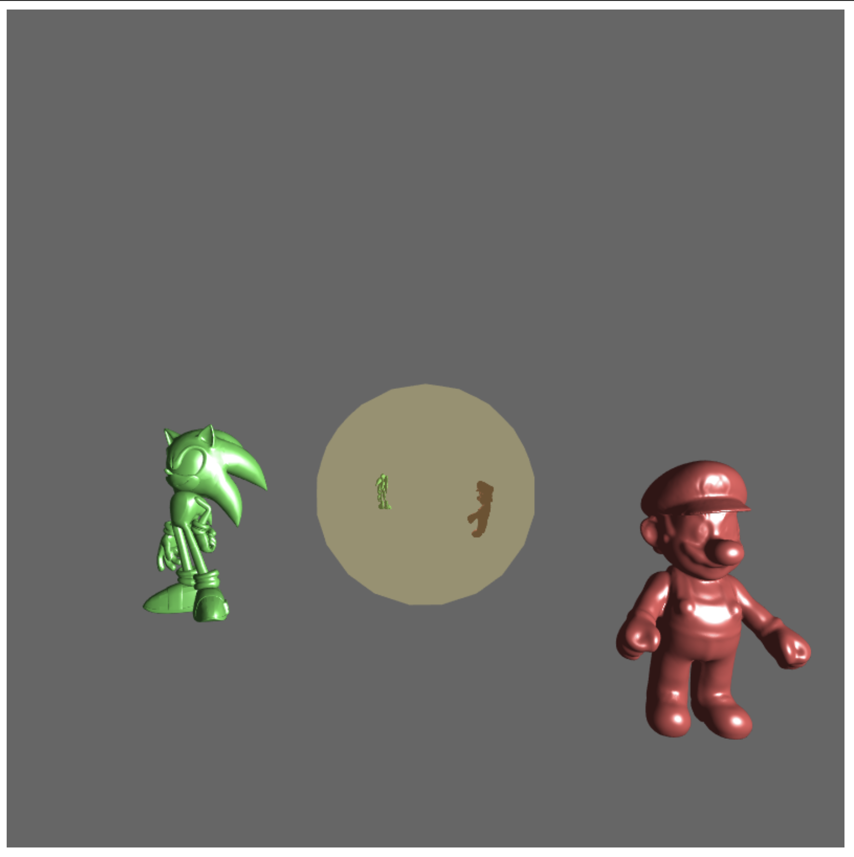
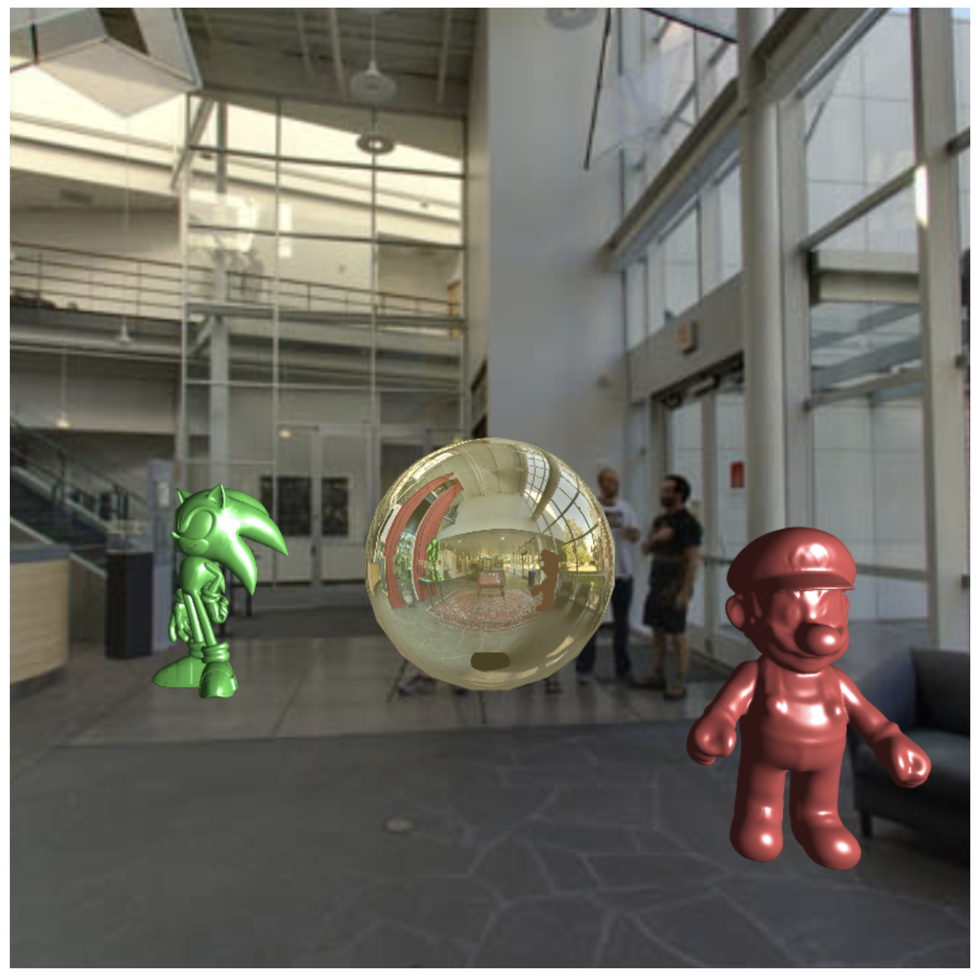
Download the lab12 template
This essentially Ex12-3, but remove the ground
Goal:
Add the environment background
Let the sphere reflect the environment background, too
Essentially, this lab is to combine Ex10-3 and Ex 12-3
https://www.youtube.com/watch?v=Qg7amBYc2QQ&ab_channel=Ko-ChihWang

Slide 3
The following is the steps I suggest
Copy and paste Ex10-3 shader to this lab (of course, remember to compile it to make a program)
Copy “initCubeTexture()” to this lab and call it in main() to create the environment background cubemap
Copy the array “quad” to this lab and use “initVertexBufferForLaterUse” to create VBO for this quad (for use of background screen)
You may add one function “drawEnvMap()”.
The responsibility of this function is to draw the environment background on the background screen quad. Similar to what we did in Line 177-186 in Ex10-3.
Call “drawEnvMap()” in draw() and renderCubeMap()
To render the background environment in your scene and on-line rendered cube map

Slide 4
What You Should Do for “Submission”

Slide 5
Submission Instruction
Create a folder
Put the html and js files in the folder
Zip the folder
Rename the zip file to your student ID
For example, if your student ID is “40312345s”, rename the zip file to “40312345s.zip”
Submit the renamed zip file to Moodle
Make sure
you put all files in the folder to zip
You submit the zip file with correct name
You won’t get any point if
the submitted file does not follow the naming rule,
TA cannot run your code,
or cannot unzip your zip file.

