Slide 1
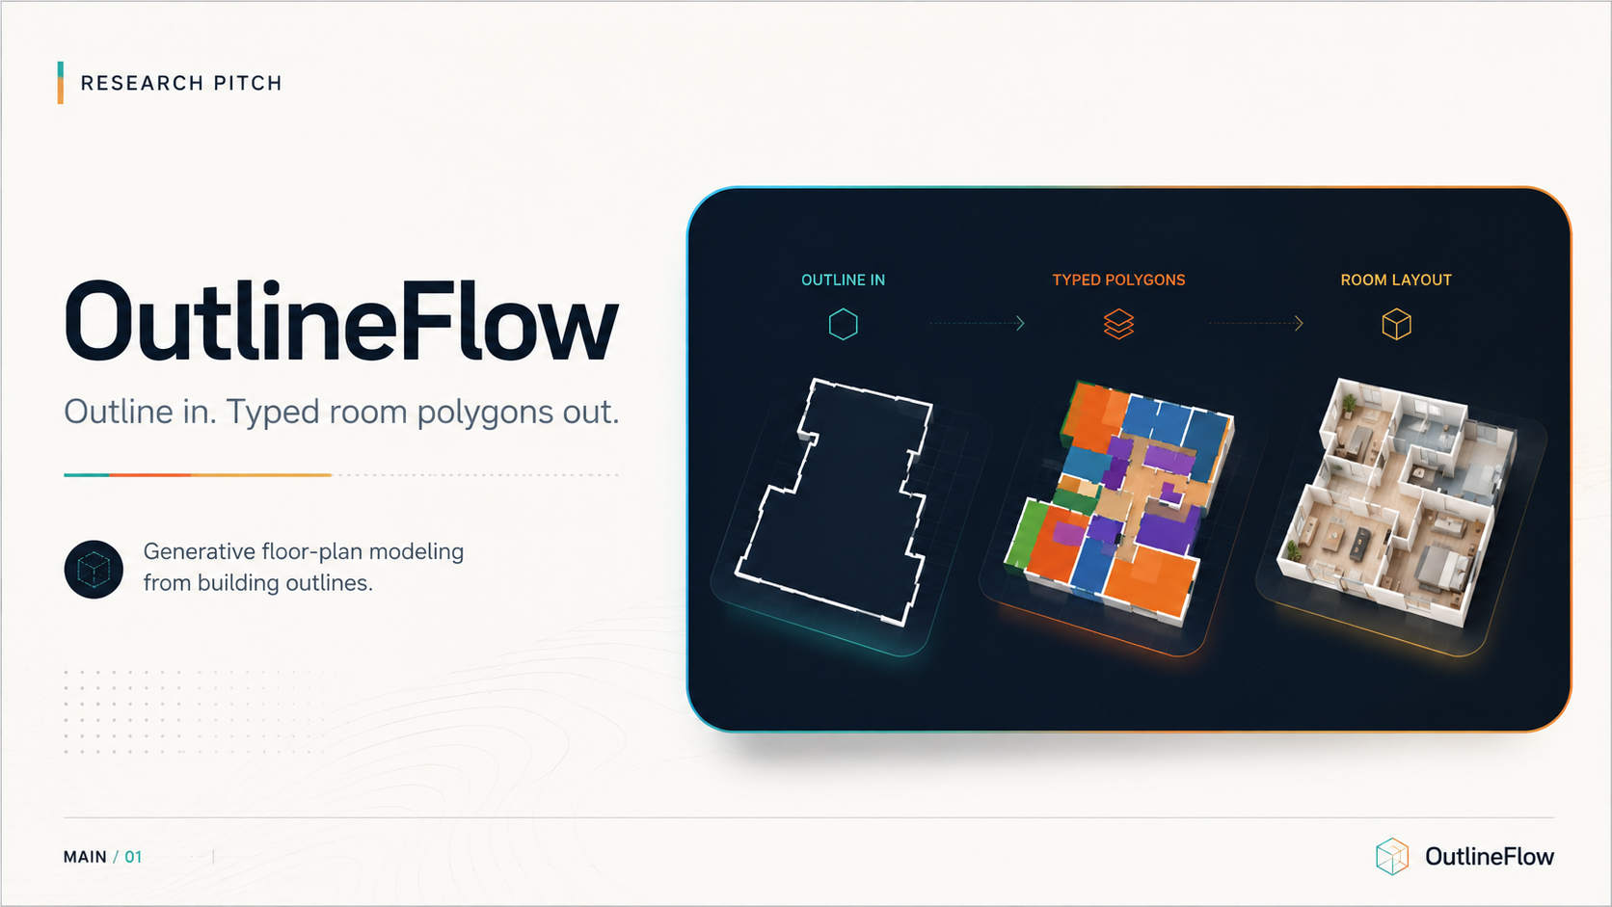

Slide 2




Slide 3
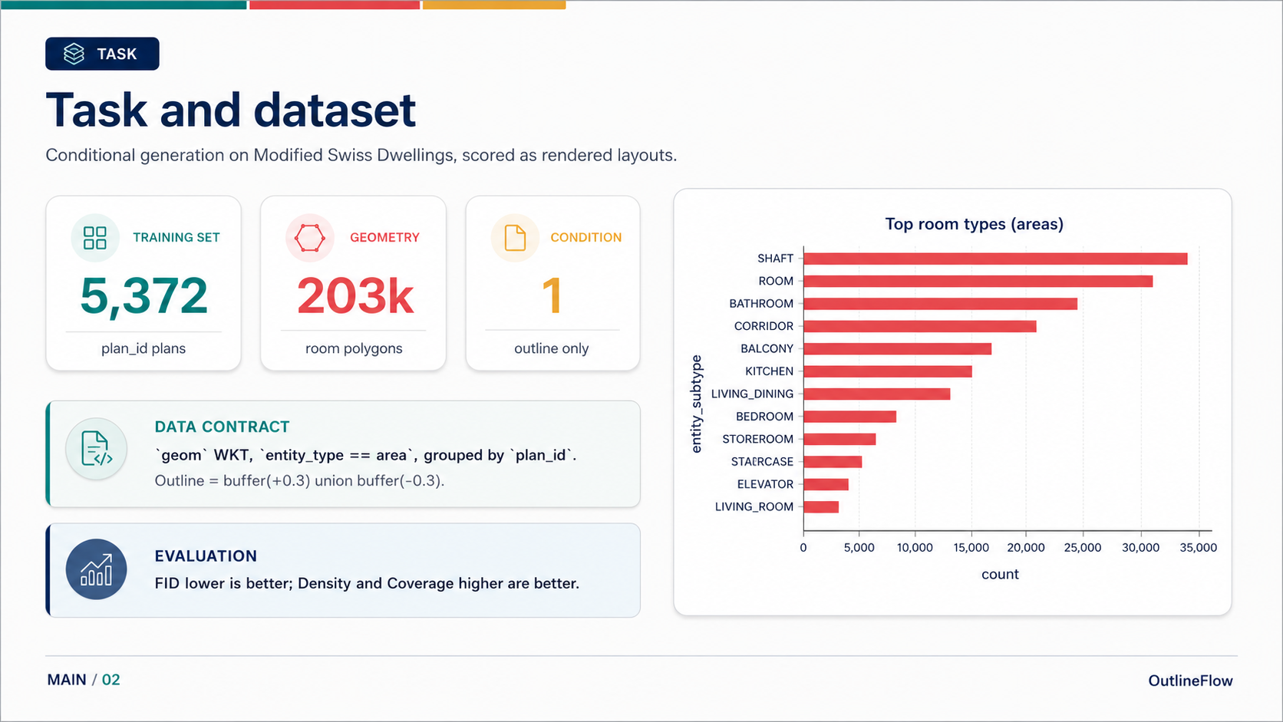

Slide 4
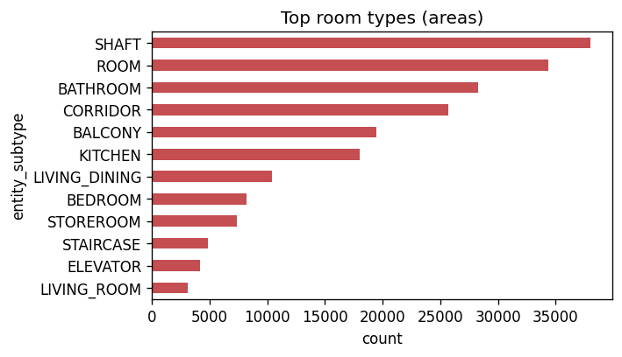
TASK
Task and dataset
Conditional generation on Modified Swiss Dwellings, scored as rendered layouts.
TRAINING SET
GEOMETRY
CONDITION
5,372
203k
1
plan_id plans
room polygons
outline only
DATA CONTRACT
`geom` WKT, `entity_type == area`, grouped by `plan_id`.
Outline = buffer(+0.3) union buffer(-0.3).
Evaluation: FID lower is better; Density and Coverage higher are better.
MAIN / 02
OutlineFlow

Slide 5
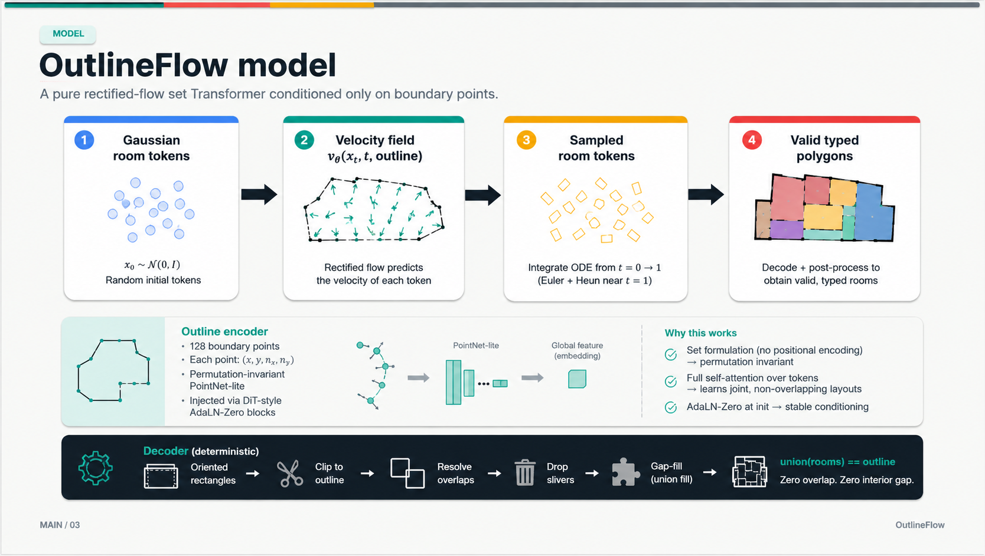

Slide 6
MODEL
OutlineFlow model
A pure rectified-flow set Transformer conditioned only on boundary points.
Gaussian
room tokens
v_theta(x_t, t,
outline)
sampled
room tokens
valid typed
polygons
Outline encoder
Permutation-invariant PointNet-lite over boundary samples; injected through DiT-style AdaLN-Zero.
Decoder: oriented rectangles -> clip to outline -> resolve overlaps -> drop slivers -> gap-fill, so union(rooms) == outline.
MAIN / 03
OutlineFlow

Slide 7
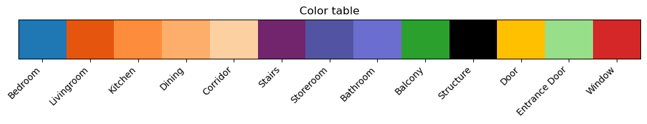
ARCHITECTURE
Token representation and architecture
The model treats a plan as a set, not a sequence.
One room token
Boundary samples
x, y, normal x, normal y
presence
cx, cy
w, h
sin2theta,
cos2theta
type
one-hot
N_max tokens, standardized in the outline-bbox frame.
Outline PointNet-lite
max + mean pooled outline code
Why no positional encoding?
Room order is arbitrary. Full self-attention lets the model learn a joint, non-overlapping layout.
Set Transformer
full self-attention, no positional encoding
AdaLN-Zero conditioning
time + outline injected into blocks
Token head
presence, geometry, type
MAIN / 04
OutlineFlow

Slide 8
DIAGNOSIS
Variance collapse
The weak Coverage/Density numbers are not just bad news; they point to the objective.
Real conditional variety
L2 objective
Generated support
predicts the conditional mean
one plausible-looking average path
Evidence:generated room-count std +/-6 vs real +/-24; baseline Coverage 0.067.
MAIN / 05
OutlineFlow

Slide 9
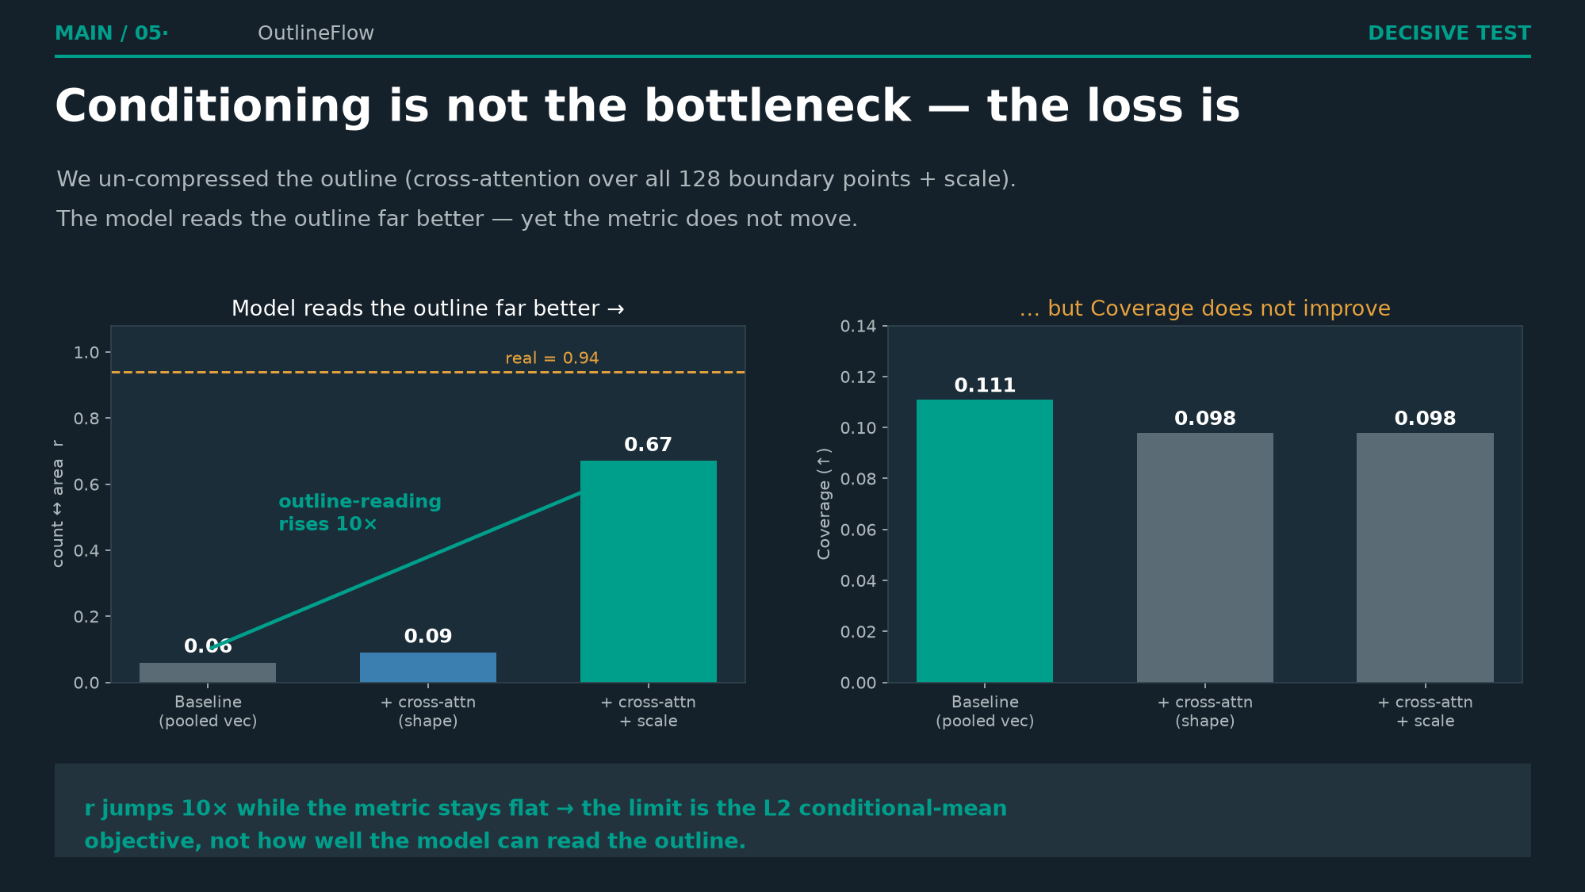

Slide 10
METHOD
Three levers
The metric gaps motivate the experiments: FID asks for cleaner geometry; Coverage asks for stochastic diversity.
1
Grid-align
2
Churn
3
EBM
Targets FID
Targets Coverage
Targets Density
Snap room edges to the building axes, then re-partition.
Inject time-scaled noise during sampling to leave the mean trajectory.
Critic helps on some runs, but gains wash out under multi-seed.
FID 167 -> 131.5
Coverage 0.098 -> 0.111
Option, not default
Final default = full plan_id flow model + grid-align g16 + churn 0.3 + count-calibrated threshold.
MAIN / 06
OutlineFlow

Slide 11
RESULTS
Final results
The corrected headline: final grid-align + churn configuration, not the old subset story.
Config
FID down
Density up
Coverage up
REALISM
DIVERSITY
-19%
+66%
Baseline
167
0.097
0.067
FID vs baseline
Coverage vs baseline
+ grid-align
131.5
0.091
0.098
Final + churn
135.3
0.088
0.111
FID
167
Coverage
0.067
Final
135.3
Final
0.111
Grid-align cleans geometry; churn buys support recall with a small FID cost.
MAIN / 07
OutlineFlow

Slide 12
COMPARISON
Comparison with DDPM / EBM
All three paradigms were tested; the simple flow + churn recipe held up best.
Paradigm
FID
Density
Coverage
Readout
Flow + grid + churn0.3
135.3
0.088
0.111
best coverage
DDPM
137.2
0.068
0.090
worse on all three
Flow + EBM guidance
136.1
0.091
0.103
marginal
DDPM inherits the same MSE mean-regression ceiling in this setup.
EBM remains a useful option, but not the final default.
MAIN / 08
OutlineFlow

Slide 13
HONESTY
Limitations and honesty
We frame the weaker metrics as evidence: diagnosis, targeted levers, and honest comparisons.
bar_chart
Density/Coverage are still low
rule
Self-reported metric protocol
Ideal is 1.0; final Coverage 0.111 means support is still limited.
Numbers depend on the repo render/eval harness, not an external official run.
grid_on
Post-processing matters
warning
EBM is not headline
Grid-align is a deterministic geometry layer, not a learned fix.
Single-run gains can wash out under multi-seed averaging.
Pitch framing: not 'we solved floor plans,' but 'we found why the baseline fails and what reliably moves it.'
MAIN / 09
OutlineFlow

Slide 14
TAKEAWAY
Final takeaway
A weak metric matrix became a research map.
OutlineFlow generates typed vector room polygons from only an outline.
Research insight
Practical fix
Final result
L2 flow matching collapses toward average layouts.
Grid-align for geometry; churn for diversity.
FID 135.3 / Density 0.088 / Coverage 0.111.
from generate import generate
rooms = generate(outline)
# [(shapely Polygon, room_type_id), ...]
MAIN / 10
OutlineFlow

Slide 15
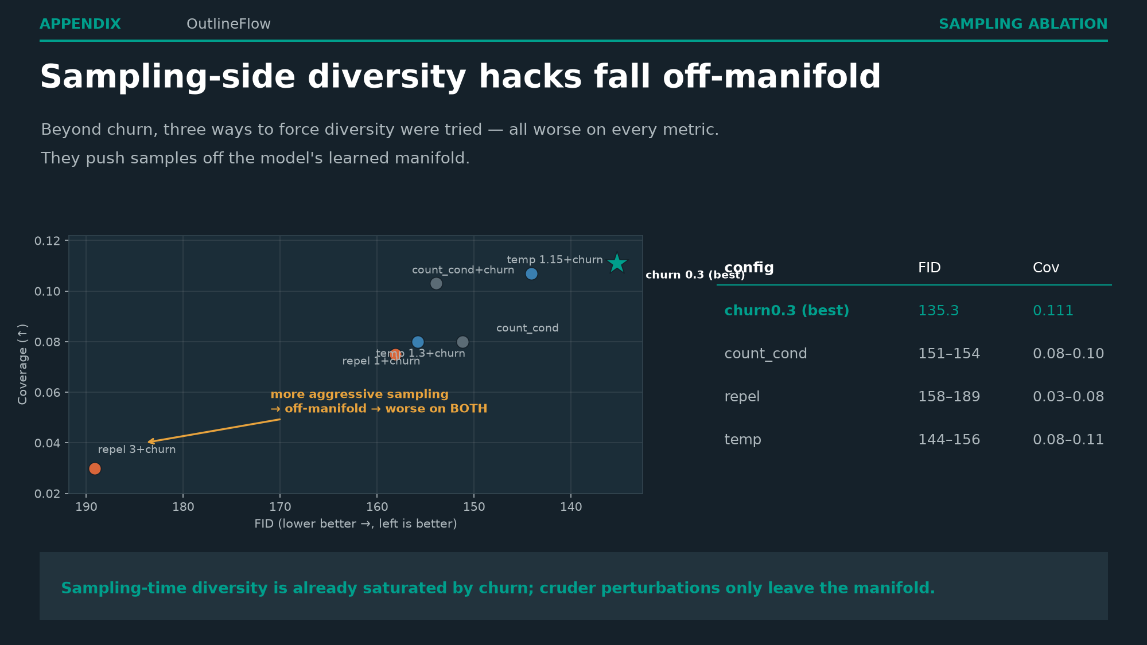

Slide 16
APPENDIX
Metrics definitions
Three scores, one rendered image space.
insights
FID
Distance between real and generated Inception feature distributions. Lower is better.
grain
Density
How often generated samples land inside local real neighborhoods. Higher is better.
track_changes
Coverage
How much of the real distribution is reached by generated samples. Higher is better.
The judging tension: clean, realistic layouts can still fail if they cover only one average mode.
APPENDIX / 11
OutlineFlow

Slide 17
APPENDIX
FID implementation
The repo uses the same renderer for real and generated plans.
real + generated
vector polygons
render_msd
MSD palette
uint8 NCHW
images
TorchMetrics
FID 2048
Caveat: absolute FID can shift with rasterization; comparisons are meaningful when the render protocol is fixed.
APPENDIX / 12
OutlineFlow

Slide 18
APPENDIX
PRDC density / coverage
Density and Coverage use the same Inception feature space as FID.
Density
Coverage
Generated points inside real k-nearest-neighbor balls.
Real points reached by nearby generated samples.
Answers: are samples on the real manifold?
Answers: how much real variety do we cover?
Implementation: vendored clovaai PRDC, k=5.
APPENDIX / 13
OutlineFlow

Slide 19
APPENDIX
Train/test and seed 42
What is fixed, and what is averaged.
Training setup
Seed discipline
Full plan_id model on 5,372 plans / 203k rooms.
Seed 42 is fixed for reproducible generation.
15k training steps, d_model=128, L=4, 1.33M params.
Final headline values are robust 3-seed means where marked.
Held-out evaluation uses the repo's seeded split.
Single stochastic runs can overstate Coverage.
APPENDIX / 14
OutlineFlow

Slide 20
APPENDIX
generate(outline) API
The shipped interface returns vector geometry, not pixels.
Defaults in final entry point
churn=0.3
align=True
grid=16
seed=42
from generate import generate
rooms = generate(outline)
# outline: shapely Polygon/MultiPolygon or WKT
# rooms: [(shapely Polygon, room_type_id), ...]
Contract Requirement
The outline is the only condition; output polygons fill the outline with zero interior gap by construction.
APPENDIX / 15
OutlineFlow

Slide 21
APPENDIX
Token representation
A vector plan becomes a fixed-size set of typed room tokens.
presence
real room vs padding
cx, cy
center in outline bbox
w, h
oriented rectangle size
sin2theta, cos2theta
rotation without angle wrap
type one-hot
room type id
Decoding clips oriented rectangles to the outline, resolves overlaps, removes slivers, then gap-fills.
APPENDIX / 16
OutlineFlow

Slide 22
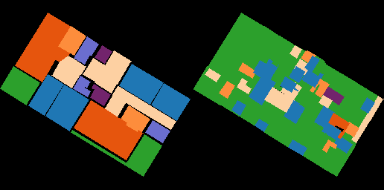
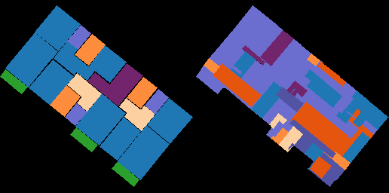
APPENDIX
Failure cases
Qualitative repo outputs illustrate the remaining diversity gap.
Remaining issues: generated plans can be simplified, off-manifold, or too average for the real layout variety.
These images are existing repo qualitative examples, not extra final metric claims.
APPENDIX / 17
OutlineFlow

Slide 23
APPENDIX
Failure cases
Qualitative repo outputs illustrate the remaining diversity gap.
Simplified Plans
Generated outputs can be overly simplified, lacking realistic partition complexity.
Off-Manifold Geometry
Layout predictions that violate realistic boundary or structural constraints.
Average / Low Variety
Converging to template averages rather than matching true layout diversity.
REPO_OUTPUT_01
REPO_OUTPUT_02
These images are existing repo qualitative examples, not extra final metric claims.
APPENDIX / 17
OutlineFlow

Slide 24
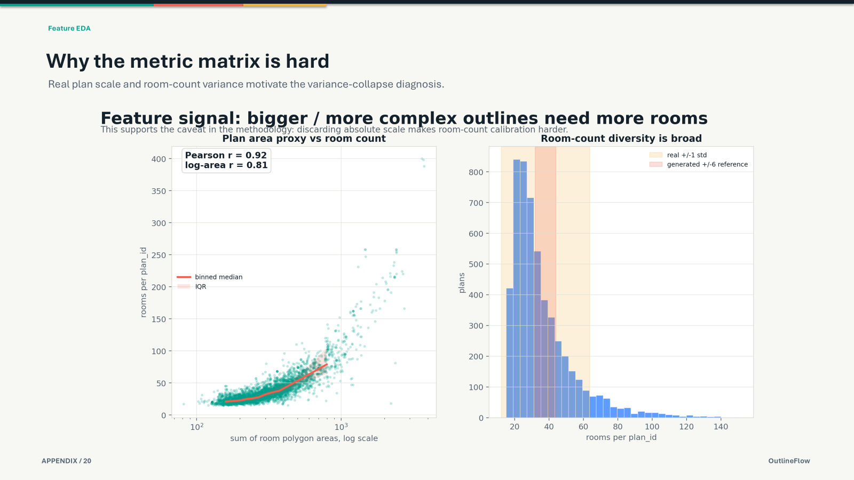
APPENDIX
Older subset results
Background only: not the corrected final story.
Grouping: unit_id
SUBSET
Grouping: plan_id
SUBSET
TRAIN / HELD
2,367 / 591
FID (LOWER IS BETTER)
129.2 ▼
TRAIN / HELD
~1,600 / 400
FID (LOWER IS BETTER)
190.5
DENSITY
0.044
COVERAGE
0.035
DENSITY
0.052
COVERAGE
0.060
These came from older subset experiments and are included only for provenance.
APPENDIX / 19
OutlineFlow

Slide 25
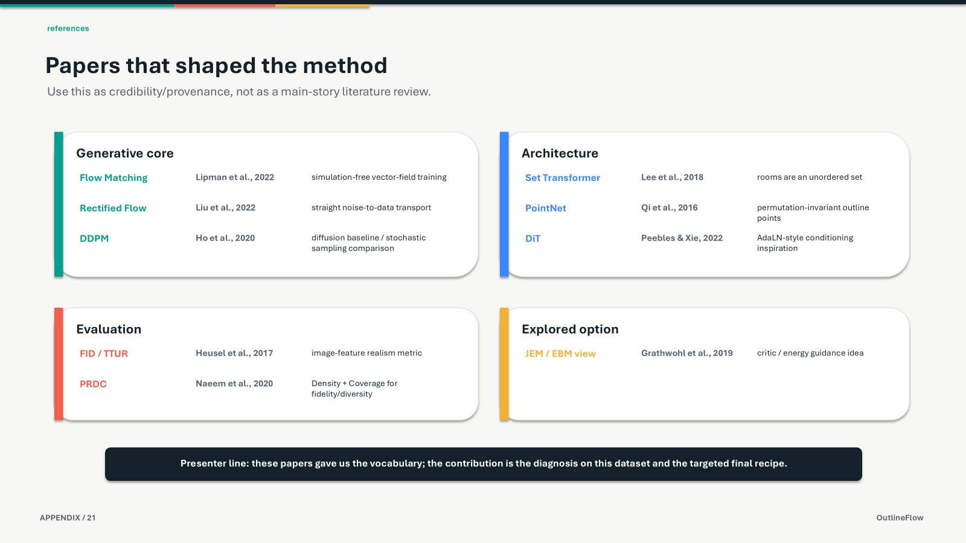
APPENDIX
Reproducibility commands
Commands are shown relative to `outlineflow/`.
# Navigate & Train model
cd outlineflow
python train.py \
--data_csv ../mds_V2_5.372k.csv \
--group plan_id \
--msd_limit 6000 \
--steps 15000 \
--out_dir outputs_full_plan_id \
--seed 42
# Basic evaluation
python sample_eval.py \
--out_dir outputs_full_plan_id \
--decoder rect \
--inception \
--metric_cpu \
--n_eval 600 \
--save 0 \
--seed 42
# Evaluation with alignment
python sample_eval.py \
--out_dir outputs_full_plan_id \
--decoder rect \
--align \
--grid 16 \
--churn 0.3 \
--inception \
--metric_cpu \
--n_eval 600 \
--save 0 \
--seed 42
For multi-seed robustness, repeat evaluation with seeds 42, 123, and 7, then average.
APPENDIX / 18
OutlineFlow

Slide 26
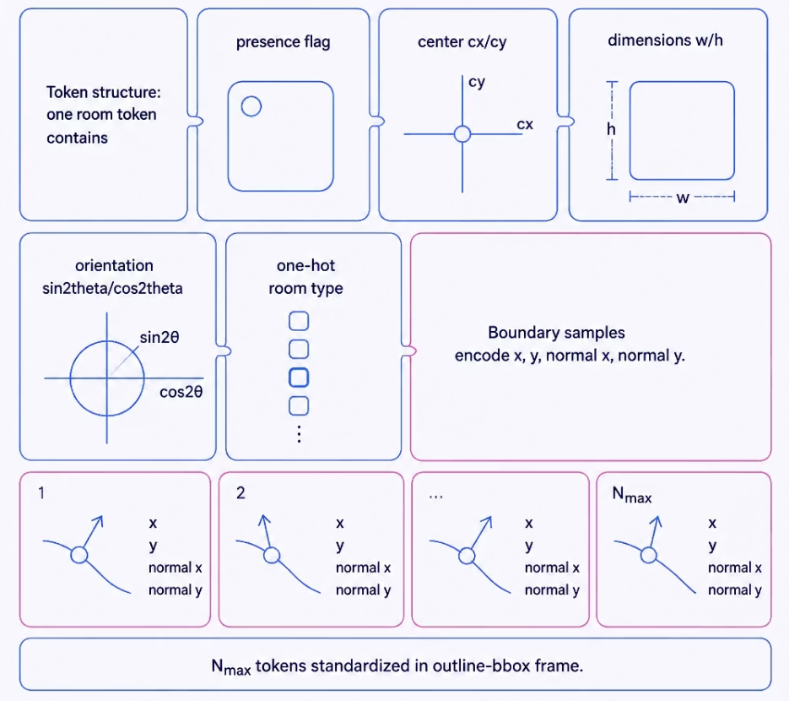

Slide 27
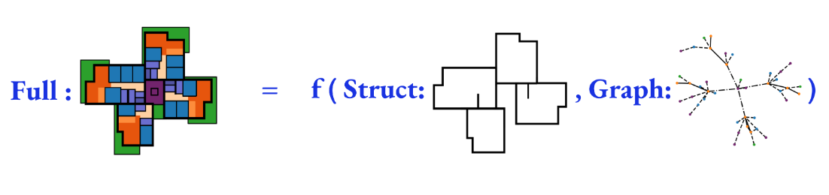

Slide 28
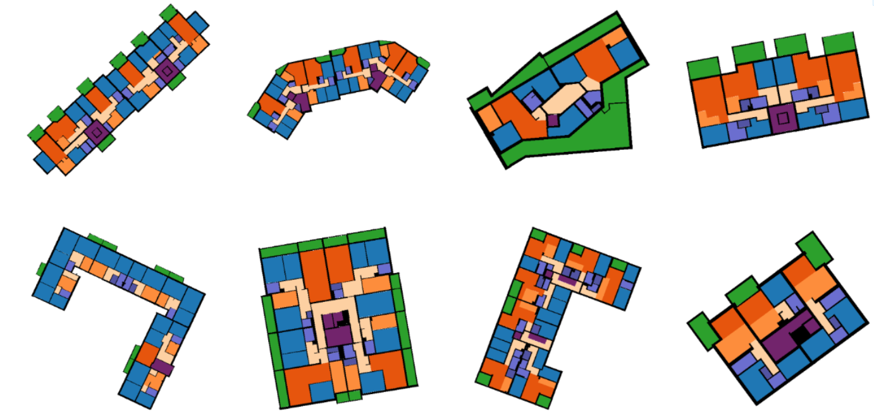

Slide 29
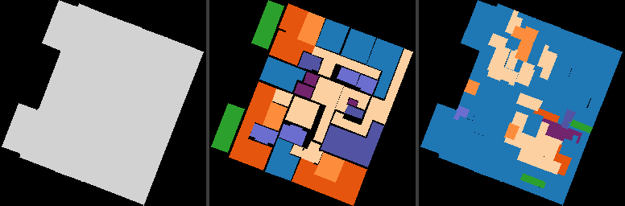
RESEARCH PITCH
OutlineFlow
Outline in. Typed room polygons out.
INPUT
Input is only the apartment or floor outline.
OUTPUT
Output is a set of vector room polygons plus room types.
THE CHALLENGE
The challenge is diversity: many valid interiors share one shell.
CORE CLAIM
The modest metric matrix is the signal: diagnose variance collapse, then target geometry and diversity separately.
Visual Generation Pipeline
Existing repo example: outline reference/generation panel.
MAIN / 01
OutlineFlow

