Slide 1
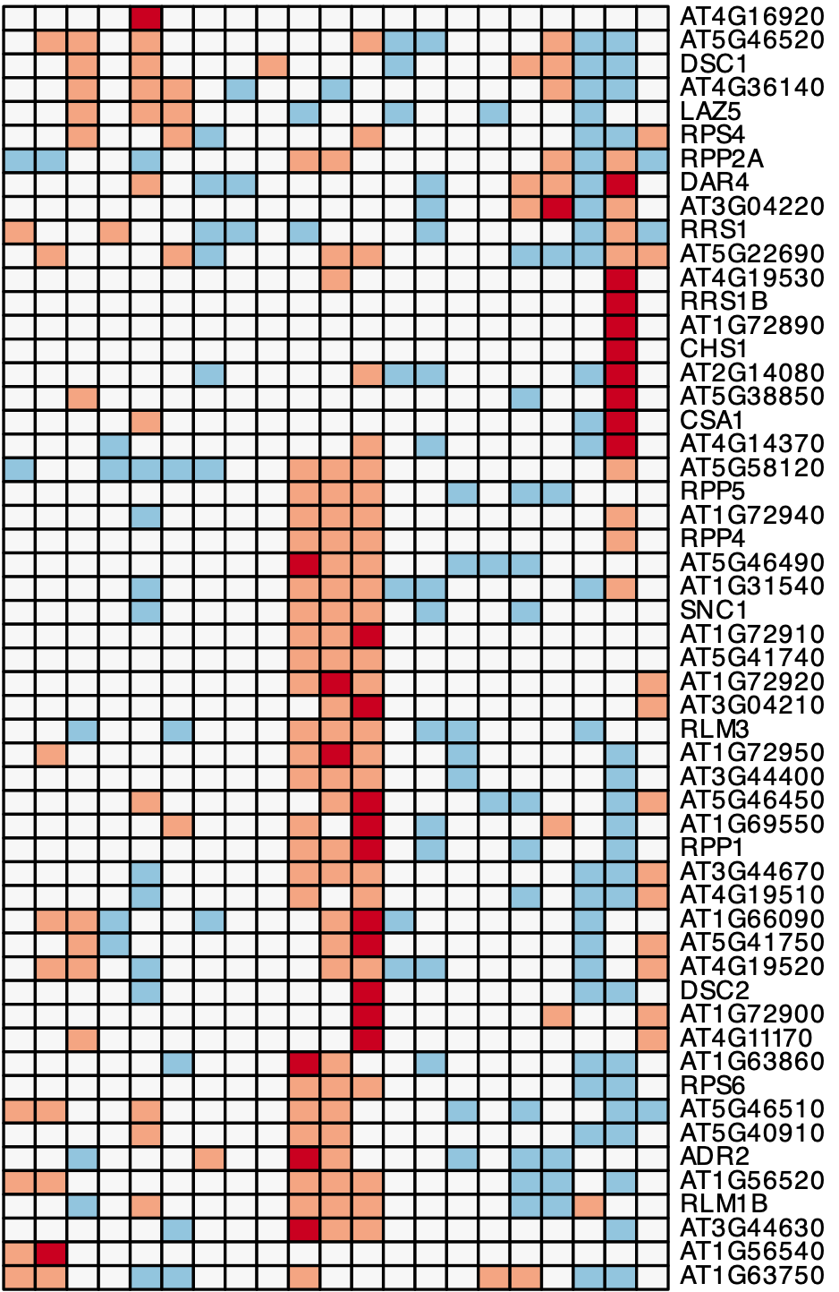

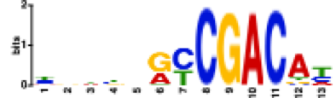

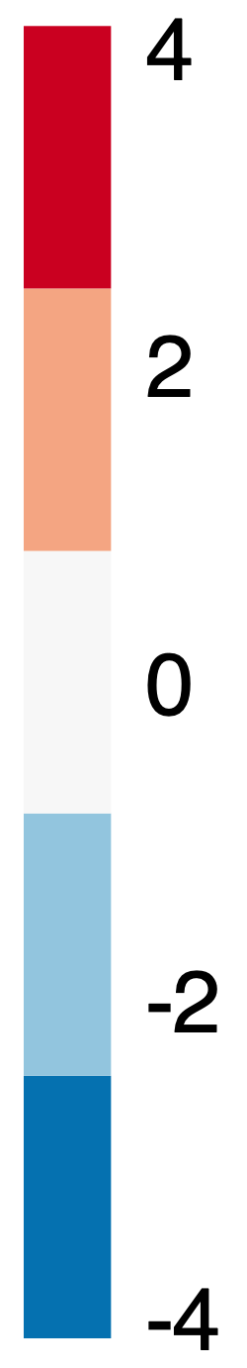
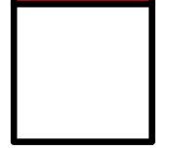

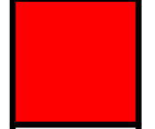


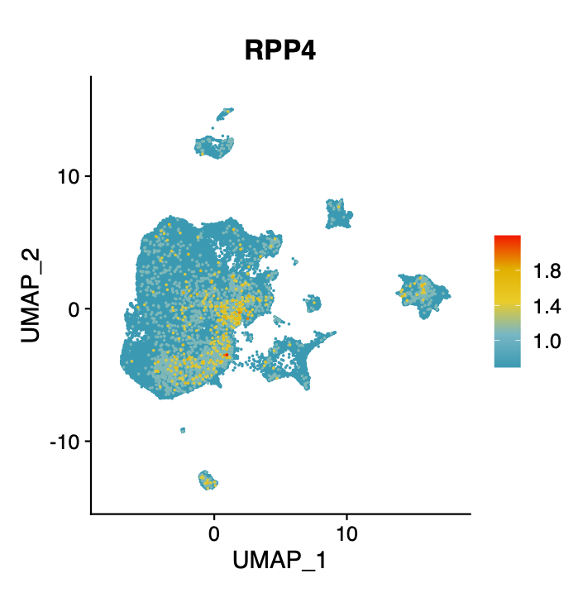
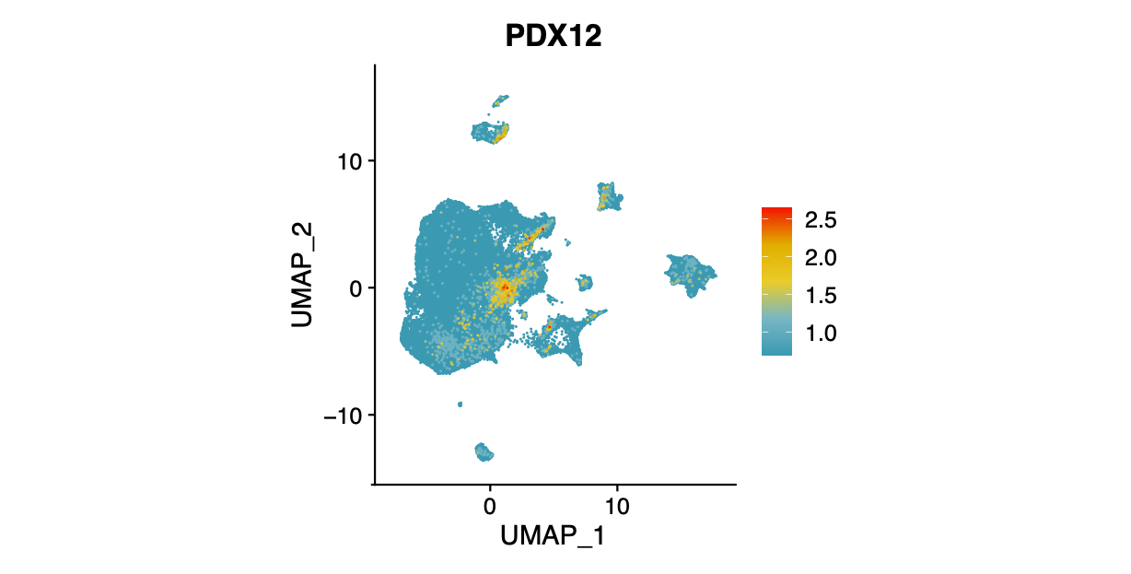
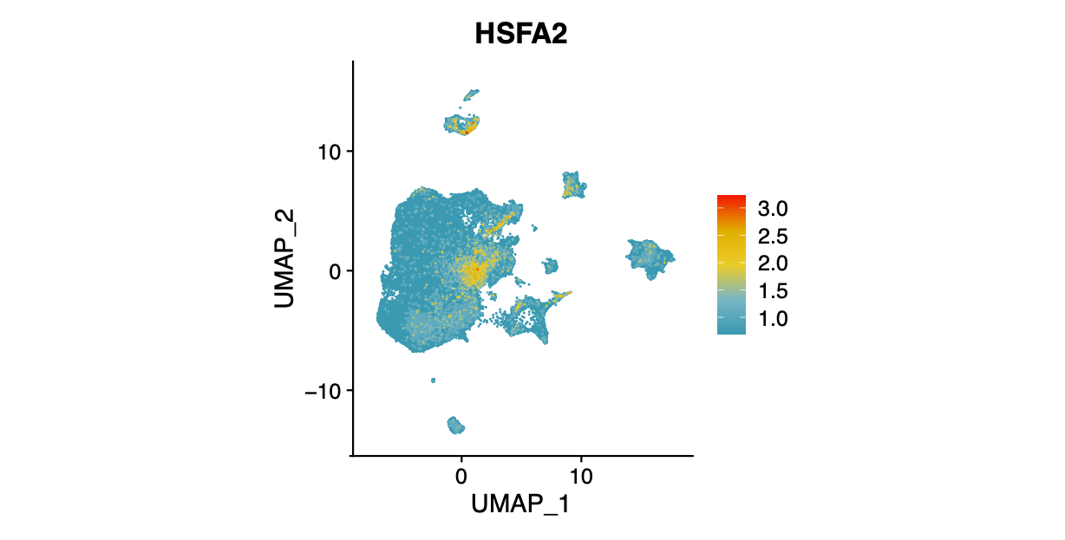
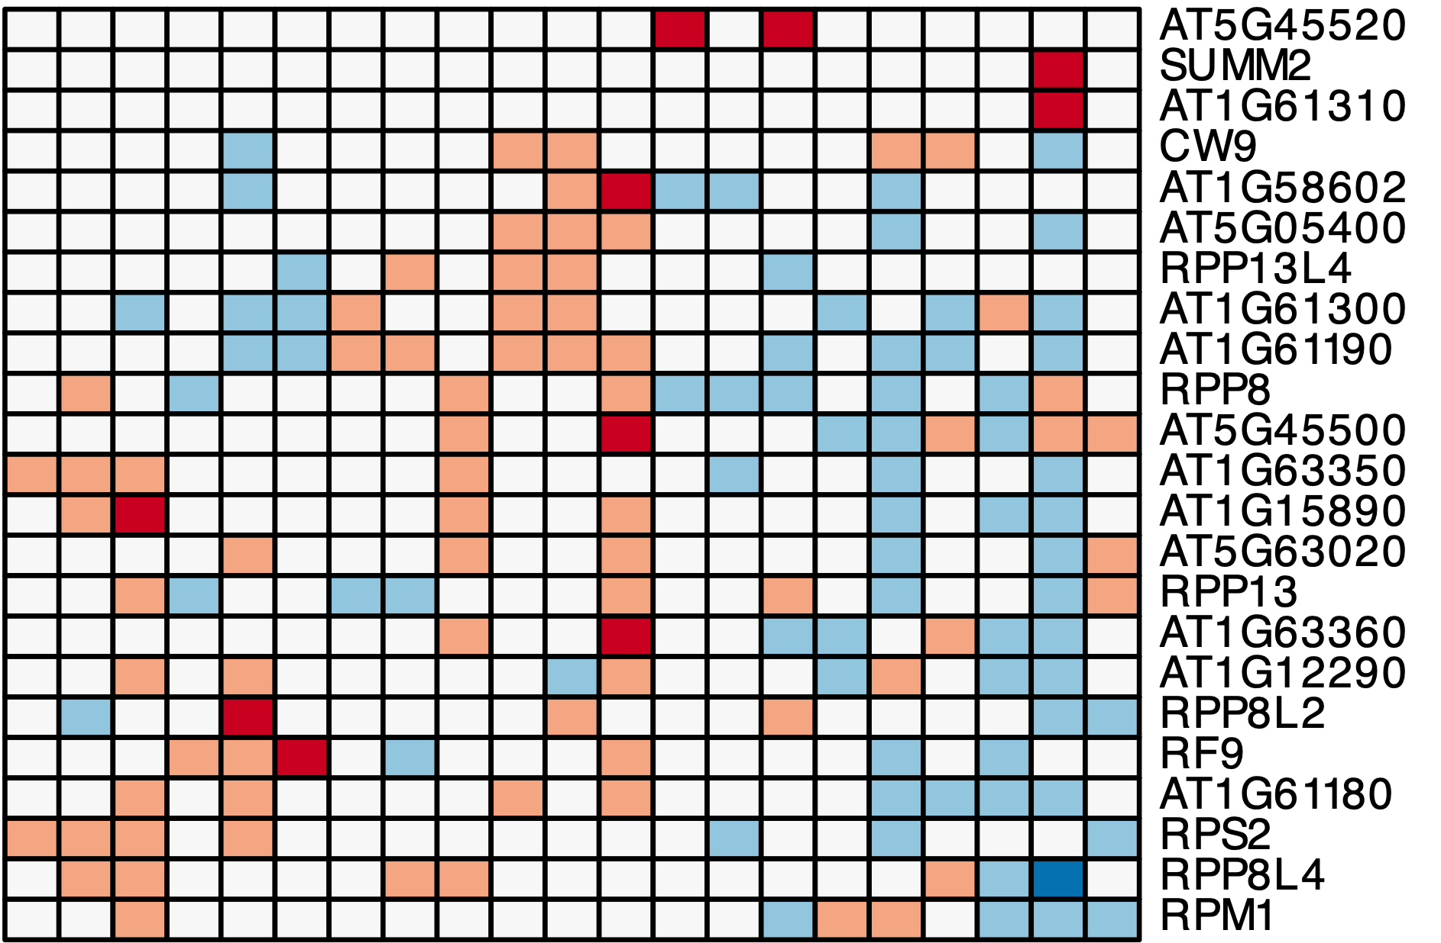
Cell-type specific expressed TNLs as regulons are potentially controlled by defined cis-elements
E
G
M
P
PP
BS
PC
E: Epidermis
G: Guard cells
DDF1
(12/17)
At3g60580
(10/17)
M: Mesophyll
P: Procambium
17 genes
Motif scanning
PP: Phloem Parenchyma
PC: Phloem Companion
BS: Bundle Sheath
33 genes
FIMO
Gene expression
Mock
24 hpi
TNL
Motif scanning
WRKY22 (20/33)
HSFA6 (14/33)
40 hpi
33 genes
33 genes
FIMO
TNL
Marker
TF
RNL
NRG1.1
NRG1.2
CNL
Notes:
Another cell type-specific expression analysis is about NLR genes.
Given,
In this heatmap is showing normalized expression level of NLR genes
Epidermal, guard cell, M,
and all of these vasculature-related cell types, from all the samples.
We found, TNLs like SNC1, RPP1 are highly expressed in procambium cells,
which is a cell type serving as young stage of vasculature system.
Many TNL like RRS1B. are specifically induced only in companion cells during early stage of infection.
We also found CNL RPS2 exhibits specific expression in epidermal cells.
For helper NLRs, we found NRG1 homologs are expressed in epidermis and procambium respectively,
ADR1 homologous display specific expression
in phloem cells, bundle sheath cells, and procambium cells, respectively.
These results suggest a fine-tunning deployment of NLRs in different cell types.
More particular, there is a general induction of TNL in vasculature-related cells,
which is not occurred in CNL, and RNL.
We were then wondering if this specific expression pattern is associated with TIR domain, or it is a TNL specific phenomenon?

Slide 2
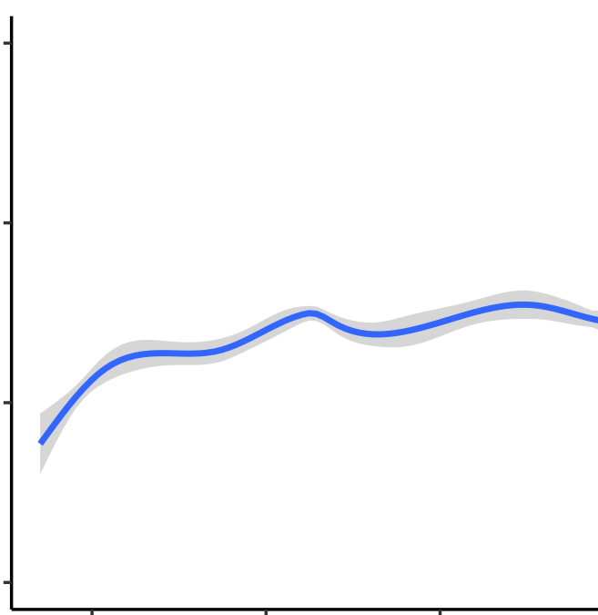
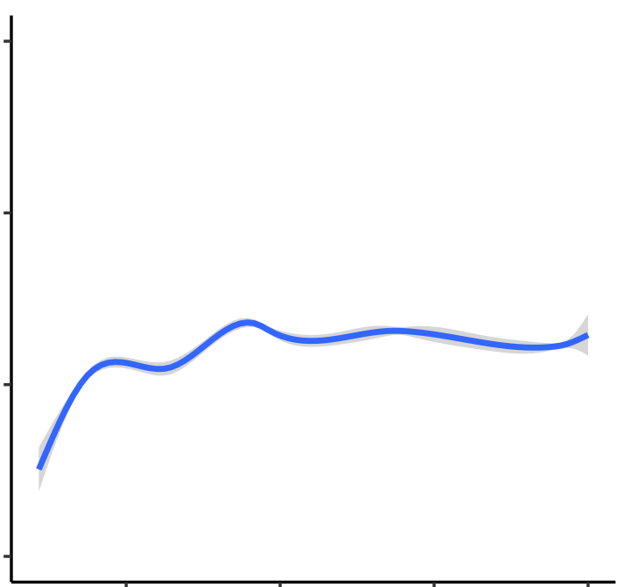
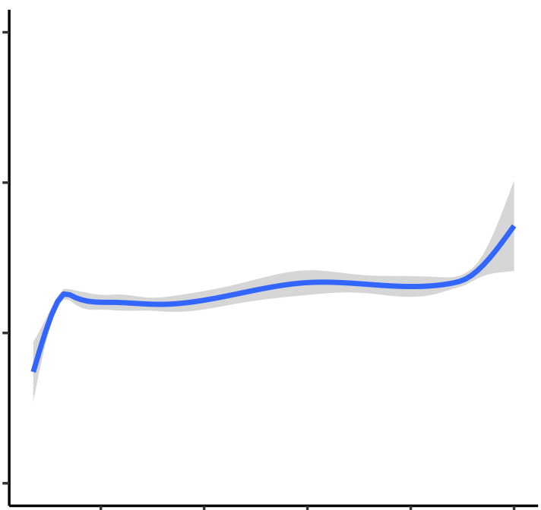
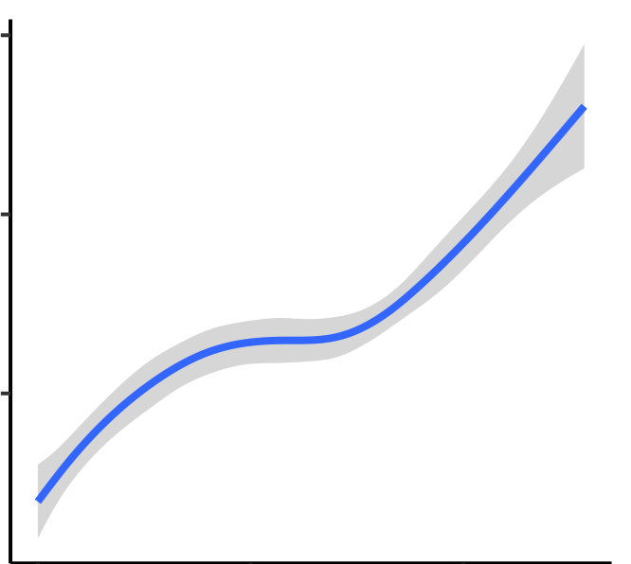
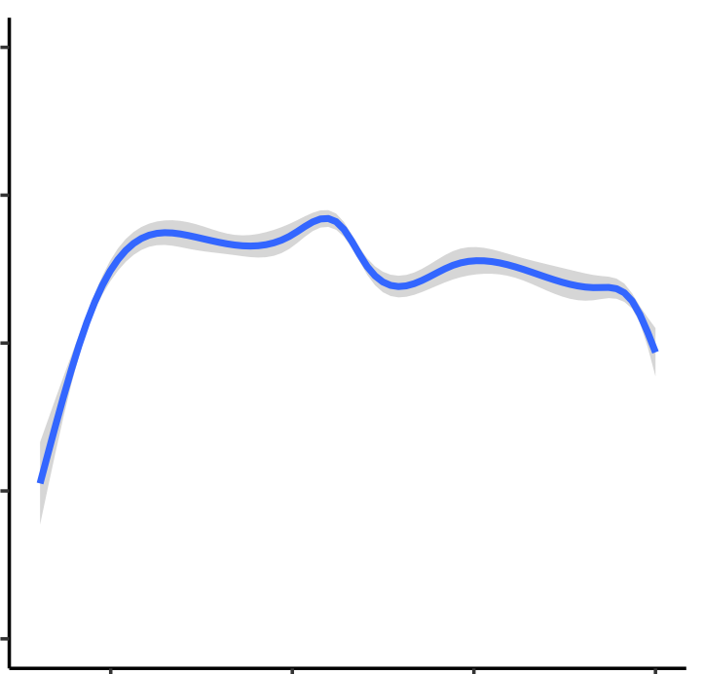
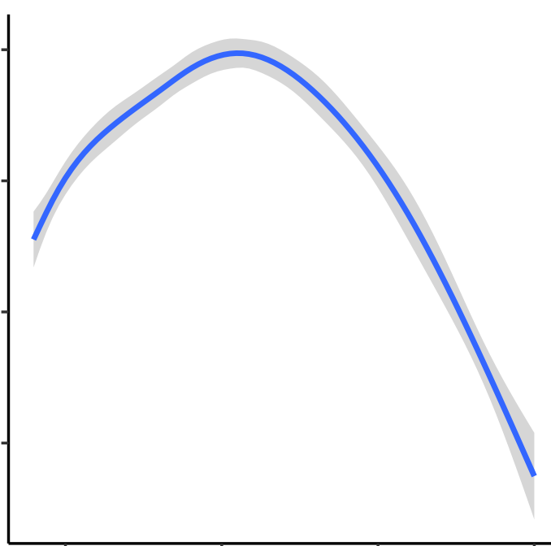
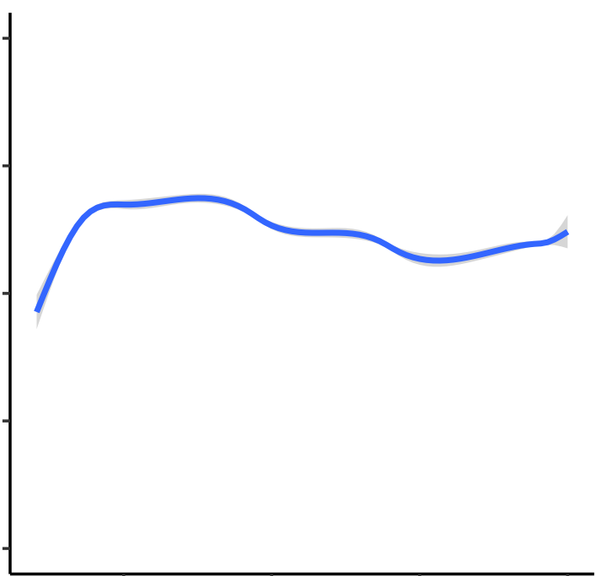
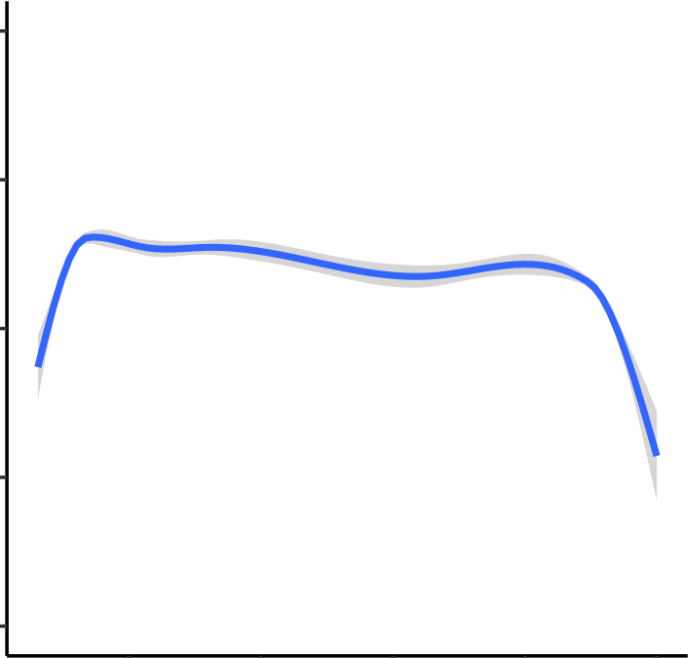
Guard cell-specific expression of ABA-related genes
0.04
R²=0.04
0.04
R² = 0.37
R²=0.07
0.04
R²=0.08
0.04
0.02
0.02
0.02
Expression of Positive regulators
0.02
0.00
0.00
0.00
0.00
-0.02
-0.02
-0.02
-0.02
R²=0.09
R² = -0.30
0.025
R²=0.16
0.025
R²=0.075
0.025
0.025
0.000
0.000
0.000
0.000
Expression of Negative regulators
-0.025
-0.025
-0.025
-0.025
-0.050
-0.050
-0.050
-0.050
-0.075
-0.075
-0.075
-0.075
0
0.5
1
0
0.5
1
0
0.5
1
0
0.5
1
Pseudotime in Epidermal cells
Pseudotime in Guard cells
Pseudotime in Mesophyll
Pseudotime in Vasculature

