Slide 1
Java Concurrency
Allen

Slide 2
Agenda:
1:basic concepts of thread
2:basic synchronisation methods
3:concurrency collections
4:thread management
5:concurrency test

Slide 3
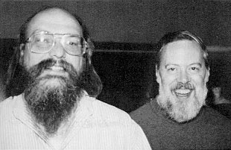
To me, process is a concept and thread is an implementation.
I would like to see the implementation get closer to the concept
Unix system
The B programming language
Ken Thompson

Slide 4
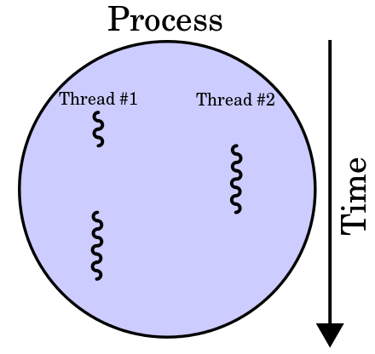
basic concepts of thread
(1)the smallest sequence of programmed instructions
(2)sharing code,data and much lighter context switch
(3)advantages and disadvantages of multithreading

Slide 5
multithread comparision
advantages | disadvantages
Responsiveness
Faster execution
Lower resource consumption
(Apache Http Server)
Better system utilization
Simplified sharing and communication
Parallelisation
synchronisation
Thread crashes a process

Slide 6
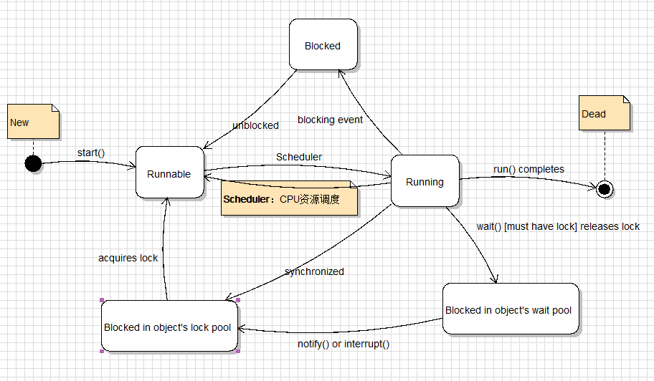
thread status

Slide 7
basic synchronisation methods
(1):synchronized && volatile
(2):Lock
ReentrantLock
ReentrantReadWriteLock

Slide 8
basic synchronisation helpful classes
(1):Semaphore
(2):CountDownLatch
(3):CyclicBarrier
(4):Exchanger
(5):Phaser(JDK 1.7)

Slide 9
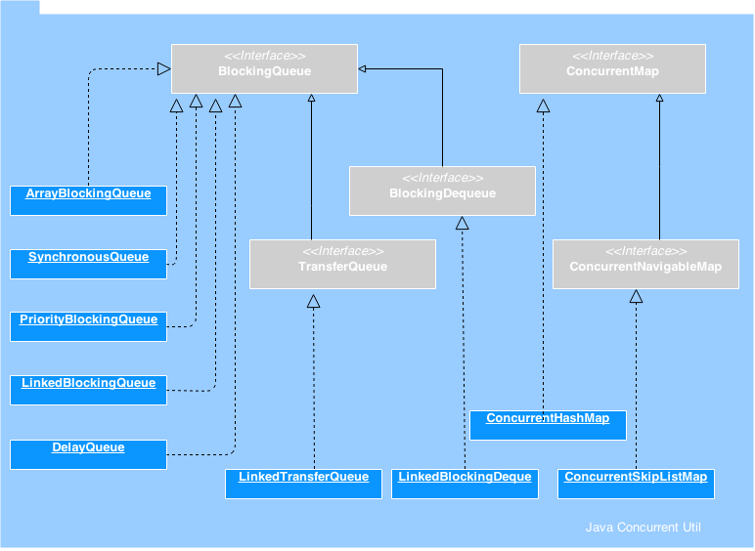
concurrency collections

Slide 10
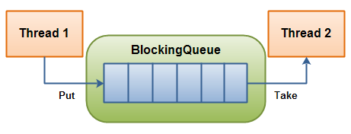
BlockingQueue
A queue that can be blocked when full or empty

Slide 11
Queue Name | Usage
ArrayBlockingQueue | fixed bounded buffer&&elements FIFO
LinkedBlockingQueue | fixed bounded buffer&&elements FIFO
PriorityBlockingQueue | unbounded buffer&&with priority
SynchronousQueue | holding no data&&just channel
DelayQueue | used for Cache or close unused connections
LinkedTransferQueue(JDK1.7) | blockingqueue+waiting for consumer

Slide 12
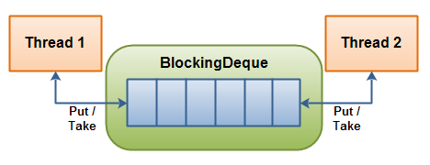
BlockingDeque(JDK1.6)
Deque Name | usage
LinkedBlockingDeque | threads can put and take from both ends of the deque

Slide 13
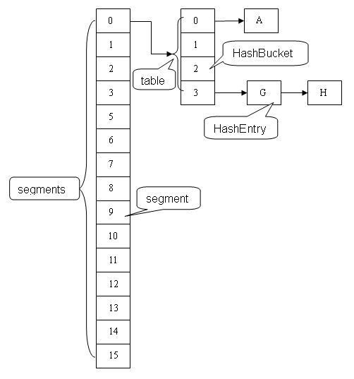
ConcurrentHashMap
Segments
HashEntry
HashBucket

Slide 14
Atomic Variable
A small toolkit of classes that support lock-free thread-safe programming on single variables

Slide 15
thread management
ExecutorService
benefits of Executor Framework:
(1)no need to write the code about the thread creation,
ending and result get;
(2)no need to create the Thread Object;
(3)have better management of the computer resources;
(4)callable interface

Slide 16
some most used thread pools
ThreadPool | usage
newFixedThreadPool | This executor is suitable for the web AppServer that deny the extra request to protect current user experience.
newSingleThreadExecutor | this executor is used only for one thread to start and can’t be reconfigurable
newCachedThreadPool | This executor is suitable for applications that launch many short-lived tasks.
newScheduledThreadPool | a fixed size thread pool that supports delayed and timed task execution.

Slide 17
concurrency test
1:test for correctness with JUnit
2:test for performance

Slide 18
Classic problems && used in RDS
(1)Producer&&Consumer
(2)DeadLock
(3)Dining Philosophers Problem

Slide 19
Reference:

Slide 20
thank you

