Slide 1
Java Concurrency
Allen

Slide 2
Agenda:
1:basic concepts of thread
2:basic synchronisation methods
3:concurrency collections
4:thread pool framework
5:concurrency test
6:some classical problems

Slide 3
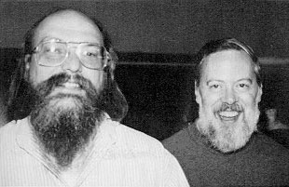
To me, process is a concept and thread is an implementation.
I would like to see the implementation get closer to the concept
Unix system
The B programming language
Ken Thompson

Slide 4
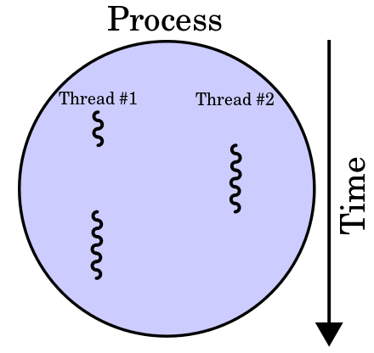
basic concepts of thread
(1)the smallest sequence of programmed instructions
(2)sharing code,data and much lighter context switch
(3)advantages and disadvantages of multithreading

Slide 5
thread completed
Terminated
waiting for acquiring lock
blocked
start()
new
runnable
lock acquired
wait()
waiting
notify()
sleep()
Timed_waiting
timeout completed()

Slide 6
multithread comparision
advantages | disadvantages
Responsiveness
Faster execution
Lower resource consumption
(Apache Http Server)
Better system utilization
Simplified sharing and communication
Parallelisation
synchronisation

Slide 7
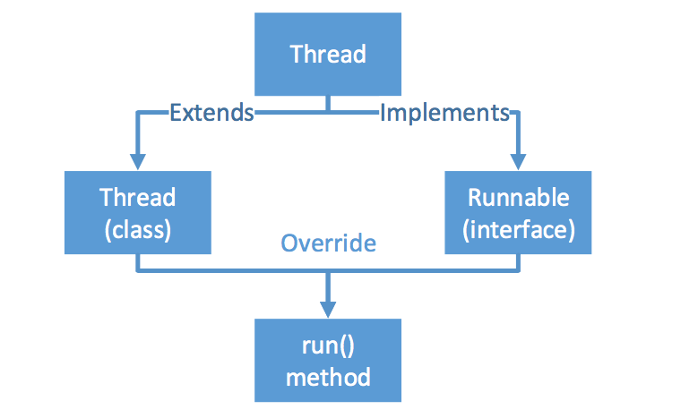
Two mechanisms of creating threads
Which is better?

Slide 8
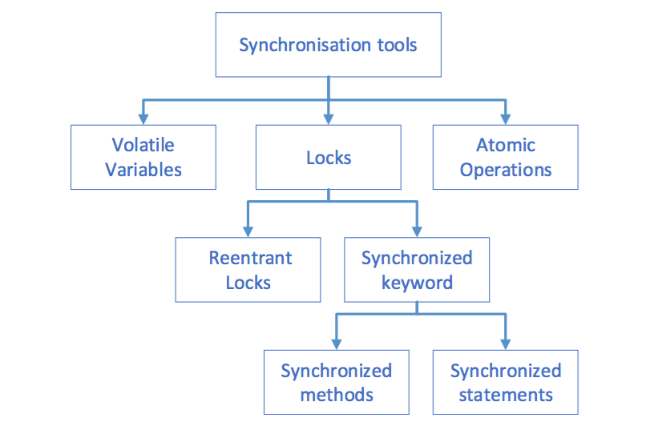
basic synchronisation methods

Slide 9
(1):synchronized && volatile
􏰀
Atomicity
Visibility

Slide 10
(2):Lock
ReentrantLock
ReentrantReadWriteLock

Slide 11
ReentrantLock vs synchronized
advantange | disadvantage
ability to handle interrupt | acquiring and releasing lock complicated code
a timeout on waiting for lock
support fairness
get List of all threads waiting for lock

Slide 12
Synchronizer
(1):Semaphore
(2):CountDownLatch
(3):CyclicBarrier
(4):Exchanger
(5):Phaser(JDK 1.7)

Slide 13
(1):Semaphore
Invented by the famous Dutch computer scientist Edsger Dijkstra in 1965
In Java, it is called counting semaphore, which maintains a set of permits (Semaphore value)
In Java, set the value to 1 and can be used as lock
􏰀

Slide 14
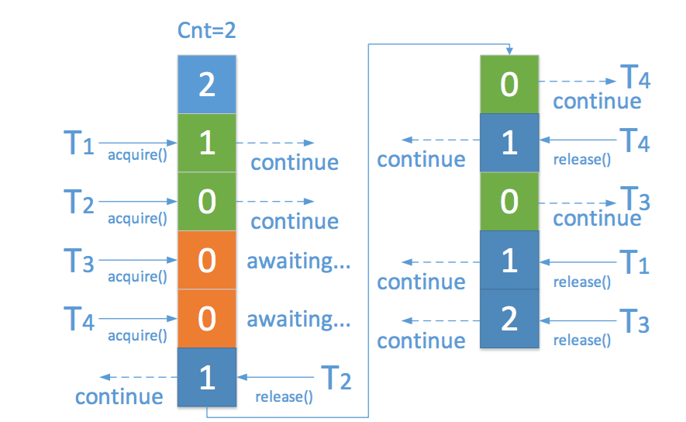
How Semaphore works?

Slide 15
(2):CountDownLatch
A type of “switch” or “trigger” in concurrent programming
A thread or threads waits for the count value to reach zero before continuing to perform some process
One-off process: Once the count value reaches 0, you cannot reset

Slide 16
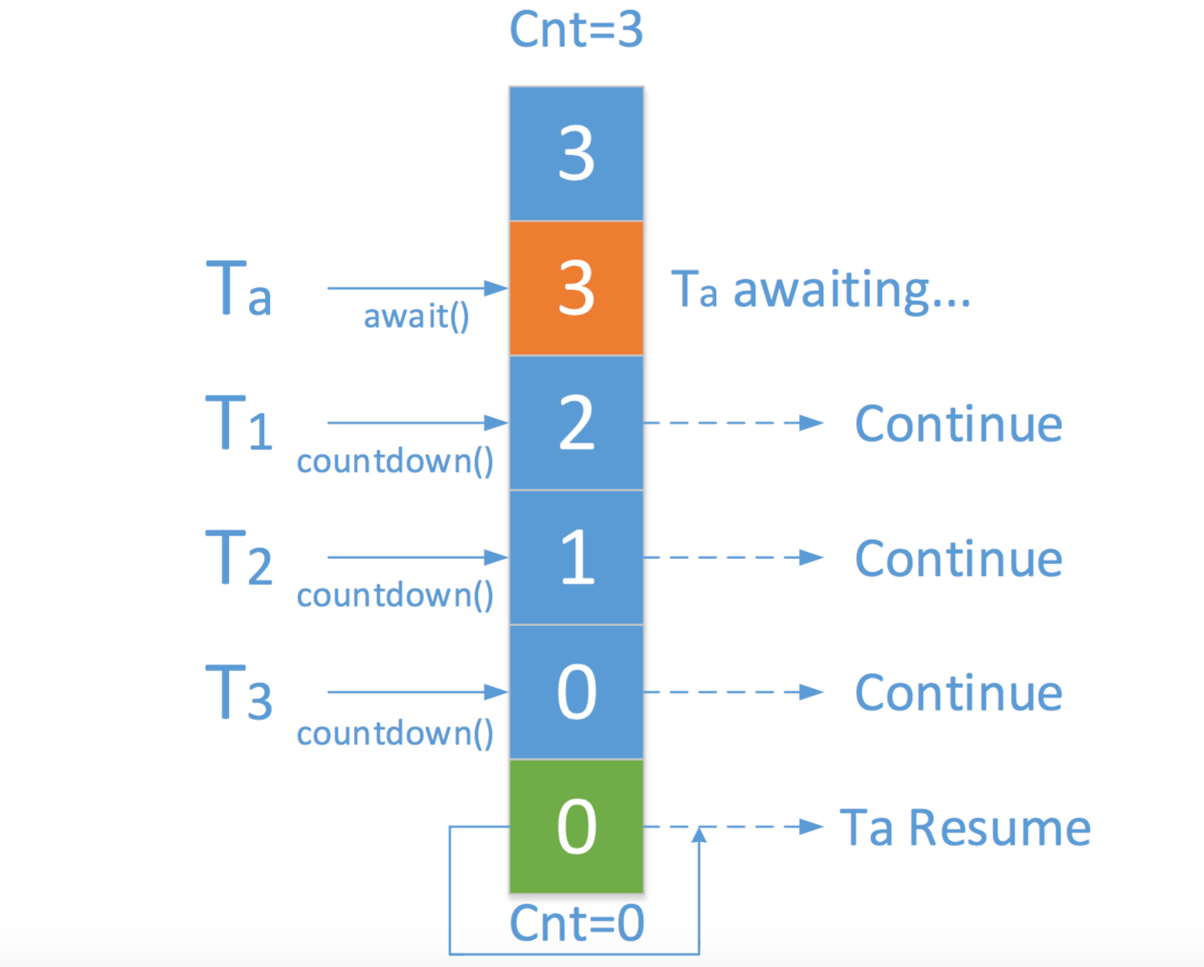

Slide 17
(3):CyclicBarrier
A synchronization aid that allows a set of threads to all wait for each other to reach a common barrier point
The barrier can be re-used after the waiting threads are released

Slide 18
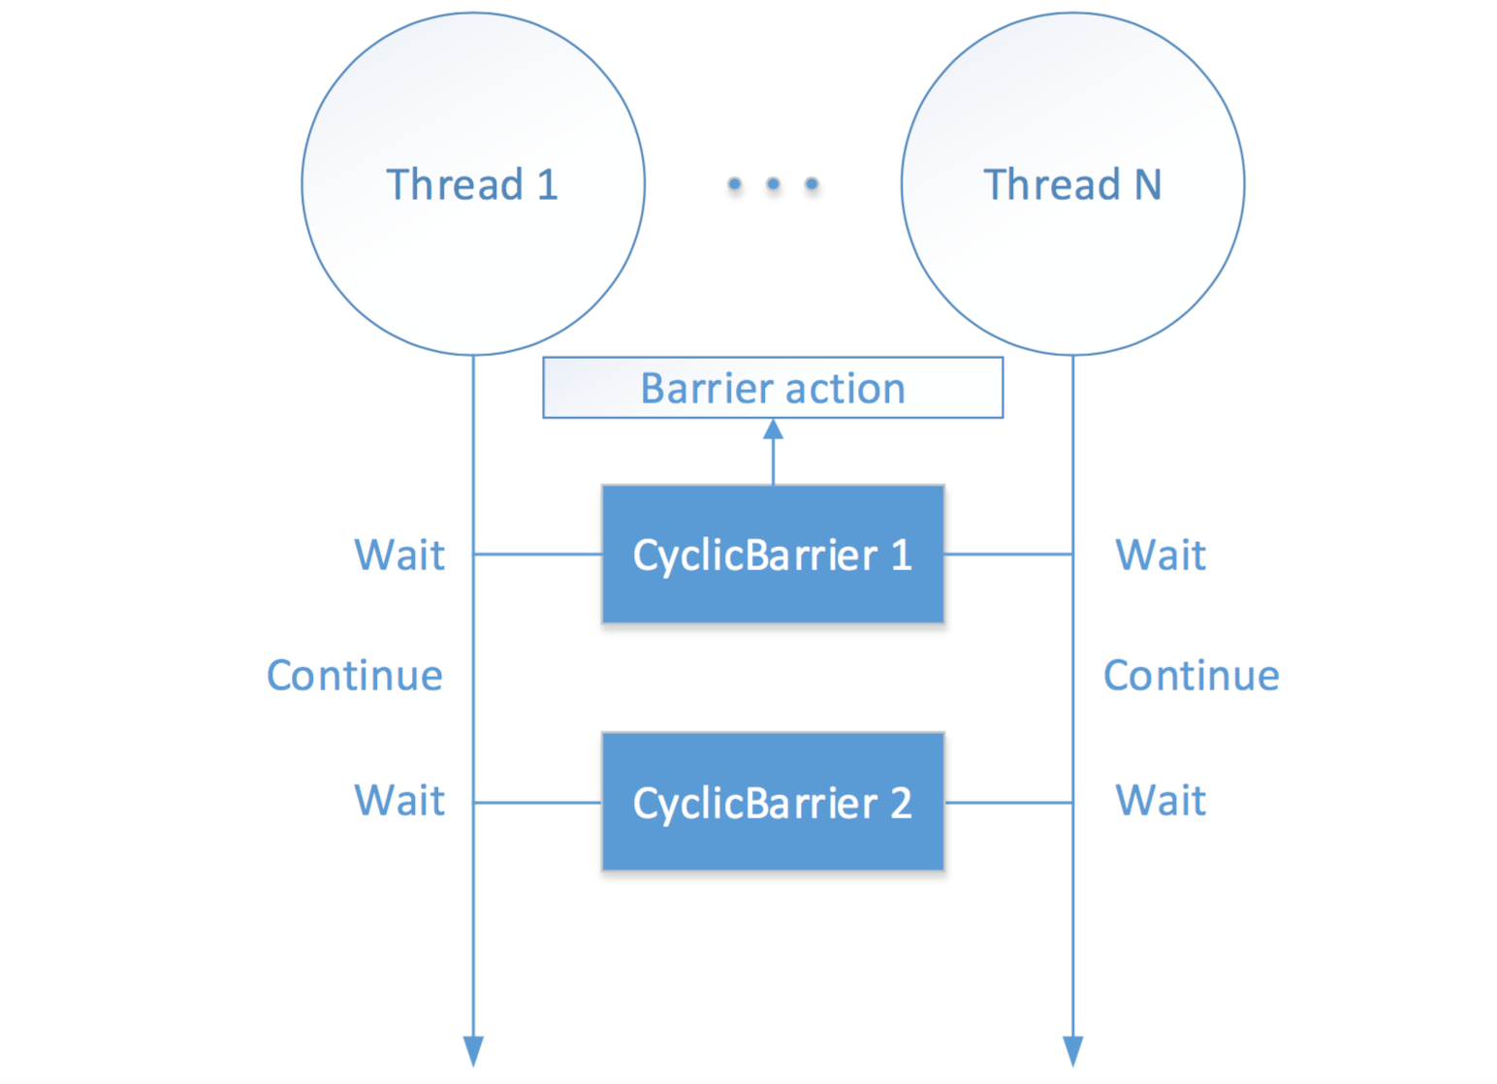

Slide 19
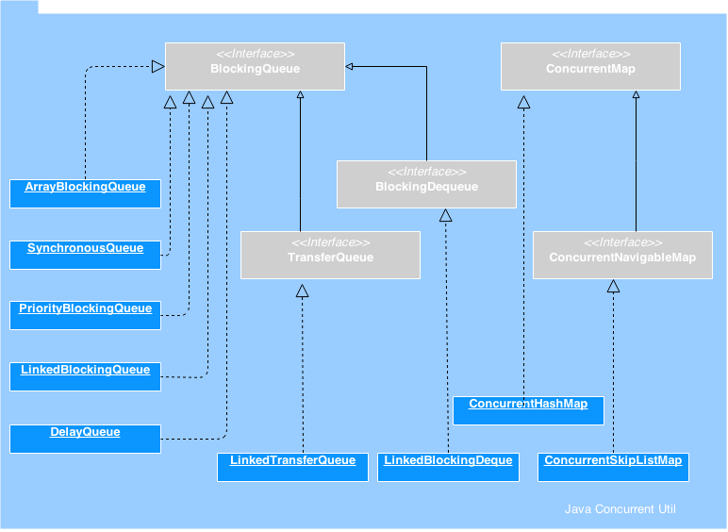
concurrency collections

Slide 20
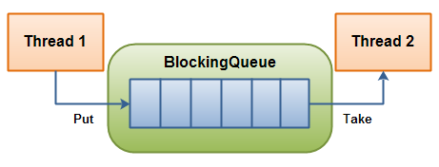
BlockingQueue
A queue that can be blocked when full or empty

Slide 21
Queue Name | Usage
ArrayBlockingQueue | fixed bounded buffer&&elements FIFO
LinkedBlockingQueue | fixed bounded buffer&&elements FIFO
PriorityBlockingQueue | unbounded buffer&&with priority
SynchronousQueue | holding no data&&just channel
DelayQueue | used for Cache or close unused connections
LinkedTransferQueue(JDK1.7) | blockingqueue+waiting for consumer

Slide 22
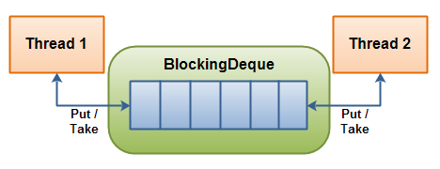
BlockingDeque(JDK1.6)
Deque Name | usage
LinkedBlockingDeque | threads can put and take from both ends of the deque

Slide 23
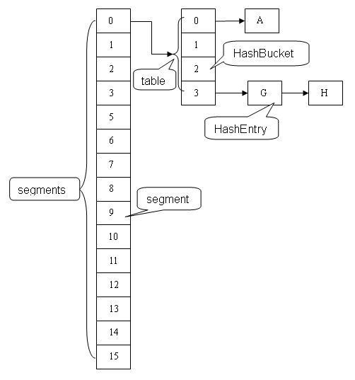
ConcurrentHashMap
Segments
HashEntry

Slide 24
Atomic Variable
(1)Used to build lighter-weight high performance non-blocking synchronisation
(2)Based on Compare-And-Swap operation
(3)Twelve atomic variable classes, two popular groups:
AtomicInteger, AtomicLong, AtomicBoolean,*********
AtomicIntegerFieldUpdater,AtomicLongFieldUpdater,*******

Slide 25
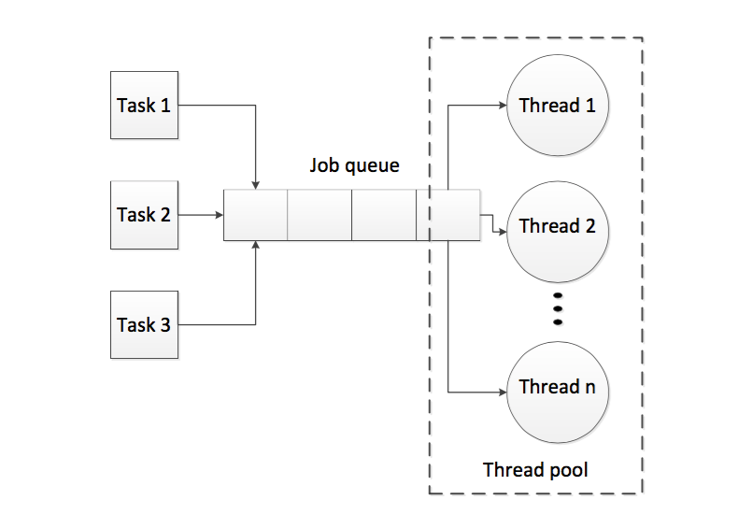
thread pool framework

Slide 26
benefits of Executor Framework:
(1)no need to write the code about the thread creation,
ending and result get(Callable interface)
(2)no need to create the Thread Object manually
(3)have better management of the computer resources

Slide 27
some most used thread pools
ThreadPool | usage
newFixedThreadPool | This executor is suitable for the web AppServer that deny the extra request to protect current user experience.
newSingleThreadExecutor | this executor is used only for one thread to start and can’t be reconfigurable
newCachedThreadPool | This executor is suitable for applications that launch many short-lived tasks.
newScheduledThreadPool | a fixed size thread pool that supports delayed and timed task execution.

Slide 28
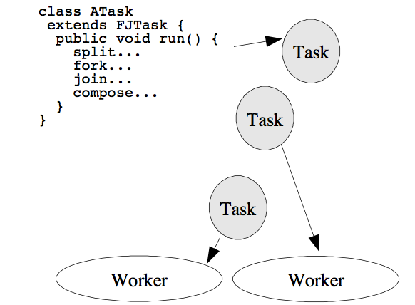
Fork/Join Framework

Slide 29
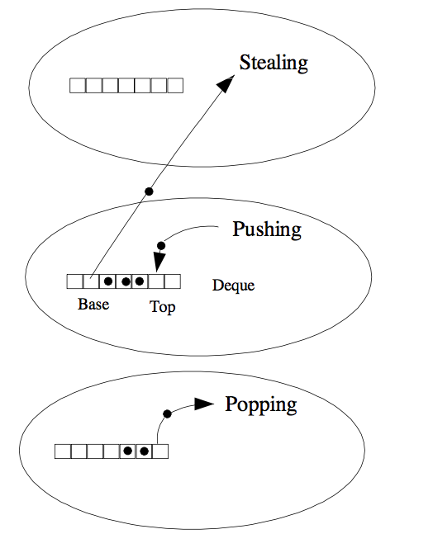
Work-Stealing

Slide 30
concurrency test
1:test for correctness with JUnit
(1)test bounded buffer
(2)test the producer&&consumers
2:test for performance
(1)concurrentHashMap&&Hashtable

Slide 31
Classical problems
(1)Producer&&Consumer
(2)Reader&&Writer
(3)Dining Philosophers Problem(Deadlock&&Solutions)

Slide 32
Thank you

