Slide 1
Salary Analysis
Evimaria Terzi
CS591

Slide 2
Goals
Industry salary conditions
What positions/industry are well-paid
Requirements for high salary
Certificates vs Working Experience

Slide 3
Dataset
2014 Boston annual salary reports
Columns we use:
Titles, Department names, injured salary, regular salary, total salary, overtime salary and retroactive salary
2014 Boston Employment statistics
Columns we use:
Titles, Median salary, Experience, Training period, education

Slide 4
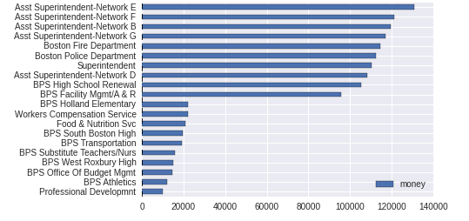
Industry salary conditions
Top 10 and last 10 industries based on salary
Name of industries
The amount of money

Slide 5
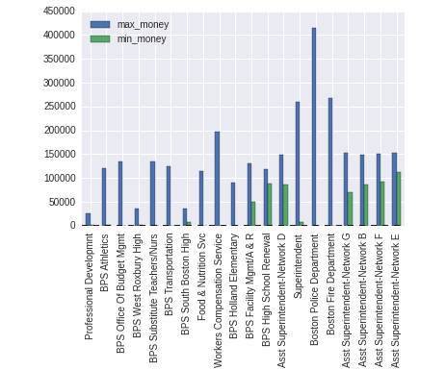
Industry salary conditions
Min salary vs max salary
Average money
Name of industries

Slide 6
Well-paid positions (police)
Techniques: svd +K-mean clustering+svm
Positions earn least:
Positions | Revelant Industry
Jr Building Custodian | 0
Asst Prin Accountant | 0
Liaison Agent (BPD) | 0
School Traffic Supv | 0
Asst Prin Accountant | 0
Police Offc/Auto Invest | 1
Criminalist II | 0
Exec Asst | 0
... | ...

Slide 7
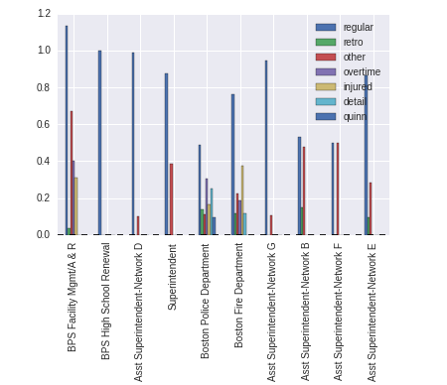
Different components of salary
For each highly-paid industry, which part of salary mainly contributes to the total salary (Linear regression)
Salary components for top 10 industries
coefficient

Slide 8
Highly-paid position and Industry
Techniques: gensim library, STOP WORDS, counter libraries
Position Names | Industry names
chief | Police
supivisor | superintendent
director | engineer
senior | millitant
manager | medical
officer | ____

Slide 9
Requirements for highly paid position and industry(logist regression)

Slide 10
Results based on tables
Bachelor's degree is very important for job hunting
Only more than 5 years' experience can work for your profile.
Doctor certificate will have a very important role on your salary

