Slide 1
Hand Pose Estimation with Early Fusion Architecture
David Wen, Tan Gemicioglu, Avinash Vemuri

Slide 2
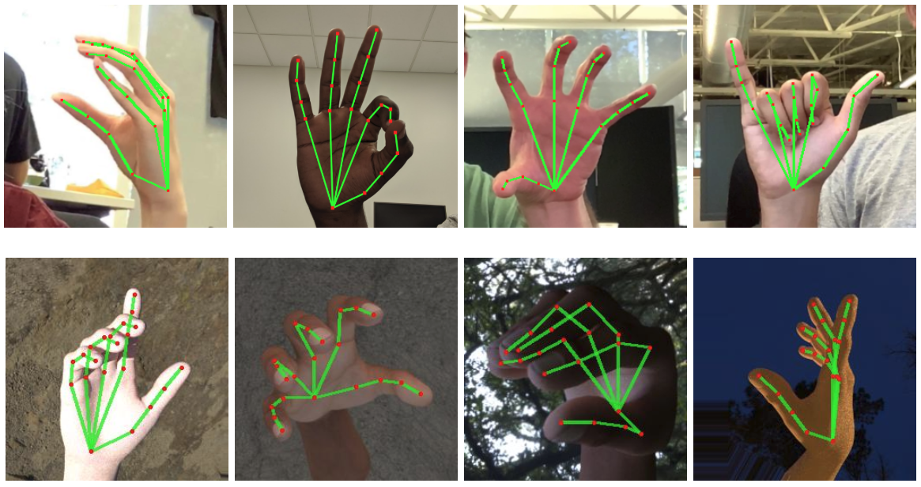
Motivation

Slide 3
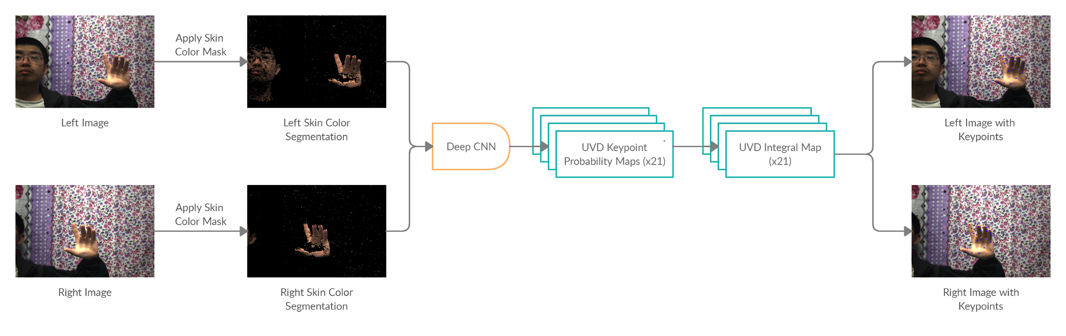
Approach

Slide 4
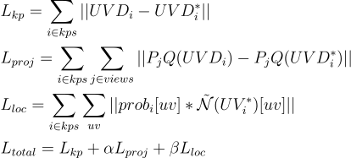
Loss function

Slide 5
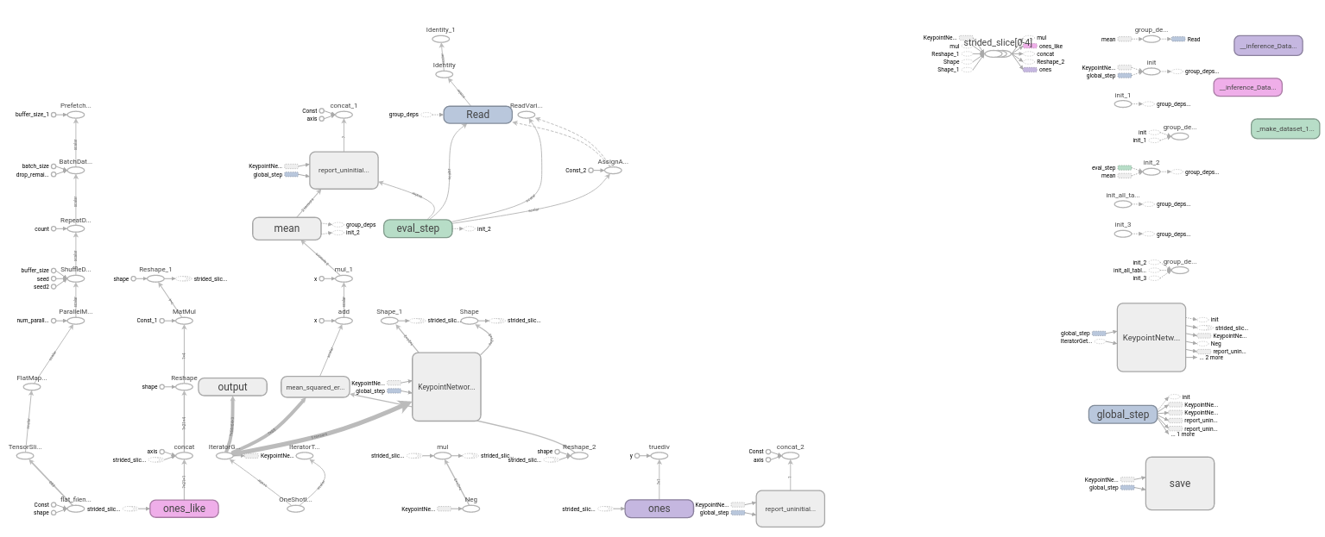
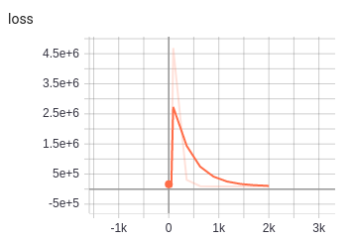
The Model

Slide 6
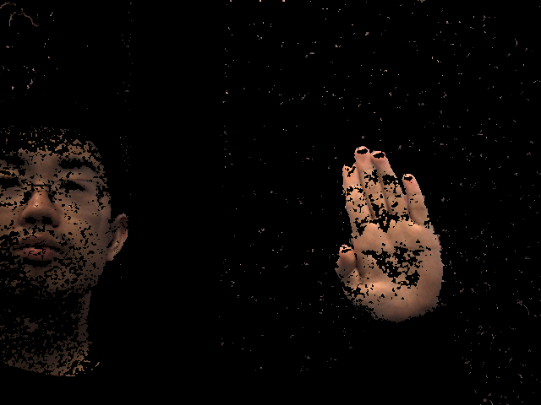
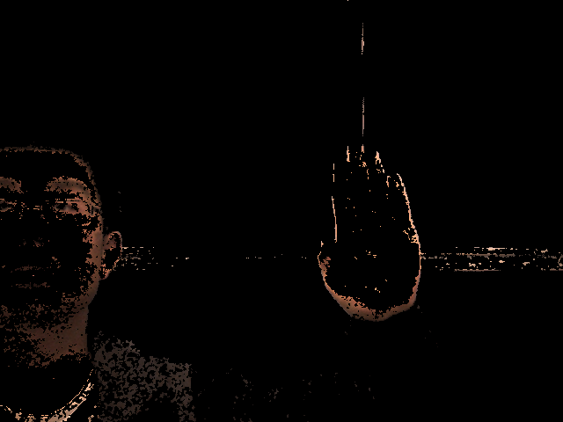
Skin Segmentation

Slide 7






















