Slide 1

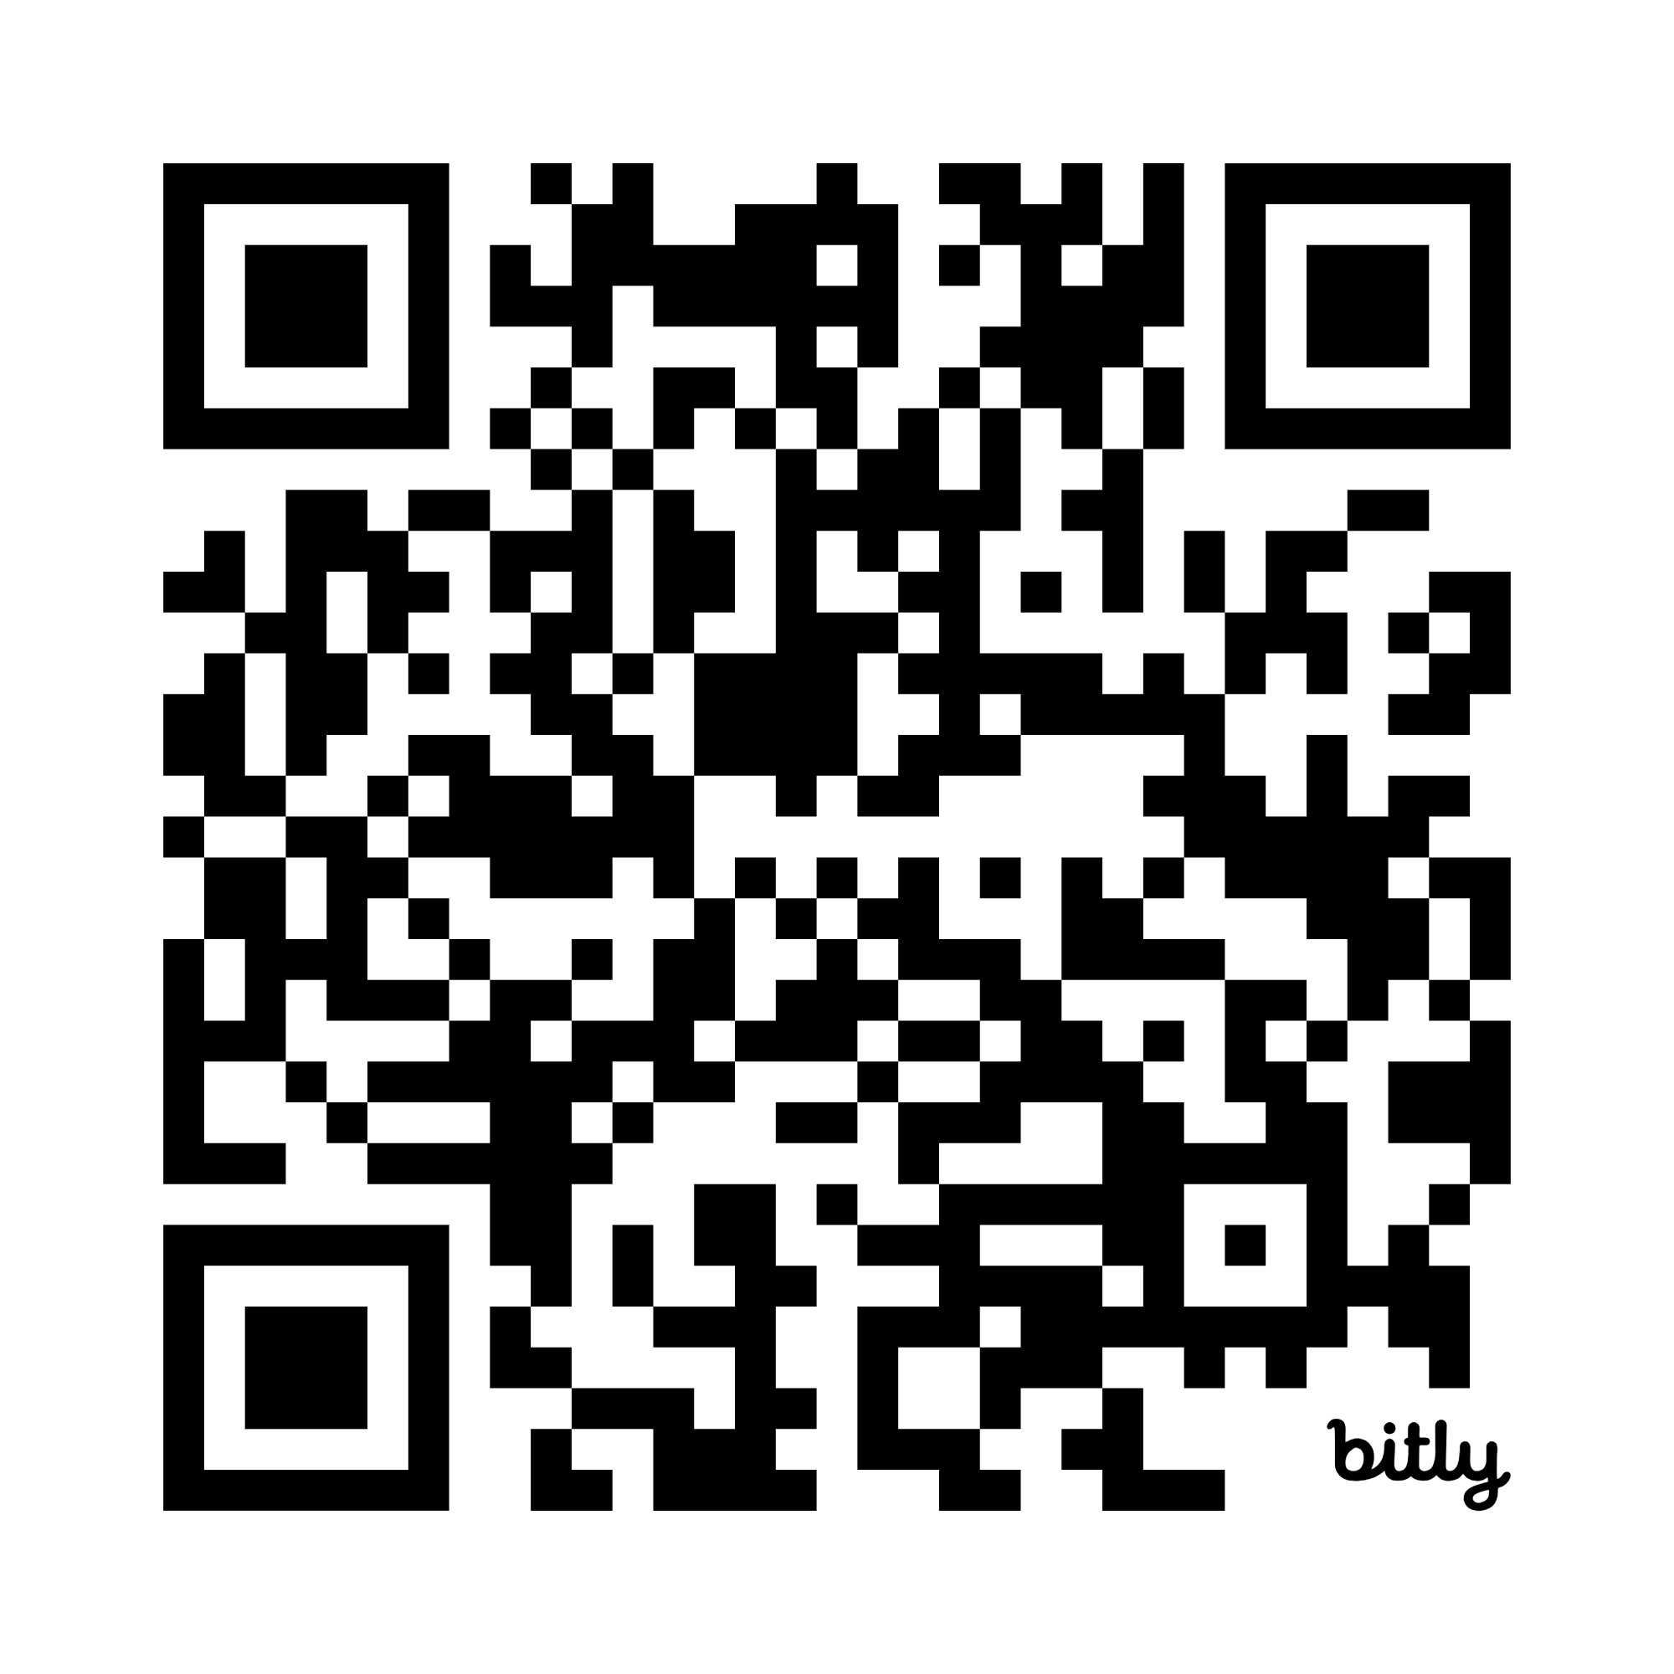


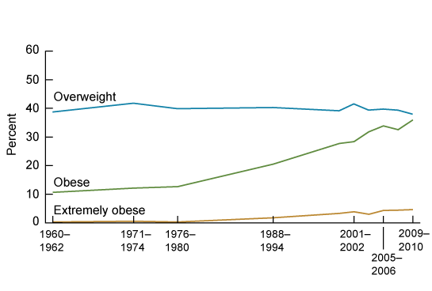


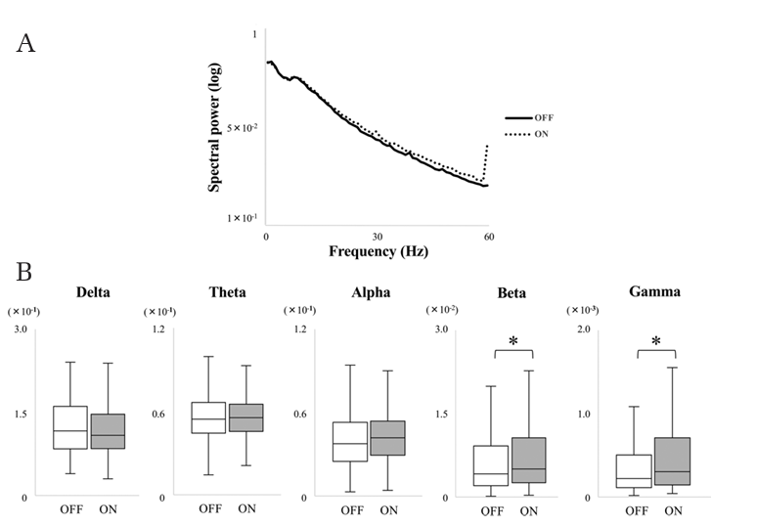
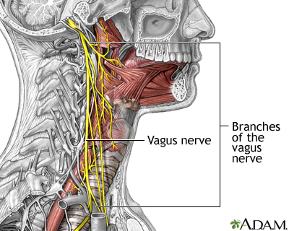
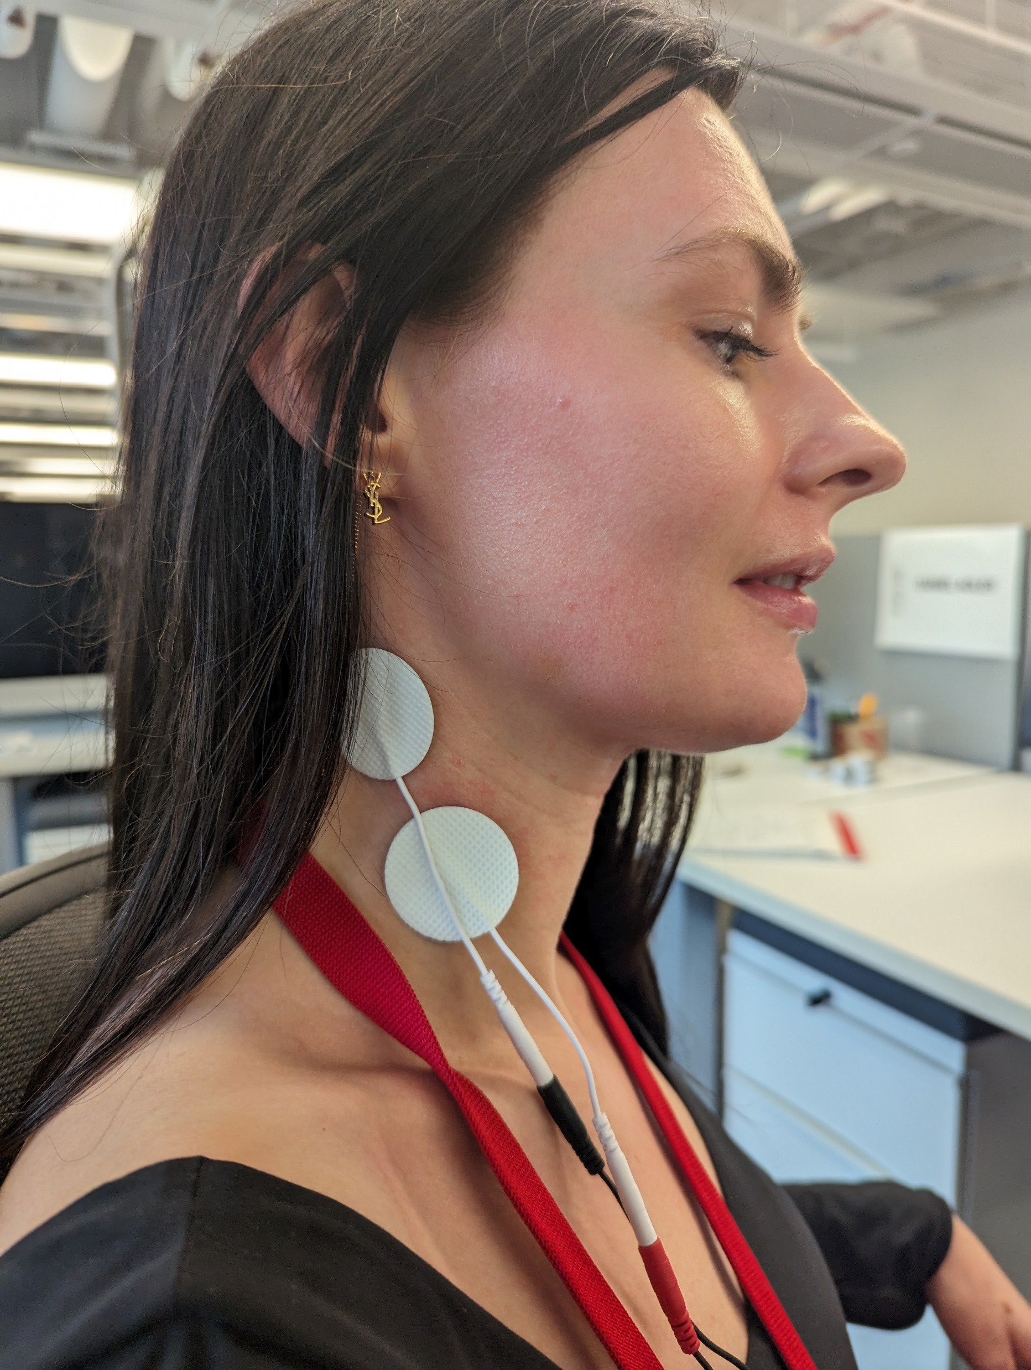
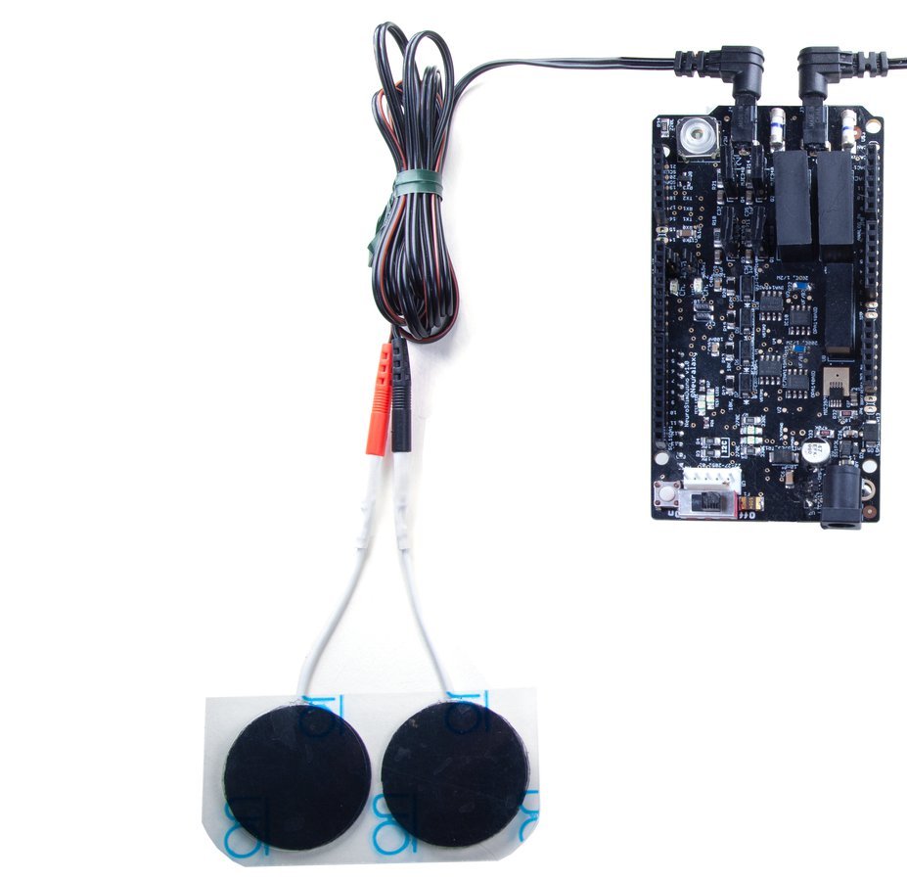
Transcutaneous Vagus Nerve Stimulation as Momentary Intervention for Modulating Satiety
Tan Gemicioglu, Jas Brooks, Tanzeem Choudhury
Contact
Tan Gemicioglu
tangemicioglu.com
tg399@cornell.edu
Motivation
Vagus nerve stimulation delivered immediately during eating can help people feel full with less food and stop eating earlier.
Preliminary Results
Overeating and emotional eating are growing problems in the US, and lead to increased risk in a number of conditions, including coronary heart disease, stroke and Type II diabetes. An increasing number of the population is obese, with 40.3% of US adults obese in 2023 (CDC).
Moreover, we increasingly work while we are eating, decoupling eating from appetite. 70% of US employees eat while working at least once a week. How can we help people feel full even when they are distracted?
Our study is ongoing, and we only have results from four pilot participants at this stage. Our preliminary results have shown promise that momentary vagus nerve stimulation can be effective for modulating satiety. Overall, participants felt full after eating less and stopped eating earlier with VNS, but also reported that they felt sleepier after receiving VNS. These results correlate with the typical signs of a parasympathetic response, but also point to some side effects of the intervention.
Vagus Nerve Stimulation for Modulating Satiety
We used transcutaneous cervical vagus nerve stimulation as a method to trigger the parasympathetic response early while eating. Electrodes were placed on the neck of participants, which was used to transmit a weak (2-4mA depending on participant tolerance) electrical stimuli at 30Hz to the vagus nerve, just below the threshold at which participants described a tingling sensation. Electrical signals were generated by the NeuroStimDuino, an open-source neural stimulator. Participants started receiving stimulation at the same time they started the primary task, where they were snacking while doing computer-based work.
Participants were offered salty or sweet snacks based on their personal preference and were asked to stop and inform the researcher when they felt full. While snacking, they completed routine computer-based tasks such as writing emails, reading articles, or watching videos.
We collected information on:
Amount of food eaten and duration of snacking
Appetite and eating impulsivity
Experience and sensation of stimulation
Agency and body ownership
Obesity has continued its rise in the US. Image Credit: CDC
Increasingly, we are eating while working and distracted.
Vagus Nerve Stimulation as Momentary Intervention
Amount of Food Eaten
Eating Duration
Appetite Questionnaire
The vagus nerve plays a central role in the autonomic nervous system by connecting the brain to several organs including the heart, lungs, stomach and kidneys. Vagus nerve stimulation (VNS) has been used as a treatment for medical conditions such as anxiety, depression, and chronic pain (Howland, 2014).
The conventional paradigm for delivering VNS is either continuously with implanted devices, or in a daily or weekly schedule with non-invasive approaches, aiming to induce long-term changes. Recent work has shown that VNS can have an effect rapidly during and after stimulation, leading to changes in sensory processing (Rodenkirch et al., 2022). This momentary approach has been used in medical treatments as well, such as for epilepsy (Yokoyama et al., 2020).
Conclusion
We proposed momentary vagus nerve stimulation, delivered immediately while participants are eating, as a method for modulating satiety and making participants feel fuller. We believe that this approach can be effective for reducing emotional eating behaviors during daily life.
Our preliminary results show promise that VNS can be effective for modulating satiety. We will continue to perform studies for more conclusive results.
Future Work
How much agency and ownership do participants feel over their decision to stop eating?
Can we create a wearable vagus nerve stimulator for delivering VNS during daily use?
References
Howland, R. H. (2014). Vagus Nerve Stimulation. Current Behavioral Neuroscience Reports, 1(2), 64–73. https://doi.org/10.1007/s40473-014-0010-5
Rodenkirch, C., Carmel, J. B., & Wang, Q. (2022). Rapid Effects of Vagus Nerve Stimulation on Sensory Processing Through Activation of Neuromodulatory Systems. Frontiers in Neuroscience, 16, 922424. https://doi.org/10.3389/fnins.2022.922424
Yokoyama, R., AKIYAMA, Y., ENATSU, R., SUZUKI, H., SUZUKI, Y., KANNO, A., OCHI, S., & MIKUNI, N. (2020). The Immediate Effects of Vagus Nerve Stimulation in Intractable Epilepsy: An Intra-operative Electrocorticographic Analysis. Neurologia Medico-Chirurgica, 60(5), 244–251. https://doi.org/10.2176/nmc.oa.2019-0221
Vagus nerve stimulation immediately leads to increased beta and gamma activity for intractable epilepsy patients. Image Credit: Yokoyama et al., 2020
Transcutaneous cervical vagus nerve stimulation targets the side of the neck.
The NeuroStimDuino, the open-source neurostimulator used in our study.

