Slide 1

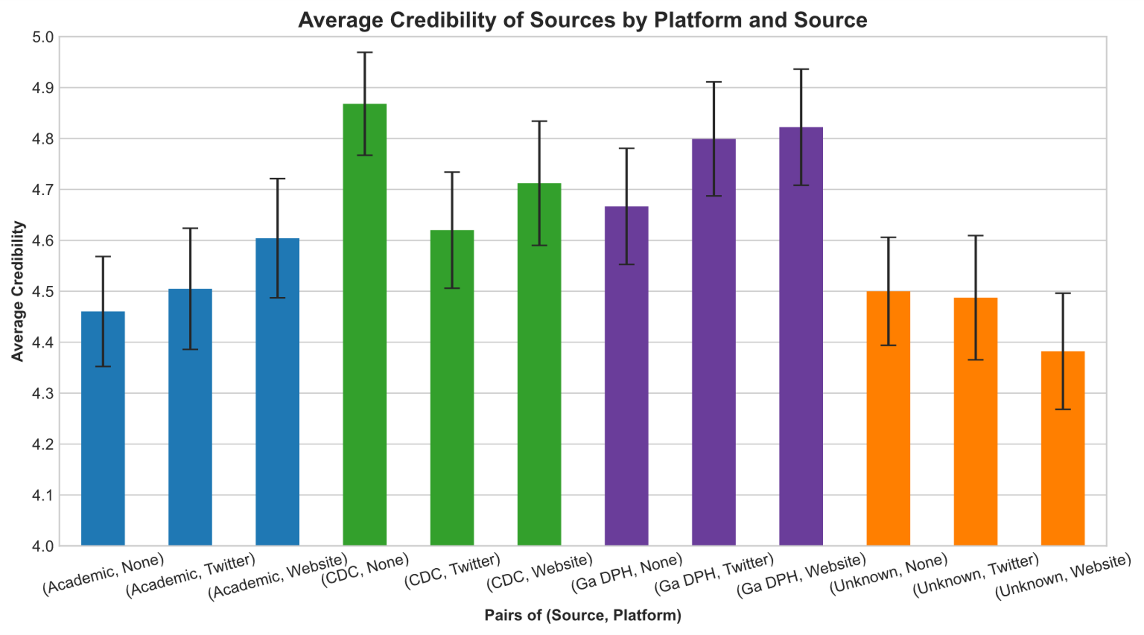
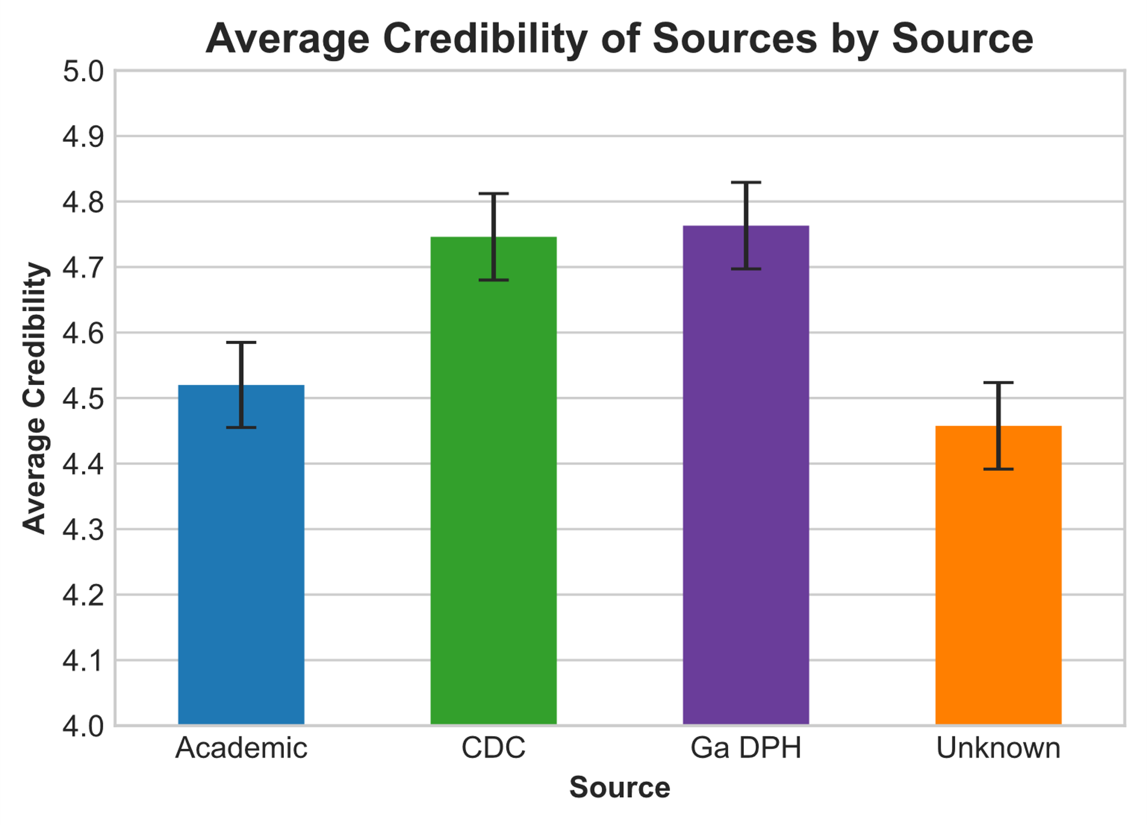
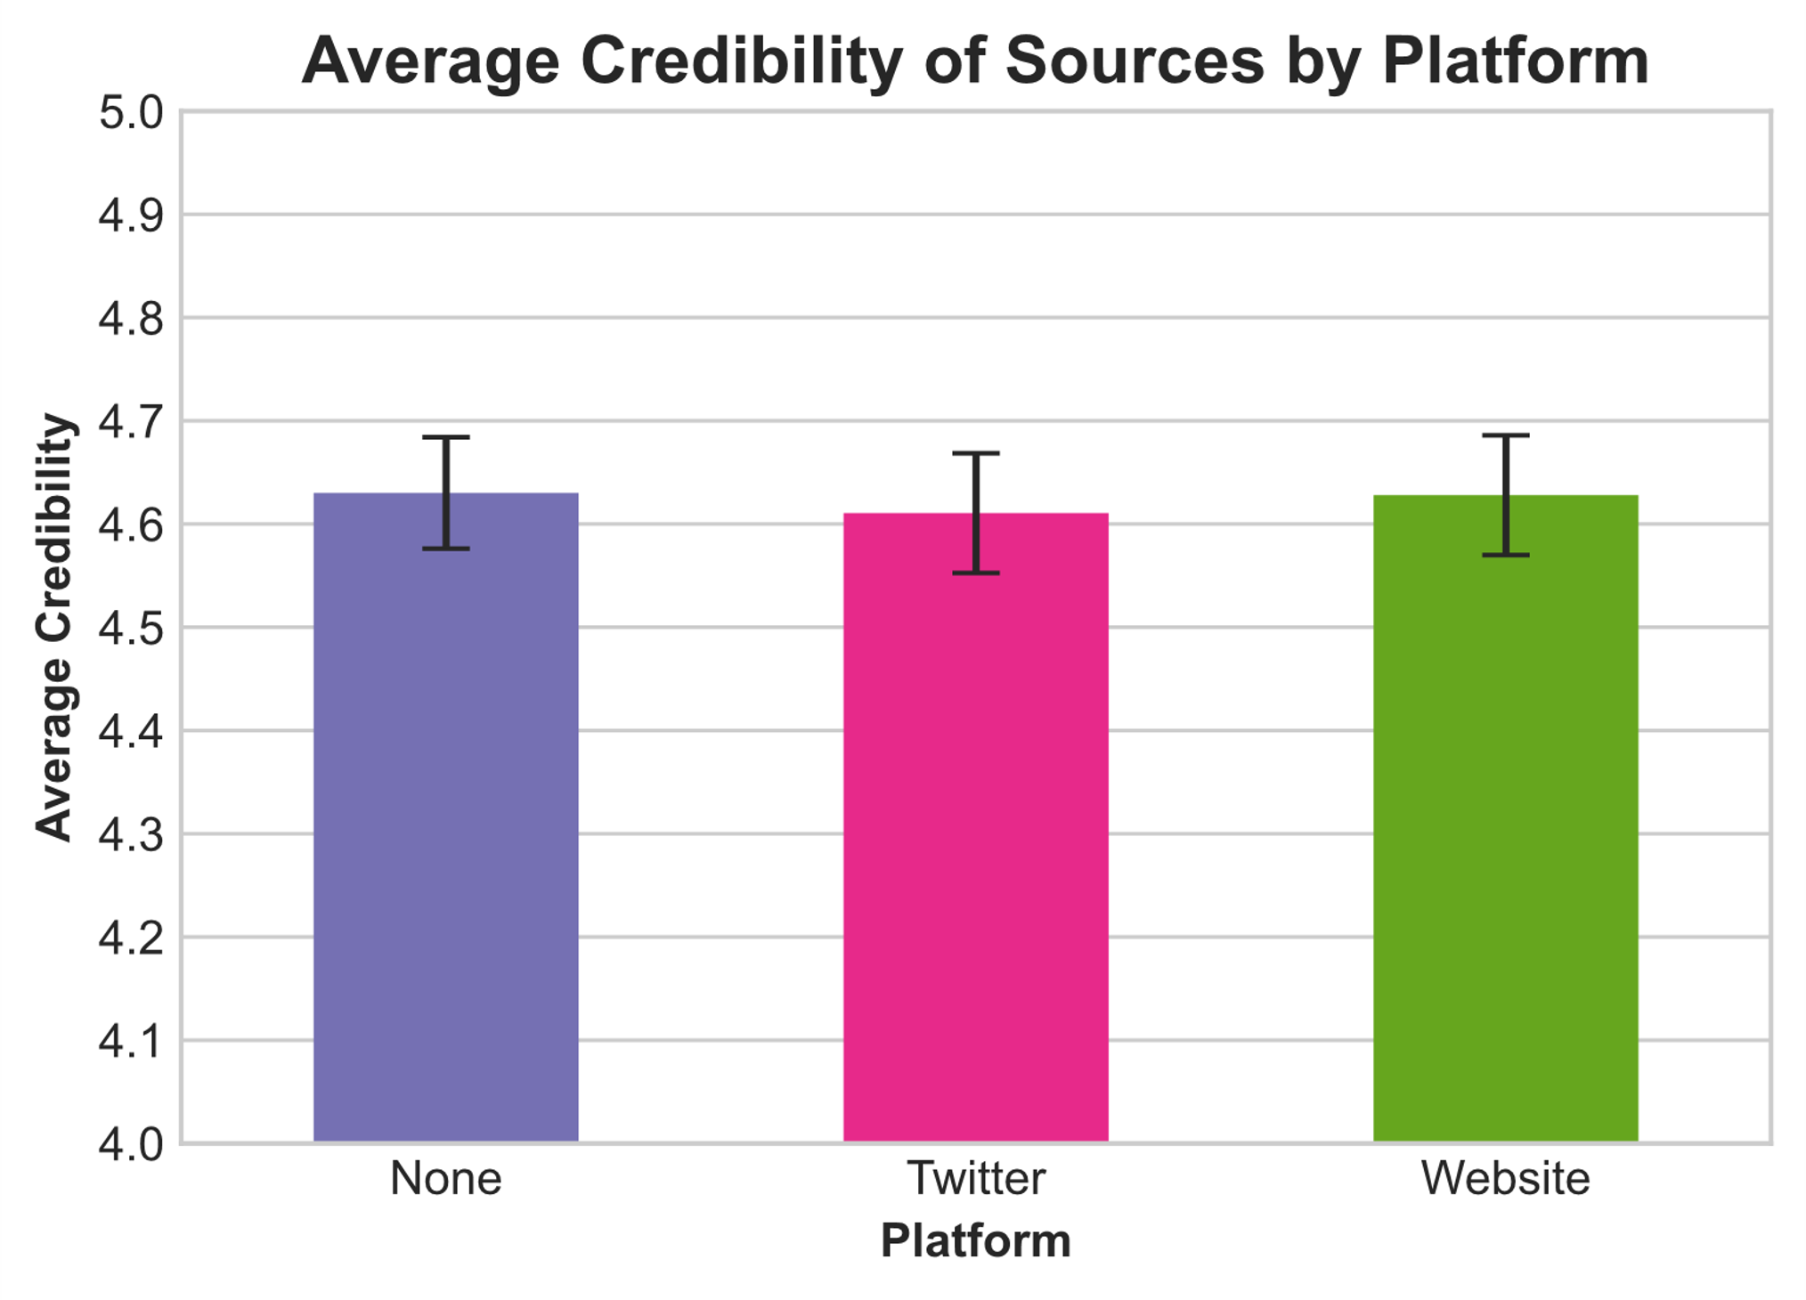
Perceived Credibility of Public Health Messages
Tan Gemicioglu, Ahmed Sabeeh, Ski Ingurgio, and Kai McKeever (PSYC 2015: Spring 2022)
Introduction
H1
H3
Within the context of the COVID-19 pandemic, effectiveness of public health messaging has become increasingly more relevant. In particular, the messages which public health entities send out must be seen as trustworthy for that message to be effective. How might the source and platform of public health messages affect perceived credibility of those messages?
Understanding effective public health messaging is important, as a study by De Choudhury et al. (2014) investigated how social media and search engines are used for health information. Other studies compare credibility to other factors besides source and platform, such as Lachlan et al.’s (2014) study on the timeliness of public health messages, and they found a significant correlation.
Hypothesis 1: Higher-level sources (national sources) will be viewed as more credible than lower-level sources (state and/or independent sources).
Hypothesis 2: When compared to a control of no original platform stated, people will assess messages from a source’s website as more credible, and messages from social media sites will be assessed as less credible.
Hypothesis 3: The messages from lower-level sources will have similar levels of credibility, regardless of which platform is used, and higher-level sources will be more impacted by the platform they are on.
Significant (p < 0.05) main effect found between source and credibility. CDC & GaDPH more credible than Unknown source.
F(3, 306) = 5.348, p = 0.001 η_{p}² = 1.747.
No significant interaction between source and platform.
F(6, 306) = .860, p = .525, η_{p}² = .281.
Discussion and Future Work
Summary
Public health organizations are recognized as more credible, even at the state level
Platform of public health message plays no impact when controlled for design features
Strengths
Text-based format limits effects to only perception of platform
Large sample size
Limitations
Limited to Georgia Tech students
Regression to the mean
Insensitive DV, answers in small range
Weak manipulation, purely text-based
Problems with mixed design limiting significance
Future Work
Examining political ideology as a moderator
Expanding sample to be more generalizable
Investigate more sources and platforms
Make message encounter more realistic (visual vs text)
H2
Methods
No significant main effect of platform on credibility.
F(2, 306) = 0.060, p = 0.941 η_{p}² = 0.020.
Participants
51 GT undergraduate students recruited from PSYC courses
Ages: 18-22, Gender: 17 females, 34 males
Sampling Method: Convenience Sampling
Design
Mixed subject design with platform being measured between subject and source being measured within subject
IV1: Source of message (Academic, National, State, Control)
IV2: Platform of message (Control, Twitter, Official website)
DV: Credibility of source/platform
Procedure
All participants received a Qualtrics survey corresponding to the platform they were assigned
The survey included a text-based questionnaire showing public health announcements along with information about the source and platform they came from
The participants then gave credibility ratings based on Eisenman et al.’s (2012) trust scale
References
De Choudhury, Munmun, Morris, Meredith, & White, Ryen. (2014). Seeking and sharing health information online: Comparing search engines and social media. Conference on Human Factors in Computing Systems - Proceedings. https://doi.org/10.1145/2556288.2557214
Eisenman, D. P., Williams, M. V., Glik, D., Long, A., Plough, A. L., & Ong, M. (2012). The public health disaster trust scale: Validation of a brief measure. Journal of Public Health Management and Practice, 18(4), E11–E18. https://doi.org/10.1097/PHH.0b013e31823991e8
Lachlan, K. A., Spence, P. R., Edwards, A., Reno, K. M., & Edwards, C. (2014). If you are quick enough, I will think about it: Information speed and trust in public health organizations. Computers in Human Behavior, 33, 377–380. https://doi.org/10.1016/j.chb.2013.08.014

