Slide 1
Project presentation

Slide 2
Object:
Develop A Simple Instant Messenger System
Team Member:
Name TUT code UQAC code Work
Gao Long 20106176 GAOL05088808 Material and Idea
Tang LuPing 20106190 TANL23059201 Team Leader
Wang WenPeng 20106191 WANW19099100 Do presentation
Xue JiPeng 20106192 XUEJ19029203 Do document
Zheng ZhiYu 20106199 ZHEZ19109106 PHP programming
Abstract:
The Project we decided to do is A Simple Instant Messenger System
For the typical 3-Tier Architecture,
1) we use PHP+HTML to design a Web Page as a GUI client front,
2) and use WampServer 2 as localhost Server,
3) and use Phpmyadmin as the database.
This system mainly demo the message transmission between 2 or more processes on a host computer, and shows the time when it happens.

Slide 3
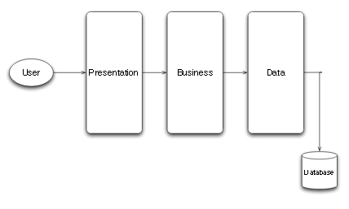
System Architecture

Slide 4
The architecture defines three tiers.
In the software-specific context, they can also be referred as functionally-distinct software layers:
1)Presentation.
The entities in this layer are responsible for the functionality
that interacts with the user. They are lightweight software components that
present data to the user (via an interface) and allow the user control and data
validation.
2)Logic or Business.
This layer is responsible for the implementation of the
main functionality of the application, such as the algorithms that process
data, and provide the features requested by the user.
3)Data
The entities in this layer are responsible for managing the persistent
data objects manipulated by the business layer. It usually implies a database
that stores the information, and consists of the software entities that model
the stored data (as object-oriented data abstractions, for instance).

Slide 5
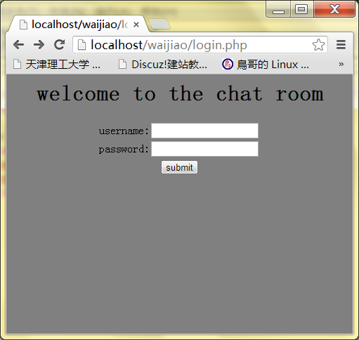
Some Print Shots
The Web Page of login.php is as follow:

Slide 6
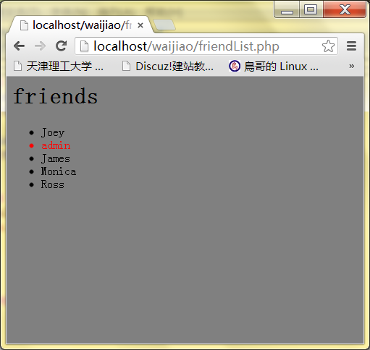
Typing username, password and then enter the Web page of friendList:

Slide 7
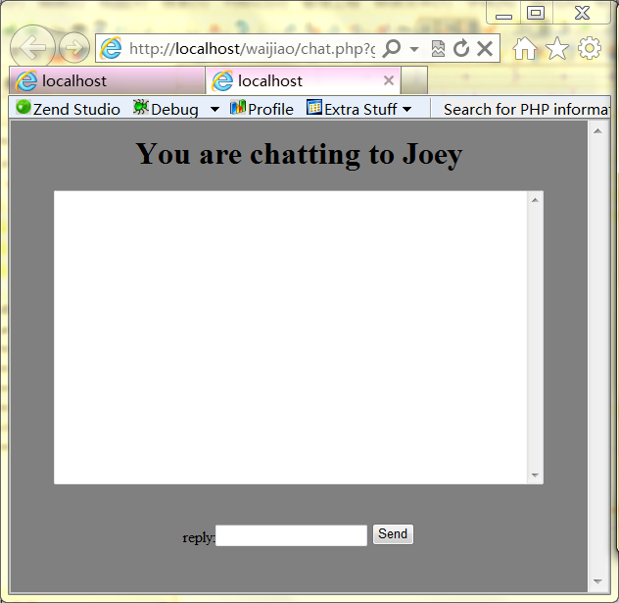
Here, We start a process and Login as Monica, And choose to chat to Joey, and Begin to send a message to him:

Slide 8
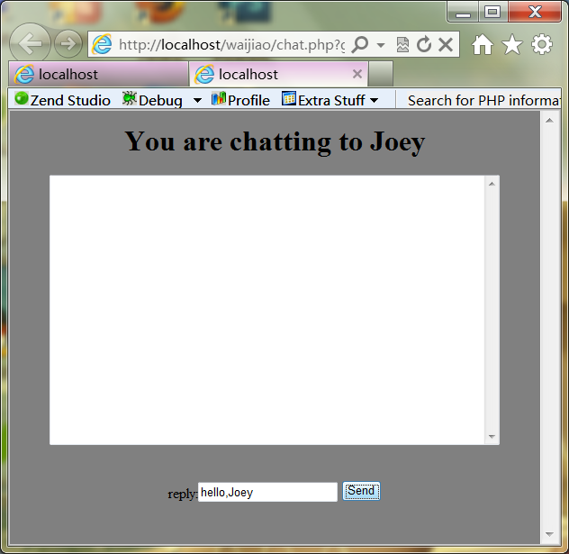

Slide 9
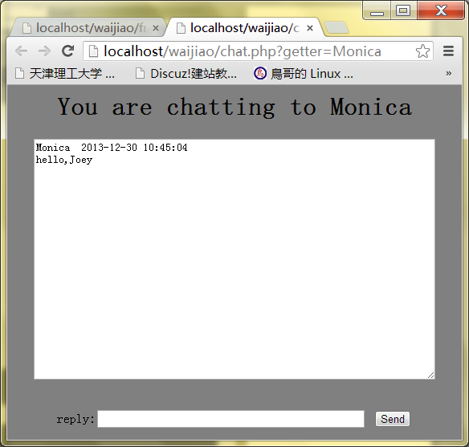
Next, We start another process and Login as Joey, And choose to chat to Monica, and Begin to send a message to her:

Slide 10
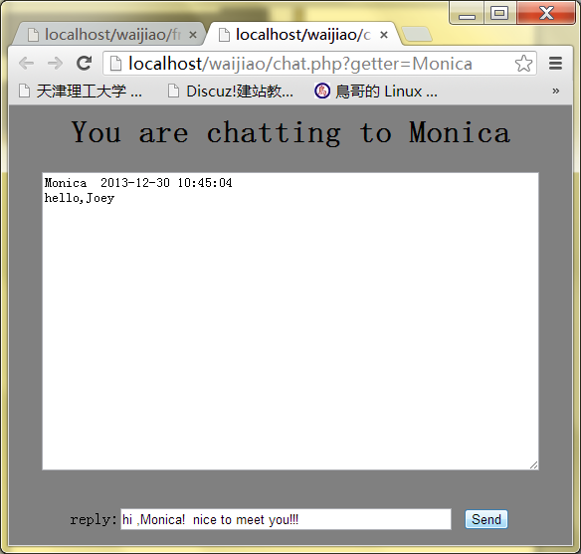

Slide 11
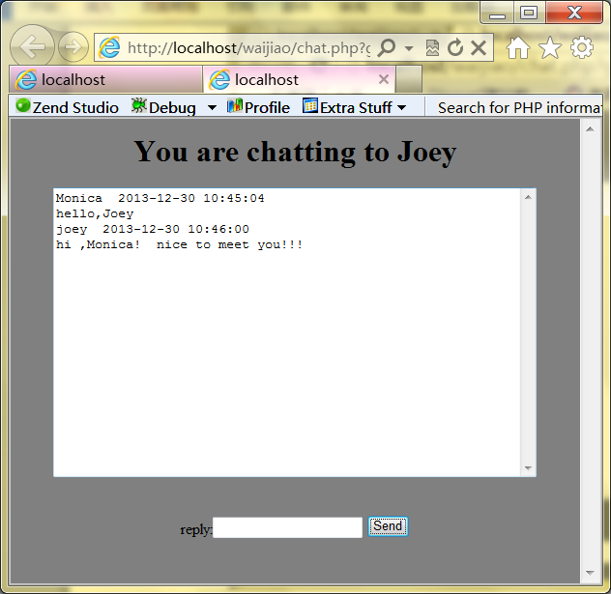
Then, In Monica’s Process of chatting, She gets the message from Joey, And then the chat will be continue...

Slide 12
Some References
1) Distributed Systems: Concepts and Design,(5th Edition), by Coulouris
2) Programming the World Wide Web (6th Edition), by Robert W. Sebesta
3) Fundamentals Of Database Systems (4th Edition), by Elmasri and Navathe
4)Reverse Engineering Object-Oriented Distributed Systems, by Dan-Calin Cosma

