Slide 1
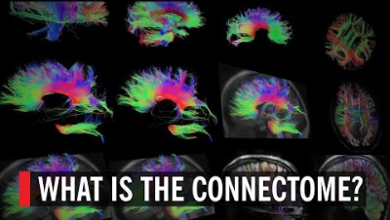

Native language differences in the structural connectome of the human brain
Native language differences in the structural connectome of the human brain
Xuehu Wei
Doctoral Researcher in the Department of Neuropsychology at the
Max Planck Institute for Human and Cognitive Sciences (Leipzig, Germany)
PUBLISHED: 2023
Figure 1. YouTube video explaining the connectome.
(World Science Festival, 2019)

Slide 2
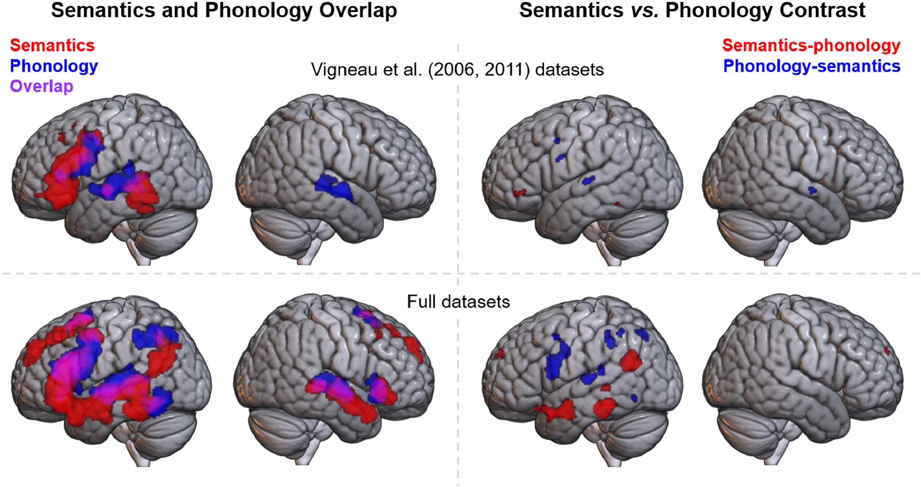
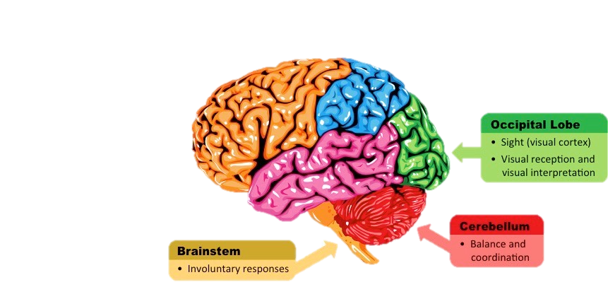
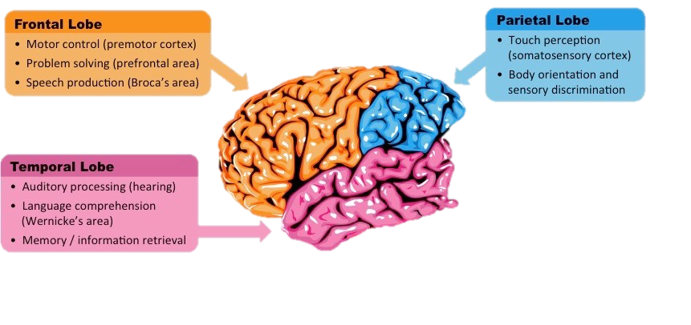
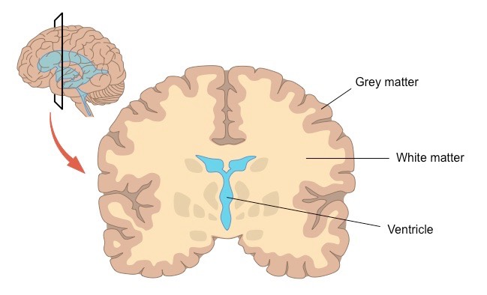
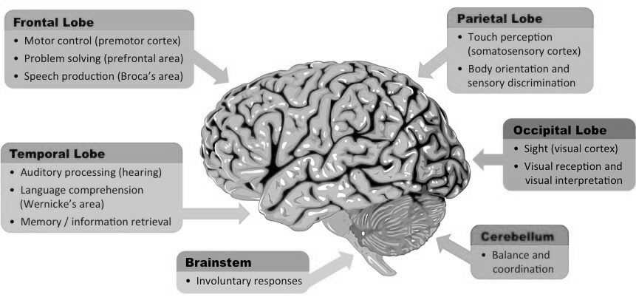
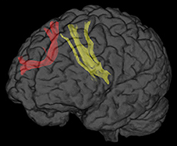
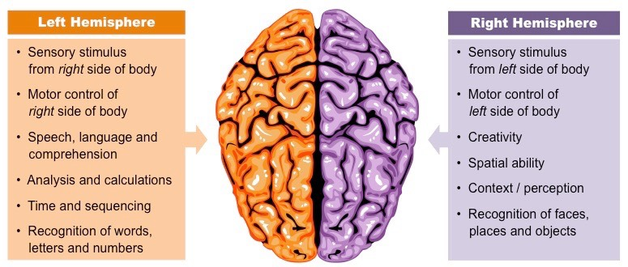
Native language differences in the structural connectome of the human brain
syntactic
CPH
“The neural language system […] is established around the age of ten/eleven years” (Wei et al., 2023)
neural language network
semantic
matter:
acquisition & development
matter changes:
1st network ≠ 2nd network
phonological
Native language differences in the structural connectome of the human brain
Native language differences in the structural connectome of the human brain
Native language differences in the structural connectome of the human brain
Figure 3. Semantics and Phonology Overlap and Contrast Brain Imaging.
Note. Adapted from Hodgson et al. (2021)
&
functional
speech network
core network
frontal aslant tract (FAT)
Figure 6. Temporal, Frontal, and Parietal lobe summary.
Note. Adapted from Cornell (2016b)
IFG (inferior frontal gyrus)
TL (temporal lobe)
IPL (inferior parietal lobe)
Figure 2. Diagram of white matter, grey matter, and ventricles.
Note. Adapted from Cornell (2016a)
Figure 5. Summaries of the left and right hemispheres of the brain.
Note. Adapted from Cornell (2016c)
+ corpus callosum (CC)
Figure 4. Diagram of the frontal aslant tract (FAT).
Note. Adapted from La Corte (2021)
Notes:
MENTION FUNCTIONAL CONNECTIVITY, BUT IT CAN BE IGNORED IN THIS CASE
“it has been shown that the gray and white matter of the brain adapts during language acquisition and development (…). The neural language system which responds to different aspects of language processing, is established around the age of ten/eleven years (….). […] However, previous studies have shown that different brain areas and networks are involved in first and second language processing (…). These processing differences are also reflected in previous structural studies of second language acquisition in adults, which showed changes in the white and gray matter of the brain that extend to areas not involved in first language processing (…). This suggests that a second language learned in adulthood is not processed in the native language system and may involve additional processing tasks such as language switching and cognitive control (…). These processing differences are found even in early bilinguals who learned the second language during childhood and the structural brain adaptation in first language acquisition during childhood differs from later second language learning (…).”

Slide 3
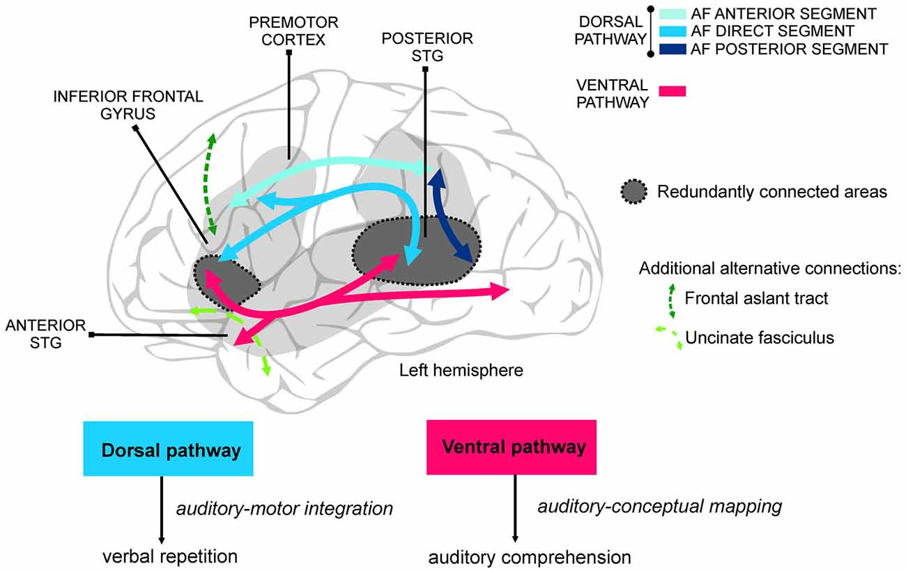
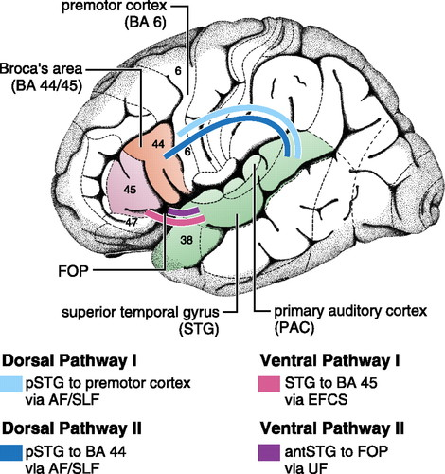
dorsally-located
syntax
Do the CHARACTERISTICS of an individual’s NATIVE language affect brain STRUCTURE*?
*i.e., the white matter network of the language processing system
Figure 7. First diagram of the dorsal and ventral pathways of language.
Note. Adapted from López-Barroso and de Diego-Balaguer (2017)
Figure 8. Second diagram of the dorsal and ventral pathways of language.
Note. Adapted from Friederici (2011)
ventrally-located
semantics & lexical

Slide 4
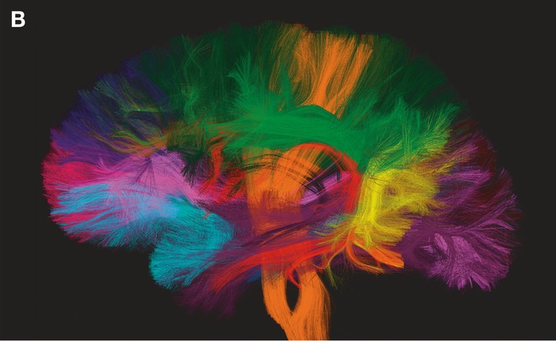
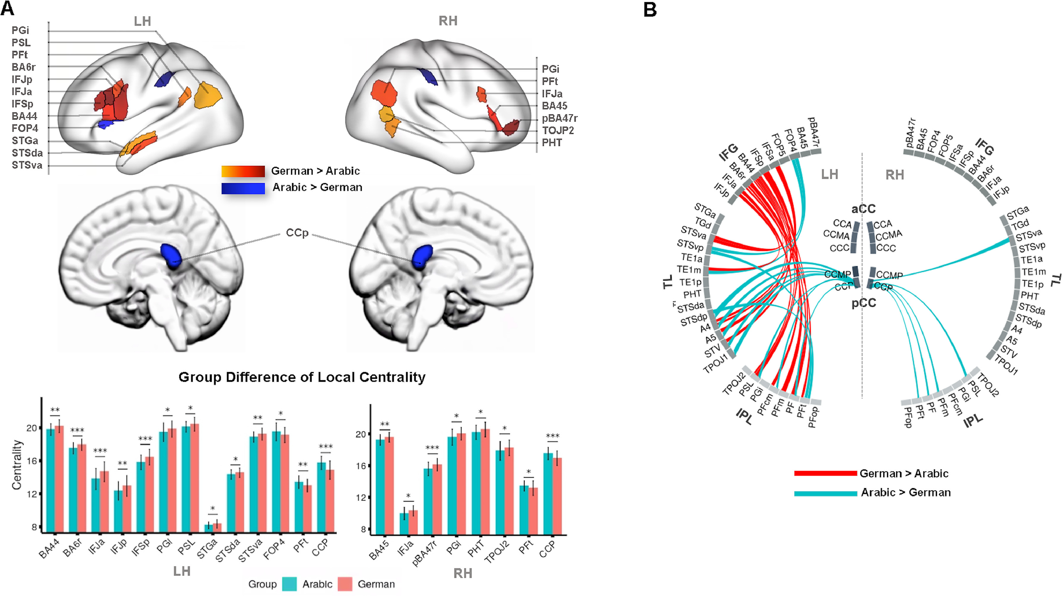
dorsally-located
QUASI-experimental
IV: native language
DV: structural connectivity
diffusion magnetic resonance imaging (dMRI)
tractography
Network Based Statistics (NBS)
Figure 10. Example of NBS.
Note. Adapted from Wei et al. (2023)
Figure 9. Example of applicability of dMRI.
Note. Adapted from Le Bihan (2014)
GERMAN vs. ARABIC
region | Germany | Levantine Arabic (migrants)
language family | Indo-European | Semitic
complexity | morphosyntactically (flexible word order) | morphologically (pairing of bound morphemes)
linear morphological structure? | Yes (linear) | No (NON-linear)
orthographical directionality | L → R | R → L
additional | - | short vowels are omitted in writing
age
health
gender
education
handedness (right)
only ONE native language
95
ventrally-located

Slide 5
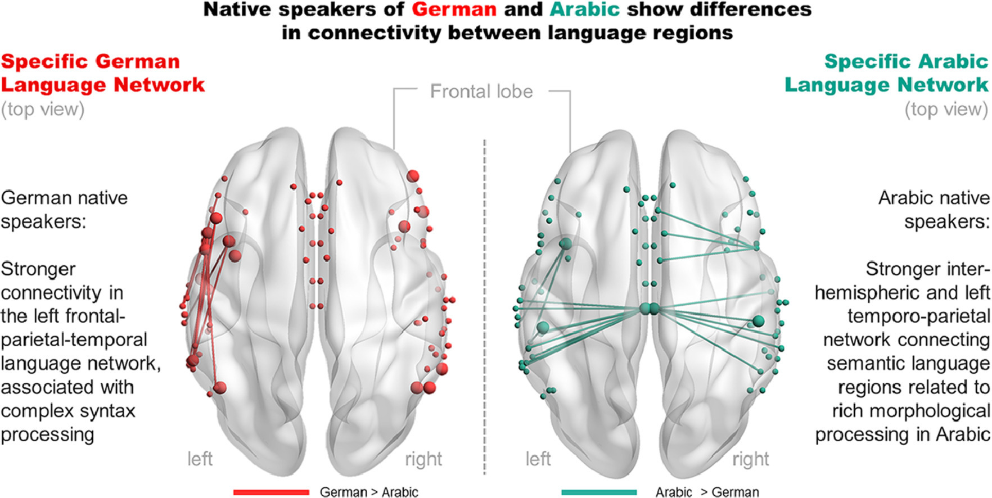
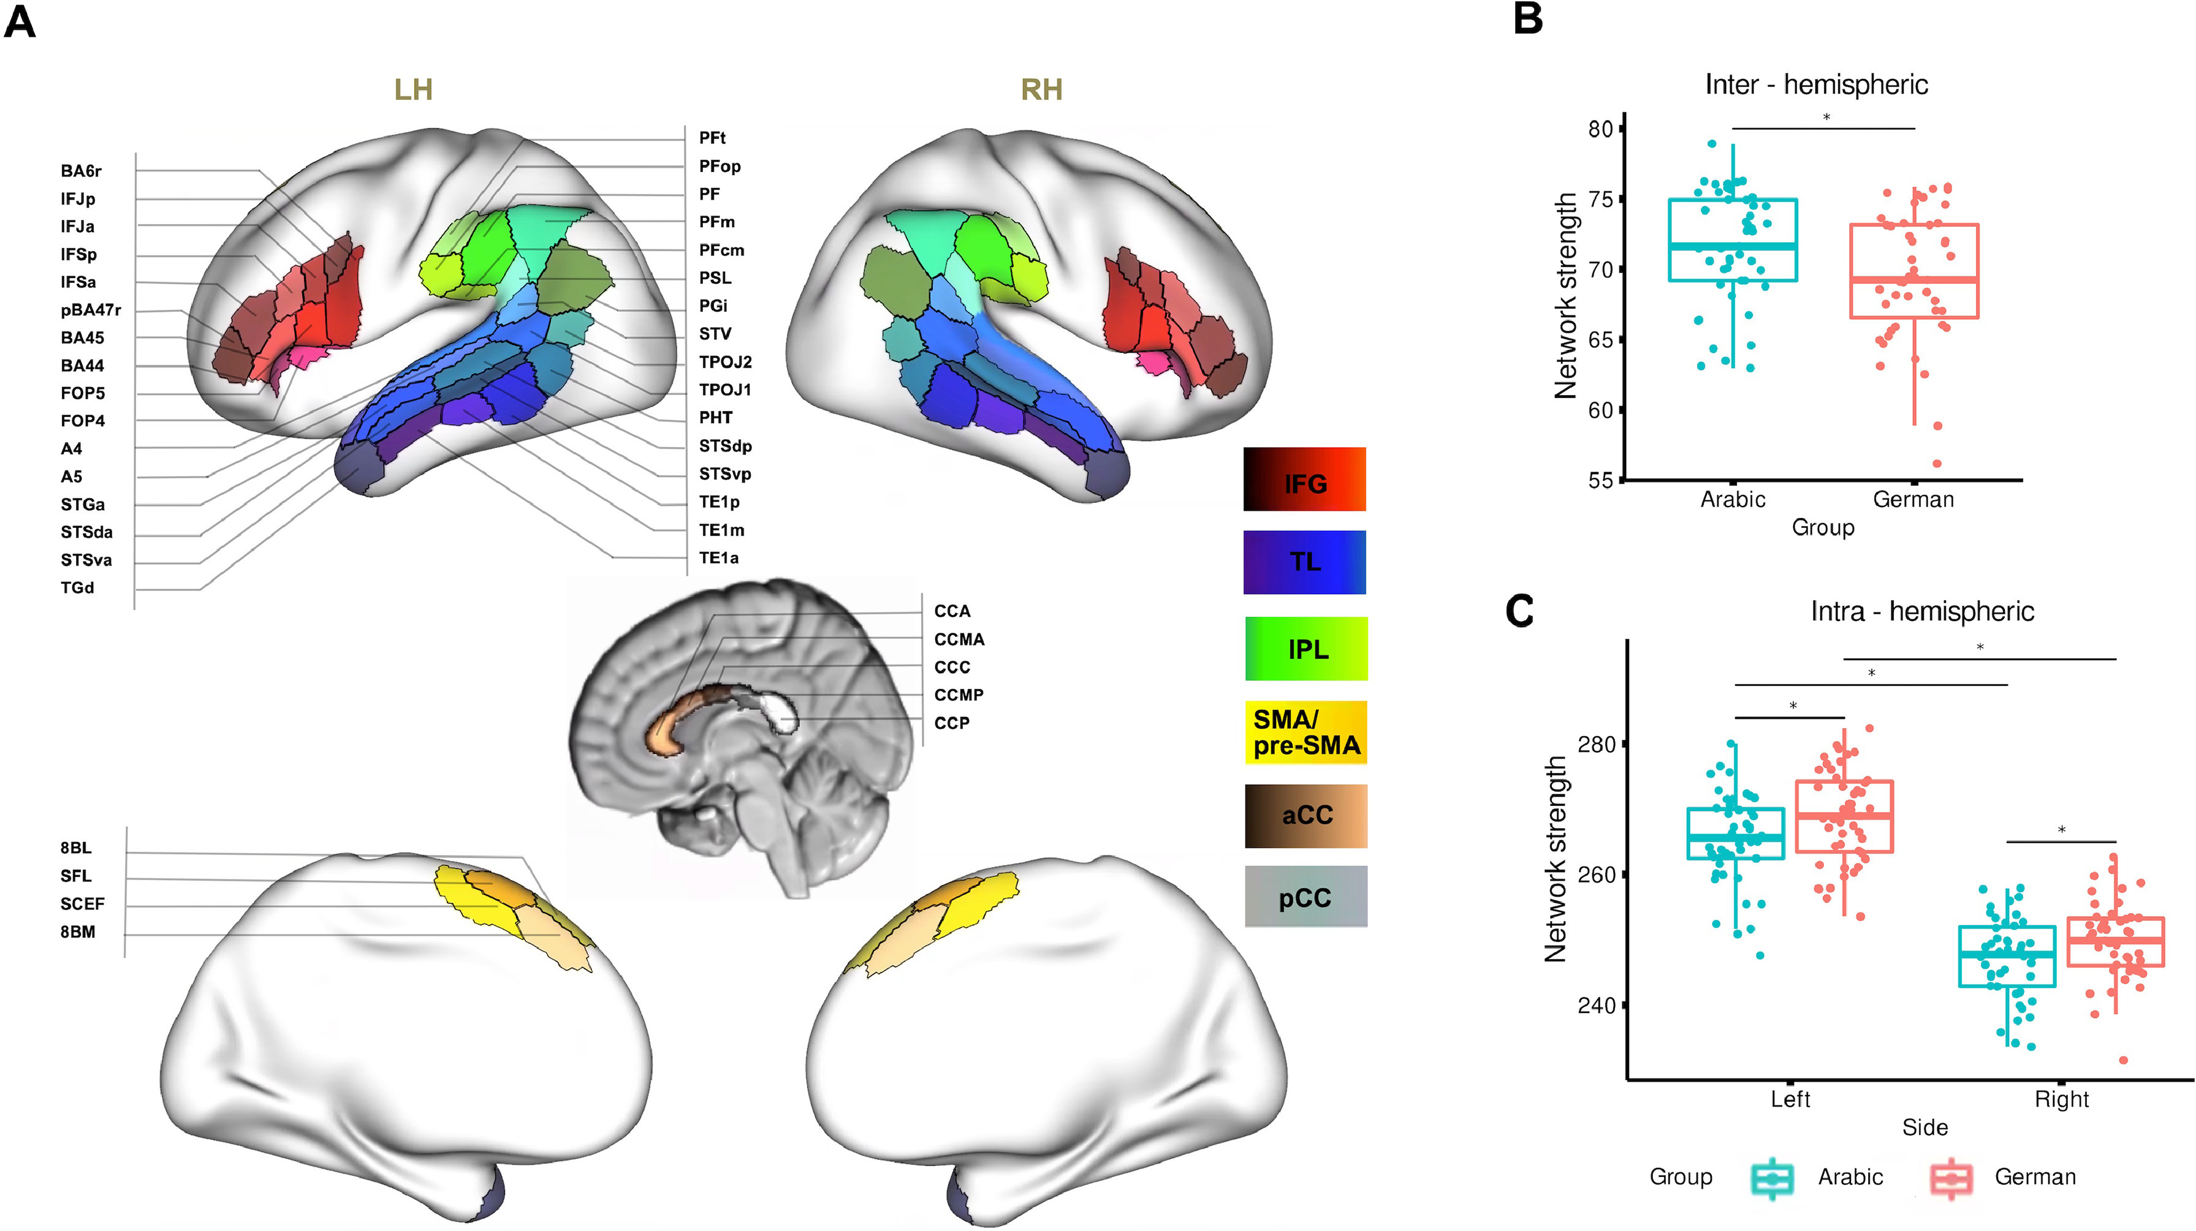
dorsally-located
German
syntax processing
hemispherical?
Arabic
semantic processing
Figure 11. NBS data as boxplots on intra-hemispheric connectivity.
Note. Adapted from Wei et al. (2023)
Figure 12. NBS data as boxplots on inter-hemispherical connectivity.
Note. Adapted from Wei et al. (2023)
ventrally-located
Figure 13. Summary image of results from Wei et al. (2023).
Note. Adapted from Wei et al. (2023)
Notes:
“it has been shown that the gray and white matter of the brain adapts during language acquisition and development (…). The neural language system which responds to different aspects of language processing, is established around the age of ten/eleven years (….). […] However, previous studies have shown that different brain areas and networks are involved in first and second language processing (…). These processing differences are also reflected in previous structural studies of second language acquisition in adults, which showed changes in the white and gray matter of the brain that extend to areas not involved in first language processing (…). This suggests that a second language learned in adulthood is not processed in the native language system and may involve additional processing tasks such as language switching and cognitive control (…). These processing differences are found even in early bilinguals who learned the second language during childhood and the structural brain adaptation in first language acquisition during childhood differs from later second language learning (…).”
Diffusion tensor imaging (DTI) is an MRI technique that uses anisotropic diffusion to estimate the axonal (white matter) organization of the brain. Fiber tractography (FT) is a 3D reconstruction technique to assess neural tracts using data collected by diffusion tensor imaging. (link)
Tractography is a new magnetic resonance technique that enables mapping and, consequently, evaluation of different white matter tracts in the central nervous system. It encompasses acquiring a sequence called diffusion tensor imaging in a common 1.5 or 3 Tesla magnetic resonance equipment, independently or associated to conventional images of the study (link2)

Slide 6
References / Works Cited
Cornell, B. (2016a). Brain Matter. BioNinja. https://ib.bioninja.com.au/options/option-a-neurobiology-and/a2-the-human-brain/brain-matter.html
Cornell, B. (2016b). Brain Sections. BioNinja. https://ib.bioninja.com.au/options/option-a-neurobiology-and/a2-the-human-brain/brain-sections.html
Cornell, B. (2016c). Cerebral Hemispheres. BioNinja. https://ib.bioninja.com.au/options/option-a-neurobiology-and/a2-the-human-brain/cerebral-hemispheres.html
Friederici, A. D. (2011). The Brain Basis of Language Processing: From Structure to Function. Physiological Reviews, 91(4), 1357-1392. https://doi.org/10.1152/physrev.00006.2011
Hodgson, V. J., Lambon Ralph, M. A., Jackson, R. L. (2021). Multiple dimensions underlying the functional organization of the language network. NeuroImage, 241(1), https://doi.org/10.1016/j.neuroimage.2021.118444
La Corte, E., Eldahaby, D., Greco, E., Aquino, D., Bertolini, G., Levi, V., Ottenhausen, M., Demichelis, G., Luigi Michele, R., Francesco, A., Morgan, B., Paolo, S. M., Grazia, B. M., Graziano, S. (2021). The Frontal Aslant Tract: A Systematic Review for Neurosurgical Applications. Frontiers in Neurology, 12(1). https://doi.org/10.3389/fneur.2021.641586
Le Bihan, D. (2014), Diffusion MRI: what water tells us about the brain. EMBO Mol Med, 6(5) 569-573. https://doi.org/10.1002/emmm.201404055
López-Barroso, D., de Diego-Balaguer, R. (2017). Language Learning within the Dorsal and Ventral Streams as a Cue for Compensatory Mechanisms in Aphasia Recovery. Frontiers in Human Neuroscience, 11(1). https://doi.org/10.3389/fnhum.2017.00476
Wei, X., Adamson, H., Schwendemann, M., Goucha, T., Friederici, A. D., Anwander, A. (2023). Native language differences in the structural connectome of the human brain. NeuroImage, 270(1). https://doi.org/10.1016/j.neuroimage.2023.119955
World Science Festival [WorldScienceFestival]. (2019, May 01). What is the Connectome? Mapping Neurons in the Brain [Video]. YouTube. https://youtu.be/fpZL-QcOqFs

