Slide 1


Parsing Expression Grammars:
A Recognition-Based Syntactic Foundation
AUTHOR : BRYAN FORD
REPOT BY : GROUP SIX

Slide 2
Team Introduction
Lei Luo（罗磊）
JinWei Liu（刘金伟）
Yong Liu（刘勇）
ZhengNan Tong（同正南）
XiaoQing He（何晓庆）
HongBin Cai（蔡鸿斌）
QingYuan Cheng（成青园）
YinKai Chen（陈吟凯）
JiaYu Dai（戴家玉）
HuiMin Tang（唐慧敏）
Can Wang（王灿）
WenWen Gu（顾雯雯）

Slide 3
Main Content
Part1 Introduction
Part2 Parsing Expression Grammars
Part3 Formal Development of PEGs
Part4 Reductions on PEGs
Part5 Conclusion

Slide 4
Part 1
Introduction

Slide 5
What Is Grammar
Grammar is a specification for a language
C/C++ Java Python

Slide 6
Previous Grammar
Chomsky’s generative system of grammars
Context-free grammars (CFGs)
S -> aSb
Regular expressions (REs)
[a-z] = a,b,c,…,x,y,z

Slide 7
Pros And Cons
Chomsky’s generative system of grammars
Pros
  Express ambiguous syntax
  Expressive power
Cons
  Difficult to express and parse machine-oriented languages

Slide 8
What is PEGs
‘’ A way of describing a language (or pattern) for string matching ‘’

Slide 9
Why is PEGs
Simplify the definition of syntax
Solve the ambiguity problem
Can be parsed in linear time

Slide 10
CFG Group
A → a b | a
A → a | a b
PEG Group
A → a b / a
A → a / a b

Slide 11
Contribution
  a new tool for describing syntax
  equivalence to two simpler formal systems
  equivalent in recognition power

Slide 12
Part 2
Parsing Expression Grammars

Slide 13
Grammar Form : A <- e
  A: a nonterminal
  e: a parsing expression

Slide 14
Unified Language Definitions
syntax descriptions:
  CFG: Hierarchical portion
  RegExp: Terminals for the CFG
PEGs:
  ? , * , + : a single Identifier not as two or more immediately adjacent, shorter ones.
  ! , \\ , . : backslash cannot be used in a literal or character class except as part of an escape sequence.
Unsuitable for lexical syntax

Slide 15
Spacing nonterminal consume whitespace
The Grammar in allow whitespace in file.

Slide 16
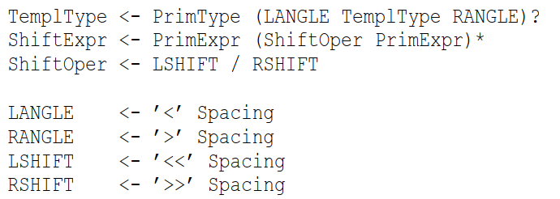
New Syntax Design Choices
PEGs solve a problem with C++ :
vector<vector<float> > MyMatrix;
In PEG, permit a '>>' sequence to either one token or two depending on its context:

Slide 17
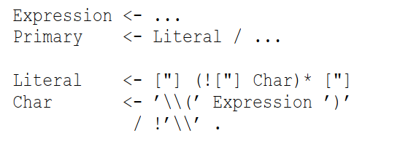
Pascal-like nestable comments are easily expressed in a PEG:
PEG could permit arbitrary expressions in such escapes:

Slide 18

Priorities
prioritized choice, greedy repetition, and syntactic predicates ➔ to solve ambiguous in the CFG.
Prioritized choice operator in a PEG:

Slide 19
Quirks and Limitations
Left recursion is unavailable in PEGs
PEG is a purely syntactic formalism

Slide 20
Part 3
Formal Development of PEGs

Slide 21
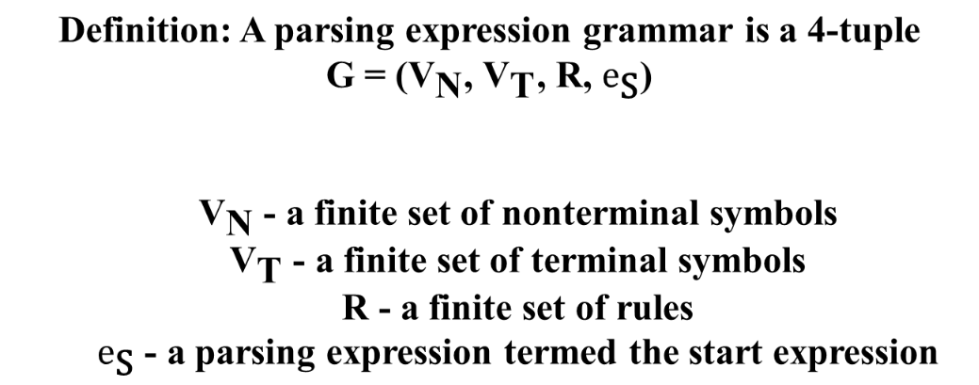
Definition of a PEG

Slide 22
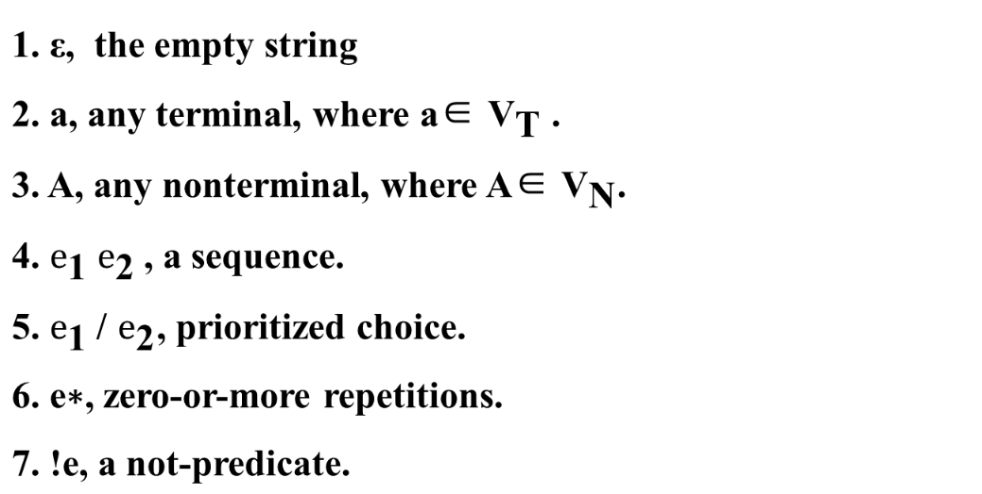
Definition of a PEG

Slide 23
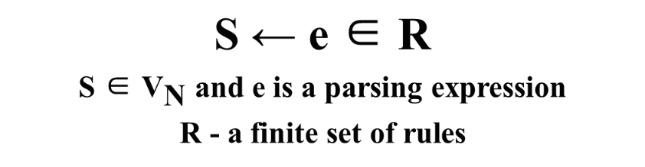
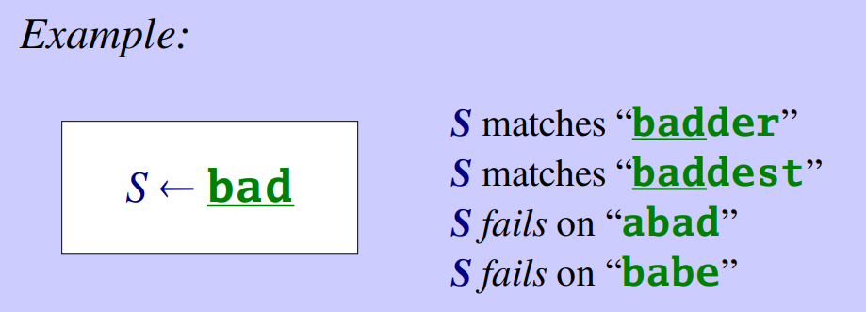
Definition of a PEG

Slide 24
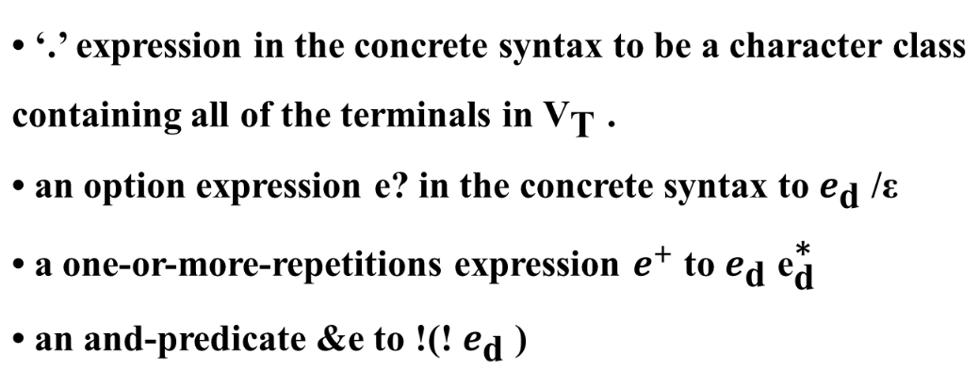
De-sugaring the Concrete Syntax

Slide 25
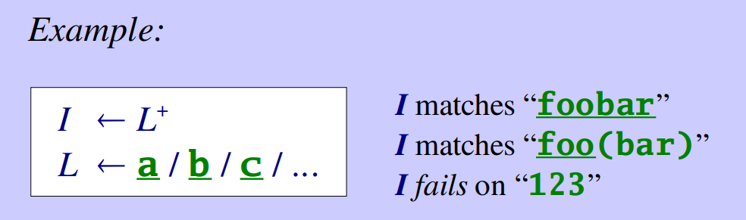
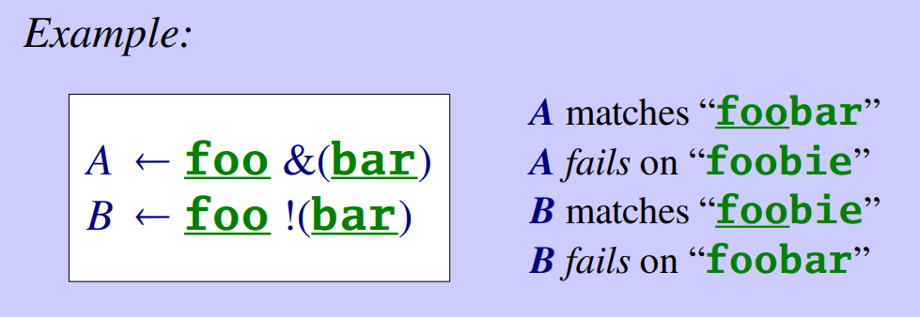
De-sugaring the Concrete Syntax

Slide 26
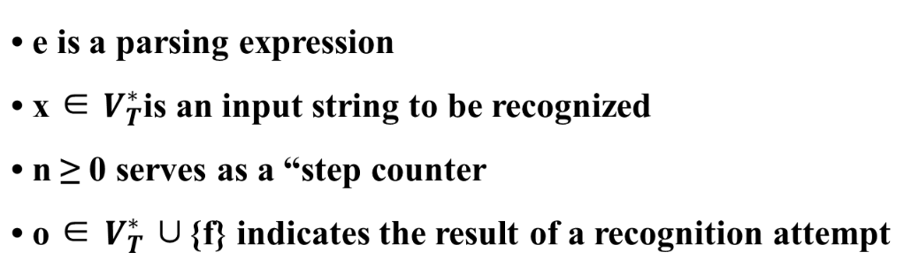
Interpretation of a Grammar
(e,x) ⇒ (n,o)

Slide 27
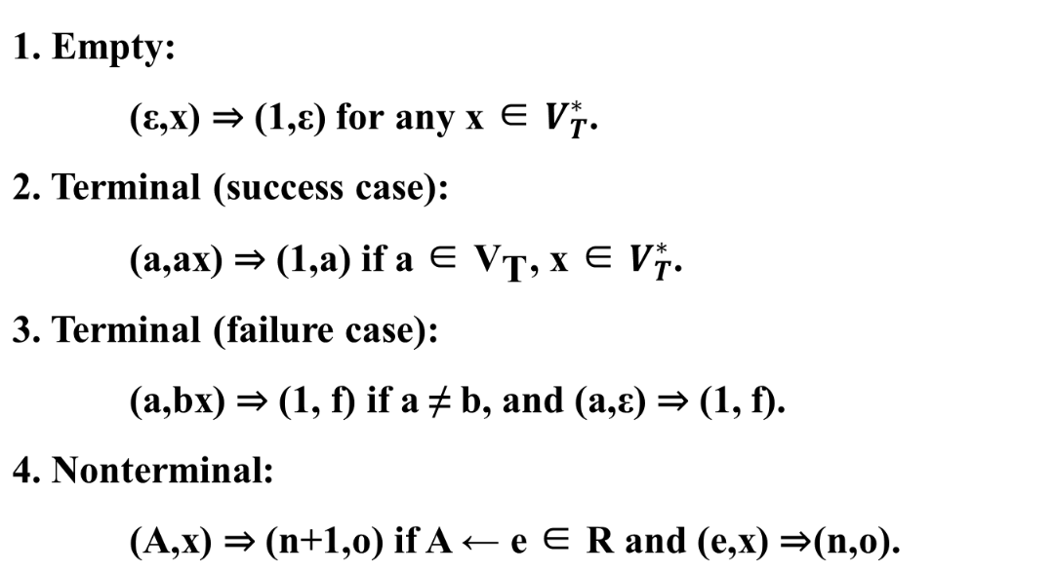
Interpretation of a Grammar

Slide 28
Language Properties
Definition: A language L over an alphabet VTis a parsing expres-
sion language (PEL) iff there exists a parsing expression grammar
G whose language is L.
Theorem 1: The class of parsing expression languages is closed un-
der union, intersection, and complement.
Theorem 2: The class of PELs includes non-context-free languages.

Slide 29
Language Properties
Definition: Two PEGs G1 and G2 are equivalent if they recognize
the same language: L(G1) = L(G2).
Theorem 1: The equivalence of two arbitrary PEGs is undecidable.
Theorem 2: It is undecidable in general whether the language L(G)
of an arbitrary parsing expression grammar G is empty.

Slide 30
Analysis of Grammars
Definition: e-> o for (e,o) ∈*G
  *G - a relation consisting of pairs of the form(e,o)
  e - an parsing expression
  o - outcome and o∈ {0,1, f}

Slide 31
Analysis of Grammars
1. ε → 0.
2. a → 1.
3. a → f.
4. A → o if RG(A) → o.
5. e₁e₂→ 0 if e₁→ 0 and e₂→ 0.
e₁e₂→ 1 if e₁→ 1 and e₂→ s.
e₁e₂→ 1 if e₁→ s and e₂→ 1.
6. e₁e₂→ f if e₁→ f.
7. e₁e₂→ f if e₁→ s and e₂→ f.
8. e₁/e₂→ s if e₁→ s.
9. e₁/e₂→ o if e₁→ f and e₂→ o.
10. e∗→ 1 if e → 1,
11. e∗→ 0 if e → f.
12. !e → f if e → s.
13. !e → 0 if e → f.

Slide 32
Analysis of Grammars
Theorem:
The relation →G summarizes ⇒G as follows:
      • If (e,x) ⇒G(n,ε), then e → 0.
      • If (e,x) ⇒G(n,y) and |y| > 0, then e → 1.
      • If (e,x) ⇒G(n, f), then e → f.

Slide 33
Well-Formed Grammars
A well-formed grammar is a grammar that contains no directly or mutually left-recursive rules
A ← A a / a

Slide 34
Part 4
Reductions on PEGs

Slide 35
How to eliminate
How to mapped

Slide 36
Eliminating Repetition Operators
Eliminating Predicates
  Stage 1 : Rewrite
  Stage 2 : Further Rewirte
  Stage 3 : Finally eliminate

Slide 37
Stage 1 Rewrite
  Rewrite definitions in R
  Three special nonterminals T,Z,F
  Define a function f recursively

Slide 38
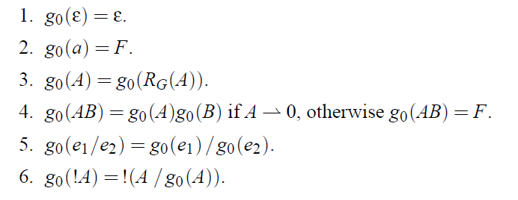
Stage 2 Further Rewrite
Stage 3 Finally eliminate

Slide 39

Reduction to TS/TDPL
The parameter is PEG G = (Vn, Vt, R, S).
S is the non terminal of Vn.
R can be summarized four items as follows:

Slide 40
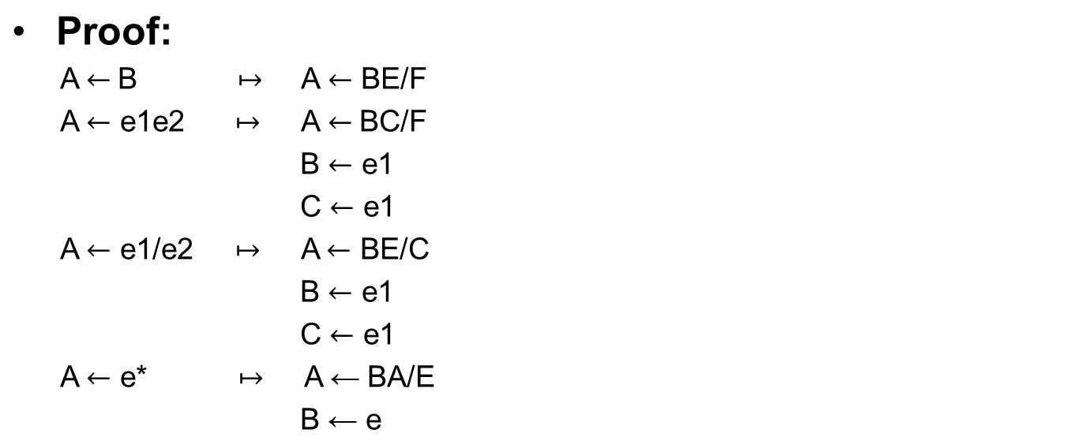
Theorem
  The form of PEG G of all unnecessary words (Vn, Vt, R, eS) be equivalent to TDPL syntax G’= (VN, VT, R, S).

Slide 41
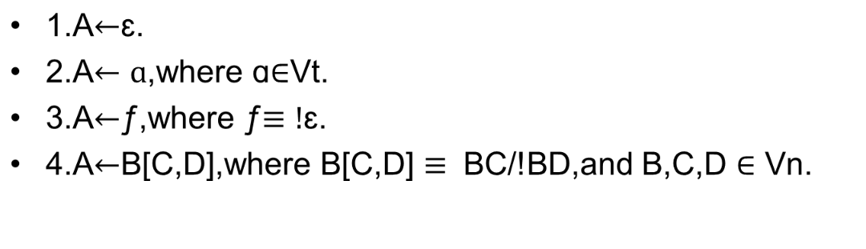
Reduction to gTS/GTDPL
GTDPL Grammar: G represents the formal parameter G= (Vn, Vt, R, S), where s is a non terminator in all definitions in relation R, which has four forms:

Slide 42
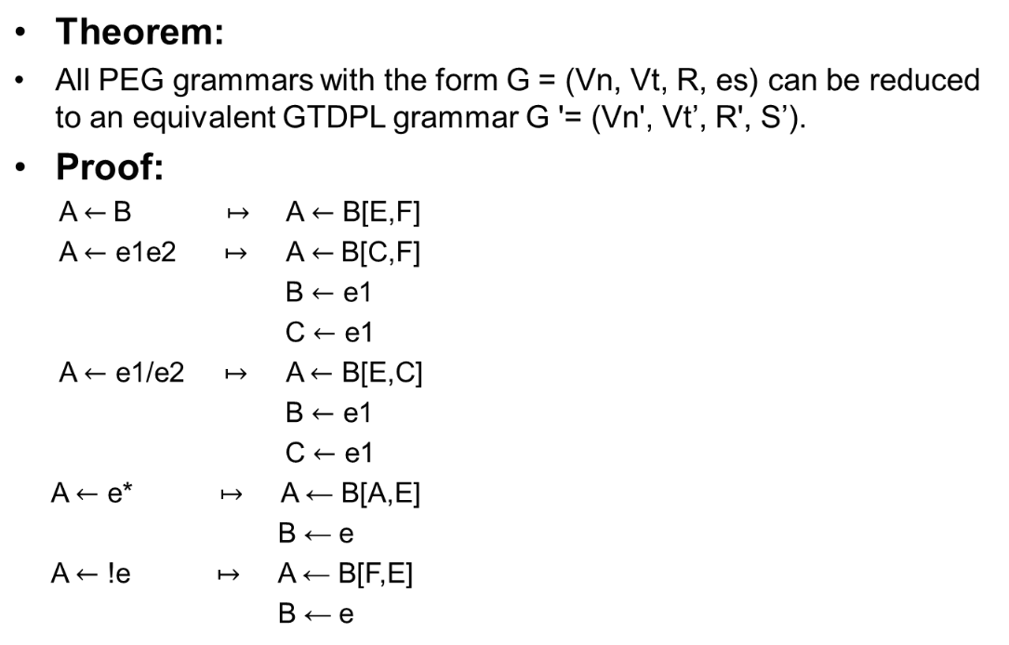

Slide 43
Parsing PEGs
Inference
  linear time parser can be constructed for all PEG
Proof
  Transform PEG into GTDPL grammar use the table
  parsing technique described

Slide 44
Equivalence of TDPL and GTDPL
Theorem
  GTDPL grammars don’t accept reducing an empty string
Proof
  GTDPL regarded as a PEG without repetition.

Slide 45
Part 5
Conclusion

Slide 46
Conclusion
Syntax of machine-oriented languages.
Introduces a new syntax design choices for future languages.
TDPL and GTDPL to be essentially equivalent in recognition power.
PEGs are parseable in linear time

Slide 47
Related Work
TS/TDPL and gTS/GTDPL systems
Modular language proto-typing framework & many practical top-down parsing libraries and toolkits
Positive and negetive form of syntactic predicate
Extensions and variations of context-free grammers

Slide 48
Future Work
A transformation on gTS
  Any PEG into a complete PEG.
  The undecidability of a grammar’s completeness.
A choice expression e1/e2 is definitely disjoint.
Extend PEG syntax with an unordered choice operator ‘|’

Slide 49
The relationship and inter-convertibility of CFGs and PEGs.
  Implied PEGs can express any deterministic LR-class context-free language.
  CFGs might be recognizable with PEGs.
  Not proven CFLs cannot be recognized by a PEG

Slide 50
Thanks
By Group Six

