Slide 1



The Fourth International Workshop on Human Brain and Artificial Intelligence (HBAI 2024)
IJCAI 2024 workshop, August 3, 2024 - Jeju, South Korea
Multi-category Brain Tumor Segmentation via Multi-scale and Cross-category Relation Modeling
Dongzhe Li Baoyao Yang* Yuebin Xie Weide Zhan and Jingsong Lin
Guangdong University of Technology, Guangzhou
Notes:
Hello everyone. I am pleased to present our work titled, ‘Multi-category Brain Tumor Segmentation via Multi-scale and Cross-category Relation Modeling.’ This research is a joint effort by Dongzhe Li and corresponding author Baoyao Yang from Guangdong University of Technology, alongside Yuebin Xie Weide Zhan and Jingsong Lin.

Slide 2
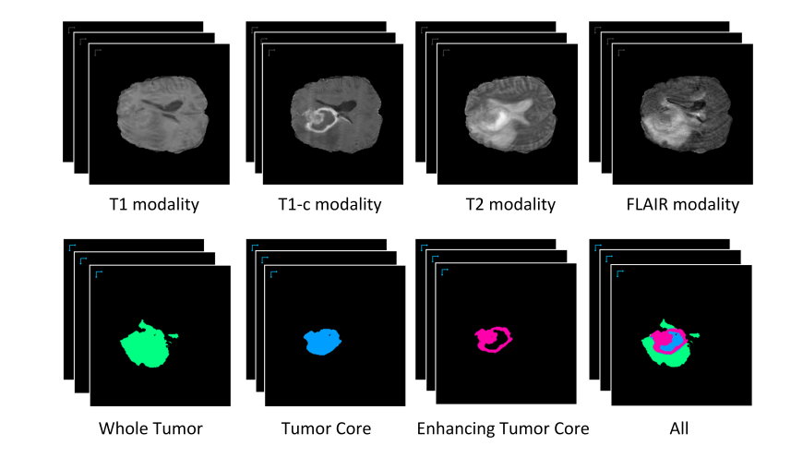
Background
Brain Tumor Segmentation Challenges
Tumor location and boundary refinement
Distinguish multiple categories of sub-regions
Notes:
Brain tumor segmentation presents several challenges, including accurately locating tumors, refining their boundaries, and distinguishing between multiple categories of sub-regions. As illustrated in the image, the accuracy of tumor segmentation hinges on precisely locating and outlining the tumor, as well as differentiating its various sub-regions.

Slide 3
Related Work
Traditional feature extraction methods in brain tumor segmentation
Element-wise addition or concatenation^{[1] [2] [3]}
Multi-scale feature aggregation^{[4] [5] [6]}
Limitations
Fail to capture the complex spatial semantic relations in multi-category tumors
Introduce redundant information
[1] O. Oktay et al.“Attention u-net: Learning where to look for the pancreas”. in preprint arXiv:1804.03999. (2018)
[2] A. Myronenko et al.: “3d mri brain tumor segmentation using autoencoder regularization”. in MICCAI Brainlesion Workshop. Springer, pp. 311–320. (2019)
[3] Z. Jiang, C. Ding, M. Liu, and D. Tao.: “Two-stage cascaded u-net: 1st place solution to brats challenge 2019 segmentation task”. in MICCAI Brainlesion Workshop. Springer, pp. 231–241. (2020)
[4] Liang-Chieh Chen.et al.: Encoder-Decoder with Atrous Separable Convolution for Semantic Image Segmentation. In: Proceedings of the European Conference on Computer Vision (ECCV), (2018)
[5] M. Yang et al.: “Denseaspp for semantic segmentation in street scenes. In: Proceedings of the IEEE/CVF Conference on Computer Vision and Pattern Recognition (CVPR), pp. 3684-3692 (2018)
[6] Shuanglang Feng et al.: “CPFNet: Context Pyramid Fusion Network for Medical Image Segmentation. In: IEEE Transactions on Medical Imaging, pp. 3008 - 3018 (2020)
Notes:
In traditional feature extraction methods for brain tumors, there are some related methods, including element-wise addition or concatenation and multi-scale feature aggregation. These methods aim to learn the features of brain tumors to improve segmentation accuracy. However, they have some limitations. Such operations do not fully consider the differential information between different levels and may introduce redundant information.

Slide 4
Motivation
Different characteristics across different levels of the encoder
Deep features carry richer semantic information
localization
Shallow features contain more low-level visual information
capture subtle boundaries
Attention mechanisms in image segmentation
Focus on the most relevant regions or features
help the model better understand the correlation between different regions in the image
Notes:
Different levels of an encoder capture distinct feature representations. Deeper layers capture rich semantic information for object localization, while shallower layers retain fine-grained details for precise boundary detection. By combining these complementary features, we can achieve a comprehensive understanding of organs or lesions, enhancing overall segmentation performance.
In recent years, attention mechanisms have been widely used in image segmentation. By selectively focusing on salient image regions and features, these mechanisms significantly enhance model performance and generalizability. By suppressing irrelevant details, this approach enables models to capture complex relationships between image elements, leading to more accurate and reliable segmentations.

Slide 5
Idea
Aggregate multi-scale information and enhance features for multiple categories
Multi-scale and Cross-category Relation Modeling
Dynamically combine local features with global dependencies
Capture positional information and category relations for localization and classification
Notes:
To leverage the multi-level information of the encoder, we plan to aggregate multi-scale information from different levels and enhance the features of multi-class brain tumors. By incorporating an attention mechanism, we effectively capture both long-range and local dependencies, facilitating accurate localization and classification.

Slide 6
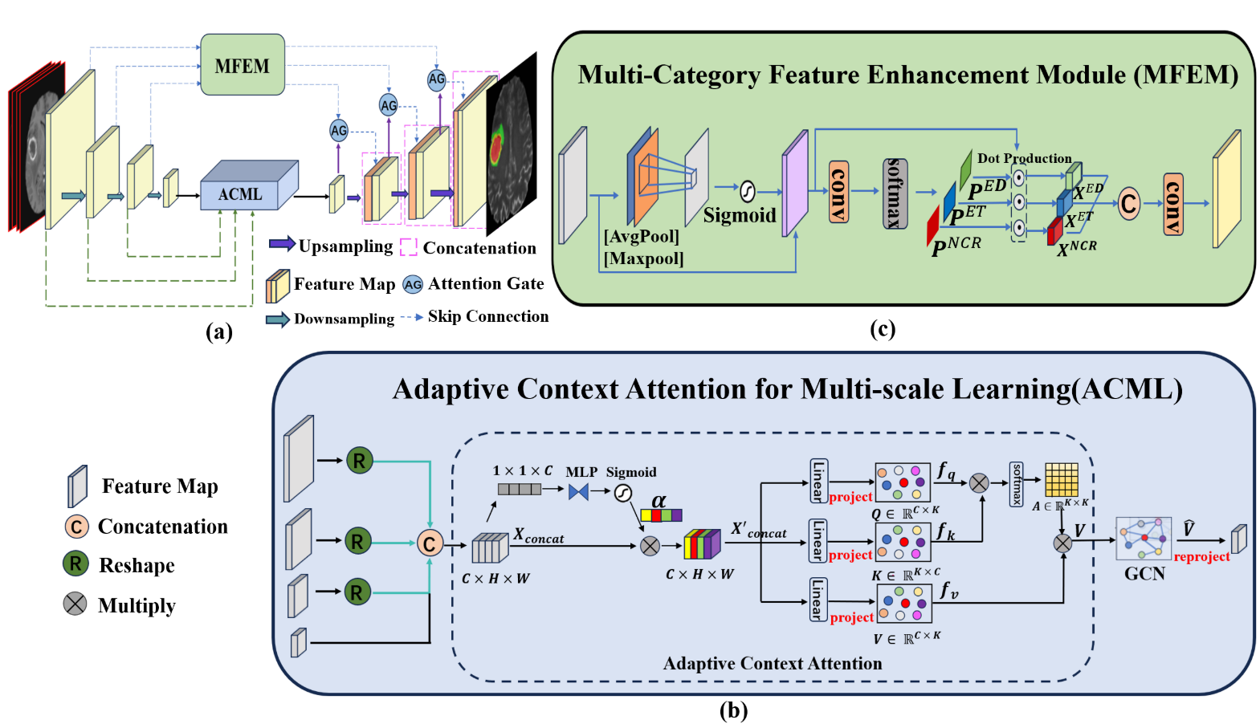
Proposed Method
Notes:
Initially, four MRI modalities are combined and progressively downsampled to generate multi-scale feature maps. At the network's bottleneck, an Adaptive Context Attention for Multi-scale Learning (ACML) is employed to capture both global and local image information across different scales. To further enhance feature representation and recover spatial details, a Multi-scale Feature Enhancement Module (MFEM) is integrated into the skip connections of each layer. The MFEM learns spatial relationships between brain tumor regions, improving tumor localization and segmentation across various scales during the upsampling phase.

Slide 7
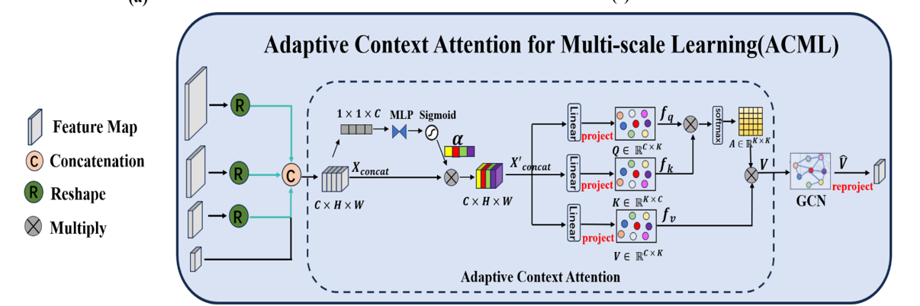
Proposed Method
Adaptive Context Attention for Multi-scale Feature Learning (ACML):
Scale attention α
Capture the relations between different scales and gain global context
Interaction coordinate space
Utilize Graph Convolutional Networks to model long-range dependence
Notes:
Next, we will discuss the detailed implementation of the Adaptive Cross-scale Modeling Layer (ACML). The feature maps at each scale are integrated and concatenated to generate a scale attention, denoted as α, which assigns weights to each layer and adaptively captures the relationships between different scales. To further explore the dependencies across different scales, we project the features into an interactive coordinate space. Finally, to capture the local relationships between different pixels, we utilize a Graph Convolutional Network (GCN) to model the long-range dependencies within the image regions

Slide 8

Proposed Method
Multi-category Feature Enhancement Module (MFEM):
Spatial attention
Perceive the spatial distribution between different regions
Probability map:
Notes:
To better understand spatial relationships and object distribution, the MFEM employs spatial attention to focus on specific regions within each layer's feature map of multi-class brain tumor images. This allows the model to concentrate more on features related to tumors. Then, to accurately distinguish between sub-regions of multiple categories, we generate probability distributions for each category, thus creating specific probability maps for each category.

Slide 9
Experiments
Experimental Setting
BraTS 2019 and BraTS 2020
335 and 369 annotated brain tumor samples
4 modalities: T1, T1ce, T2, and FLAIR
label 1：Non-enhancing umor core (NCR&NET), label 2：Peritumoral edema (ED), label 4 Enhancing tumor (ET), and label 0: Background
Each modality scan is sliced and cropped into dimensions of 160 × 160. The datasets are split into 80% for training our model and 20% for testing.
Evaluation metrics:
Dice score
95% Hausdorff distance (HD)
Notes:
Here are some details of our experiment setting. We used the publicly available datasets BraTS 2019 and BraTS 2020, which contain 335 and 369 annotated samples, respectively. Each sample includes four modalities: T1, T1ce, T2, and FLAIR. There are four labels: label 1 for Non-enhancing tumor core (NCR&NET), label 2 for Peritumoral edema (ED), label 4 for Enhancing tumor (ET), and label 0 for Background. Each modality was cropped to a size of 160 x 160 pixels. The dataset was split into 80% for training and 20% for testing. For evaluation metrics, we used the Dice score and the 95% Hausdorff distance (HD).

Slide 10
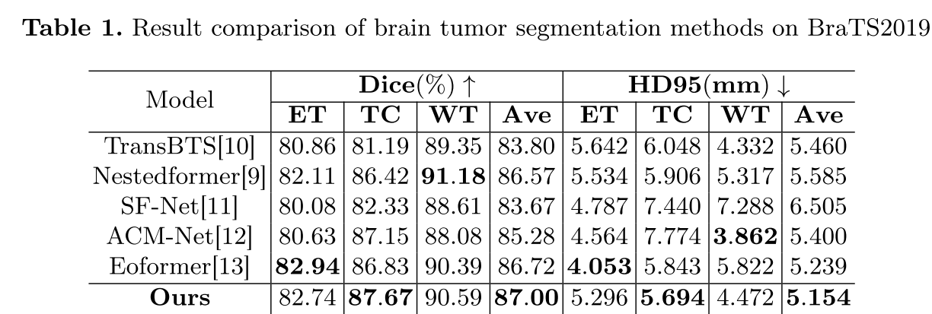
Experiments
Comparison Results with SOTA methods
Highest Dice scores for the Tumor Core region, indicating its efficacy in capturing the interrelations among brain tumor sub-region
Notes:
This table shows the comparison results with state-of-the-art (SOTA) methods on the BraTS 2019 dataset. As can be seen, our method achieved the highest score in the Tumor Core category, indicating its efficacy in capturing the interrelations among brain tumor sub-regions. Moreover, it also obtained the highest average score, demonstrating the effectiveness of our approach.

Slide 11
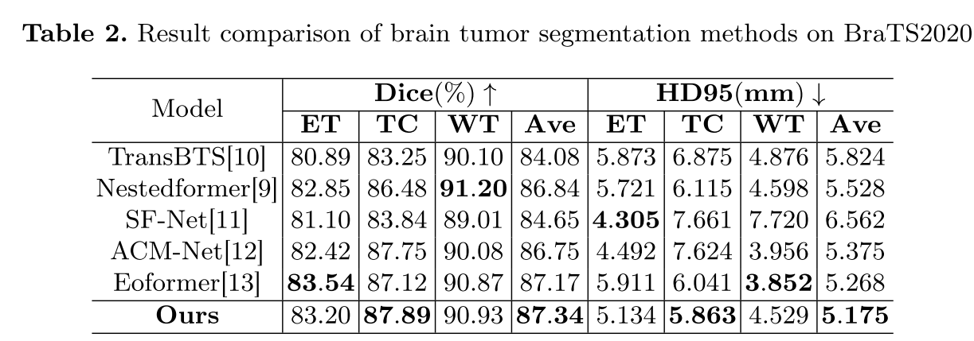
Experiments
Comparison Results with SOTA methods
Notes:
This table shows the comparison results with state-of-the-art (SOTA) methods on BraTS 2019. The results are similar to those on BraTS 2019, with our method achieving the best performance in both the Tumor Core (TC) category and the average score.

Slide 12
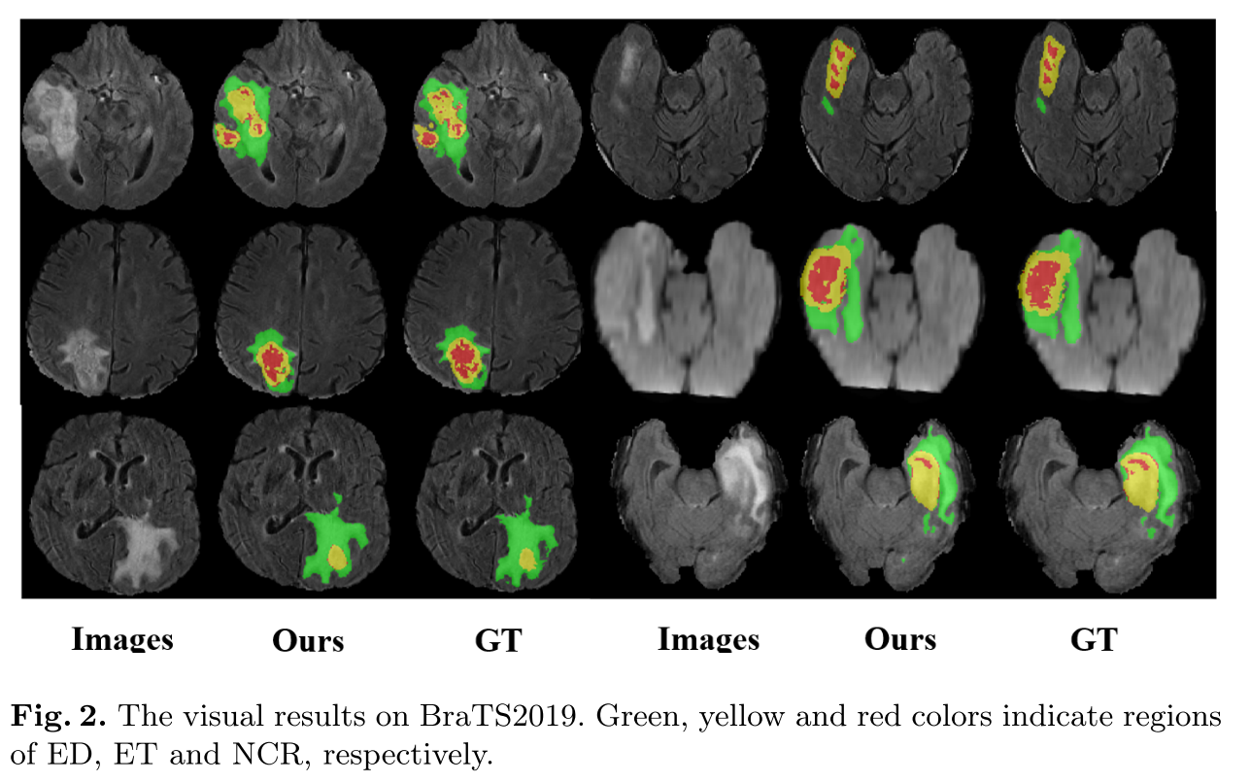
Experiments
Comparison Results Visualization
Accurately segments the shape of brain tumors as well as their edges
Even small necrotic(NCR) areas and enhanced tumor regions(ET) overlapping are correctly distinguished
Notes:
We visualize the comparison results on the BraTS 2019 dataset. As shown in the figure, our method accurately segments the shape of brain tumors as well as their edges. Even small necrotic (NCR) areas and overlapping enhanced tumor regions (ET) are correctly distinguished.

Slide 13
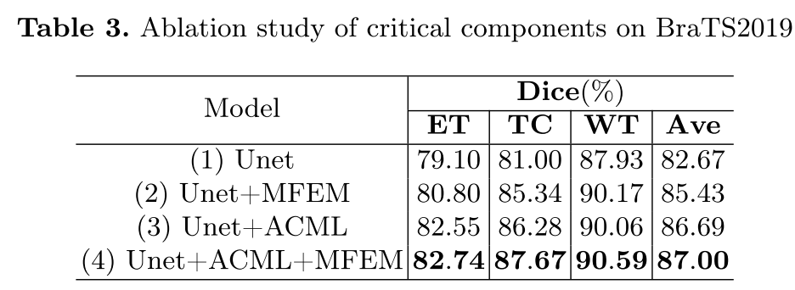
Experiments
Ablation Study
Unet+ACML: Significant improvement in the segmentation of all categories, confirming that the global contextual information is effective
Compared to Unet+MFEM , ET has shown a greater improvement in Unet+ACML over Unet, indicates that ACML can simultaneously focus on local features
Notes:
We conducted an ablation study on the BraTS 2019 dataset using the standard U-Net as the baseline model. We then added different components to evaluate their effects. Specifically, we compared the performance of four models: (1) U-Net, (2) U-Net + MFEM, (3) U-Net + ACML, and (4) U-Net + ACML + MFEM.
Our analysis demonstrates that each component contributes significantly to improved segmentation performance. The U-Net+ACML model exhibited superior enhancement of the tumor (ET) region compared to U-Net + MFEM, highlighting ACML's effectiveness in capturing local features. Integrating both MFEM and ACML further boosted brain tumor segmentation performance, achieving a peak average Dice score of 87.00%

Slide 14
Conclusion
To capture enough global context and handle morphological heterogeneity relations across tumor categories, this paper presents a novel approach for adaptively capturing multi-scale and multi-category semantic relations.
Multi-category Brain Tumor Segmentation via Multi-scale and Cross-category Relation ModelingFramework is proposed:
Adaptive Context Attention for Multi-scale Feature Learning
Multi-category Feature Enhancement Module
Experiments among public datasets BraTS 2019 and BraTS 2020 validate the effectiveness of the proposed method.
Notes:
In conclusion, to effectively capture global context and address the morphological diversity across tumor types, we propose a novel framework for multi-class brain tumor segmentation that leverages multi-scale and cross-category semantic relationships. Our model incorporates an Adaptive Context Attention module to effectively capture global context and a Multi-category Feature Enhancement module to focus on class-specific regions. Experimental results on BraTS 2019 and 2020 datasets demonstrate the superior performance of our method.

