Slide 1



MMS: Morphology-mixup Stylized Data Generation for Single Domain Generalization in Medical Image Segmentation
Xiaochen He¹, Baoyao Yang¹, Fei Lyu²
¹ School of Computers, Guangdong University of Technology
² Department of Computer Science, Hong Kong Baptist University
Representer: Yang Lu, Xiamen University
Notes:
Hello everyone. I’m here to present our work, 'MMS: Morphology-mixup Stylized Data Generation for Single Domain Generalization in Medical Image Segmentation.'
This research is a joint effort by Xiaochen He and corresponding author Baoyao Yang from the School of Computers at Guangdong University of Technology, alongside Fei Lyu from the Department of Computer Science at Hong Kong Baptist University.

Slide 2
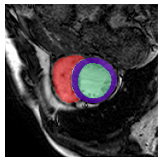
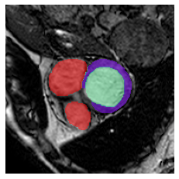
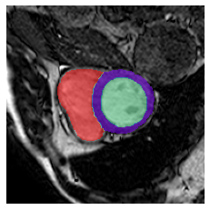
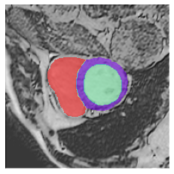
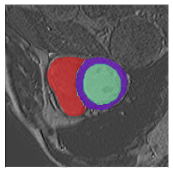
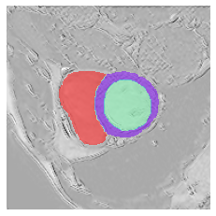
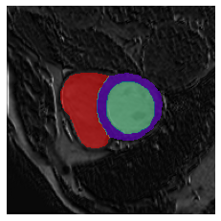
Overview
We focues on increase the diversity and informativeness of training samples for single-source domain generalization.
We propose a date generation method considering the morphology and style.
We design a new model that simulate probable morphological structures by morphology mix-up.
The proposed method outperform existing benchmarks in three cross-domain medical segmentation datasets.
Slice 1 from
Sample A
Slice 2 from
Sample B
Morphology Mix-up Sample
Morphology Mixup
…
Style 1
Style 2
Style 3
Style N
Style Transformation
Morphology Mix-up Stylized Data Generation
Notes:
Here is a quick review. The key to address single-source domain generalization lies in increasing the diversity and informativeness of the training samples. In this work, we propose to generate data from a new perspective of morphology, which further enhance the diversity and fidelity of generated data. Specifically, we design a new network that simulate probable morphological structures through a technique, called morphology mix-up. And the proposed method achieves SOTA performance in three cross-domain medical segmentation datasets.

Slide 3
Background
Deep Learning Challenges in Medical Image Segmentation
Data Limitation
Training requires extensive, diverse labeled datasets^{[1]}
Difficult to compile due to data privacy, annotation costs^{[2]}
Domain Shift
Performance drops when test data distribution differs from training data^{[3]}
Common in medical context due to variations in imaging techniques, equipment settings, and scanner models^{[4]}
[1] Enhancing MR image segmentation with realistic adversarial data augmentation, MIA, 2022
[2] Generalizing Deep Learning for Medical Image Segmentation to Unseen Domains via Deep Stacked Transformation, TMI, 2020
[3] A theory of learning from different domains, Machine Learning, 2010
[4] Machine learning with multi-site imaging data: An empirical study on the impact of scanner effects, ArXiv, 2019
Notes:
We begin by discussing the background of our work. Traditional deep learning methods face two major challenges in medical image segmentation. The first one is the data limitation: robust models need extensive and diverse labeled images, which is usually very hard to obtain because of the privacy concerns and the high cost of expert annotations. The second one is called the domain shift. This happens when the training samples don't match the test ones, leading to a drop in model performance. While in healthcare, this issue is very common because different hospitals might use different imaging techniques, equipment settings and scanner models, making the image vary from one site to another.

Slide 4
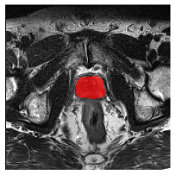
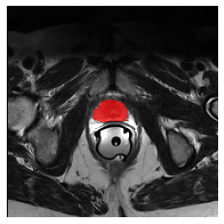
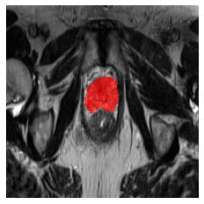
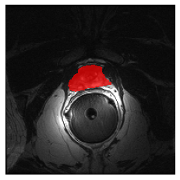
Problem
Single Source Domain Generalization in Medical Segmentation
Training
Testing
...
Center A
Center B
Center C
Center F
Examples from Prostate Dataset^{[1]}
[1] Shape-aware meta-learning for generalizing prostate mri segmentation to unseen domains, MICCAI, 2020
Notes:
Building on the background we just discussed, we arrive at a specific problem: Single Source Domain Generalization in Medical Image Segmentation. In this scenario, we train a model on data from one source domain, say Center A, and then apply it to other unseen target domains, like Centers B and C. Our goal is to minimize the performance drop when the model is used in these different target domains. We can find that the images from the different centers show discrepancies in the appearance, such as the variations in the imaging angles, and subtle differences in the tissue representation due to the MRI machine's calibration and settings.

Slide 5
Related Works
Adversarial Data Augmentation^{[1][2][3]}
Random Style Transformation^{[4][5][6]}
Limitations
Not faithful enough: not consider characteristic of medical image
Not diverse enough: only consider style transformation
[1] Learning to Diversity for Single Domain Generalization, ICCV, 2021
[2] Progressive Domain Expansion Network for Single Domain Generalization, CVPR, 2021
[3] Enhancing MR image segmentation with realistic adversarial data augmentation, MIA, 2022
[4] Generalizing Deep Learning for Medical Image Segmentation to Unseen Domains via Deep Stacked Transformation, TMI, 2020
[5] Causality-inspired Single-source Domain Generalization for Medical Image Segmentation, TMI, 2022
[6] Rethinking Data Augmentation for Single-source Domain Generalization in Medical Image Segmentation, AAAI, 2023
Notes:
Here are some related methods addressing our problem, including Adversarial Data Augmentation and Random Style Transformation. These techniques aim to increase the diversity and informativeness of training samples, enhancing the model's resilience to domain shifts.
Adversarial-learning-based methods generate images with perturbations. On the other hand, the random style transformation techniques drive the network to learn shape information by altering image styles/textures randomly. However, we've identified some limitations in these methods. The first one is the lack of fidelity; they usually not fully consider the characteristic of medical image. The second one is the limited diversity. These methods focus mainly on style transformations and do not cover the full range of variations needed in real-world scenarios.

Slide 6
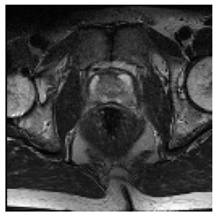
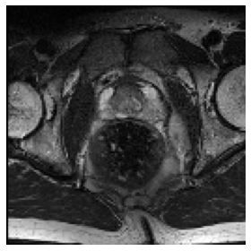
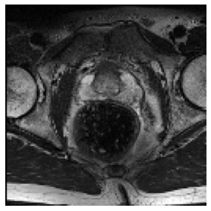
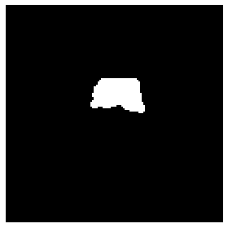
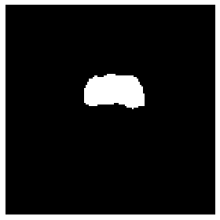
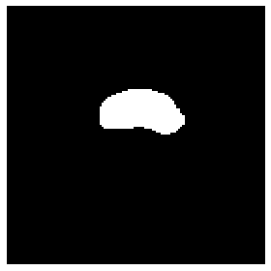
Motivation
Morphology-continuous Changes in Adjacent 2D Slices of Medical Image^{[1]}
Slice 1
Slice 2
Slice 3
[1] Deep Learners and Deep Learner Descriptors for Medical Applications, Springer Nature, 2020
Notes:
After observing the medical imaging, we notice that there is a consistent morphological evolution across consecutive 2-D slices. In the series showcased below, slices 1 through 3 illustrate this point clearly: the prostate, delineated by the white segmentation masks, subtly elongates as we advance from the first to the third slice. This transition exemplifies the nature of morphological changes in medical imaging, where each slice can reveal minute, yet critical, variations in structure.

Slide 7
Main Idea
Main Idea
generate novel data with novel morphologies and styles
Morphology Mix-up
Simulate probable morphological structures between similar slices from different patients
Slice 1 from
Sample A
Slice 2 from
Sample B
Morphology Mix-up Sample
Morphology Mixup
…
Style 1
Style 2
Style 3
Style N
Style Transformation
Notes:
Building on our motivation to enhance medical image analysis, we propose a novel approach to data generation that focuses on the diversity of morphological structures.
Our method introduces 'morphology mix-up,' where we combine characteristics from similar anatomical slices. However, we don't just limit ourselves to a single patient's data. To inject even greater diversity and reflect the natural variation found across different individuals, we cross-mix morphologies from similar slices originating from distinct patients. This cross-patient morphology mix-up generates a more complex and rich set of data, simulating a broader spectrum of anatomical variations. Furthermore, to add another layer of variation, we apply a style transformation process. This involves altering the imaging style from a single morphological perspective to multiple stylistic variations, represented here as Style 1 through Style N. The synthesis of these two techniques, including morphology mix-up and style transformation, is designed to create a comprehensive and diversified dataset. This, in turn, equips the resulting models with the capacity to generalize across unseen medical imaging challenges, ultimately improving diagnostic accuracy and patient outcomes.

Slide 8
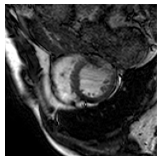
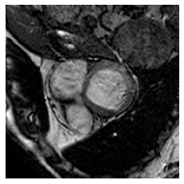

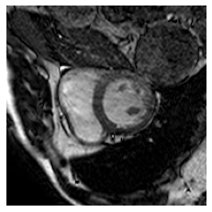
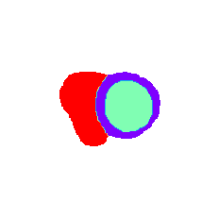
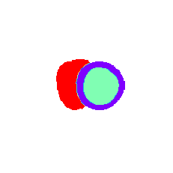
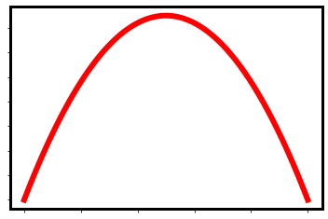

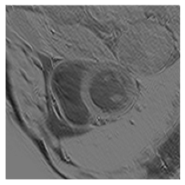
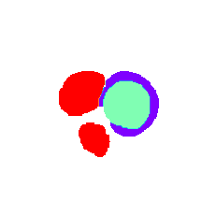
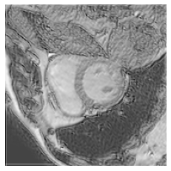





























Method
Training Phase
DG Phase
Feature
Re-Projection
Feature Consistency Loss
$$E$$
Encoder
$${\tilde{z}}_{λ}$$
$$X_{1}$$
$$X_{2}$$
Reconstruction & Segmentation Loss
MDs-AE
$$R$$
Reconstructor
$$E$$
$λ$~
$$S$$
Segmentor
$$z_{1}$$
$$R$$
$${\tilde{X}}_{λ}$$
$${\tilde{Y}}_{λ}$$
$$Y_{1}$$
$$X_{1}$$
Random Styler
$$E$$
$${\tilde{X}}_{1}$$
$${\tilde{X}}_{λ}$$
$${\tilde{X}}_{2}$$
$${\hat{Y}}_{1}$$
$$z_{λ }$$
$$S$$
$$𝒯_{1}({\tilde{X}}_{λ})$$
$${\tilde{Y}}_{λ}$$
$$f_{φ}$$
Prediction Consistency Loss
$$z_{2}$$
$$1−λ$$
$${\tilde{Y}}_{1}$$
$${\tilde{Y}}_{λ}$$
$${\tilde{Y}}_{2}$$
Seg. Network
$$Y_{2}$$
$$X_{2}$$
Mixed Dual-stream AE (MDs-AE)
$$𝒯_{2}({\tilde{X}}_{λ})$$
$${\tilde{Y}}_{λ}$$
Reconstruction & Segmentation Loss
Segmentation Loss
$${\hat{Y}}_{2}$$
Notes:
The is the framework of our method. It consists of two phases: the training and the domain generalization (DG) phases. In the training phase, a Mixed Dual-stream Auto-Encoder (MDs-AE) is introduced, which comprises an encoder, reconstruction, and segmentation decoder, where features from the reconstructor's layers are fed into the segmentor to enhance segmentation accuracy to enhance the relevance between them. It takes slice pairs as inputs and mixes up their features to generate morphology mix-up images with their corresponding masks. The morphology mix-up images are then projected back to the feature space and enforced to be consistent to the original mixed features to ensure the effectiveness of feature mixing. In the DG phase, the trained MDs-AE is adopted to mix the morphology within a pair of images and the resulting samples are further subjected to style transformation. Finally, the augmented data is employed to train the segmentation model.

Slide 9
















Method
$$E$$
Encoder
Mixed Dual-stream Auto-encoder
1. Extract morphology-related features
Extract the same bottom feature z from reconstruction and segmentation branches
2. Model the morphology shift
Mix-up the z and project it back to image and segmentation mask
$$R$$
Reconstructor
Training Phase
$$S$$
Segmentor
Feature
Re-Projection
Feature Consistency Loss
$${\tilde{z}}_{λ}$$
Reconstruction & Segmentation Loss
$$E$$
$λ$~
$$ℒ_{rec}(X,\tilde{X})=ℒ_{MSE}(X,\hat{X})$$
$$z_{1}$$
$$R$$
$$Y_{1}$$
$$X_{1}$$
$$ℒ_{seg}(Y,\tilde{Y})=ℒ_{Dice}(Y,\hat{Y})$$
$$E$$
$${\tilde{X}}_{1}$$
$${\tilde{X}}_{λ}$$
$${\tilde{X}}_{2}$$
$$z_{λ }$$
$$z_{2}$$
$$S$$
$$1−λ$$
$${\tilde{Y}}_{1}$$
$${\tilde{Y}}_{λ}$$
$${\tilde{Y}}_{2}$$
$$Y_{2}$$
$$X_{2}$$
Mixed Dual-stream AE (MDs-AE)
Reconstruction & Segmentation Loss
$$z_{k}=z_{i}+\left(1−λ\right)z_{i}$$
$$λ\sim Beta(α,α)$$
$${\tilde{x}}_{k},{\tilde{y}}_{k}=R\left(z_{k}\right),S\left(z_{k}\right)$$
Notes:
This slide delves into the intricacies of our Mixed Dual-stream Auto-encoder (MDs-AE). At its core, MDs-AE specializes in the extraction of morphology-related features, achieved through harmonizing the fundamental feature z extracted from both the reconstruction and segmentation branches. To supervise the MDs-AE, we implement mean square error (MSE) for the reconstruction task, honing the model's ability to replicate input images accurately. Concurrently, the segmentation task employs the Dice loss, which is crucial for the precise delineation of anatomical structures within the images. These tasks are undertaken simultaneously, promoting a robust training process that encourages the model to develop a keen sensitivity to both image reconstruction and segmentation.
Another pivotal feature of MDs-AE is its ability to model morphological shifts. We simulate realistic morphological variations by blending the feature z from an image pair, a process informed by the mixing parameter lambda, drawn from a Beta distribution with the hyperparameter alpha.

Slide 10

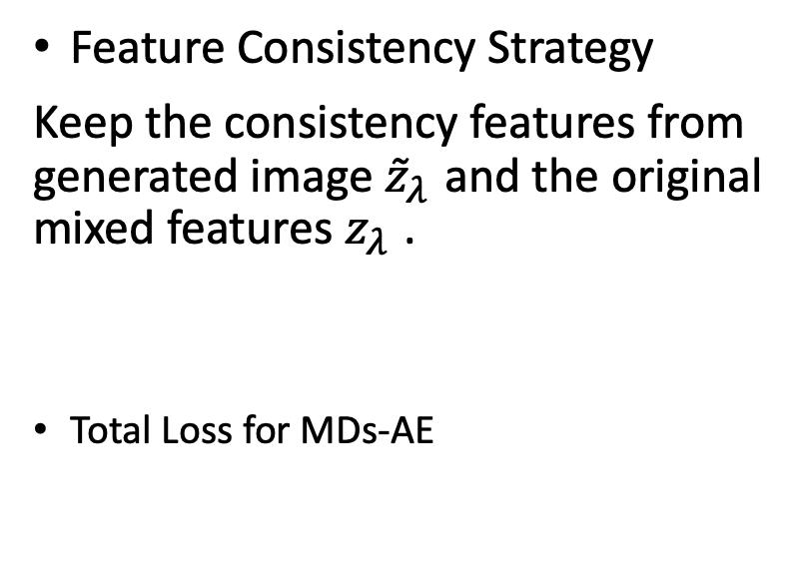
Method
$$E$$
Encoder
Feature Consistency Strategy
Keep the consistency features from generated image ${\tilde{z}}_{λ}$ and the original mixed features $z_{λ }$.
Total Loss for MDs-AE
$$R$$
Reconstructor
Training Phase
$$S$$
Segmentor
Feature
Re-Projection
Feature Consistency Loss
$${\tilde{z}}_{λ}$$
Reconstruction & Segmentation Loss
$$E$$
$λ$~
$$ℒ_{fea−con}=ℒ_{mse}\left(z_{kr},{\tilde{z}}_{kr}\right)$$
$$z_{1}$$
$$R$$
$$Y_{1}$$
$$X_{1}$$
$${\tilde{X}}_{1}$$
$${\tilde{X}}_{λ}$$
$${\tilde{X}}_{2}$$
$$E$$
$$z_{λ }$$
$$z_{2}$$
$$S$$
$$ℒ_{IDs−AE}=ℒ_{rec}+ℒ_{Dice}+λ_{fea−con}ℒ_{fea−con}$$
$$ℒ_{IDs−AE}=ℒ_{rec}+ℒ_{Dice}+λ_{fea−con}ℒ_{fea−con}$$
$$1−λ$$
$${\tilde{Y}}_{1}$$
$${\tilde{Y}}_{λ}$$
$${\tilde{Y}}_{2}$$
$$Y_{2}$$
$$X_{2}$$
Mixed Dual-stream AE (MDs-AE)
Reconstruction & Segmentation Loss
Notes:
Furthermore, to enhance efficient feature mixing, we propose a feature consistency strategy. This strategy is key to ensuring that the characteristics of the generated image align closely with the original mixed features. To quantify and minimize the disparity between these feature sets, we employ the mean square error (MSE) as a distance metric. The comprehensive loss function for MDs-AE encapsulates three distinct components: the reconstruction loss, the segmentation loss, and the feature consistency loss. These are combined into a total loss calculation that guides the training process. The hyper-parameter, lambda of feature consistency plays a crucial role here. It's meticulously adjusted to strike the right balance between the task-specific losses and the feature consistency loss.

Slide 11







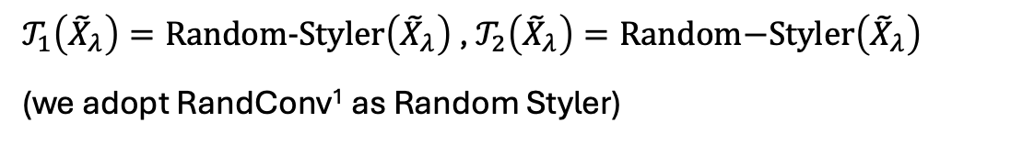







Method
DG Phase
Augment Data from Morphology and Style Perspective
Train Segmentor with Consistency Loss
$$E$$
Encoder
$$\left({\tilde{X}}_{λ},{\tilde{Y}}_{λ}\right)=\text{MDs}\text{−}\text{AE}(X_{1},X_{1})$$
$$X_{1}$$
$$X_{2}$$
MDs-AE
$$R$$
Reconstructor
$𝒯_{1}\left({\tilde{X}}_{λ}\right)=\text{Random}\text{−}\text{Styler}\left({\tilde{X}}_{λ}\right)$ , $𝒯_{2}\left({\tilde{X}}_{λ}\right)=\text{Random}\text{−}\text{Styler}\left({\tilde{X}}_{λ}\right)$
(we adopt RandConv¹ as Random Styler)
$$S$$
Segmentor
$${\tilde{X}}_{λ}$$
$${\tilde{Y}}_{λ}$$
Random Styler
$${\hat{Y}}_{1}$$
$$𝒯_{1}({\tilde{X}}_{λ})$$
$${\tilde{Y}}_{λ}$$
$$f_{φ}$$
Prediction Consistency Loss
$${\hat{y}}_{λ,k}=\text{Seg}\text{−}\text{Net}(𝒯_{k}\left({\tilde{X}}_{λ}\right))$$
Seg. Network
$$𝒯_{2}({\tilde{X}}_{λ})$$
$${\tilde{Y}}_{λ}$$
$$ℒ_{pred−con}=KLD({\hat{y}}_{λ,1},{\hat{y}}_{λ,2})$$
Segmentation Loss
$${\hat{Y}}_{2}$$
$$ℒ_{DG}=ℒ_{seg}+ℒ_{pred−con}$$
[1] Robust and Generalizable Visual Representation Learning via Random Convolutions, ICLR, 2021
Notes:
Finally, during the Domain Generalization (DG) phase, the trained Mixed Dual-stream Auto-encoder (MDs-AE) plays a crucial role in enhancing the training of our segmentation model. This stage involves carefully selecting pairs of similar slices from different patients, utilizing the MDs-AE to introduce novel morphological variations. We don't stop at morphological diversity, we proceed to apply random style transformations to these newly generated morphology variations, enriching the dataset even further. It's imperative to highlight that our training regimen integrates a prediction consistency loss on top of the segmentation loss. The random styler, in this case, Random Convolution, is applied not once, but twice, to each sample. And the prediction consistency loss encourages our task segmentation model to maintain stable predictions despite the dual style transformations, thus enhancing the robustness and reliability of the model against variations in data presentation. This strategy is a testament to our commitment to achieving consistency and reliability in medical image segmentation, even when faced with significant stylistic shifts in the data.

Slide 12
Experiment
Datasets and Generation Setting
Details of cross-domain datasets used in this study
Name | Labels | View | Split | Domains | No. of 3-D scans | Origin
Cross-modality Abdominal | Liver, L-kidney, R-kidney, Spleen | Axial | Source Target | CT T2 MRI | 30 20 | [1] [2]
Cross-sequence Cardiac | L-ventricle, Myocardium, R-ventricle | Short-axis | Source Target | bssFP MRI LGE MRI | 45 45 | [3]
Cross-center Prostate | Prostate | Axial | 1 Source 5 Targets | Prostate MRI from 6 centers | 30, 30, 19 13, 12, 12 | [4] [5]-[7]
[1] Miccai multi-atlas labeling beyond the cranial vault–workshop and challenge, MICCAI, 2015 [2] Chaos challengecombined (ct-mr) healthy abdominal organ segmentation, Medical Image Analysis, 2021 [3] Cardiac segmentation on late gadolinium enhancement mri: a benchmark study from multi-sequence cardiac mr segmentation challenge, Medical Image Analysis, 2020 [4] Shape-aware meta-learning for generalizing prostate mri segmentation to unseen domains, MICCAI, 2020
[5] Nciisbi 2013 challenge: automated segmentation of prostate structures, The Cancer Archive, 2015
[6] Computer-aided detection and diagnosis for prostate cancer based on mono and multi-parametric mri: a review, Computers in biology and medicine, 2015
[7] Evaluation of prostate segmentation algorithms for mri: the promise12 challenge, MIA, 2014
Notes:
Here are the details of cross-domain datasets used in this study. We conduct experiment on three scenarios. a cross-modality dataset with abdominal imaging transitioning between CT and MRI modalities. a cross-sequence cardiac dataset, which examines variations between balanced steady-state free precession (bSSFP) MRI sequences and late gadolinium enhancement (LGE) MRI sequences. And a cross-center prostate dataset that spans across multiple clinical centers, with one serving as the source and the other five as varied target centers.

Slide 13
Experiment
Implementation Details
ResNet-18 backbone for Encoder, R and S are the reverse of E
U-Net with an EfficientNet-b2 backbone as our task model
Training Details
Adam optimizer with learning rate decay used for training
578 generated images, the same as traditionally augmented samples to other methods.
Pair Selection Details
measure MSE between slices from the whole dataset and pick the closest pair from different patients
Notes:
Here are some details of our work. In the MDs-AE, the encoder uses a ResNet-18 backbone. The reconstructor is the reverse of encoder, and the segmentor is identical to reconstructor. We utilize U-Net with an EfficientNet-b2 backbone as our task segmentation model. Adam optimizer is adopted to update network parameters with learning rate decay. For a fair comparison, we generate 578 images for each dataset, which is the same as the traditionally augmented samples used in other methods to ensure an equal number of training samples. For pair selection, we adopt the mean square error to measure the distance between slices from the whole dataset and pick the closest pair from different patients.

Slide 14
Experiment
Segmentation Results on Three Cross-Domain Scenarios. Dice Score is the Evaluation Metric. The Highest are in red.
Method | Cardiac bSSFP-LGE |  |  |  | Abdominal CT-MRI |  |  |  |  | Prostate Cross-center
 | L-ventricle | Myocardium | R-ventricle | Avg | Liver | R-Kidney | L-Kidney | Spleen | Avg | Avg
Upper bound | 89.89 | 80.58 | 89.97 | 86.15 | 91.66 | 92.26 | 89.51 | 87.46 | 90.22 | 85.86
Baseline | 74.98 | 53.45 | 63.09 | 63.84 | 81.95 | 85.75 | 75.19 | 65.60 | 77.12 | 51.90
Mixup [1] | 81.38 | 68.41 | 71.89 | 73.89 | 77.17 | 82.61 | 83.25 | 59.62 | 75.66 | 58.25
MixStyle [2] | 86.73 | 61.48 | 77.48 | 75.23 | 82.34 | 86.22 | 78.71 | 68.27 | 78.88 | 55.68
Pix2Pix[3] | 82.44 | 69.10 | 79.11 | 76.89 | 78.83 | 84.12 | 80.21 | 69.12 | 78.07 | 60.12
AdvChain [4] | 80.15 | 72.12 | 82.33 | 80.15 | 79.62 | 83.20 | 82.29 | 80.15 | 81.32 | 63.34
CSDG [5] | 87.59 | 74.96 | 86.12 | 82.89 | 87.30 | 86.34 | 87.73 | 86.84 | 87.05 | 70.01
SLAug [6] | 88.48 | 78.18 | 87.12 | 84.60 | 89.68 | 88.47 | 86.65 | 85.13 | 87.48 | 68.44
ours | 88.83 | 79.05 | 87.93 | 85.27 | 87.74 | 89.13 | 89.66 | 86.25 | 88.19 | 71.96
[1] mixup: BEYOND EMPIRICAL RISK MINIMIZATION, ICLR, 2018
[2] DOMAIN GENERALIZATION WITH MIXSTYLE, ICLR, 2021
[3] Image translation for medical image generation: Ischemic stroke lesion segmentation, BSPC, 2022
[4] Enhancing MR image segmentation with realistic adversarial data augmentation, MIA, 2022
[5] Causality-inspired Single-source Domain Generalization for Medical Image Segmentation, TMI, 2022
[6] Rethinking Data Augmentation for Single-source Domain Generalization in Medical Image Segmentation, AAAI, 2023
Notes:
This table shows the comparison results across the datasets with the Dice Score as evaluation metric. We can see that our proposed method MMS surpass recent state-of-the-art SSDG methods.Compared to adversarial-learning-based network AdvChain and style-transformation-based methods: CSDG and SLAug, our proposed method can further augment the diversity of the data and ensure the fidelity at the same time. Compared with other methods that employ mixing strategy such as mix-up, mix-style or generative networks like pix2pix, MMS consistently demonstrates its superiority.

Slide 15
Experiment
Dices Score in Cross-Center Prostate Dataset. Dice Score is the Evaluation Metric. The Highest are in red.
 | A | B | C | D | E | F | Avg
Upper bound | 91.71 | 86.18 | 83.08 | 87.53 | 87.93 | 84.72 | 85.86
Baseline | 70.68 | 56.82 | 47.71 | 64.50 | 42.62 | 29.07 | 51.90
Mixup [1] | 72.03 | 60.52 | 53.98 | 64.78 | 54.12 | 44.08 | 58.25
MixStyle [2] | 67.93 | 56.31 | 51.39 | 68.25 | 43.78 | 46.41 | 55.68
Pix2Pix[3] | 68.33 | 62,23 | 56,13 | 69.13 | 55.91 | 47.22 | 60.12
AdvChain [4] | 72.98 | 65.26 | 59.40 | 71.46 | 50.23 | 60.73 | 63.34
CSDG [1] | 81.73 | 65.27 | 63.90 | 73.61 | 65.25 | 70.63 | 70.01
SLAug [2] | 80.87 | 62.31 | 63.47 | 71.93 | 60.97 | 71.07 | 68.44
Ours | 82.31 | 69.34 | 67.47 | 74.20 | 66.98 | 71.43 | 71.96
[1] mixup: BEYOND EMPIRICAL RISK MINIMIZATION, ICLR, 2018
[2] DOMAIN GENERALIZATION WITH MIXSTYLE, ICLR, 2021
[3] Image translation for medical image generation: Ischemic stroke lesion segmentation, BSPC, 2022
[4] Enhancing MR image segmentation with realistic adversarial data augmentation, MIA, 2022
[5] Causality-inspired Single-source Domain Generalization for Medical Image Segmentation, TMI, 2022
[6] Rethinking Data Augmentation for Single-source Domain Generalization in Medical Image Segmentation, AAAI, 2023
Notes:
This is the detailed comparison of sub-experiments within the cross-center prostate segmentation task. We observe the performance of various methods across different target domains, with each column indicating the average Dice scores when a specific dataset serves as the source domain. Notably, our method, consistently enhances segmentation outcomes, irrespective of the chosen source domain.

Slide 16
Experiment
Ablation Study
Ablation Study on MMSR in Cardiac Dataset
MDsAE | Random Styler | L-ventricle | Myocardium | R-ventricle | Avg
 |  | 74.98 | 53.45 | 63.09 | 63.84
√ |  | 86.21 | 73.39 | 85.79 | 81.78
 | √ | 87.57 | 73.96 | 86.56 | 82.70
√ | √ | 88.83 | 79.05 | 87.93 | 85.27
Notes:
We conducted an ablation study on the Cardiac Dataset. We can see that the MDs-AE and random styler individually improve the model's robustness to domain shifts in SSDG by enhancing training data diversity in morphology and style, respectively, Incorporating both components significantly boosts performance, highlighting the importance of simultaneous morphology and style augmentation in medical image segmentation.

Slide 17
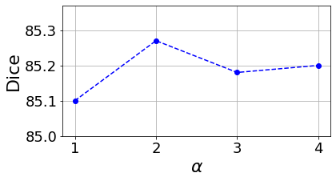
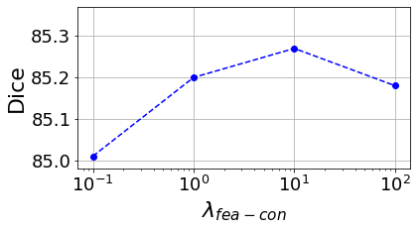


Experiment
Hyper-parameters Analysis
Performances of Using Different values of α and $λ_{fea−con}$ in Cardiac dataset
$$z_{k}=z_{i}+\left(1−λ\right)z_{i}$$
$$λ\sim Beta(α,α)$$
$$ℒ_{IDs−AE}=ℒ_{rec}+ℒ_{Dice}+λ_{fea−con}ℒ_{fea−con}$$
Notes:
We further analyze two hyperparameters in our model: alpha and lambda of feature consistency. We found that setting alpha to 2 yields the best performance, as it balances the number of morphology-mixup samples with original samples. Similarly, setting lambda of feature consistency to 10 optimizes performance by balancing the MDs-AE’s focus on consistency learning with its reconstruction and segmentation tasks.

Slide 18
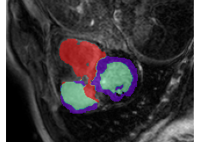
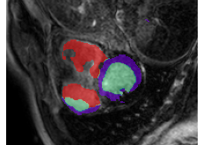
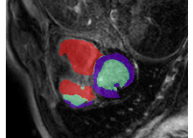
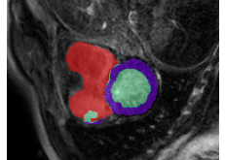
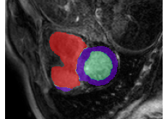
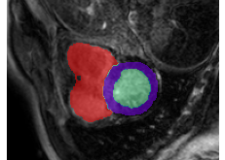
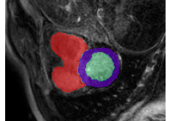
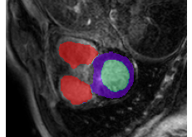

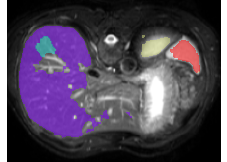
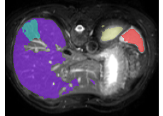
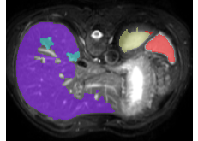

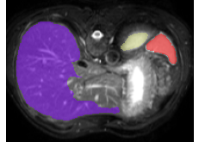
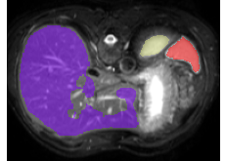
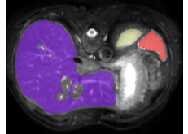
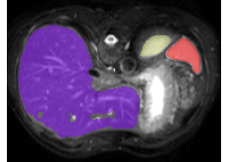
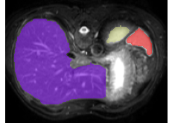
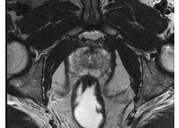
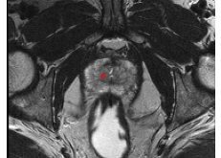
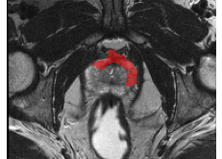
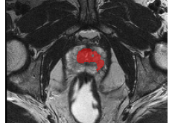




Experiment
Comparison Results Visualization
Baseline
Mixup
MixStyle
Pix2Pix
AdvChain
CSDG
SLAug
Ours
Ground Truth
Notes:
This slide presents the qualitative results for comparison. The first row highlights the advantage of our approach in capturing fine-grained details, such as the spatial separation of two regions. The second and third rows demonstrate that predictions from our method exhibit better contour continuity compared to other methods.

Slide 19




Experiment
Visualization of Morphology Shift from MDs-AE
Sample A
$$λ=0.25$$
$$λ=0.5$$
$$λ=0.75$$
Sample B
Notes:
Finally, We visualize the morphology-mixup samples on the cardiac dataset. We notice that, as the mixing parameter lambda increases from 0 to 1, disjointed red regions progressively merge into an integral whole, validating the ability of our method to mix the morphology within two slices.

Slide 20
MMS: Morphology-mixup Stylized Data Generation for Single Domain Generalization in Medical Image Segmentation
Thanks for Listening
Contact info:
Baoyao Yang (ybaoyao@gdut.edu.cn)

