Slide 1

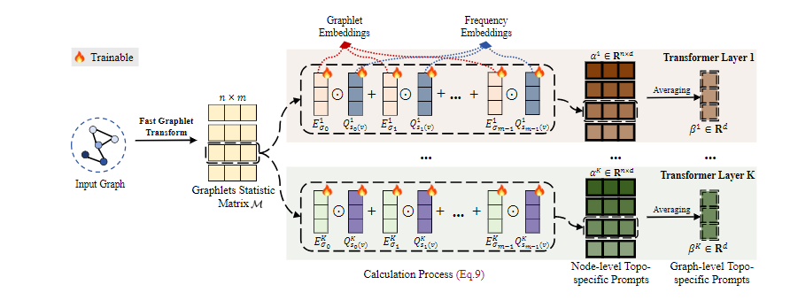
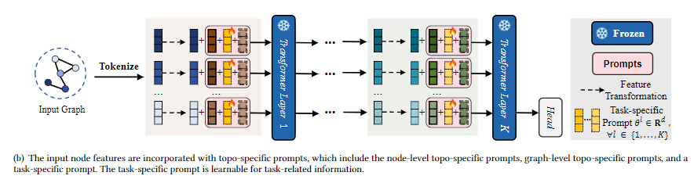
A Novel Prompt Tuning for Graph Transformers: Tailoring Prompts to Graph Topologies Jingchao Wang, Zhengnan Deng, Tongxu Lin, Wenyuan Li, Shaobin Ling
Motivation
The continuous prompts are used to perform feature transformation for the input nodes, adapting the pre-trained model to the downstream tasks. Inspired by prompt tuning, Deep Graph Prompt Tuning (DeepGPT) proposes tuning the graph transformers by a series of continuous prompts, which are integrated into the input graph of the transformer layers that are kept frozen. These prompts are used to learn task-related information, utilizing relevant pre-trained knowledge on input graphs by performing feature transformation (adding or pre-pending prompt features for the graph)
Contribution
1. We propose specifying prompts tailored to the structure of input graph, which are used for tuning graph transformers by dynamic feature transformation. This enhances the adaptability of prompts for input graphs with different topological structures.
2. We propose a Topo-specific Graph Prompt Tuning (TGPT), which tunes the graph transformers by trainable graphlet embeddings and frequency embeddings. These embeddings are employed to generate topo-specific prompts, providing specified feature transformations for graph nodes tailored to the surrounding structures.
3. Our method shows its outstanding capability through extensive experiments on datasets from Open Graph Benchmark (OGB) and Moleculenet Benchmark, showing its proficiency in both molecular graph classification and regression.

