Slide 1


2025 IEEE International Conference on Image Processing
Harnessing Feature Distribution Consistency for Federated Learning with Noisy Labels
Yali Ma¹, Baoyao Yang^{1,*}, Yanchao Tang¹, Weide Zhan¹ , Wenyin Yang²
¹Guangdong University of Technology
²Foshan University
Notes:
My name is Yali Ma,, and I am a graduate student at Guangdong University of Technology. My research focuses on federated learning, particularly in the context of noisy label environments, which is a common and challenging issue in real-world distributed systems.
At this ICIP conference, I am presenting our paper titled “Harnessing Feature Distribution Consistency for Federated Learning with Noisy Labels”, which addresses the problem of learning robust models under federated settings with label noise.

Slide 2
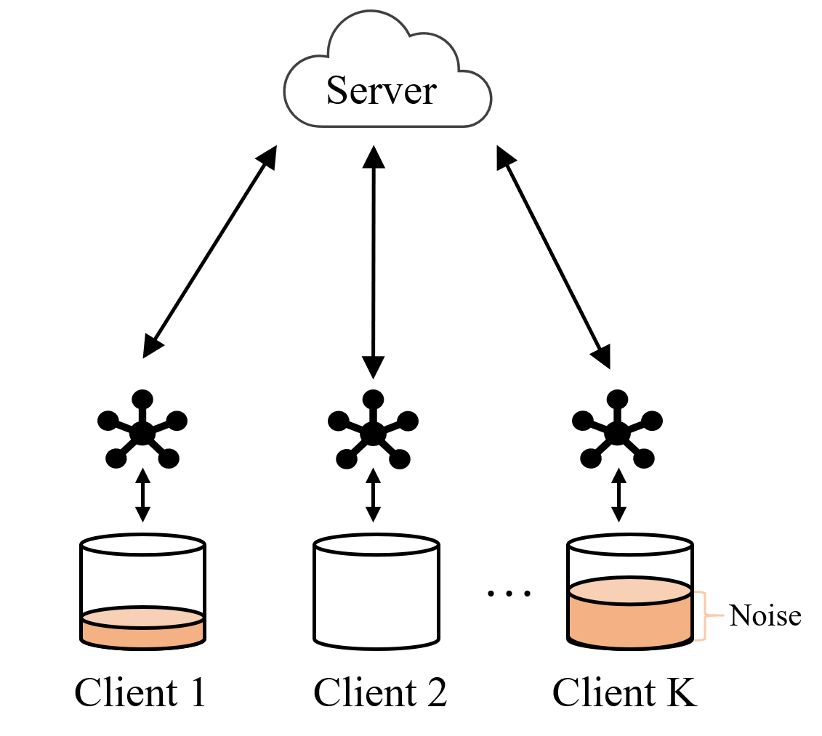
Background
Federated learning (FL) allows clients to train a generalized model without sharing local data, thereby effectively protecting client privacy. However, annotators may wrongly demarcate different categories due to a lack of experience or cognitive biases.
clients with noisy data
Local models are susceptible to interference from erroneous information, leading to a decrease in their generalization performance and harming the globally aggregated model.
Federated Learning with Noisy Labels
Notes:
As we know, federated learning, or FL, is a promising paradigm that enables clients to collaboratively train a shared model without exchanging their local data. This helps protect client privacy while still achieving a generalizable model.
However, most existing FL methods assume that the labels on each client are correctly annotated. Unfortunately, this assumption often doesn’t hold in real-world scenarios. In practice, annotators may mislabel data due to inexperience or cognitive bias.
These noisy labels can negatively impact the local training process, causing the local models to learn from incorrect information. And when these flawed models are aggregated, the performance of the global model may degrade significantly.

Slide 3
Related Work
The client-based methods [1-3] recognize clean clients without any noisy labels and then utilize the model trained on clean clients to correct the labels of noisy clients. As clean clients are regarded as references for noisy label detection, these methods are inapplicable in real-world scenarios where all the clients contain noisy labels.
Many sample-based methods [4-5] directly detect noisy labels. However, limited information is considered for noisy label detection, these methods are less effective when labels are seriously poisoned.
[1] Xu, Jingyi, et al. "Fedcorr: Multi-stage federated learning for label noise correction ".in CVPR 2022.
[2] Nannan Wu, Li Yu, et al. "Fednoro: Towards noise-robust fed-erated learning by addressing class imbalance and labelnoise heterogeneity" .in IJCAI 2023.
[3] Lu, Yang, et al. "Federated learning with extremely noisy clients via negative distillation. " in AAAI 2024.
[4] FedRN: Exploiting k-reliable neighbors towards robust federated learning. In CIKM 2022.
[5] Learning cautiously in federated learning with noisy and heterogeneous clients. In ICME 2023
Notes:
Currently, numerous methods address Federated Learning with Noisy Labels (FLNL), and they can be roughly categorized into client-based and sample-based methods.
The client-based methods [1-3] recognize clean clients without any noisy labels and then utilize the model trained on clean clients to correct the labels of noisy clients. As clean clients are regarded as references for noisy label detection, these methods are inapplicable in real-world scenarios where all the clients contain noisy labels.
Many sample-based methods [4-5] directly detect noisy labels. However, limited information is considered for noisy label detection, these methods are less effective when labels are seriously poisoned.

Slide 4
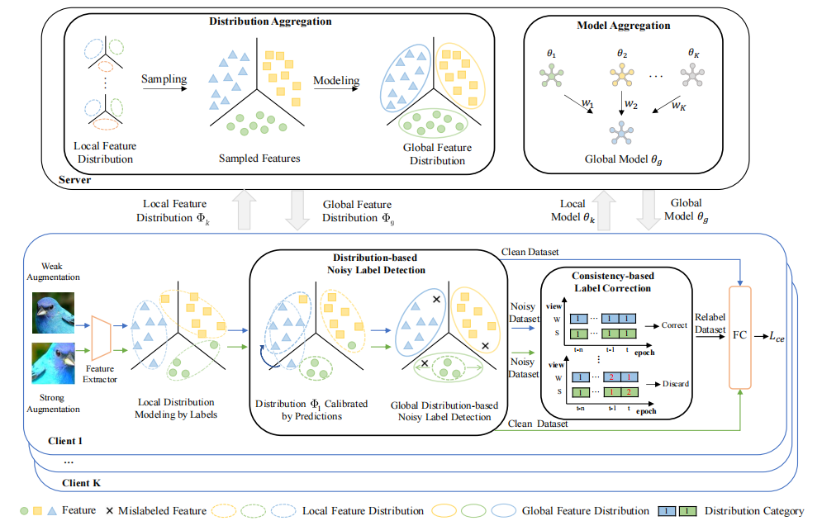
Proposed Method
We propose a distribution-based noisy label detection method, FedFDC, which enhances noisy label detection with the help of global feature distribution, thus improving the FL performance.
We design a TDC mechanism to correct noisy labels in FL. It considers the consistency of the distributions to which the dual views belong and the continuity of label correction, thereby increasing sample utilization and improving reliability.
Notes:
To address the noisy label issue in FL, we propose a new FL method, namely Federated Learning with Feature Distribution Consistency (FedFDC), which comprehensively evaluates data distribution among the whole FL system to detect and correct noisy labels on each client. Specifically, in conjunction with model integration, the distributions of client features are aggregated on the server, outputting a global feature distribution that is subsequently allocated to the clients. The global feature distribution, as auxiliary information, delimits the range of feature expressions and local feature distributions are calibrated to identify noisy labels on each client. Moreover, to improve data utilization, we augment client samples to dual-view data and design a temporal dual-view consistency (TDC) mechanism to correct the labels of client samples. The TDC mechanism corrects the detected noisy labels based on the consistency of the distributions to which the dual views belong and the continuity of label corrections between communication rounds. Finally, the local models are updated using samples with clean or corrected labels on the client side and uploaded to the server, starting the next communication round.

Slide 5
Experimental Setting
Datasets: We validate FedFDC on three classic benchmark datasets, which include two synthetic noisy label datasets: CIFAR-10 and CIFAR-100 , as well as one real-world noisy label dataset, Animal-10N .
Label Noise Settings: For CIFAR10 and CIFAR100 datasets, two widely-used corruption methods, symmetric flipping (Sym) and pair flipping (Pair), are applied to simulate the wrongly labeled cases. The images in Animal-10N are crawled from multiple online search engines, with a label noise rate of approximately 8%.
Notes:
In our experiments, we evaluate the performance of FedFDC on three widely-used benchmark datasets. These include two synthetic noisy label datasets, CIFAR-10 and CIFAR-100, and one real-world noisy label dataset, Animal-10N.
For CIFAR-10 and CIFAR-100, we introduce label noise using two common corruption strategies — symmetric flipping and pair flipping — to simulate incorrect annotations. These settings are standard in noisy label research and help us assess the robustness of our method under different noise patterns.
As for the Animal-10N dataset, it's a real-world dataset where the images are collected from various online search engines. This naturally introduces label noise due to errors in keyword-based crawling, and the estimated noise rate is around 8%, making it a realistic testbed for our approach.

Slide 6
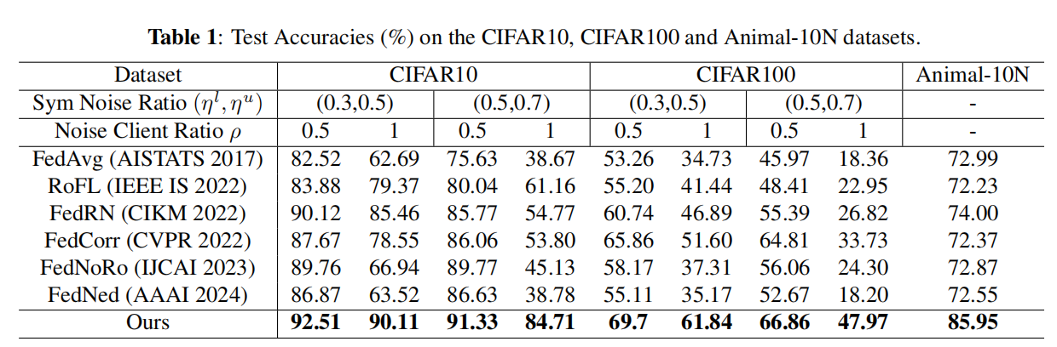
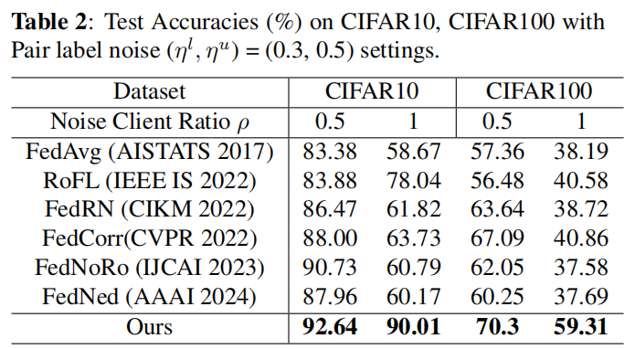
Experimental Results
Overall, FedFDC consistently achieves the best test accuracies across different noise levels for Sym and Pair noise types, with particularly significant outperformance in extremely noisy scenarios.
Notes:
We compare the performance of these methods across multiple noise types and noise levels on the CIFAR-10 and CIFAR-100 datasets. The averaged accuracies over the final 10 rounds are shown in Table1 and Table2. Overall, FedFDC consistently achieves the best test accuracies across different noise levels for Sym and Pair noise types, with particularly significant outperformance in extremely noisy scenarios.
In contrast, due to the lack of consideration for noisy labels, the performance of the conventional FL method FedAvg shows a significant decline as the ratio of noisy labels increases.
Furthermore, as the ratio of noisy clients increases, we notice that FedCorr and FedNoRo become ineffective, since their methods rely on the assumption of the existence of clean clients. The robustness and effectiveness of other FLNL methods are also insufficient in extremely noisy environments; meanwhile, our method demonstrates superior performance, achieving gains of 23\% and 14\% on CIFAR-10 and CIFAR-100, respectively.

Slide 7
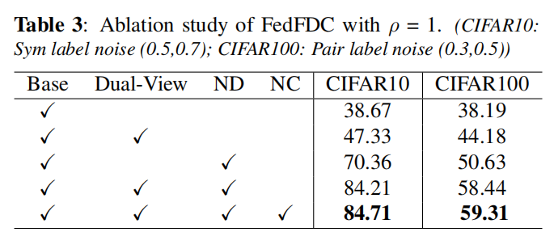
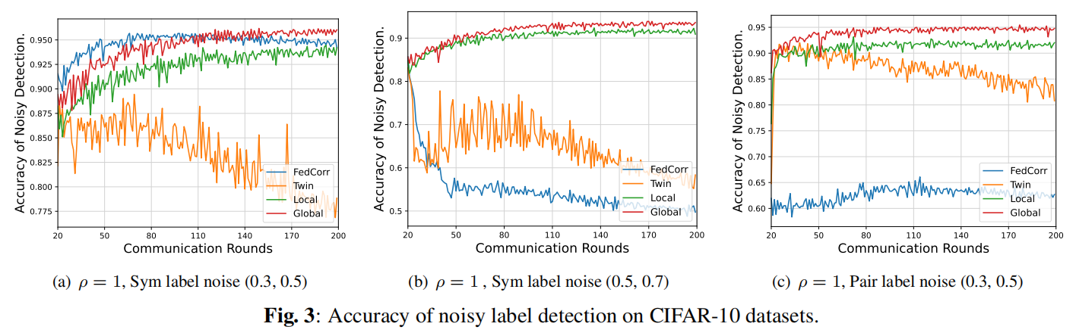
Ablation Study
Notes:
We conduct an ablation study to evaluate the contribution of each component in FedFDC. Results show that the Dual-View strategy significantly improves model robustness, while the ND module plays a key role in accurately detecting noisy labels and reducing their negative impact. Even without label correction, combining Base and ND already outperforms existing methods. Finally, the NC module further boosts generalization by effectively correcting the detected noisy labels.
To further demonstrate the effectiveness of our method, we also evaluate its ability to detect noisy labels directly. Our approach leverages the underlying data distribution, which allows it to maintain consistently high detection accuracy across a wide range of noise levels and types. As shown in the figure, the detection results remain stable and reliable, even under challenging and highly corrupted scenarios.

Slide 8
2025 IEEE International Conference on Image Processing
Thank you!
Yali Ma¹, Baoyao Yang^{1,*}, Yanchao Tang¹, Weide Zhan¹ , Wenyin Yang²
¹Guangdong University of Technology
²Foshan University
Notes:
This is the end of my talk. Thank you all for your time and attention.

