Slide 1

The OSI Model
Trident Technical College
Frank W. Gibbes

Slide 2
The OSI model
The OSI (Open System Interconnection) model was developed by ISO (International Organization for Standardization) in 1984.
Its purpose is to provide a reference model and framework to explain how different networking technologies work together and interact.
It divides the different functions and services provided by network technology into 7 layers.
The model is intended to:
facilitate modular engineering
simplify teaching and learning network technologies
reduce complexity, and
ensure interoperability, compatibility and standardization
Notes:
Interesting to note OSI is ISO spelled backward.

Slide 3
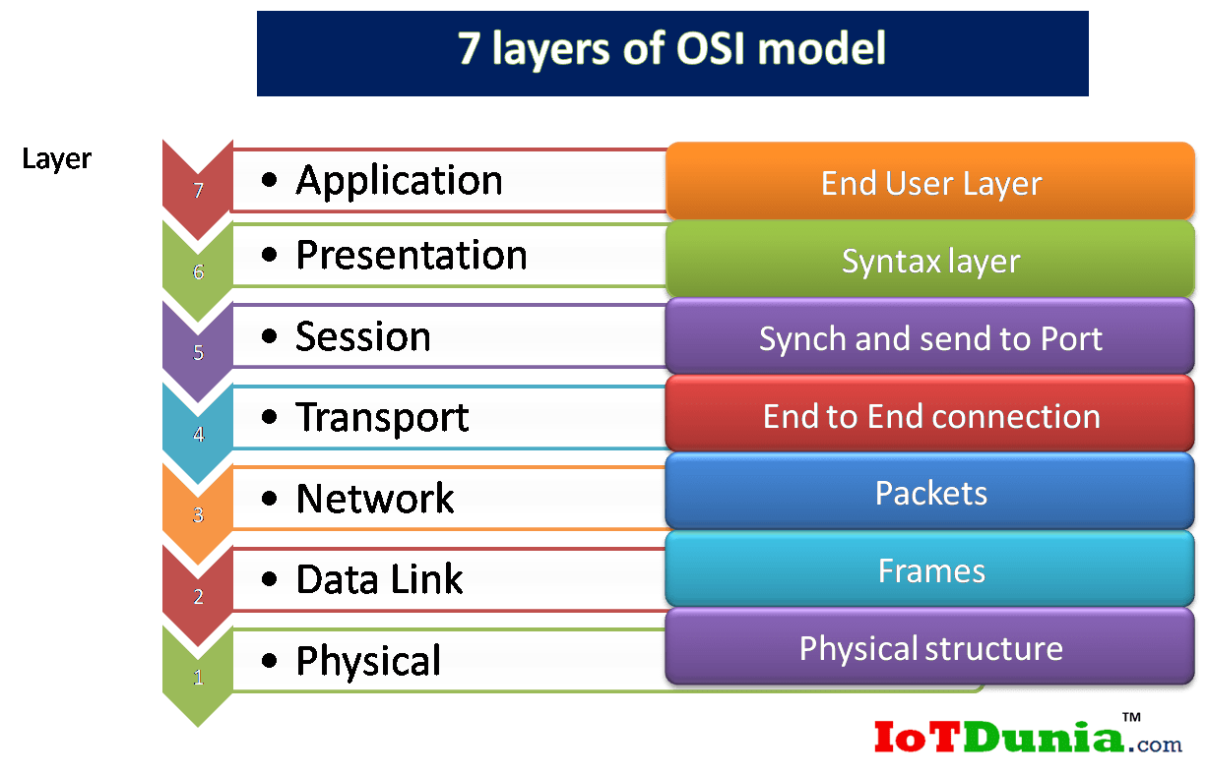
The 7 Layer Framework
This diagram shows the 7 layers of the OSI Model.
To remember them in the correct order, a common mnemonic is often used:
All People Seem To Need Data Processing.

Slide 4
OSI 7 Layers: Protocol Data UnitS (PDU)
Each layer’s information is referred to as a Protocol Data Unit (PDU).
Along with the data, a PDU contains protocol-specific control information.
Each layer will add (or remove) its protocol information as a PDU moves down (or up) each layer. This information is added/removed at each layer in a header.
The PDU is given a different name at each layer to represent its role:
Application, Presentation, Session (Layers 7, 6, 5) = Data
Transport (Layer 4) = Segment
Network (Layer 3) = Packet
Data Link (Layer 2) = Frame
Physical (Layer 1) = bits

Slide 5
OSI 7 Layers: A quick Overview
1. Application, Presentation and Session: converts user input to data.
2. Transport: adds port numbers converting the data into segments.
3. Network: adds IP addresses converting segments into packets.
4. Data Link: adds MAC addresses converting the packets into frames.
a. LLC sublayer: Responsible for sequencing/acknowledging of individual frames
b. MAC sublayer: converts the frames into a bits.
5. Physical: puts the bits on the wire.

Slide 6
OSI Layer 7: The Application Layer
Describes the interface between two applications on separate computers.
Provides network services directly to the user's application such as a web browser or email client.
This layer is said to be "closest to the user".
Protocols that operate on this layer include TELNET, HTTP, FTP, TFTP, SMTP, and NTP.

Slide 7
OSI Layer 6: The presentation Layer
Represents data in a particular format to the Application layer by reformatting, compressing, and/or encrypting data in a way that the receiving application can read.
Defines encryption, compression, conversion and other coding functions.
Examples of specifications defined at this layer are GIF, JPEG, MPEG, and ASCII.

Slide 8
OSI Layer 5: The Session Layer
Establishes, maintains, and terminates end-to-end connections (sessions) between two applications on two network nodes.
Controls the dialogue between the source and destination node.
Provides error reporting for the Application, Presentation and Session layers.
Examples of protocols/API's that operate on this layer are RPC and NETBIOS.
Notes:
RPC (Remote Procedure Call): when a computer program causes a procedure (subroutine) to execute in a different address space (commonly on another computer on a shared network), which is coded as if it were a normal (local) procedure call, without the programmer explicitly coding the details for the remote interaction. The RPC model implies a level of location transparency, namely that calling procedures are largely the same whether they are local or remote, but usually they are not identical, so local calls can be distinguished from remote calls. Remote calls are usually orders of magnitude slower and less reliable than local calls, so distinguishing them is important.
NetBIOS: an acronym for Network Basic Input/Output System, a non-routable OSI Session Layer 5 Protocol and a service that allows applications on computers to communicate with one another over a local area network (LAN). This results in each computer in the network having both an IP address and a NetBIOS name corresponding to a (possibly different) host name. NetBIOS is also used for identifying system names in TCP/IP (Windows). Simply saying, it is a protocol that allows communication of files and printers through the Session Layer of the OSI Model in a LAN.

Slide 9
OSI Layer 4: The Transport Layer
Converts the data received from the upper layers into segments (TCP) or datagrams (UDP) and prepares them for transport by adding port numbers in a segment header.
Responsible for end-to-end delivery of entire messages - if a message is too large, messages are divided into smaller segments/datagrams.
Uses sequencing to guarantee delivery in the same order that it was sent.
Provides services such as error checking and flow control.
Examples of protocols operating on this layer are TCP and UDP.
Notes:
Adds Port Numbers

Slide 10
OSI Layer 3: The Network Layer
Converts segments from the Transport layer into packets.
Responsible for path determination, routing, and the delivery of packets across internetworks.
Adds for logical addressing (also known as network addressing or Layer 3 addressing), for example IP addressing
Notes:
Adds IP Addresses

Slide 11
OSI Layer 3: The Network Layer (cont.)
Treats packets independently, without recognizing any relationship between individual packets.
Relies on higher layers for reliable delivery and sequencing.
Examples of protocols defined at this layer are IP, ICMP, and ARP.
Examples of devices that operate on this layer are layer-3 switches and routers, including WAPs (Wireless Access Points) with built-in routing capabilities.

Slide 12
OSI Layer 2: The Data link Layer
Adds frame header converting the packets into frames.
Ensures frames are in the correct order and requests retransmission of frames in case an error occurs.
Responsible for reassembling bits, taken off the wire by the Physical layer, into frames.
Provides error checking by adding a CRC (Cyclic Redundancy Check) to the frame.
Examples of devices operating on this layer are switches, WAPs, and NICs.
Notes:
Adds MAC addresses
CRC (Cyclic Redundancy Check): an error-detecting code commonly used in digital networks and storage devices to detect accidental changes to digital data. Blocks of data entering these systems get a short check value attached, based on the remainder of a polynomial division of their contents. On retrieval, the calculation is repeated and, in the event the check values do not match, corrective action can be taken against data corruption. CRC is the most popular FCS algorithm.

Slide 13
OSI Layer 2: The Data link Layer (cont.)
Consists of two sublayers:
1. LLC sublayer (Logical Link Control)
Upper sublayer which is defined in the IEEE 802.2 standard.
Masks the underlying physical network technologies to provide a single interface to the Network layer.
Acts as an intermediary between different network protocols (TCP/IP, etc.) and the different network technologies (Ethernet, Token Ring, etc.).
Responsible for sequencing\acknowledging of individual frames.
Notes:
IEEE 802.2: defines logical link control (LLC) as the upper portion of the data link layer of the OSI Model. The original standard was developed by the Institute of Electrical and Electronics Engineers (IEEE) in collaboration with the American National Standards Institute (ANSI) was adopted by the International Organization for Standardization (ISO) in 1998.
LLC is a software component that provides a uniform interface to the user of the data link service, usually the network layer. LLC may offer three types of services: Unacknowledged connectionless mode services (mandatory) [TCP], Connection mode services (optional), Acknowledged connectionless mode services (optional) [UDP].
Token Ring: A token-ring network is a local area network (LAN) topology that sends data in one direction throughout a specified number of locations by using a token. Token Ring was introduced by IBM in 1984, and standardized in 1989 as IEEE 802.5. It uses a special three-byte frame called a token that is passed around a logical ring of workstations or servers. This token passing is a channel access method providing fair access for all stations, and eliminating the collisions of contention-based access methods. Token Ring was a successful technology, particularly in corporate environments, but was gradually eclipsed by the later versions of Ethernet.

Slide 14
OSI Layer 2: The Data link Layer (cont.)
Consists of two sublayers:
2. MAC sublayer (Media Access Control)
Takes care of physical addressing (MAC Addresses) and allows upper layers access to physical media.
Handles frame addressing and error checking.
Controls and communicates directly with the physical network media through the network interface card (NIC).
Converts the frames into bits to pass them on to the Physical layer which puts them on the wire (and vice versa).

Slide 15
OSI Layer 1: The Physical Layer
Activates, maintains and deactivates the physical link.
Handles raw bits stream and places it on the wire.
Defines electrical and optical signaling, voltage levels, data transmission rates, and mechanical specifications, such as cable lengths, connectors, the number of pins and their functions.
Examples of devices that operate on this layer are hubs, repeaters, NICs, WAPs, and LAN/WAN interfaces.
Notes:
FCS (Frame Check Sequence): an error-detecting code added to a frame in a communication protocol. Frames are used to send payload data from a source to a destination. The FCS field contains a number that is calculated by the source node based on the data in the frame. This number is added to the end of a frame that is sent. When the destination node receives the frame the FCS number is recalculated and compared with the FCS number included in the frame. If the two numbers are different, an error is assumed and the frame is discarded.

Slide 16
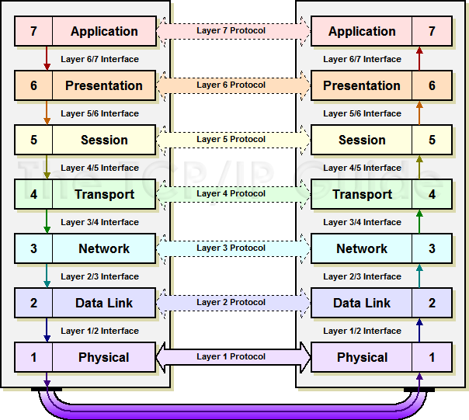
The OSI Model in Action
Host A
Host B
The OSI model represents the flow of data from endpoint-to-endpoint.
Data entered at the Application Layer on one device (Host A) traverses down through the 7 layers on the source device.
Once the data reaches the destination device (Host B), it travels back up the 7 layers in reverse order.

Slide 17
The 7 Layers: data headers
Each layer of OSI Model (except Physical) adds its own header to the data that originated from the operating system
Header contains information that describes what each layer of the OSI Model should do with the data:
OSI Layer | Protocol Data Unit (PDU) | Header
Application | Data | Data
Presentation | Data | Data
Session | Data
Transport | Segment/Datagram | Port Number
Network | Packet | IP addresses
Data Link | Frame | MAC Address

Slide 18
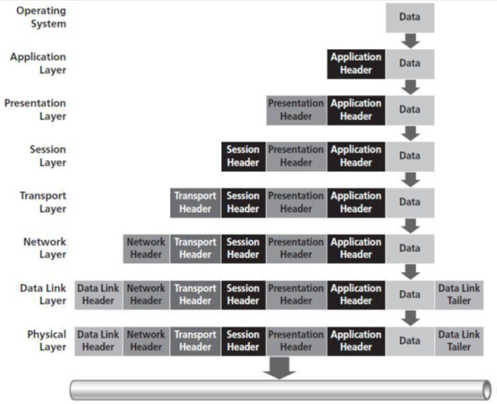
The 7 Layers: How They Work Together
The 7 Layers move data between layers of the OSI Model using two processes:
Encapsulation: Data > segment > packet > frame > bits
De-encapsulation: Bits > frame > packet > segment > data

Slide 19
the OSI Model: Summary
The seven layers of the OSI model are Application, Presentation, Session, Transport, Network, Data Link, and Physical.
At Layers 7, 6, and 5, user information and input/output are simply identified as data. These three layers are often referred to together as the Application layers.
A message at the Transport layer (layer 4) is called a segment (TCP) or a datagram (UDP).

Slide 20
the OSI Model: Summary
A message at the Network layer (layer 3) is called a packet.
A message at the Data Link layer (layer 2) is called a frame.
A message at the Physical layer (layer 1) is put on the wire as bits.
Each layer’s information is referred to as a Protocol Data Unit (PDU).
Encapsulation and Decapsulation are the two processes which move data between the layers of the OSI model.

Slide 21
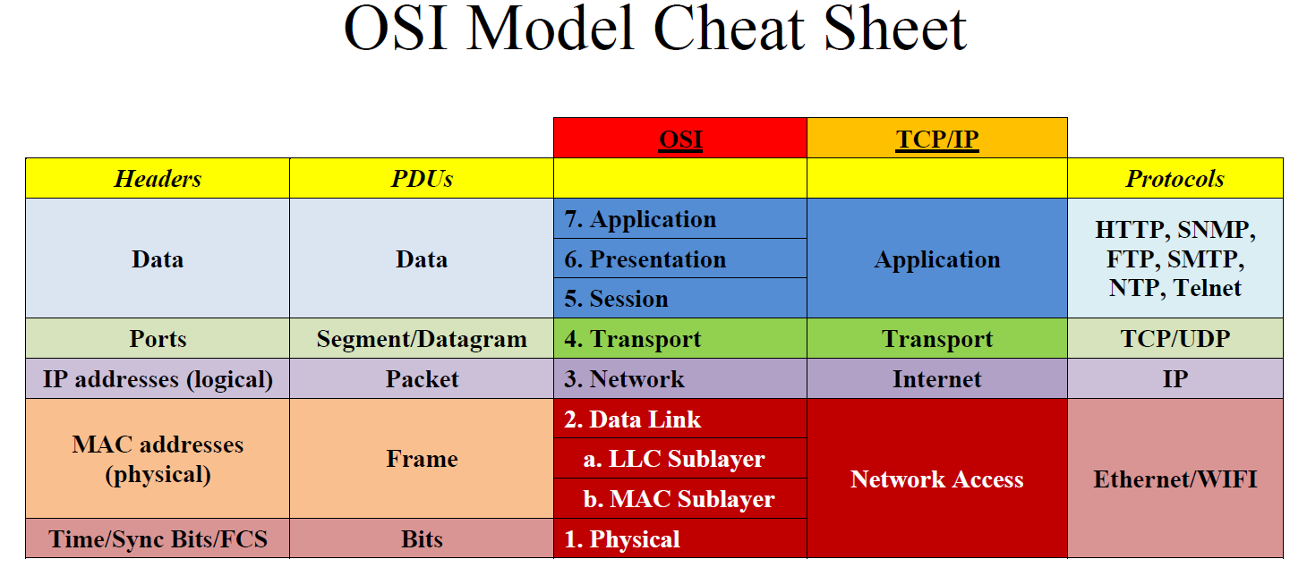

Slide 22
References
Datta, Subham. Definition of Network Units: Packet, Fragment, Frame, Datagram, and Segment. 27 February 2021. 28 May 2022. https://www.baeldung.com/cs/networking-packet-fragment-frame-datagram-segment
GeeksforGeeks. Protocol Data Unit (PDU). 29 April 2022. 28 May 2022. <https://www.geeksforgeeks.org/protocol-data-unit-pdu/>
Infocellar.com. OSI Model. 2022. 28 May 2022. https://infocellar.com/networks/osi-model/
IOTdunia.com. What is OSI model? 7 end to end layers in OSI model. 13 May 2022. 28 May 2022. https://iotdunia.com/7-end-to-end-layers-in-osi-model/
Jill West, Tamara Dean, Jean Andrews. Network+ Guide to Networks 7th Edition. Boston, MA: Cengage Learning, 2016.
TechExams.net. 7-Layer OSI Model. n.d. 28 May 2022

