Slide 1
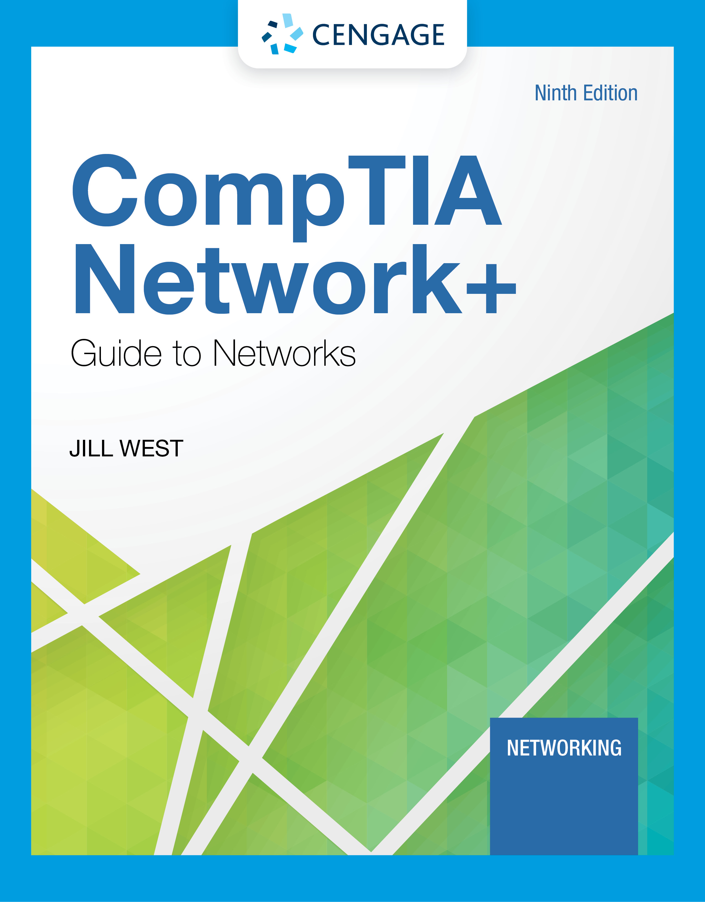
Module 3: Addressing
CompTIA Network+ Guide to Networks, Ninth Edition

Slide 2
Module Objectives
By the end of this module, you should be able to:
1. Work with MAC addresses
2. Configure TCP/IP settings on a computer, including IP address, subnet mask, default gateway, and DNS servers
3. Identify the ports of several common network protocols
4. Describe domain names and the name resolution process
5. Use command-line tools to troubleshoot common network problems

Slide 3
Addressing Overview
There are four addressing methods:
Data link layer MAC (Media Access Control) address is 48 bits, written as six hex numbers separated by colons
It is also called a physical address
MAC addresses are embedded on every NIC in the world
Network layer IP (Internet Address) address can be used to find any computer in the world
IPv4 addresses have 32 bits and are written as four decimal numbers called octets
IPv6 addresses have 128 bits and are written as eight blocks of hexadecimal number
Transport layer port numbers are used to find applications
Application layer FQDNs, computer names, and host names
Fully qualified domain name (FQDN) – a unique character-based name

Slide 4
MAC Addresses (1 of 2)
Traditional MAC addresses contain two parts
The first 24 bits are known as the OUI (Organizationally Unique Identifier) or manufacturer-ID
This part is assigned by the IEEE
The last 24 bits make up the extension identifier or device ID
Manufacturer’s assign each NIC a unique device ID
Switches use MAC addresses to identify devices on the local area network

Slide 5
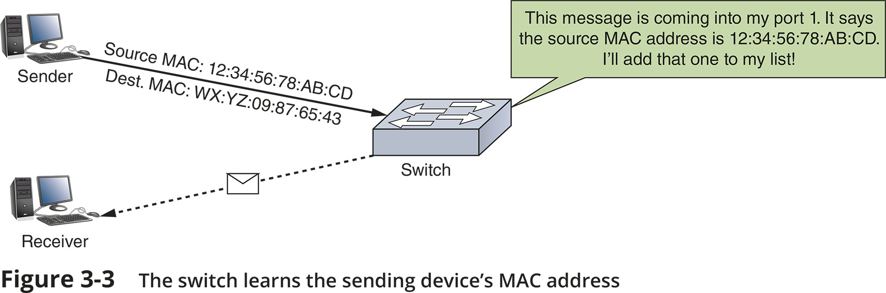
MAC Addresses (2 of 2)
Figure 3-3 The switch learns the sending device’s MAC address

Slide 6
IP Addresses
Static IP addresses are assigned manually by the network administrator
Dynamic IP addresses are automatically assigned by a DHCP server
You’ll learn more about DHCP later in the chapter
There are two types of IP addresses:
IPv4 is a 32-bit address
IPv6 is a 128-bit address

Slide 7
IPv4 Addresses (1 of 4)
A 32-bit IPv4 address is organized into four groups of 8 bits each (known as octets)
Each of the four octets can be any number from 0 to 255
Some IP addresses are reserved
Example of an IPv4 address: 72.56.105.12
Classful addressing
The dividing line between the network and host portions is determined by the numerical range the IP address falls in
Classful IPv4 addresses are divided into five classes:
Class A, Class B, Class C, Class D, and Class E

Slide 8
IPv4 Addresses (2 of 4)
Class A, B, and C licensed IP addresses are available for use on the Internet
These are called public IP addresses
A company can use private IP addresses on its private networks
The IANA recommends the following IP addresses be used for private networks:
10.0.0.0 through 10.255.255.255
172.16.0.0 through 172.31.255.255
192.168.0.0 through 192.168.255.255
Classless addressing allows the dividing line between network and host portions to fall anywhere along the string of binary bits in an IP address
CIDR (Classless Interdomain Routing) notation takes the network ID or a host’s IP address and follows it with a forward slash (/) followed by the number of bits that are used for the network ID

Slide 9
IPv4 Addresses (3 of 4)
Network Address Translation (NAT) is a technique designed to conserve public IP addresses needed by a network
Address translation is a process where a gateway device substitutes the private IP addresses with its own public address
When these computers need access to other networks or Internet
Port Address Translation (PAT) is the process of assigning a TCP port number to each ongoing session between a local host and Internet host
Two variations of NAT to be aware of:
SNAT (Source Network Address Translation) - the gateway assigns the same public IP address to a host each time it makes a request to access the Internet
DNAT (Dynamic Network Address Translation) - the gateway has a pool of public address that it is free to assign to a local host when it makes a request to access the Internet

Slide 10
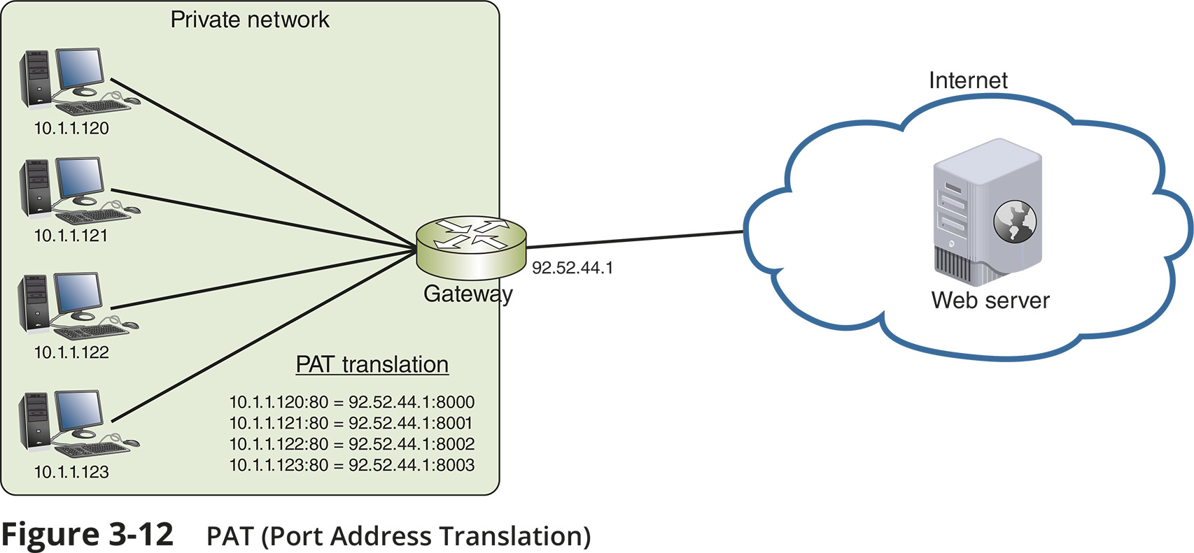
IPv4 Addresses (4 of 4)
Figure 3-12 PAT (Port Address Translation)

Slide 11
IPv6 Addresses (1 of 2)
An IPv6 address has 128 bits written as eight blocks of hexadecimal numbers separated by colons
Ex: 2001:0000:0B80:0000:0000:00D3:9C5A:00CC
Each block is 16 bits
Leading zeros in a four-character hex block can be eliminated
If blocks contain all zeroes, they can be written as double colons (::), only one set of double colons is used in an IP address
Therefore, above example can be written two ways:
2001::B80:0000:0000:D3:9C5A:CC
2001:0000:B80::D3:9C5A:CC (this is the preferred method because it contains the fewest zeroes)

Slide 12
IPv6 Addresses (2 of 2)
IPv6 terminology:
A link (sometimes called local link) is any LAN bounded by routers
Neighbors are two or more nodes on the same link
Dual stacked is when a network is configured to use both IPv4 and IPv6
Tunneling is a method used by IPv6 to transport IPv6 packets through or over an IPv4 network
Interface ID is the last 64 bits or four blocks of an IPv6 address that identify the interface

Slide 13
Types of IPv6 Addresses (1 of 4)
Unicast address - specifies a single node on a network
Global address can be routed on the Internet
Link local address can be used for communicating with nodes in the same link
Loopback address can be used to test that an interface and supporting protocol stack are functioning properly
Multicast address – delivers packets to all nodes on a network
Anycast address - can identify multiple destinations, with packets delivered to the closest destination

Slide 14
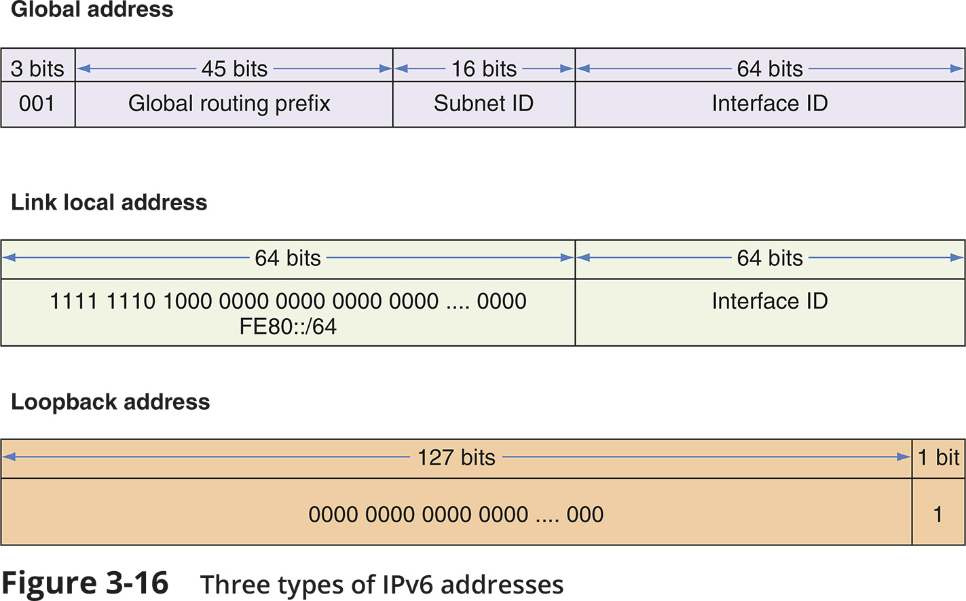
Types of IPv6 Addresses (2 of 4)
Figure 3-16 Three types of IPv6 addresses

Slide 15
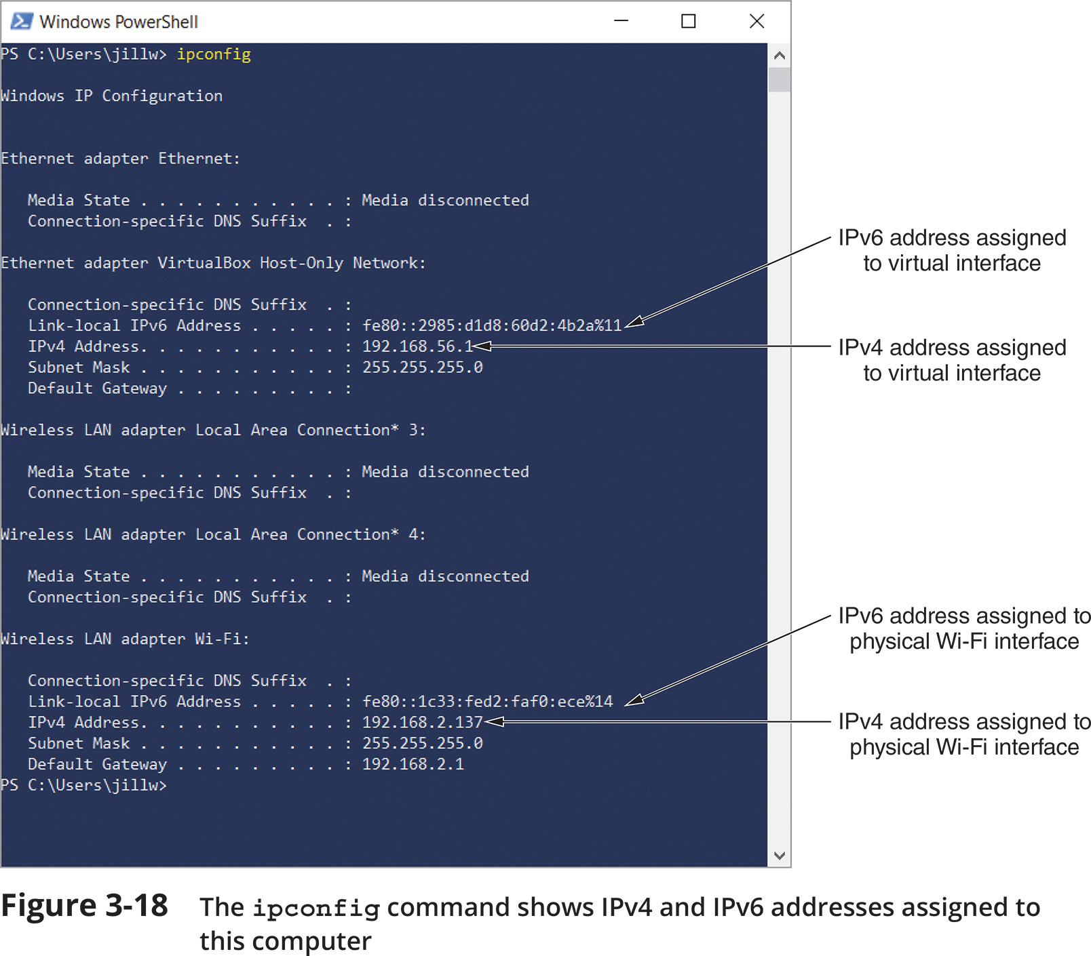
Types of IPv6 Addresses (3 of 4)
Figure 3-18 The ipconfig command shows IPv4 and IPv6 addresses assigned to this computer

Slide 16
Types of IPv6 Addresses (4 of 4)
IPv6 autoconfiguration
IPv6 addressing is designed so that a computer can autoconfigure its own link local IP address
This process is called SLAAC (stateless address autoconfiguration)
Step 1 - The computer creates its IPv6 address
It uses FE80::/64 as the first 64 bits (called prefix)
The last 64 bits are generated from the network adapter’s MAC address
Step 2 - The computer checks to make sure its IP address is unique on the network
Step 3 - The computer asks if a router on the network can provide configuration information
This message is called an RS (router solicitation) message

Slide 17
Knowledge Check Activity 3-1
Which of the following IPv4 addresses is a public IP address?
10.0.2.14
172.16.156.254
192.168.72.73
64.233.177.189
Notes:
Instructions:
Net+: you will choose two of the Self-Check questions from each module and re-use them for Knowledge Check Activities. The activity numbers change based on the module you are in. (e.g., 1-1 and 1-2; 2-1 and 2-2; etc.) The CM will provide you with the final page proofs from the textbook.

Slide 18
Knowledge Check Activity 3-1: Answer
Which of the following IPv4 addresses is a public IP address?
Answer: d. 64.233.177.189
IP addresses within the ranges of 10.0.0.0 through 10.255.255.255, 172.16.0.0 through 172.31.255.255, and 192.168.0.0 through 192.168.255.255 are RFC1918, or private, IP addresses. The address 64.233.177.189 is a public IP address.
Notes:
Include only the question and the correct answer on the slide or include only the correct answer on the slide. The CM will provide you with the Solution and Answer Guide for the correct answers.

Slide 19
Ports and Sockets (1 of 2)
A port is a number assigned to a process that can receive data
Port numbers ensure data is transmitted to the correct process among multiple processes running on a single device
A socket consists of host’s IP address and the port number of an application running on the host
A colon separates the two values
Example - 10.43.3.87:23
Port numbers are divided into three types:
Well-known ports - 0 to 1023
Registered ports - 1024 to 49151
Dynamic and private ports - 49152 to 65535

Slide 20
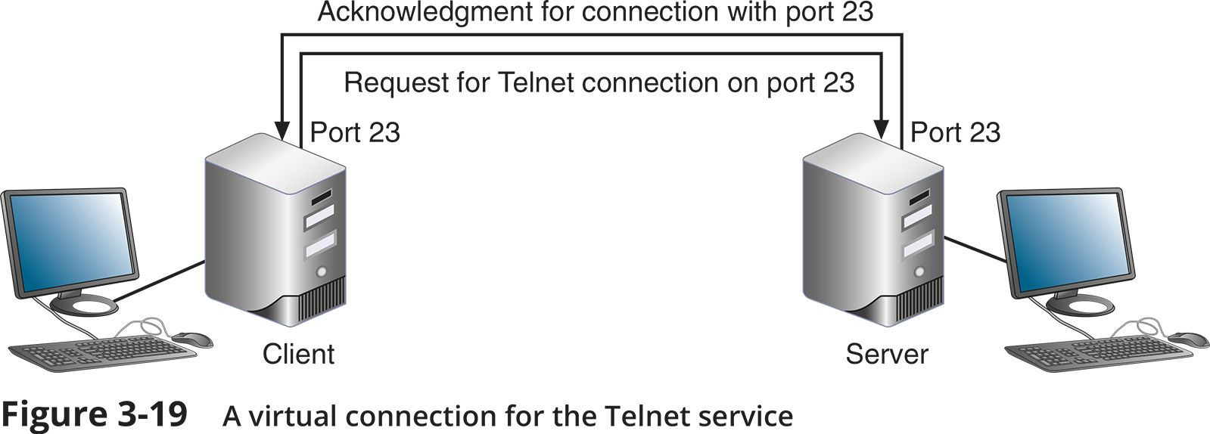
Ports and Sockets (2 of 2)
Figure 3-19 A virtual connection for the Telnet service

Slide 21
Domain Names and DNS (1 of 2)
Character-based names are easier to remember than numeric IP addresses
A URL (uniform resource locator) is an addressing scheme that identifies where to find a particular resource on a network
Last part of an FQDN is called the top-level domain (TLD)
Domain names must be registered with an Internet naming authority that works on behalf of ICANN
ICANN restricts what type of hosts can be associated with .arpa, .mil, .int, .edu, and .gov
Name resolution is the process of discovering the IP address of a host when you know the FQDN

Slide 22
Domain Names and DNS (2 of 2)
DNS is an Application layer client-server system of computers and databases made up of these elements:
Namespace - the entire collection of computer names and their associated IP addresses stored in databases on DNS name servers around the globe
Name servers - hold databases, which are organized in a hierarchical structure
Resolvers - a DNS client that requests information from DNS name servers

Slide 23
Namespace Databases
Each organization that provides host services is responsible for providing and maintaining its own DNS authoritative servers for public access
An authoritative name server is the authority on computer names and their IP addresses for computers in their domains
The domains that the organization is responsible for managing are called a DNS zone

Slide 24
Name Servers (1 of 4)
Four common types of DNS servers:
Primary DNS server – the authoritative name server for the organization
Holds the authoritative DNS database for the organization’s zones
Secondary DNS server – backup authoritative name server for the organization
Caching DNS server – accesses the public DNS data and caches the DNS information it collects
Forwarding DNS server – receives queries from local clients but doesn’t work to resolve the queries
Any of these DNS server types can co-exist on the same machine
DNS name servers are organized in a hierarchical structure
At the root level, 13 clusters of root DNS servers hold information used to locate top-level domain (TLD) servers

Slide 25
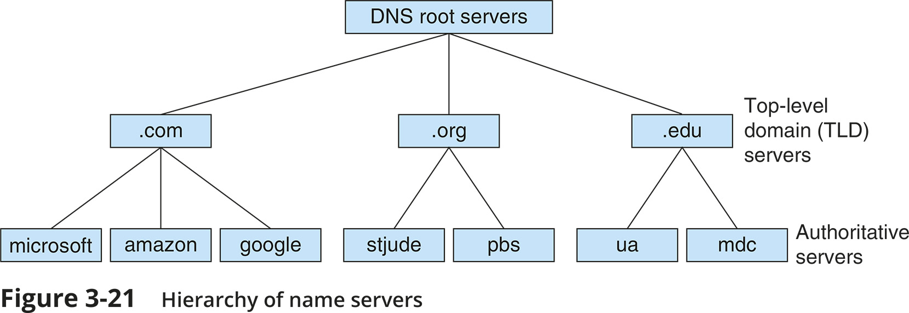
Name Servers (2 of 4)
Figure 3-21 Hierarchy of name servers

Slide 26
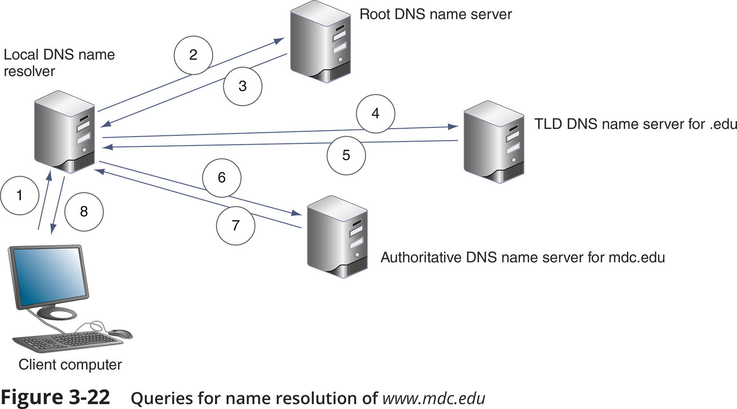
Name Servers (3 of 4)
Figure 3-22 Queries for name resolution of www.mdc.edu

Slide 27
Name Servers (4 of 4)
Ways the resolution process can get more complex:
A caching server typically is not the same machine as the authoritative server
The caching server exists only to resolve names for its own local clients
Name servers within a company might not have access to root servers
A TLD name server might be aware of an intermediate name server rather than the authoritative name server
Two types of DNS requests:
Recursive lookup – a query that demands a resolution or the answer “It can’t be found”
Iterative lookup – a query where the local server issues queries to other servers
Other servers only provide information if they have it
Do not demand a resolution

Slide 28
Resource Records in a DNS Database
Several types of records, called resource records are kept in a DNS database:
SOA (start of authority) record – gives information about the zone
A (address) record – stores the name-to-address mapping for a host
AAAA (address) record – holds the name-to-address mapping, the IP address is an IPv6 type IP address
CNAME (canonical Name) record – holds alternative names for a host
PTR (pointer) record – used for reverse lookups
NS (name Server) record – indicates the authoritative name server for a domain
MX (mail exchanger) record – identifies a mail server and is used for email traffic
SRV (service) record – identifies the hostname and port of a computer that hosts a specific network services besides email
TXT (text) record – holds any type of free-form text

Slide 29
DNS Server Software
BIND (Berkeley Internet Name Domain) is the most popular DNS server software
Open source - the term for software whose code is publicly available for use and modification
Microsoft DNS Server is a built-in DNS service in the Windows Server OS
Windows Server is capable of split-brain or split-horizon deployment, which is used to handle internal clients and external clients

Slide 30
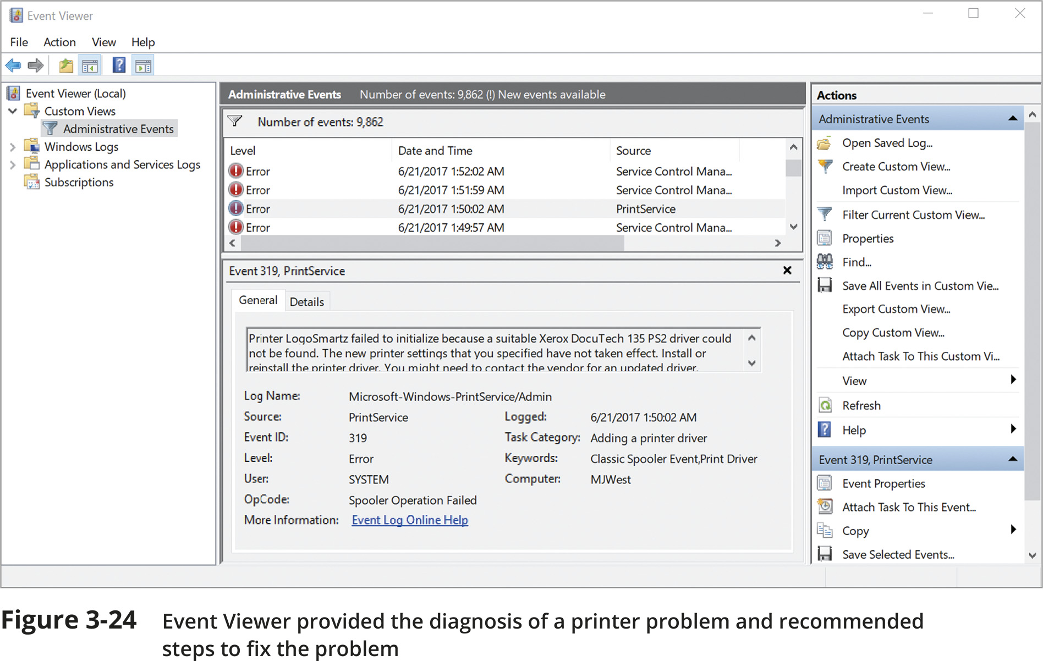
Troubleshooting Address Problems
Figure 3-24 Event Viewer provided the diagnosis of a printer problem and recommended steps to fix the problem

Slide 31
Troubleshooting Tools (1 of 8)
Command-line tools are a great resource to troubleshoot network problems
ping (Packet Internet Groper) utility is used to verify that TCP/IP is:
Installed
Bound to the NIC
Configured correctly
Communicating with the network
The ping utility sends out a signal called an echo request to another device (request for a response)
The other computer responds in the form of an echo reply
ICMP (Internet Control Message Protocol) is the protocol used by the echo request/reply to carry error messages and information about the network

Slide 32
Troubleshooting Tools (2 of 8)
IPv6 networks use a version of ICMP called ICMPv6
ping6 – on Linux computers running IPv6, use ping6 to verify whether an IPv6 host is available
ping -6 – on Windows computers, use ping with the -6 switch to verify connectivity on IPv6 networks
For the ping6 and ping -6 commands to work over the Internet, you must have access to the IPv6 Internet

Slide 33
Troubleshooting Tools (3 of 8)
The ipconfig command shows current TCP/IP addressing and domain name information on a Windows computer
Use ipconfig/all to see a more complete summary of TCP/IP addressing information

Slide 34
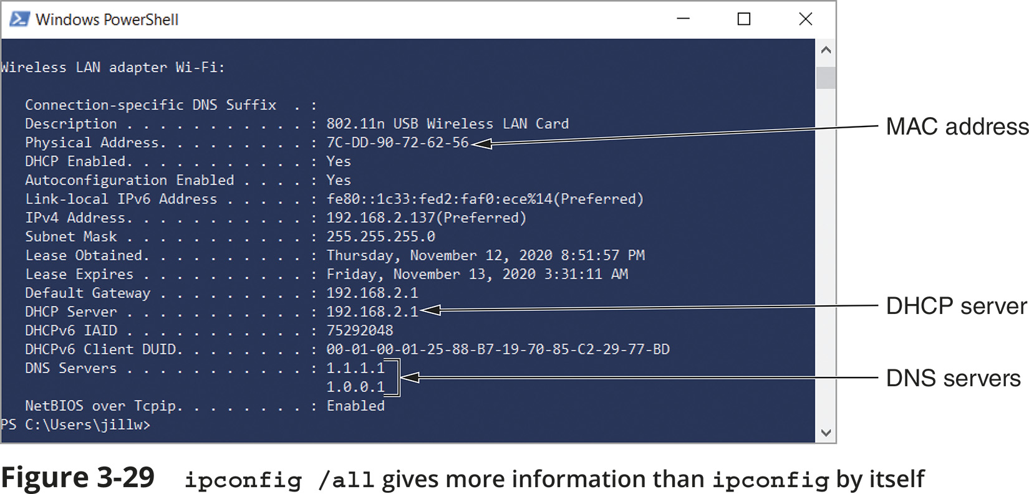
Troubleshooting Tools (4 of 8)
Figure 3-29 ipconfig /all gives more information than ipconfig by itself

Slide 35
Troubleshooting Tools (5 of 8)
Use the ip utility to view and manage TCP/IP settings
The ip utility is only available on UNIX and Linux systems
Any ip commands that change the state of a link require elevated privileges
This is accomplished by logging in as the root user or by temporarily elevating the current user's privileges with the sudo (superuser do) command
ifconfig is a similar utility used to view and manage TCP/IP settings
If your Linux or UNIX system provides a GUI
Open a shell prompt, then type ifconfig

Slide 36
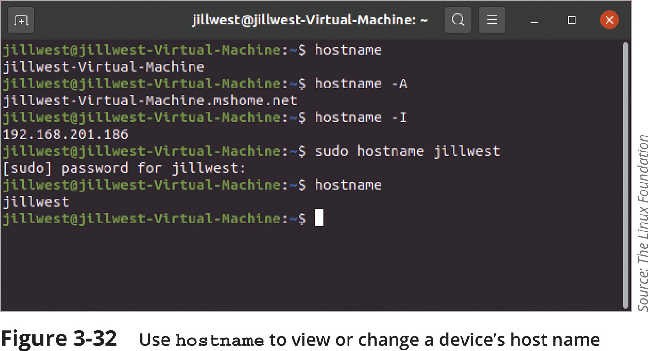
Troubleshooting Tools (6 of 8)
Figure 3-32 Use hostname to view or change a device’s host name

Slide 37
Troubleshooting Tools (7 of 8)
The nslookup (name space lookup) utility allows you to query the DNS database from any computer on a network
To find the host name of a device by specifying its IP address, or vice versa
It is useful for verifying a host is configured correctly or for troubleshooting DNS resolution problems
Reverse DNS lookup - to find the host name of a device whose IP address you know
nslookup 69.23.208.74
The nslookup utility is available in two modes:
Interactive - to test multiple DNS servers at one time
Noninteractive - test a single DNS server
You can change DNS servers from within interactive mode with the server subcommand and specifying the IP address of the new DNS server
To exit nslookup’s interactive mode, enter exit

Slide 38
Troubleshooting Tools (8 of 8)
The dig (domain information groper) utility is available on Linux and macOS
Provides more detailed information than nslookup and uses more reliable sources of information to output its results
Use dig to query DNS nameservers for information about host addresses and other DNS records
An IP scanner can be used to gather information about all devices connected to a network

Slide 39
Common Network Issues (1 of 2)
Incorrect time
Check a domain computer’s time source from a Command Prompt window by entering w32tm /query /source
DHCP Issues
If you are getting DHCP errors or if multiple clients are having trouble connecting to the network, try the following:
Check the settings on your DHCP server
Make sure the DHCP scope is large enough to account for the number of clients the network must support
Consider implementing a shorter lease time on larger networks

Slide 40
Common Network Issues (2 of 2)
Network Connection Configuration Issues
Common configuration errors:
Incorrect IP address
Duplicate IP address
Incorrect subnet mask
Incorrect gateway
Incorrect DNS or DNS issues
When a computer is struggling to establish a network connection
Check its TCP/IP configuration settings
If the computer is not obtaining an IP address and related information from a DHCP server
Static settings might be using the wrong information
Try switching to DHCP

Slide 41
Knowledge Check Activity 3-2
What protocol does ping use?
HTTP
ICMP
DHCP
FTP
Notes:
Instructions:
Net+: you will choose two of the Self-Check questions from each module and re-use them for Knowledge Check Activities. The activity numbers change based on the module you are in. (e.g., 1-1 and 1-2; 2-1 and 2-2; etc.) The CM will provide you with the final page proofs from the textbook.

Slide 42
Knowledge Check Activity 3-2: Answer
What protocol does ping use?
Answer: b. ICMP
The protocol used by the ping echo request and echo reply is ICMP (Internet Control Message Protocol), a lightweight protocol used to carry error messages and information about a network.
Notes:
Include only the question and the correct answer on the slide or include only the correct answer on the slide. The CM will provide you with the Solution and Answer Guide for the correct answers.

Slide 43
Summary
Now that the lesson has ended, you should be able to:
Work with MAC addresses
Configure TCP/IP settings on a computer, including IP address, subnet mask, default gateway, and DNS servers
Identify the ports of several common network protocols
Describe domain names and the name resolution process
Use command-line tools to troubleshoot common network problems

