Slide 1
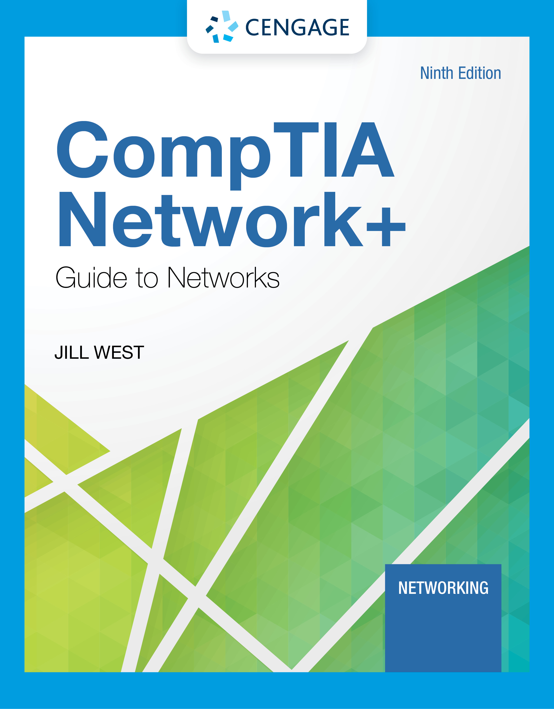
Module 4: Protocols
CompTIA Network+ Guide to Networks, Ninth Edition

Slide 2
Module Objectives
By the end of this module, you should be able to:
1. Describe the functions of core TCP/IP protocols
2. Identify how each protocol’s information is formatted in a TCP/IP message
3. Secure network connections using encryption protocols
4. Configure remote access connections between devices
5. Employ various TCP/IP utilities for network discovery and troubleshooting

Slide 3
TCP/IP Core Protocols (1 of 3)
TCP/IP is a suite of protocols including:
TCP, IP (IPv4 and IPv6), UDP, ARP, and many others
TCP/IP protocols add a header to data inherited from the layer above it
Layers 7, 6, and 5 - Data and instructions, known as payload, are generated by applications running on source host
Layer 4 – A Transport Layer protocol, usually TCP or UDP, adds a header to the payload
Includes a port number to identify the receiving app
Layer 3 - Network layer adds it own header and becomes a packet
Layer 2 - packet is passed to Data Link layer on NIC, which encapsulates data with its own header and trailer, creating a frame
Layer 1 - Physical layer on the NIC receives the frame and places the transmission on the network

Slide 4
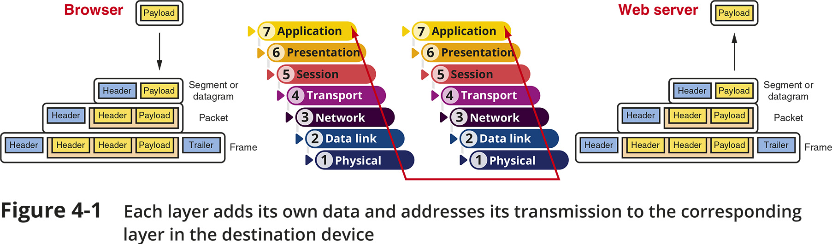
TCP/IP Core Protocols (2 of 3)
Figure 4-1 Each layer adds its own data and addresses its transmission to the corresponding layer in the destination device

Slide 5
TCP/IP Core Protocols (3 of 3)
The receiving host decapsulates the message at each layer in reverse order and presents payload to the receiving applications
In transit, transmissions might pass through a number of connectivity devices
Connectivity devices are specialized devices that allow two or more networks or multiple parts of one network to connect and exchange data
Known by the highest OSI layer they read and process

Slide 6
TCP (Transmission Control Protocol) (1 of 4)
TCP operates in the transport layer of OSI model
Three characteristics of TCP:
Connection-oriented - TCP ensures that a connection or session is established by using a three-step process called a three-way handshake
Sequencing and checksums - TCP sends a character string called a checksum that is checked by the destination host along with a sequence number for each segment
Flow control - gauges rate of transmission based on how quickly recipient can accept data

Slide 7
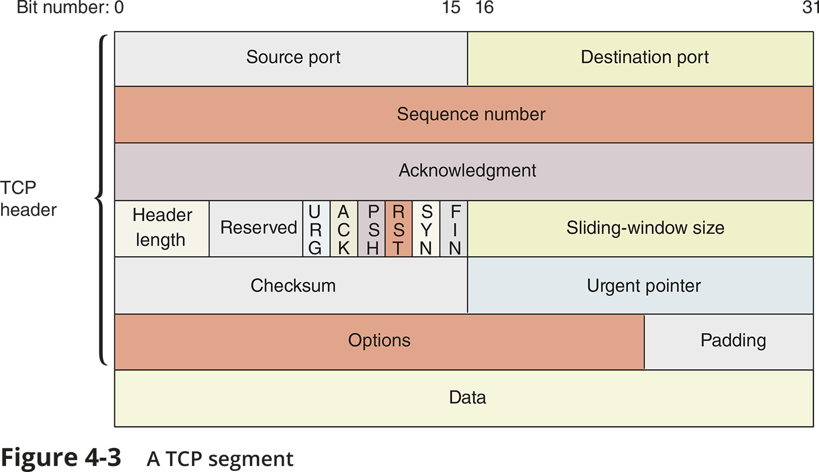
TCP (Transmission Control Protocol) (2 of 4)
Figure 4-3 A TCP segment

Slide 8
TCP (Transmission Control Protocol) (3 of 4)
The TCP three-way handshake establishes a session before TCP transmits actual data
Three transmissions are sent before data transmission:
Step 1 – a request for a connection (SYN)
Step 2 – a response to the request (SYN/ACK)
Step 3 – a connection is established (ACK)
After the three initial messages, the payload or data is sent
Sequence numbers will be increased by the number of bits included in each received segment
Confirms the correct length of message was received

Slide 9
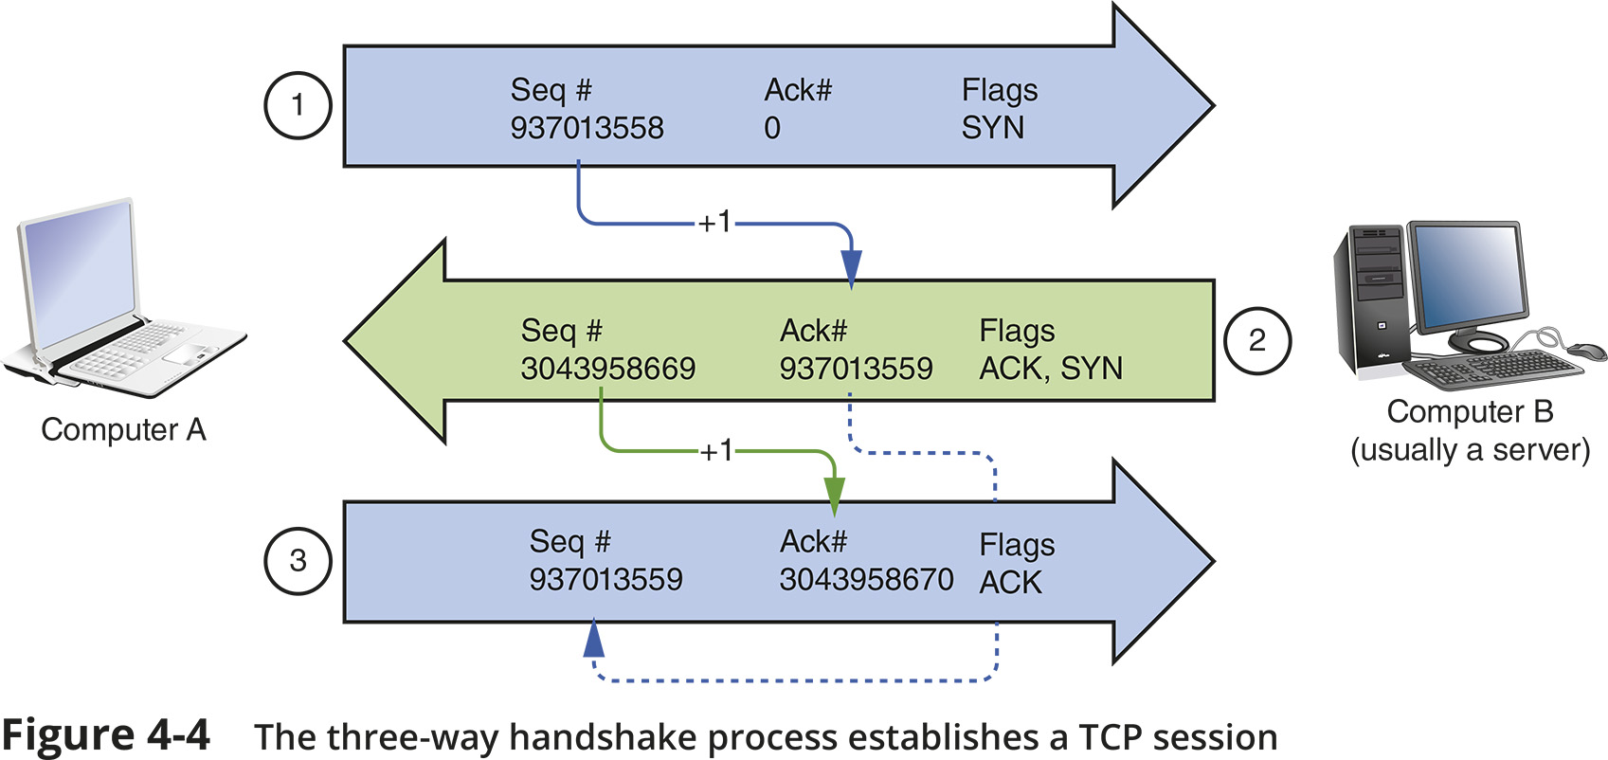
TCP (Transmission Control Protocol) (4 of 4)
Figure 4-4 The three-way handshake process establishes a TCP session

Slide 10
UDP (User Datagram Protocol)
UDP is an unreliable, connectionless protocol
No three-way handshake is performed
UDP does not guarantee delivery of data
UDP provides no error checking, sequencing, or flow control
This makes UDP more efficient than TCP
Useful for live audio or video transmissions over the Internet
Also more efficient for carrying messages that fit within one data packet
A UDP header contains only four fields: Source port, Destination port, Length, and Checksum
Use of Checksum field in UDP is optional in IPv4, but required in IPv6

Slide 11
IP (Internet Protocol) (1 of 3)
IP operates at the network layer of the OSI model
It specifies where data should be delivered
Identifies the data’s source and destination IP addresses
IP enables TCP/IP to internetwork
To traverse more than one LAN segment and more than one type of network through a router
IP is an unreliable, connectionless protocol
That means that IP does not guarantee delivery of data and no session is established before data is transmitted
IP depends on TCP to ensure messages are put back together in the right order and to ensure each message reaches the correct application on the receiving host

Slide 12
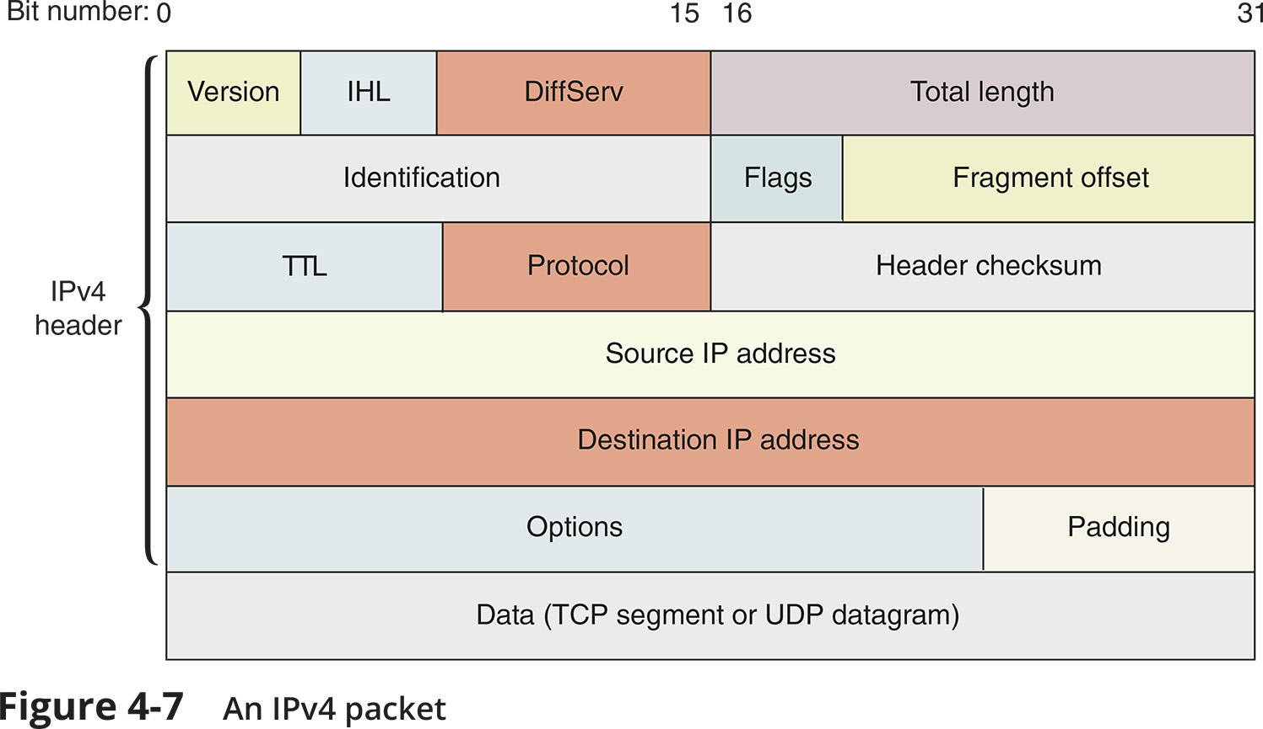
IP (Internet Protocol) (2 of 3)
Figure 4-7 An IPv4 packet

Slide 13
IP (Internet Protocol) (3 of 3)
IPv6 Packets
IPv6 uses a different packet format than IPv4
IPv6 can accommodate the much longer IPv6 addresses
There is no Fragment offset field
IPv6 hosts adjust their packet sizes to fit the requirements of the network before sending IPv6 messages

Slide 14
ICMP (Internet Control Message Protocol)
ICMP is a core network layer protocol that reports on the success or failure of data delivery
ICMP can indicate the following:
When part of a network is congested
When data fails to reach its destination
When data has been discarded because the allotted TTL has expired
ICMP announces transmission failures to the sender but does not correct errors it detects
It provides critical information for troubleshooting network problems
ICMPv6 on IPv6 networks performs the functions of ICMP and ARP on IPv4 networks

Slide 15
ARP (Address Resolution Protocol) on IPv4 Networks (1 of 2)
ARP works in conjunction with IPv4 to discover the MAC address of a host or node on the local network
And to maintain a database that maps IP addresses to MAC addresses on the local network
ARP is a Layer 2 protocol that uses IP in Layer 3 and relies on broadcasting
Operates only within its local network
ARP table is the database of IP-to-MAC address mappings
An ARP table can contain two types of entries:
Dynamic - created when a client makes an ARP request that could not be satisfied by data already in the ARP table
Static - those someone entered manually using the ARP utility (arp command)
To view a Window’s workstation’s ARP table, enter the command:
arp -a

Slide 16
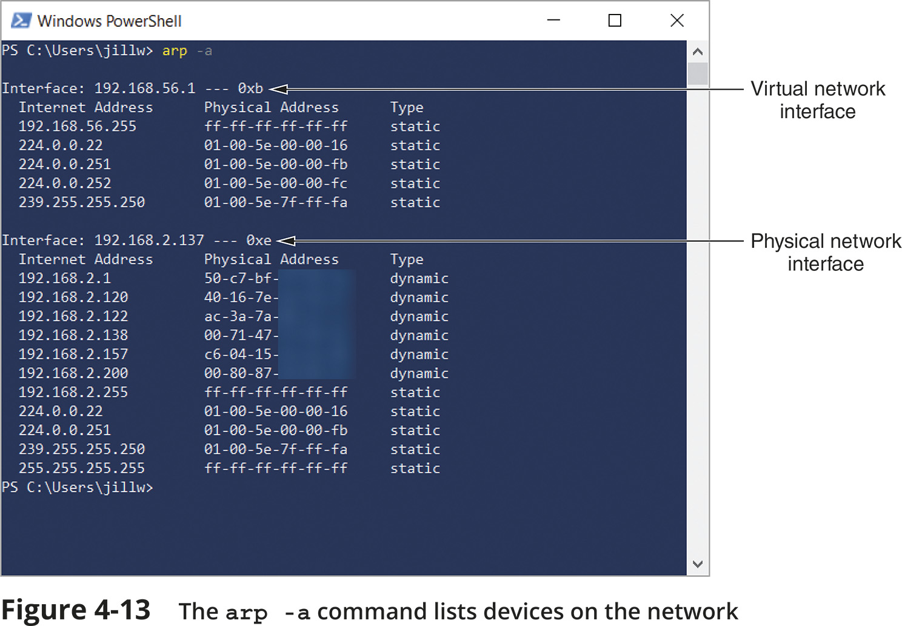
ARP (Address Resolution Protocol) on IPv4 Networks (2 of 2)
Figure 4-13 The arp –a command lists devices on the network

Slide 17
NDP (Neighbor Discovery Protocol)
IPv6 devices learn about other devices on their networks through a process called neighbor discovery
NDP (Neighbor Discovery Protocol) information carried in ICMPv6 messages automatically detects neighboring devices and automatically adjusts when nodes fail or are removed
NDP offers several ICMPv6 message types:
RA (router advertisement)
RS (router solicitation)
Redirect
NS (neighbor solicitation)
NA (neighbor advertisement)

Slide 18
Ethernet (1 of 2)
Ethernet is the most important data link layer standard
It is capable of running on a variety of network media
Ethernet offers excellent throughput at a reasonable cost
It is the most popular network technology used on modern LANs
Ethernet II is the current standard
Ethernet adds both a header and a trailer to the payload
This creates a frame around the payload
The header and FCS make up the 18-byte “frame” around the data
The data portion of an Ethernet frame may contain from 46 to 1500 bytes
MTU (maximum transmission unit) is the largest size that routers in a message’s path will allow at the Network Layer

Slide 19
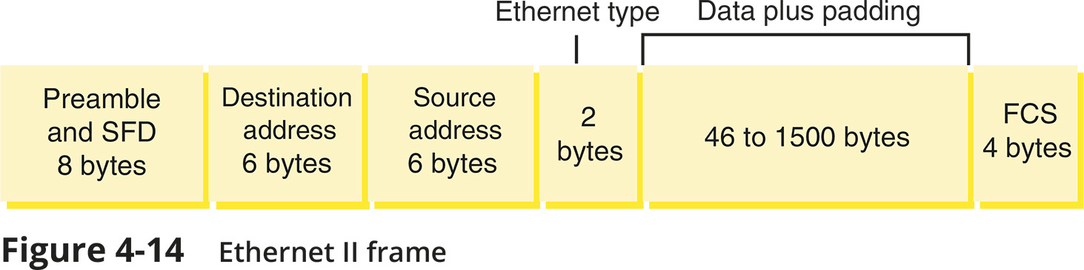
Ethernet (2 of 2)
Figure 4-14 Ethernet II frame

Slide 20
Knowledge Check Activity 4-1
Which protocol’s header includes the source MAC address?
Ethernet
UDP
IP
TCP
Notes:
Instructions:
Net+: you will choose two of the Self-Check questions from each module and re-use them for Knowledge Check Activities. The activity numbers change based on the module you are in. (e.g., 1-1 and 1-2; 2-1 and 2-2; etc.) The CM will provide you with the final page proofs from the textbook.

Slide 21
Knowledge Check Activity 4-1: Answer
Which protocol’s header includes the source MAC address?
Answer: a. Ethernet
Ethernet encapsulates data with a header and trailer, creating a frame. This frame includes the MAC address of the sender.
Notes:
Include only the question and the correct answer on the slide or include only the correct answer on the slide. The CM will provide you with the Solution and Answer Guide for the correct answers.

Slide 22
Encryption Protocols
Encryption protocols use a mathematical code, called a cipher, to scramble data into a format that can be read only by reversing the cipher
The purpose of encryption is to keep information private
Encryption methods are primarily evaluated by three benchmarks:
Confidentiality
Integrity
Availability
The principles above form the standard security model called the CIA triad

Slide 23
Key Encryption (1 of 2)
A key is a random string of characters woven into original data’s bits
It generates unique data block called ciphertext
The key is created according to a specific set of rules (algorithms)
Key encryption can be separated into two categories:
Private key encryption
Public key encryption

Slide 24
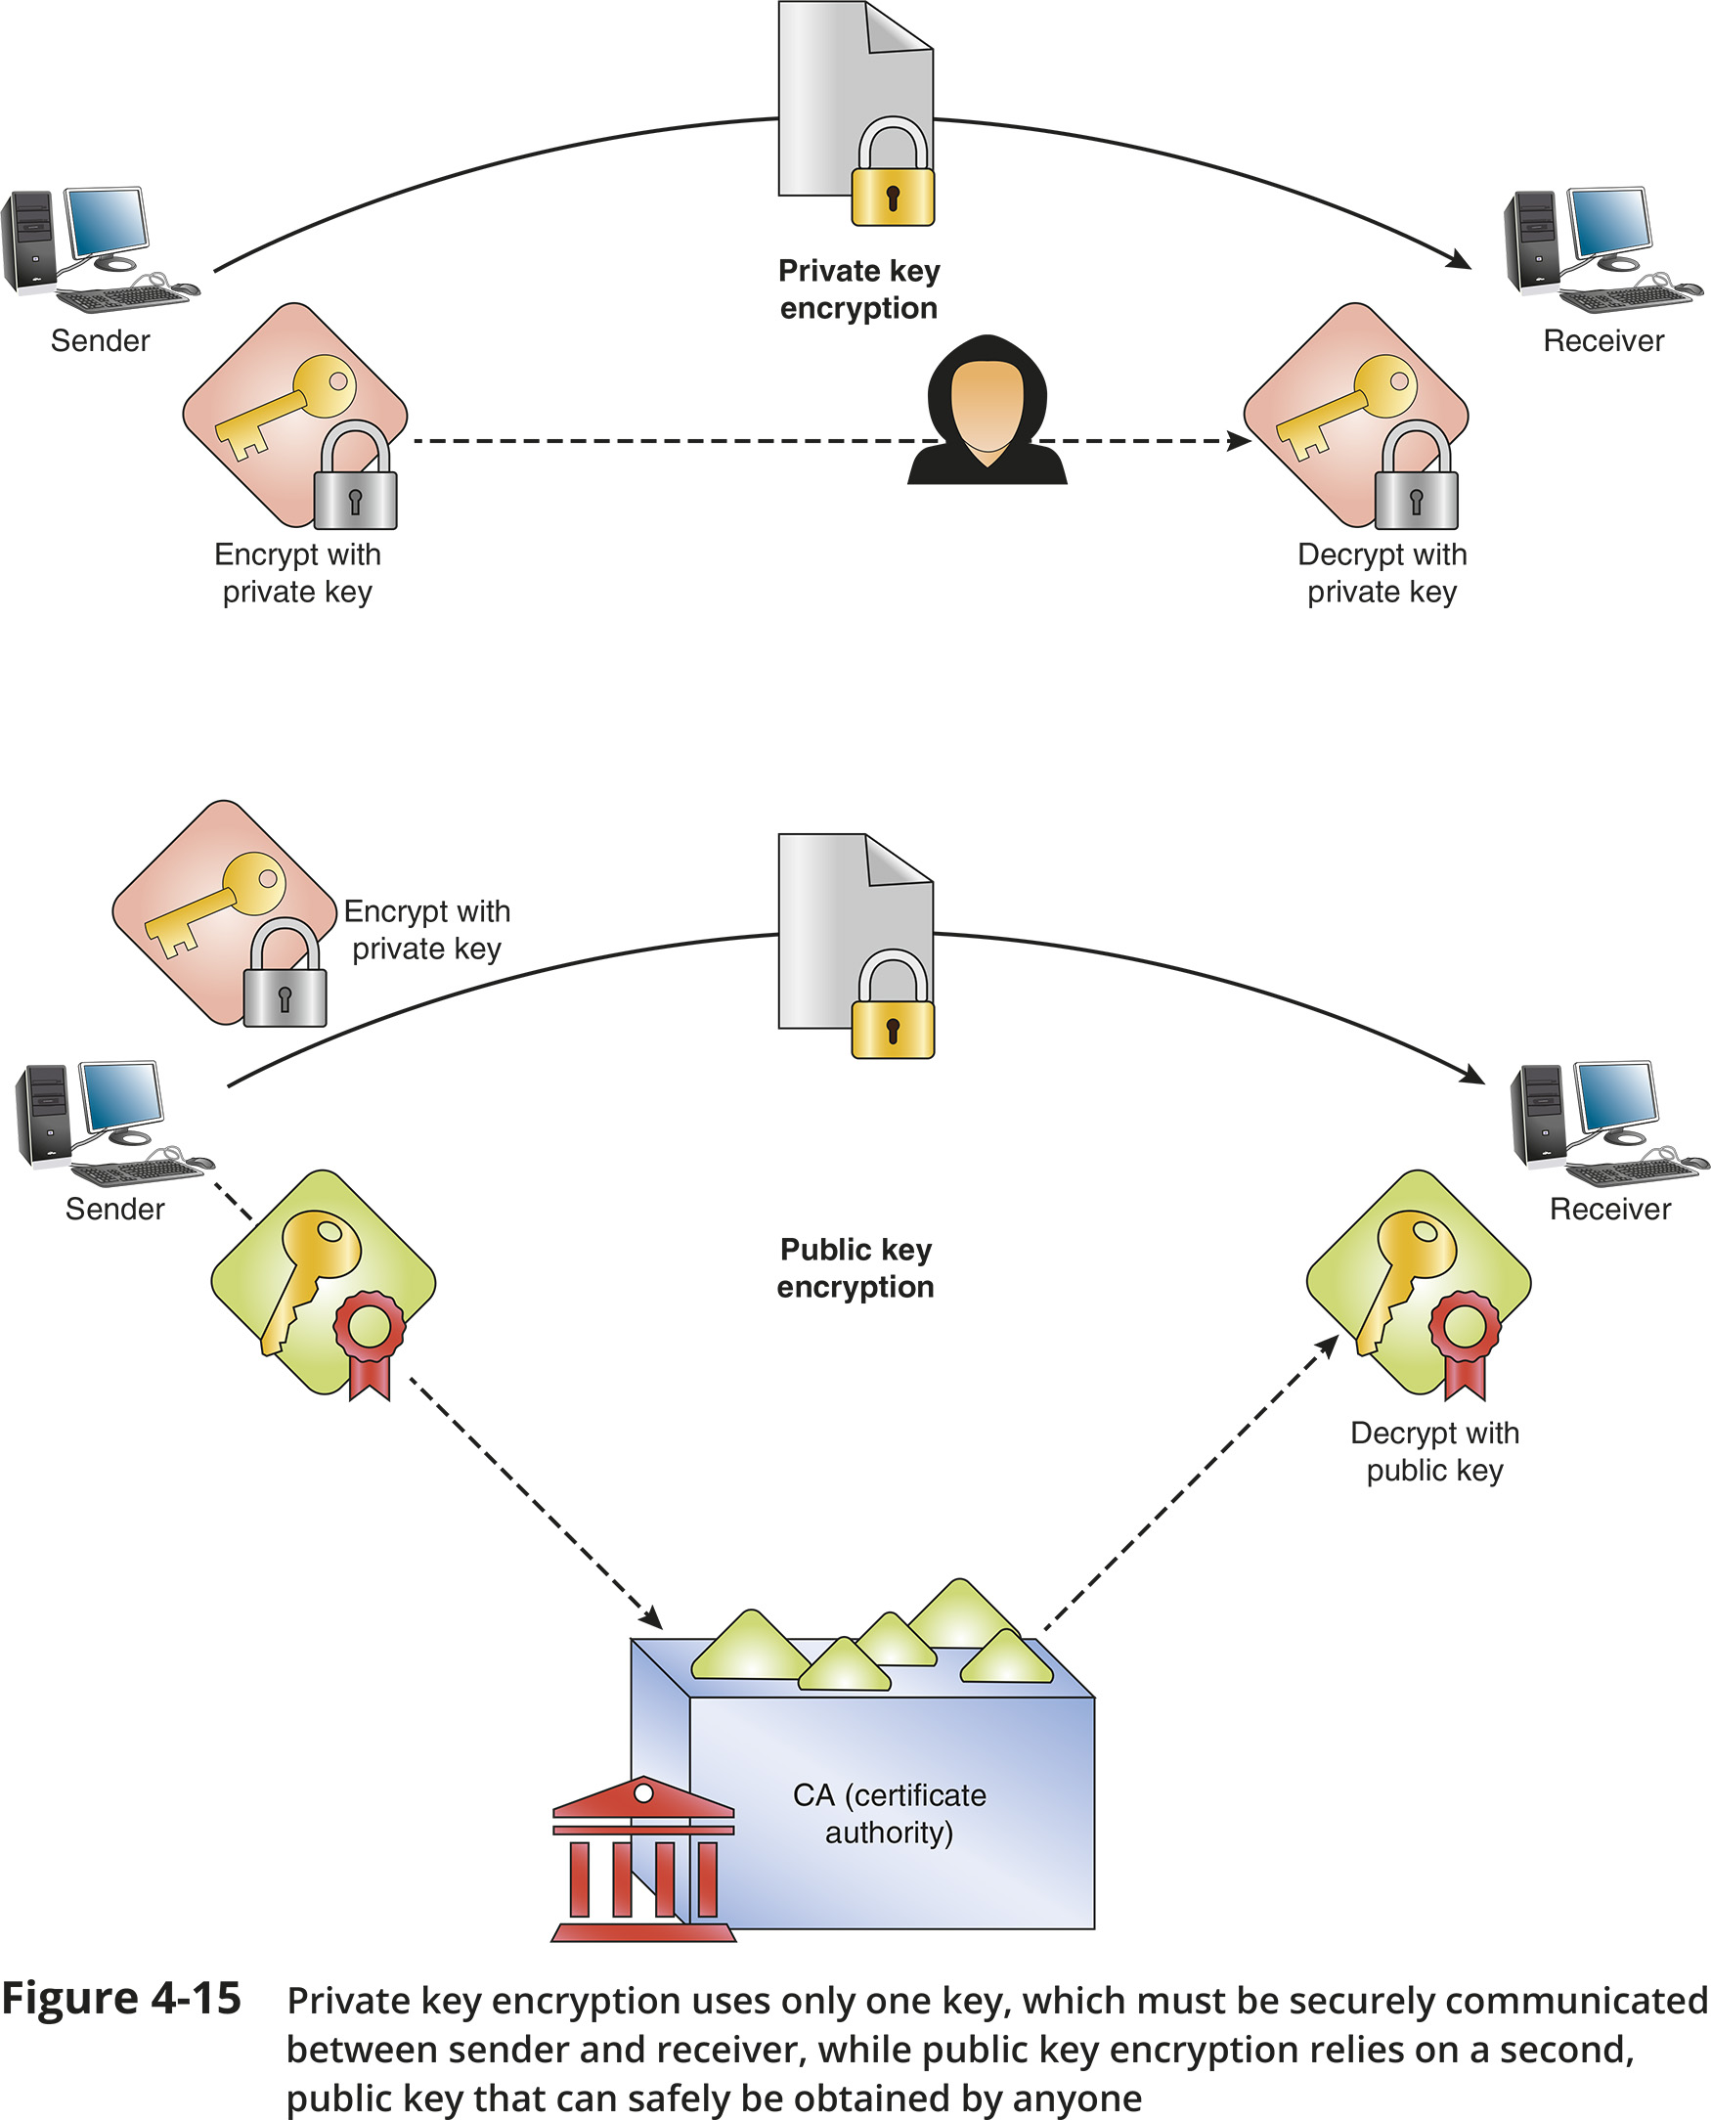
Key Encryption (2 of 2)
Figure 4-15 Private key encryption uses only one key, which must be securely communicated between sender and receiver, while public key encryption relies on a second, public key that can safely be obtained by anyone

Slide 25
IPsec (Internet Protocol Security)
IPsec is an encryption protocol suite that defines rules for encryption, authentication, and key management for TCP/IP transmissions
IPsec creates secure connections in five steps:
1. IPsec initiation
2. Key management
3. Security negotiations
4. Data transfer
5. Termination
Operates in two modes:
Transport mode
Tunnel mode

Slide 26
SSL (Secure Sockets Layer) and TLS (Transport Layer Security)
Both SSL and TLS are methods of encrypting TCP/IP transmissions
Both protocols work side by side and are widely known as SSL/TLS or TLS/SSL
When a client and server establish a SSL/TLS connection, they establish a unique session which is an association between client and server
The session is defined by an agreement on a specific set of encryption techniques
A session is created by an SSL handshake protocol
The handshake protocol allows client and server to authenticate
This handshake is similar to a TCP three-way handshake

Slide 27
Remote Access Protocols
Remote access is a service that allows a client to connect with and log on to a server, LAN, or WAN in a different geographical location
Remote access requires a type of RAS (remote access server)
There are two types of remote access servers:
Dedicated devices
Software running on a server
Types of remote access include:
Remote file access
Terminal emulation, also called remote virtual computing
VPN (virtual private network)

Slide 28
Remote File Access
FTP (File Transfer Protocol) provides remote file access
Three related technologies include the following:
FTPS (FTP Secure or FTP over SSL) offers an added layer of protection for FTP using SSL/TLS
SFTP (Secure FTP) is a file-transfer version SSH that include encryption and authentication for transferring files
TFTP (Trivial FTP) is a simple protocol similar to FTP except that it includes no authentication or security for transferring files

Slide 29
Terminal Emulation (1 of 4)
A terminal emulator is software that allows a user on one computer (client) to control another computer (host or server)
Examples of command-line software:
Telnet and SSH
Examples of GUI-based software:
Remote Desktop for Windows
join.me
VNC
Team Viewer

Slide 30
Terminal Emulation (2 of 4)
Telnet is a terminal emulation utility that allows an administrator or other user to control a computer remotely
It provides little security for establishing a connection (poor authentication)
It provides no security for transmitting data (no encryption)
SSH (Secure Shell) is a collection of protocols that provides for secure authentication and encryption
Guards against a number of security threats
Unauthorized access to a host
IP spoofing
Interception of data in transit
DNS spoofing
Secure connection requires SSH running on both client and server
Allows for password authentication using public and private key generation

Slide 31
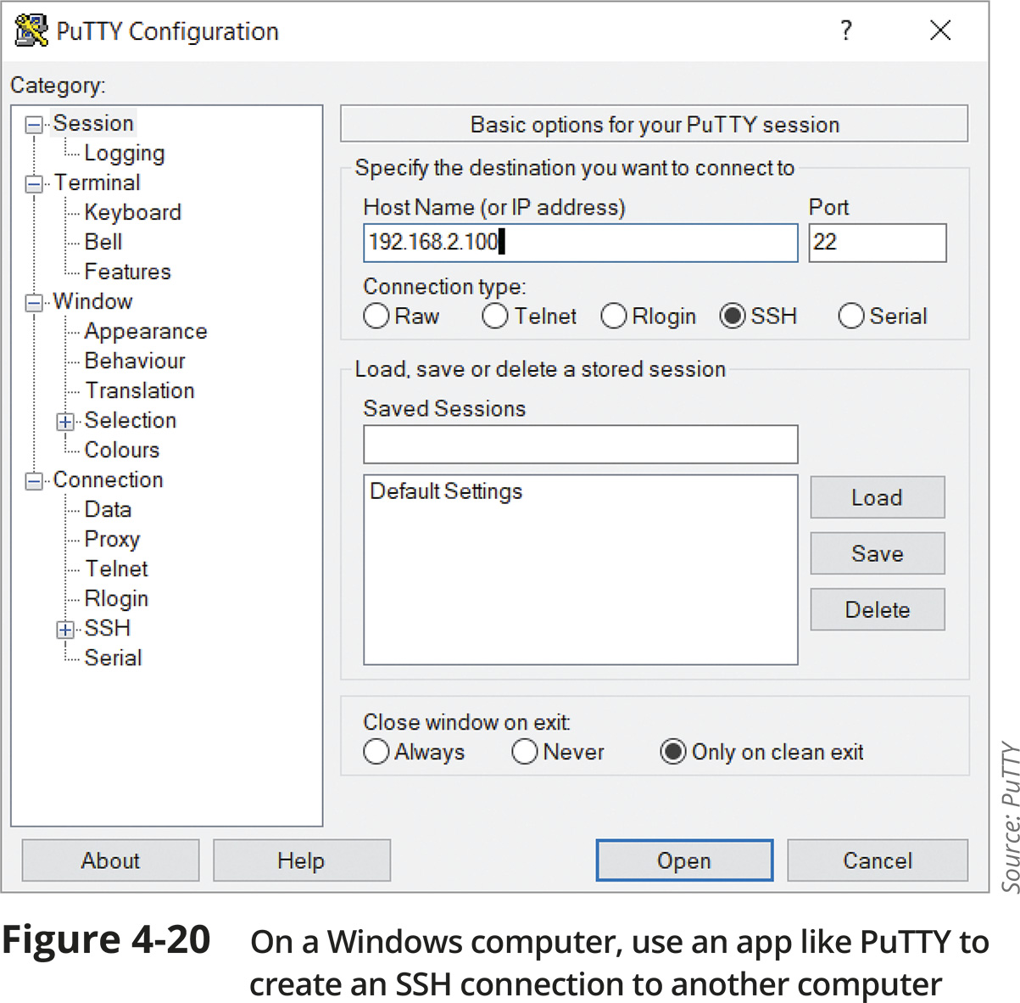
Terminal Emulation (3 of 4)
Figure 4-20 On a Windows computer, use an app like PuTTY to create an SSH connection to another computer

Slide 32
Terminal Emulation (4 of 4)
RDP (Remote Desktop Protocol) is a Microsoft proprietary protocol used to connect to and control a remote computer
VNC (Virtual Network Computing) uses the cross-platform protocol RFB (remote frame buffer) to remotely control a workstation or server
VNC is open source so many companies have developed their own software that can:
Run OSes on client computers
Remotely access computers, tablets, and smartphones
Remotely control media equipment and surveillance systems
Out-of-band management relies on a dedicated connection between the network administrator’s computer and each network device
A remote management card is attached to the network device’s console port
A single device, such as a console server or console router, provides centralized management of all linked devices

Slide 33
VPNs (Virtual Private Networks) (1 of 4)
A VPN is a network connection encrypted from end to end that creates a private connection to a remote network
A VPN is sometimes referred to as a tunnel
VPNs can be classified according to three models:
Site-to-site VPN
Client-to-site VPN
Also called host-to-site VPN or remote-access VPN
Host-to-host VPN

Slide 34
VPNs (Virtual Private Networks) (2 of 4)
To ensure VPNs can carry all types of data securely, special VPN protocols encapsulate higher-layer protocols in a process known as tunneling
Many VPN tunneling protocols operate at the data link layer to encapsulate the VPN frame into a network layer packet
Some VPN tunneling protocols work at Layer 3, which enables additional features and options
Most tunneling protocols rely on an additional encryption protocol to provide data security
Common VPN tunneling protocols include:
L2TP (Layer 2 Tunneling Protocol)
GRE (Generic Routing Encapsulation)
Open VPN
IKEv2

Slide 35
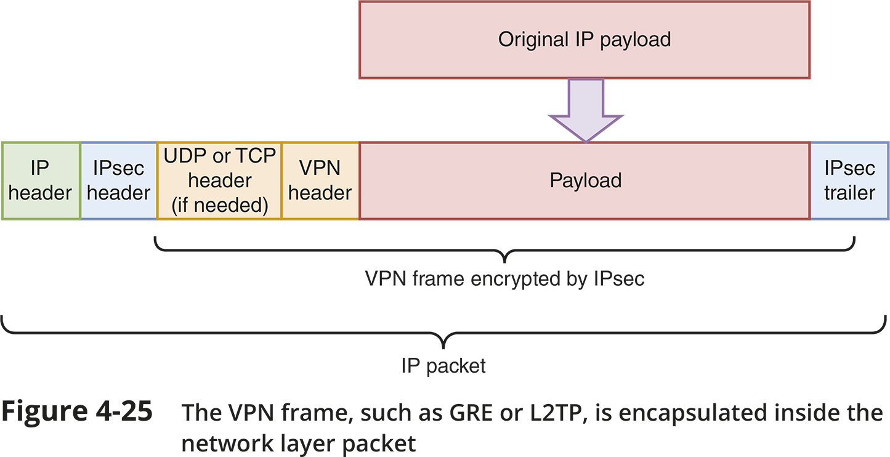
VPNs (Virtual Private Networks) (3 of 4)
Figure 4-25 The VPN frame, such as GRE or L2TP, is encapsulated inside the network layer packet

Slide 36
VPNs (Virtual Private Networks) (4 of 4)
Cisco developed a proprietary protocol called mGRE (multipoint GRE) that allows the configuration of multiple tunnel destinations on a single interface
A type of enterprise VPN using Cisco devices is called DMVPN (Dynamic Multipoint VPN)
DMVPN dynamically creates VPN tunnels between branch locations as needed rather than requiring constant, static tunnels for site-to-site connections

Slide 37
Remote Access Policies
Common requirements of a good remote access policy:
Remote access devices must be up to date with patches, anti-malware software, and a firewall
Device access must be controlled by a strong password or biometric measures
Passwords must be strong and must be changed periodically
The device’s internal and external storage devices must be encrypted
Company and customer data must be kept secure
The loss or theft of any devices used for remote access must be reported immediately
Encrypted VPN software must be used to remotely access company network resources
While remotely connected to the company network, the device must not be connected to the open Internet or any other network not fully owned or controlled by the employee
Remote sessions must be terminated when not in use

Slide 38
Troubleshooting Network Issues (1 of 3)
netstat displays TCP/IP statistics and details about TCP/IP components/connections on a host
Information that can be obtained from the netstat command includes:
The port on which a TCP/IP service is running
Which network connections are currently established for a client
How many messages have been handled by an interface since it was activated
How many data errors have occurred on a particular network interface
tracert or traceroute
Windows tracert utility uses ICMP echo requests to trace the path from one networked node to another, identifying all intermediate hops between the nodes
Linux, UNIX, and OS X system use the traceroute utility to send UDP messages to a random port on the destination node (concept is the same as tracert)

Slide 39
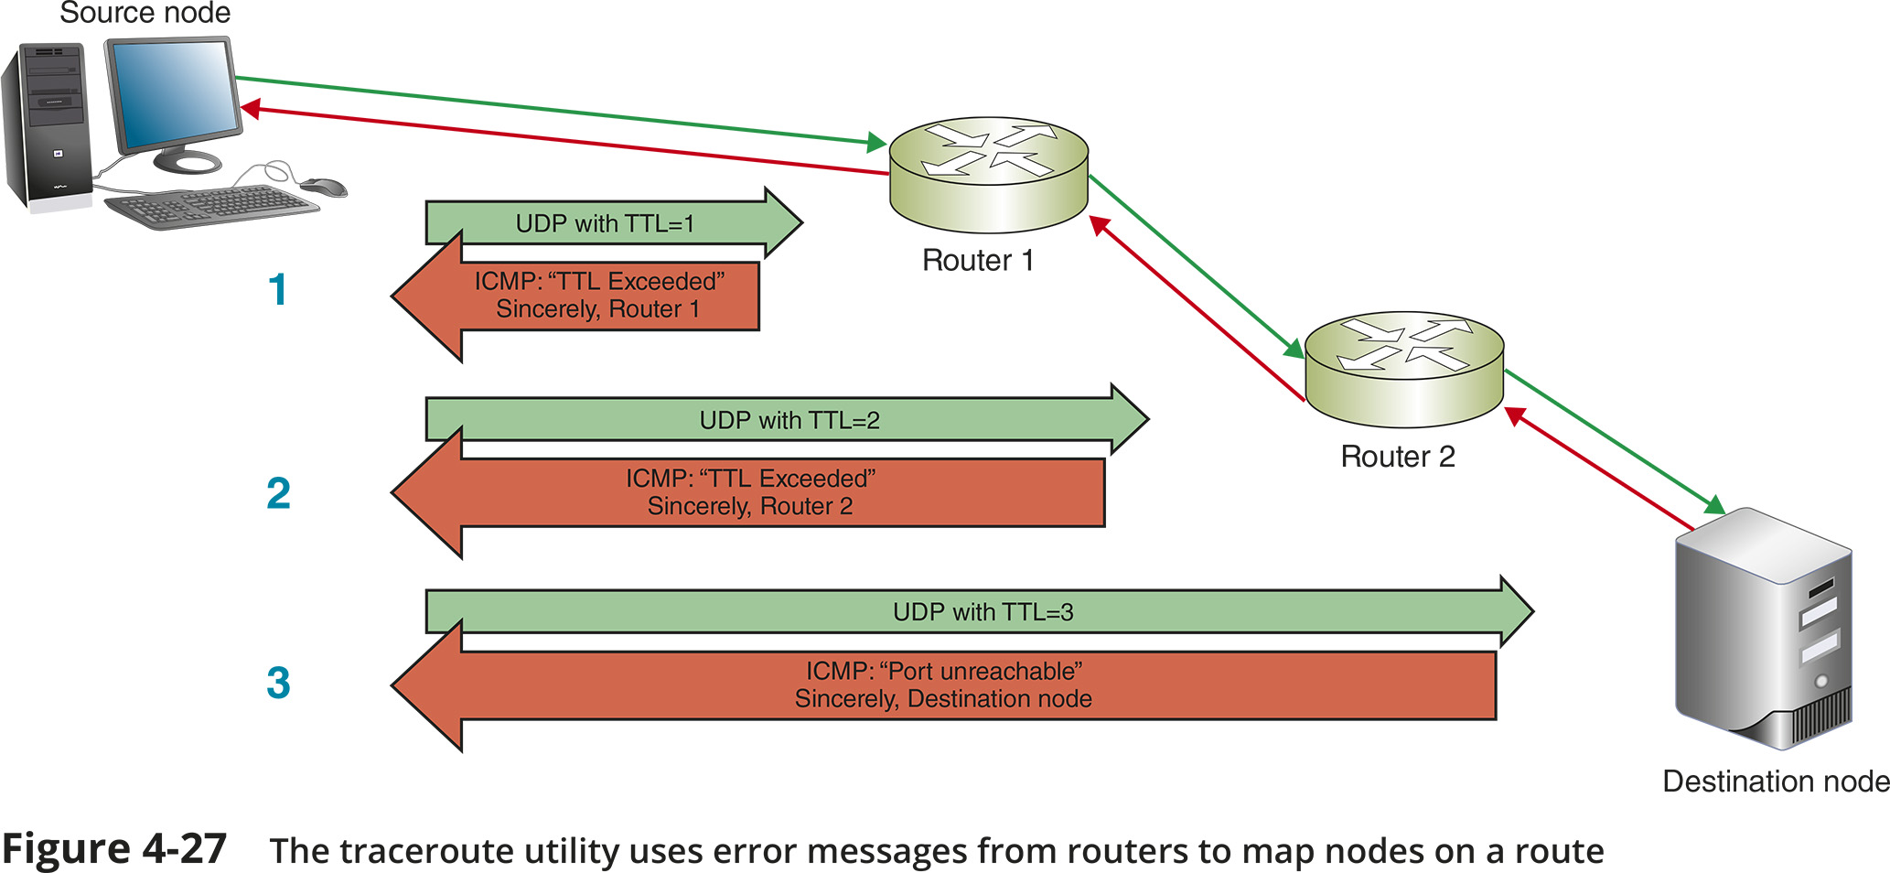
Troubleshooting Network Issues (2 of 3)
Figure 4-27 The traceroute utility uses error messages from routers to map nodes on a route

Slide 40
Troubleshooting Network Issues (3 of 3)
tcpdump is a free, command-line packet sniffer that runs on Linux and other Unix OSs
It captures traffic that crosses a computer’s network interface
Output can be saved to a file that you can filter or play back
You must either use the sudo command or log in as root to access tcpdump

Slide 41
Solving Common Network Problems (1 of 2)
Duplicate MAC Addresses
Two devices on the same network with the same MAC address is a problem
MAC addresses can be impersonated, which is a security risk called spoofing
It happens most often when managing multiple virtual devices on a large network
Most switches will detect the problem and produce helpful error messages
Then it’s a matter of tracking down which virtual devices have the same MAC address and update each device’s configuration

Slide 42
Solving Common Network Problems (2 of 2)
Hardware Failure - when a router, switch, NIC, or other hardware goes down:
Use tracert or traceroute to track down malfunctioning routers and other devices on larger networks
Get more accurate trace feedback on a questionable router by targeting a node on the other side of that router, rather than aiming for that router itself
Use ping to test for network connectivity

Slide 43
Knowledge Check Activity 4-2
What protocol must be allowed through a firewall for tracert to work correctly?
SSH
NDP
ICMP
TLS
Notes:
Instructions:
Net+: you will choose two of the Self-Check questions from each module and re-use them for Knowledge Check Activities. The activity numbers change based on the module you are in. (e.g., 1-1 and 1-2; 2-1 and 2-2; etc.) The CM will provide you with the final page proofs from the textbook.

Slide 44
Knowledge Check Activity 4-2: Answer
What protocol must be allowed through a firewall for tracert to work correctly?
Answer: c. ICMP
The Windows tracert utility sends an ICMP (Internet Control Message Protocol) echo request to the destination node and listens for an ICMP echo reply from that node.
Notes:
Include only the question and the correct answer on the slide or include only the correct answer on the slide. The CM will provide you with the Solution and Answer Guide for the correct answers.

Slide 45
Summary
Now that the lesson has ended, you should be able to:
Describe the functions of core TCP/IP protocols
Identify how each protocol’s information is formatted in a TCP/IP message
Secure network connections using encryption protocols
Configure remote access connections between devices
Employ various TCP/IP utilities for network discovery and troubleshooting

