Slide 1
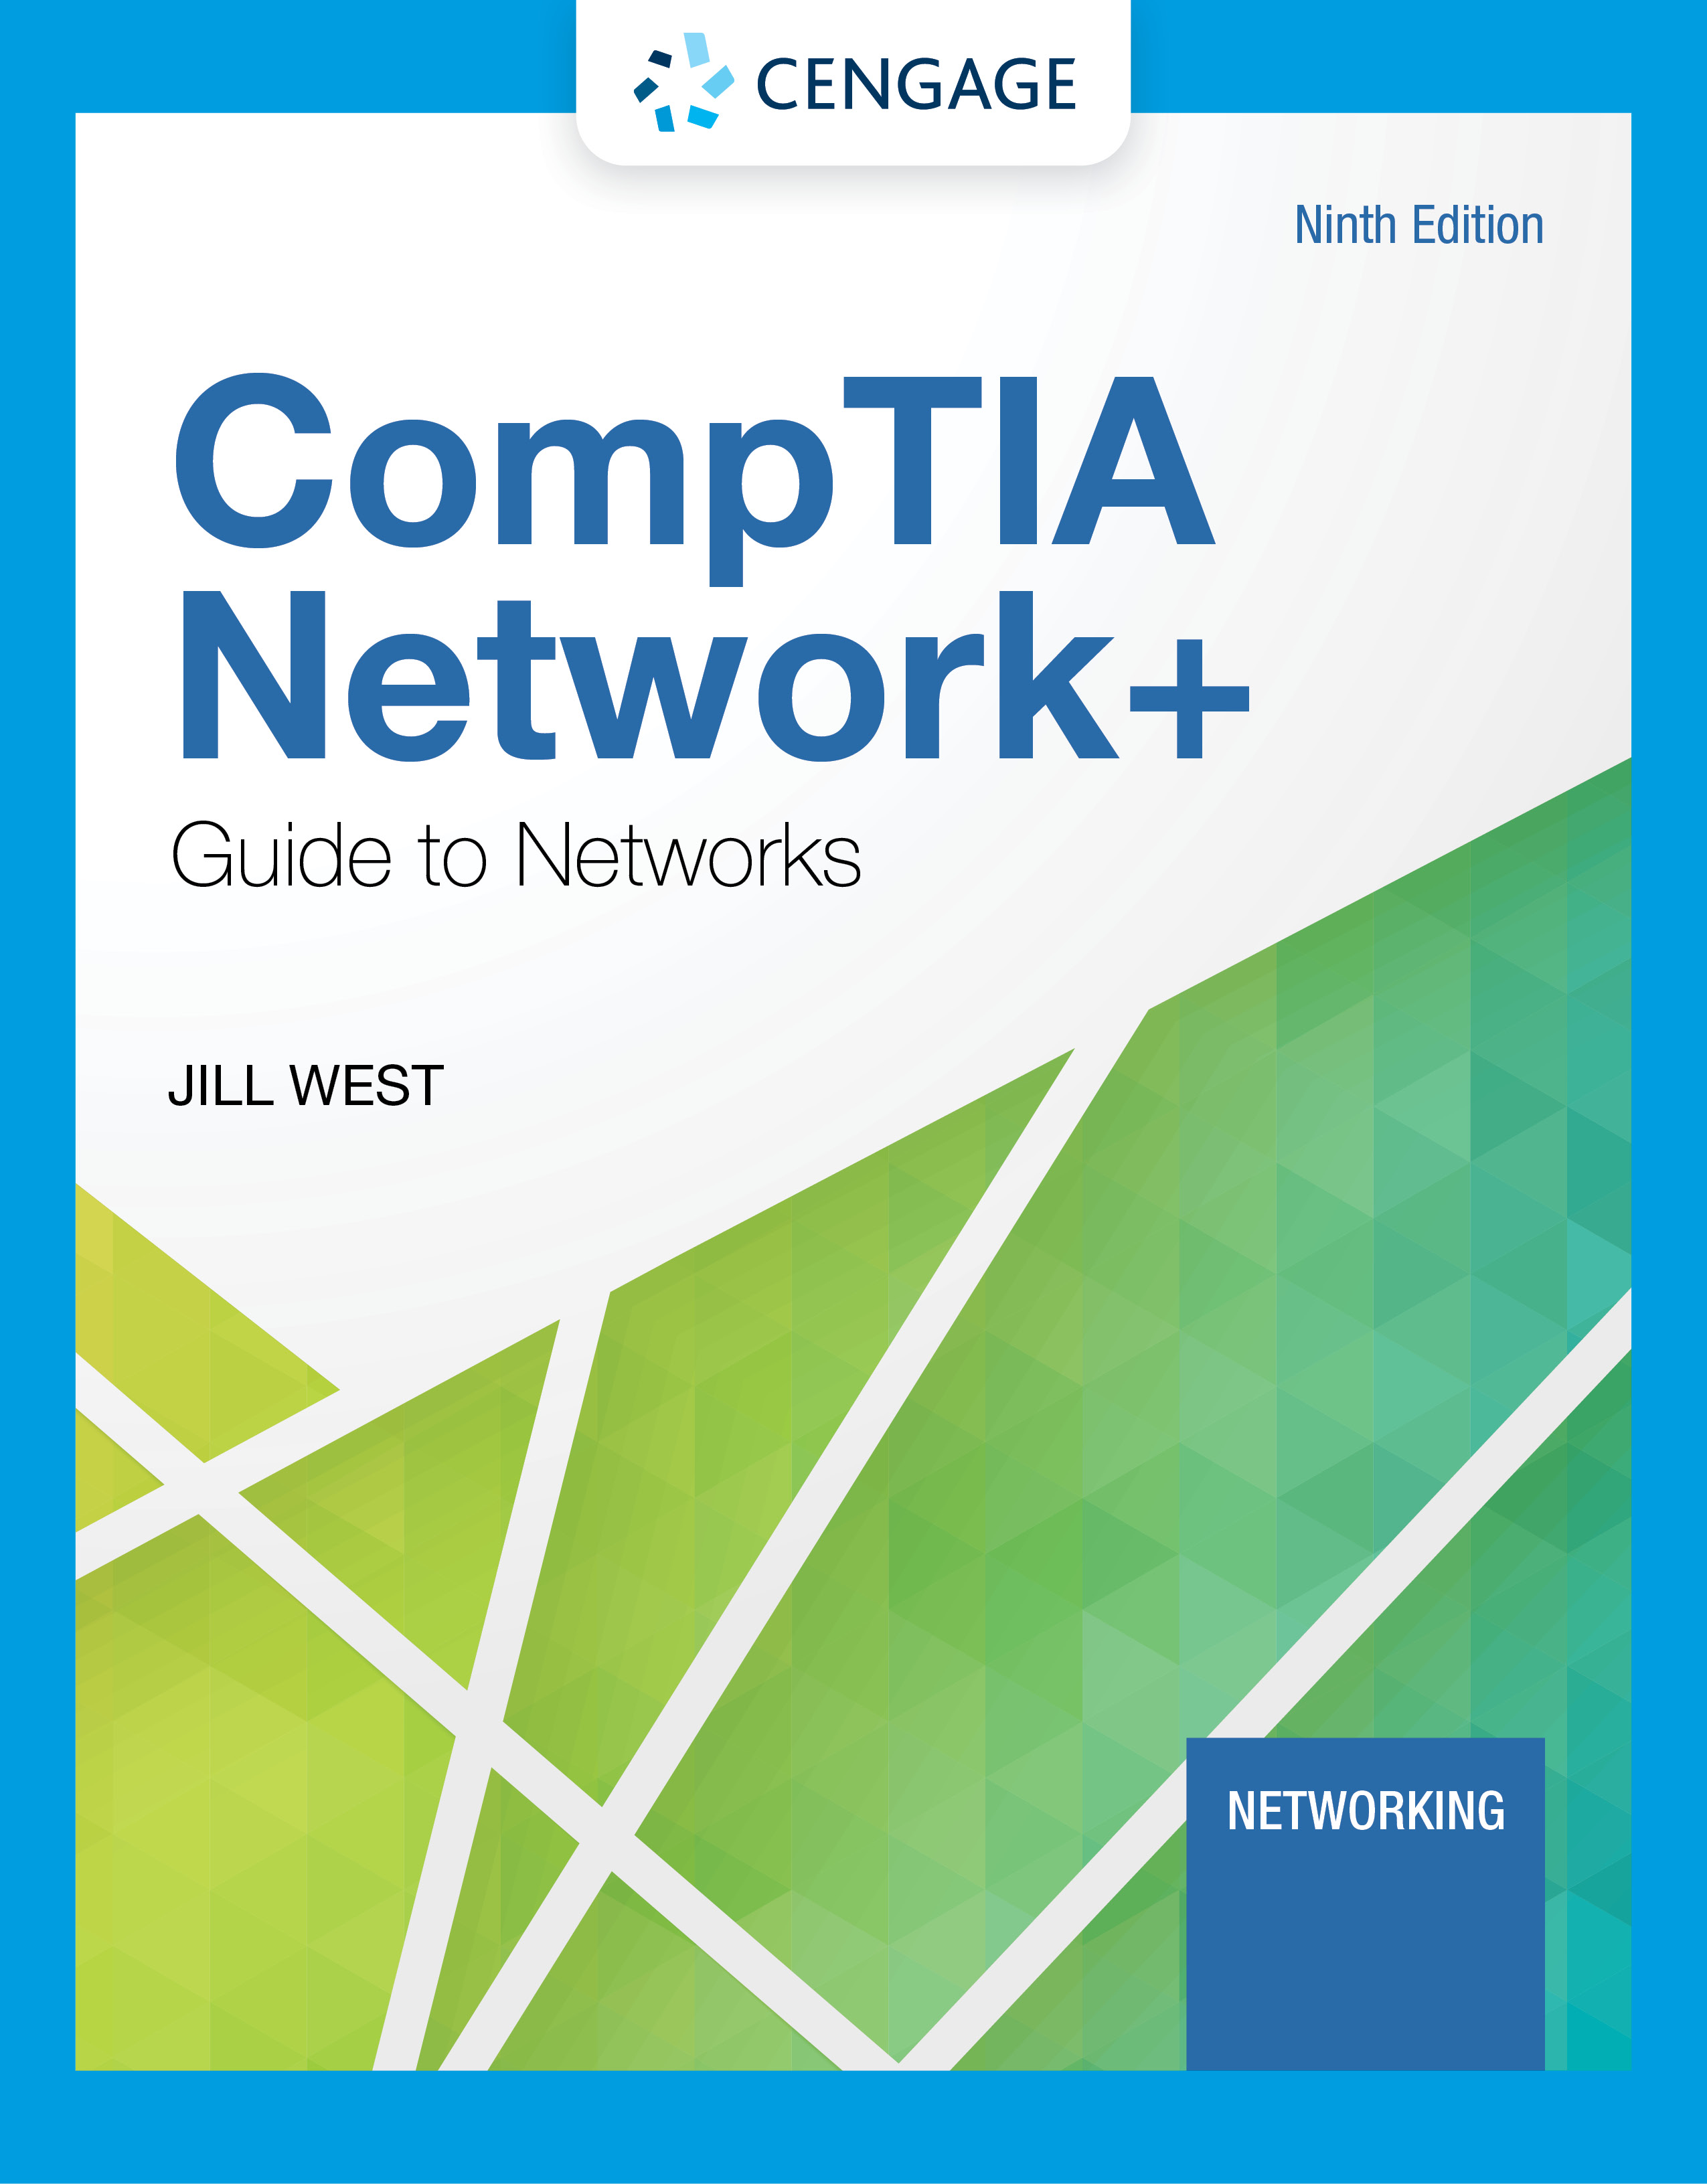
Module 5: Cabling
CompTIA Network+ Guide to Networks, Ninth Edition

Slide 2
Module Objectives
By the end of this module, you should be able to:
1. Explain basic data transmission concepts, including frequency, bandwidth, throughput, multiplexing, and common transmission flaws
2. Describe the physical characteristics of and official standards for coaxial cable, twinaxial cable, twisted-pair cable, fiber-optic cable, and their related connectors
3. Compare the benefits and limitations of various networking media
4. Select and use the appropriate tool to troubleshoot common cable problems

Slide 3
Transmission Basics
Transmission techniques in use on today’s network are complex and varied
This section covers:
Measurements that indicate network efficiency
Obstacles to good network performance

Slide 4
Frequency, Bandwidth, and Throughput
Frequency is typically measured in MHz or GHz, which indicates the number of times in a second that an electrical signal can change states
Bandwidth is the amount of data that could be theoretically transmitted during a given period of time
Throughput is the measure of how much data is actually transmitted during given time period
New technologies such as modulation (sending data over an analog signal) and encoding (converting data into a digital signal for transmission) offer methods for increasing theoretical bandwidth and effective data throughput given the same maximum frequency

Slide 5
Transmission Flaws (1 of 2)
Noise is any undesirable influence degrading or distorting signal
Noise is measured in dB (decibels)
Two common sources of noise include the following:
EMI (electromagnetic interference) is caused by motors, power lines, televisions, copiers, fluorescent lights, etc…
One type of EMI is RFI (radio frequency interference)
Cross-talk occurs when the signal on one wire infringes on adjacent wire signal
Alien cross-talk occurs between two cables
Near end cross-talk (NEXT) occurs near source
Far end cross-talk (FEXT) occurs at the far end

Slide 6
Transmission Flaws (2 of 2)
Attenuation is the loss of a signal’s strength as it travels away from source
Signals can be boosted using a repeater, which regenerates a digital signal in its original form without noise previously accumulated
Latency is the delay between signal transmission and receipt
Latency may cause network transmission errors
The length of the cable affects latency, as does the existence of any intervening device
RTT (round trip time) is the time for packet to go from sender to receiver, then back from receiver to sender
If packets experience varying amounts of delay they can arrive out of order
A problem commonly called jitter or PDV (packet delay variation)

Slide 7
Duplex, Half-Duplex, and Simplex (1 of 2)
NIC settings include the direction in which signals travel over the media and the number of signals that can traverse the media at any given time
These two settings are combined to create different methods of communication
Full-duplex – Signals travel in both directions over a medium simultaneously
Half-duplex – Signals may travel in both directions but only in one direction at a time
Simplex – Signals may travel in only one direction and is sometimes called one-way or unidirectional, communication
In Windows, use Device Manager to configure a NIC, including speed and duplex settings

Slide 8
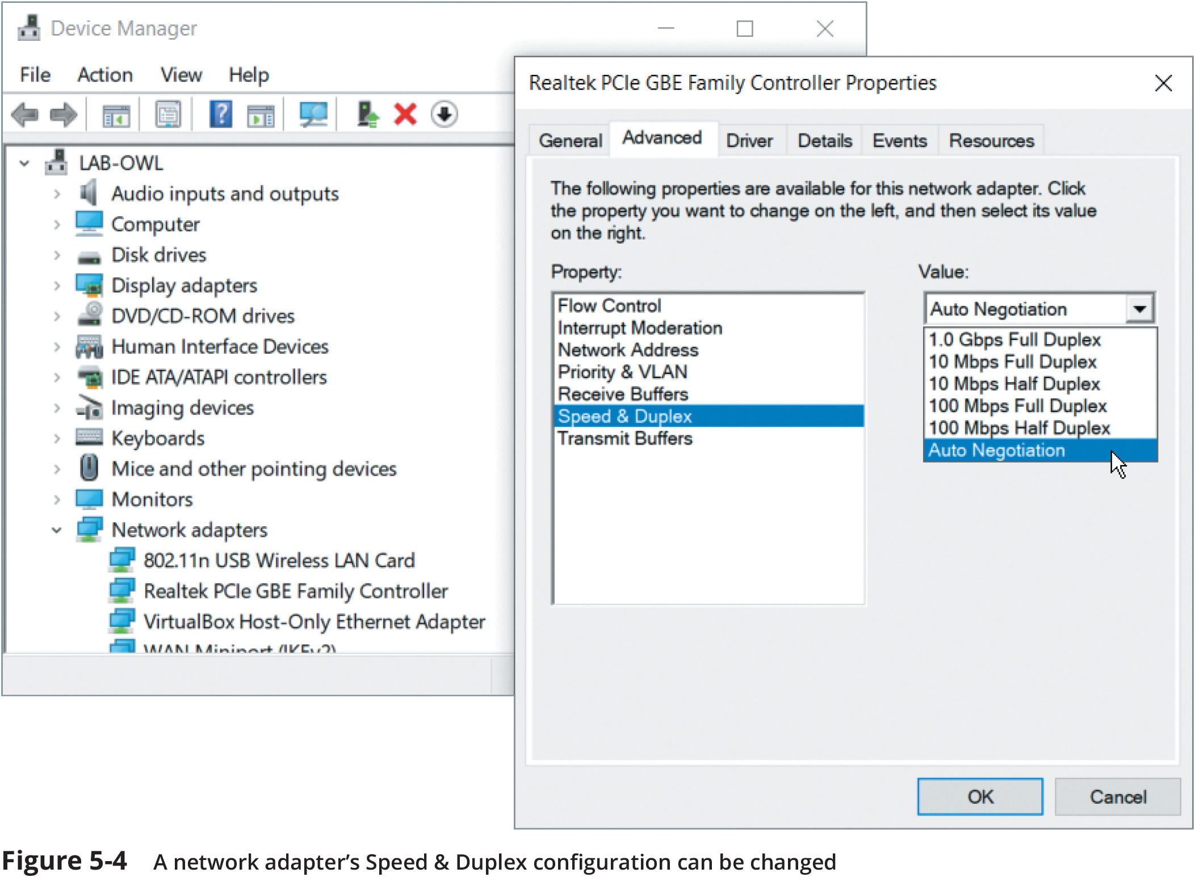
Duplex, Half-Duplex, and Simplex (2 of 2)
Figure 5-4 A network adapter’s Speed & Duplex configuration can be changed

Slide 9
Multiplexing (1 of 2)
Multiplexing is a form of transmission that allows multiple signals to travel simultaneously over one medium
To carry multiple signals, the medium’s channel is logically separated into multiple smaller channels, or subchannels
Multiplexer (mux) is a device that combines many channel signals
It is required at the transmitting end of the channel
A demultiplexer (demux) separates the combined signals on the receiving end
Three types of multiplexing are used on copper lines:
TDM (Time division multiplexing) divides a channel into multiple time intervals
STDM (statistical time division multiplexing) assigns slots to nodes according to priority and need
FDM (Frequency Division Multiplexing) assigns different frequency band for each communications subchannel

Slide 10
Multiplexing (2 of 2)
Three types of multiplexing are used on fiber-optic cable
WDM (Wavelength Division Multiplexing) carries multiple light signals simultaneously by dividing a light beam into different wavelengths or colors
DWDM (Dense Wavelength Division Multiplexing) increases the number of channels provided by normal WDM
CWDM (Coarse Wavelength Division Multiplexing) lowers cost by spacing frequency bands wider apart to allow for cheaper transceiver equipment

Slide 11
Coaxial Cable and Twinaxial Cable (1 of 3)
Coaxial cable, called “coax”, was the foundation for Ethernet networks in the 1980s
Coax has been replaced by newer media types
A form of coax is still used for cable Internet, cable TV, and some multimedia connection types
Coax has a central metal core surrounded by an insulator, a braided metal shielding, and an outer cover, called the sheath or jacket
Two types of coax, RG-6 and RG-59, can terminate with one of two connector types:
F-connector
BNC connector

Slide 12
Coaxial Cable and Twinaxial Cable (2 of 3)
Twinaxial cable, called “twinax”, looks similar to coax except there are two cores
The two cores cooperate in a half-duplex fashion to transmit data
This makes it capable of supporting much higher throughput than coax
Twinax is made from 26 or 28 AWG copper so it is resistant to damage from rough handling
The type of twinax cable determines its maximum supported distances
Passive is sufficient for the shortest distances of less than about 5 or 7 meters
Active contains internal electrical components to strengthen signals up to 10 meters

Slide 13
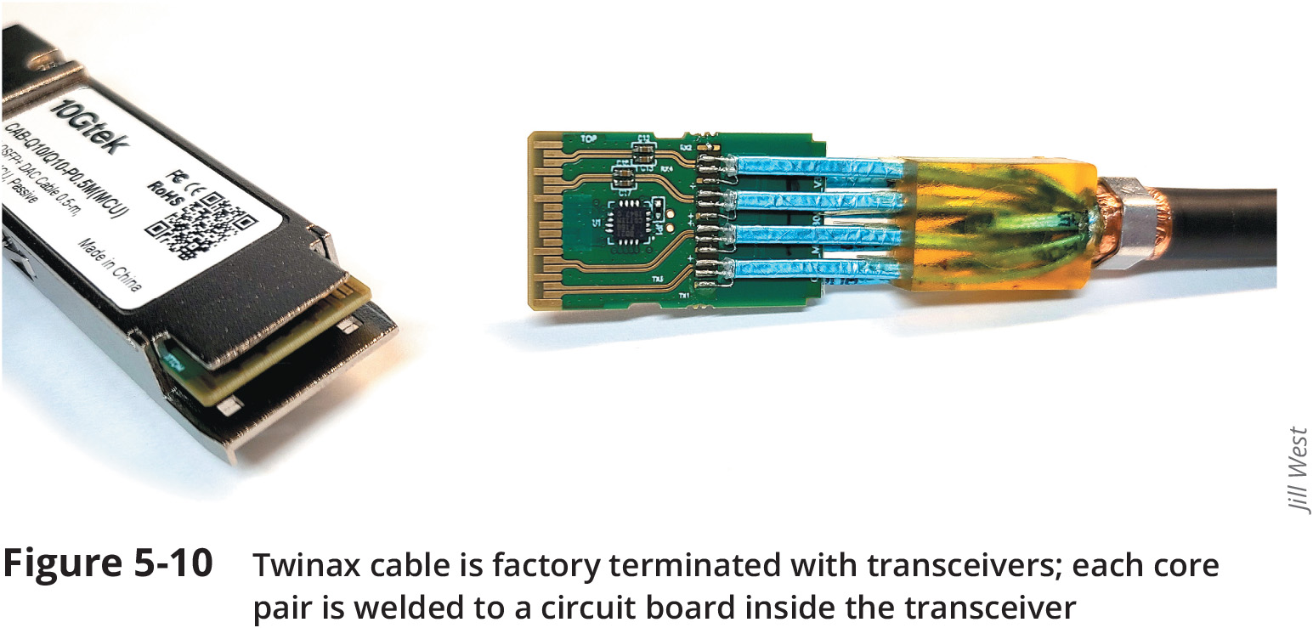
Coaxial Cable and Twinaxial Cable (3 of 3)
Figure 5-10 Twinax cable is factory terminated with transceivers; each core pair is welded to a circuit board inside the transceiver

Slide 14
Twisted-Pair Cable
Twisted-pair cable consists of color-coded insulated copper wire pairs each with a 0.4 to 0.8 mm diameter
Every two wires are twisted together to form pairs encased in a plastic sheath
Twisted-pair cabling in Ethernet networks contains four wire pairs
Fast Ethernet uses one pair to send data and one pair to receive data
Networks using Gigabit Ethernet use all four pairs for both sending and receiving
Most common twisted pair types include the following:
Category (cat) 3, 5, 5e, 6, 6a, 7, 7a, and 8
CAT 5e or higher used in modern LANs
All twisted-pair cable falls into one of two classifications:
Shielded twisted pair (STP)
Unshielded twisted pair (UTP)

Slide 15
STP (Shielded Twisted Pair) (1 of 3)
Wires in STP cable are individually insulated and may also be surrounded by metallic substance shielding (foil)
Shielding acts as a barrier to external electromagnetic forces
The shielding must be grounded to enhance its protective effects
Effectiveness of STP’s shield depends on the following:
Level and type of environmental noise
Thickness and material used for the shield
Grounding mechanism
Symmetry and consistency of the shielding
Newer types of cable, such as Cat 8, incorporate more sophisticated shielding materials, more tightly twisted wires, higher bandwidths to offer data rates rivaling fiber-optic cable at short distances

Slide 16
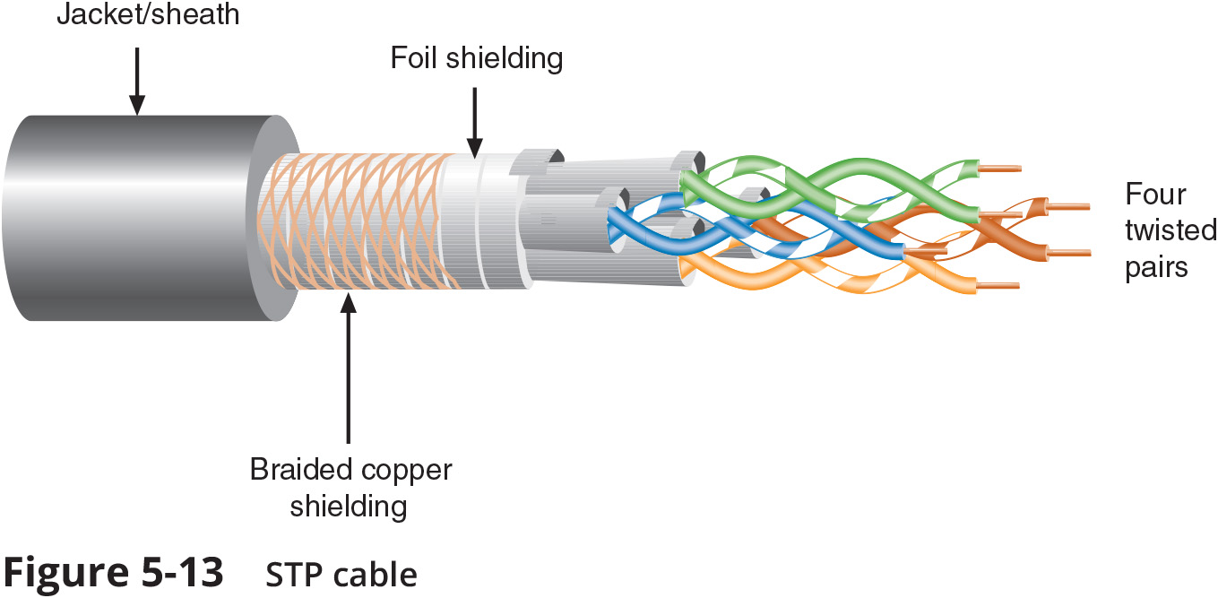
STP (Shielded Twisted Pair) (2 of 3)
Figure 5-13 STP cable

Slide 17
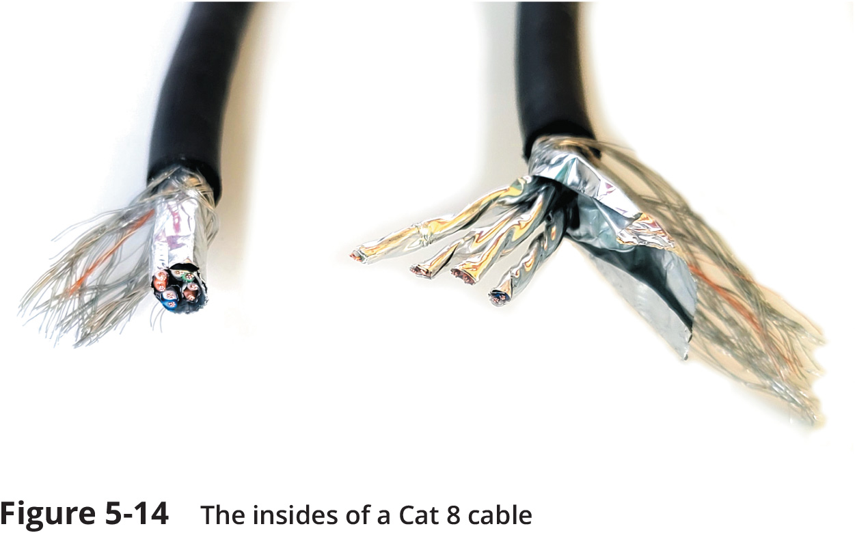
STP (Shielded Twisted Pair) (3 of 3)
Figure 5-14 The insides of a Cat 8 cable

Slide 18
UTP (Unshielded Twisted Pair)
UTP cabling consists of one or more insulated wire pairs encased in plastic sheath
UTP does not contain additional shielding
This makes UTP less expensive and less resistant to noise than STP
Historically, UTP was more popular than STP
Modern cable prices have dropped low enough that STP prices are becoming more reasonable

Slide 19
Comparing STP and UTP
STP and UTP similarities and differences include the following:
Throughput – STP and UTP can transmit the same rates
Cost – STP and UTP vary in cost
STP is typically more expensive than UTP
Connector – STP and UTP use RJ-45 (registered jack 45)
Noise immunity – STP is more noise resistant
Size and scalability – The maximum segment length for both is 100 meters on Ethernet networks that support data rates from 1 Mbps and 10 Gbps
Some categories of STP require shorter segment lengths to achieve maximum throughput

Slide 20
Cable Pinouts (1 of 3)
Proper cable termination is a requirement for two nodes on a network to communicate
Poor terminations can lead to loss or noise in a signal
TIA/EIA specifies two methods of inserting wires into RJ-45 plugs:
TIA/EIA 568A
TIA/EIA 568B
There is no functional difference between the two standards
Just make sure you use the same standard on every RJ-45 plug and jack

Slide 21
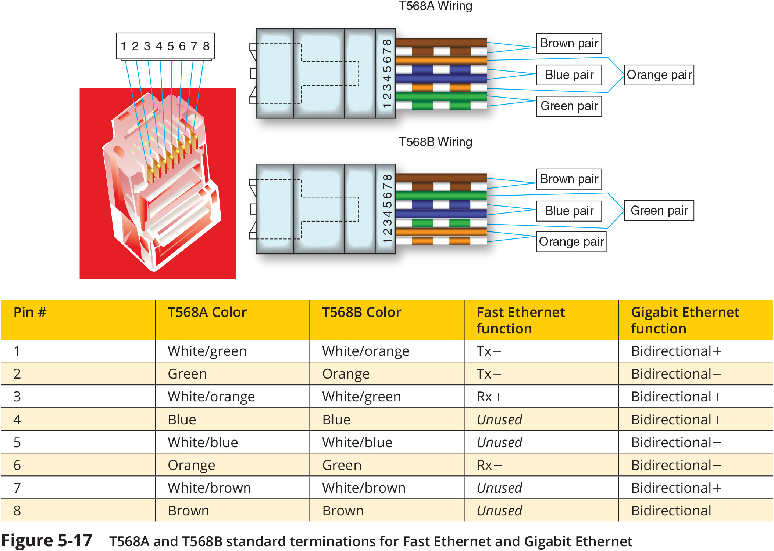
Cable Pinouts (2 of 3)
Figure 5-17 T568A and T568B standard terminations for Fast Ethernet and Gigabit Ethernet

Slide 22
Cable Pinouts (3 of 3)
The most common type of networking cable is a straight-through cable (also called patch cable)
To create one, terminate RJ-45 plugs at both ends identically
Rollover cables (also called console cables) are used to connect a computer to the console port of a router
All wires are reversed
Terminations are a mirror image of each other

Slide 23
PoE (Power over Ethernet) (1 of 2)
PoE is an IEEE 802.3af standard which specifies a method for supplying electrical power over twisted-pair Ethernet connections
Amount of power provided is 15.4 watts for standard PoE devices and 25.5 watts for newer PoE+ devices (802.3at standard)
PoE standard specifies two types of devices:
PSE (power sourcing equipment)
PDs (powered devices)
PoE requires Cat 5 or better copper cable
The PSE device first determines whether a node is PoE-capable before attempting to supply it with power
On networks that demand PoE but don’t have PoE-capable equipment, you can add PoE adapters

Slide 24
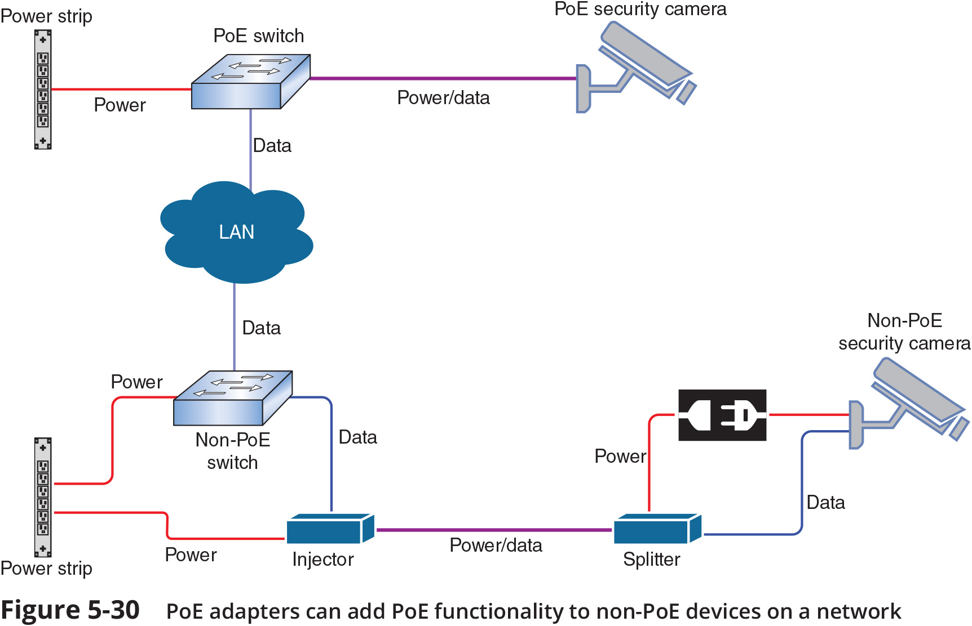
PoE (Power over Ethernet) (2 of 2)
Figure 5-30 PoE adapters can add functionality to non-PoE devices on a network

Slide 25
Ethernet Standards for Twisted-Pair Cable
A cable’s category (Cat 5e or Cat 6) determines the fastest network speed it can support
This is a Layer 1 characteristic
A device’s NIC is also rated for maximum network speeds
Most LANs today use devices and NICs that can support Fast Ethernet and Gigabit Ethernet
Devices can auto-negotiate for the fastest standard they have in common
The fastest Ethernet standard currently is 100GBASE-T
Two new standards were recently ratified by IEEE:
2.5GBASE-T
5GBASE-T
These new standards provide intermediate steps between Gigabit Ethernet and 10-Gigabit Ethernet

Slide 26
Knowledge Check Activity 5-1
What is the typical maximum segment length for Ethernet networks?
10 meters
100 meters
1000 meters
10,000 meters
Notes:
Instructions:
Net+: you will choose two of the Self-Check questions from each module and re-use them for Knowledge Check Activities. The activity numbers change based on the module you are in. (e.g., 1-1 and 1-2; 2-1 and 2-2; etc.) The CM will provide you with the final page proofs from the textbook.

Slide 27
Knowledge Check Activity 5-1: Answer
What is the typical maximum segment length for Ethernet networks?
Answer: b. 100 meters
The maximum segment length for both STP and UTP is 100 meters, or 328 feet, on Ethernet networks that support data rates from 1Mbps to 10 Gbps.
Notes:
Include only the question and the correct answer on the slide or include only the correct answer on the slide. The CM will provide you with the Solution and Answer Guide for the correct answers.

Slide 28
Fiber-Optic Cable (1 of 3)
Fiber-optic cable, also called fiber, contains one or more glass or plastic fibers at its center (core)
Data is transmitted via a pulsing light sent from laser or light-emitting diode (LED) through central fibers
Surrounding the fibers is a layer of glass or plastic called cladding
The cladding is less dense than the glass or plastic in the strands and so reflects light back to the core in patterns
This reflections allows the fiber to bend
Outside the cladding, a plastic buffer protects the cladding and core
The buffer is opaque, it absorbs escaping light
It is surrounded by Kevlar (polymeric fiber) strands

Slide 29
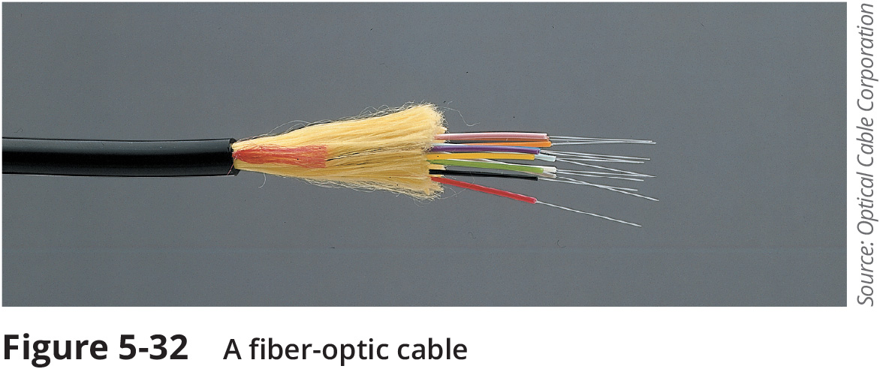
Fiber-Optic Cable (2 of 3)
Figure 5-32 A fiber-optic cable

Slide 30
Fiber-Optic Cable (3 of 3)
Fiber-optic cabling offers the following benefits over copper cabling:
Extremely high throughput
Very high noise resistance
Excellent security
Able to carry signals for longer distances
Drawbacks
More expensive than twisted pair cable
Requires special equipment to splice

Slide 31
SMF (Single Mode Fiber)
SMF (single mode fiber) consists of a narrow core (8-10 microns in diameter)
Laser-generated light travels over one path, reflecting very little
The light does not disperse as the signal travels
SMF can carry signals many miles before repeating is required
SMF is rarely used for shorter connections due to high cost
The Internet backbone depends on SMF

Slide 32
MMF (Multimode Fiber)
MMF (multimode fiber) contains a core with a larger diameter than single mode fiber
Common sizes are 50 or 62.5 microns
Laser or LED generated light pulses travel at different angles through MMF
Signals traveling over MMF experience greater attenuation than single-mode fiber
Common uses include the following:
Cables connecting routers, switches, and servers on the backbone of a network
Cables to connect a desktop workstation to the network
The transition between SMF and MMF might occur at an FDP (fiber distribution panel)

Slide 33
Fiber Connectors
MMF connectors can be classified by the number of fibers they connect
SMF connectors are classified by size and shape of the ferrule
The ferrule is the extended tip of a connector that makes contact with the receptacle in the jack
Shapes and polishes used by SMF ferrules to reduce back reflection include the following:
Ultra Polished Connector (UPC)
Angle Polished Connector (APC)
SMF connectors are typically available with a 1.25-mm ferrule or a 2.5-mm ferrule
The most common 1.25-mm connector is the LC (local connector)
Two 2.5-mm connectors are the SC (standard connector) and ST (straight tip)
Most common MMF connector is the MTRJ (mechanical transfer-registered jack)

Slide 34
Media Converters
A media converter is hardware that enables networks or segments running on different media to interconnect and exchange signals
The media converter completes the physical connection and converts electrical signals from copper cable to light wave signals
Can also be used to convert networks using MMF with networks using SMF

Slide 35
Fiber Transceivers (1 of 2)
Some switches allow you to change and upgrade its interfaces
They contain sockets where one of many types of modular interfaces, called transceivers, can be plugged in
GBIC, pronounced jee-bick, was a standard type of transceiver designed for Gigabit Ethernet connections
Newer transceivers that have made the GBIC obsolete include the following:
SFP (small form-factor pluggable)
XFP (10 Gigabit small form-factor pluggable)
SFP+
QSFP (quad small form-factor pluggable)
QSFP+
CFP (centum form-factor pluggable)

Slide 36
Fiber Transceivers (2 of 2)
To avoid using the incorrect transceiver, you must pair these devices based on supported speeds and protocols
Installing a transceiver can be achieved by sliding the transceiver into a socket on the back of the connectivity device
Most transceivers come with a tab or latch system and keyed so that they will slide into the socket when aligned properly

Slide 37
Ethernet Standards for Fiber-Optic Cable
Important details about Ethernet standards include the following:
100BASE-SX is a low-cost solution for Fast Ethernet and uses a short 850-nanometer wavelength light signal
100BASE-FX also offers Fast Ethernet speeds, uses a longer wavelength, and is rated up to 2 kilometers
1000BASE-SX is a form of Gigabit Ethernet and uses short wavelengths of 850 nanometers
1000BASE-LX is the more common fiber version of Gigabit Ethernet and uses long wavelengths or 1300 nanometers
10GBASE-SR is the “short range” standard for 10-Gigabit Ethernet
10GBASE-LR uses lasers emitting 1310 nanometer light

Slide 38
Common Fiber-Cable Problems
Fiber type mismatch is actually more of a fiber core mismatch
Even same-mode cables can be mismatched if the cores have different widths
Wavelength mismatch occurs when transmissions are optimized for one type of cable but sent over a different type of cable
Dirty connectors
If fiber connectors get dirty, signal loss and other errors can start to cause problems
Link loss – the power of a light signal emitted at one end of a connection is subjected to many losses along its way to the other end
These include losses from distance along the cable, losses from multiplexing, and losses from imperfect connections, patches, or splices

Slide 39
Cable Troubleshooting Tools
You can start troubleshooting a network connection problem by checking the network connection LED status indicator lights
A steady light indicates connectivity
A blinking light indicates activity
A red or amber light might indicate a problem
If a cabling issue is suspected, you need to know which tools are designed to analyze and isolate problems

Slide 40
Toner and Probe Kit
Tone generator (toner) is a small electronic device that issues a signal on a wire pair
Tone locator (probe) is a device that emits a tone when electrical activity detected
Probe kit or toner probe is a generator and locator combination, sold as a set
Tone generators and tone locators are used to determine where wired pair terminates
They cannot be used to determine cable characteristics

Slide 41
Multimeter
A multimeter measures electric circuit characteristics such as resistance, voltage, and impedance
Use a multimeter to do the following:
Measure voltage to verify cable is conducting electricity
Check for the presence of noise
Test for short or open circuits in the wire
A short circuit is an unwanted connection
An open circuit is one where needed connections are missing

Slide 42
Cable Continuity Tester
Cable continuity testers (cable testers) test whether a cable carries a signal to destination
Copper-based cable tester consists of two parts:
A base unit generates voltage
A remote unit detects voltage
Most cable testers provide a series of lights and some emit an audible tone
They are used to signal pass/fail
Some continuity testers verify UTP, STP wires are paired correctly
Not reversed, crossed, or split
Fiber optic continuity testers issue light pulses on the fiber and determine whether pulses reach the other end
Most testers are portable, lightweight, and are inexpensive

Slide 43
Cable Performance Tester (1 of 2)
A cable performance tester, line tester, or certifier performs similarly to continuity testers but can be used to:
Measure distance to a connectivity device, termination point, or cable fault
Measure attenuation
Measure NEXT (near end cross-talk)
Measure termination resistance and impedance
Issue pass/fail ratings for Cat 3-7 standards
Store and print results or save to a computer database
Graphically depict attenuation and cross-talk

Slide 44
Cable Performance Tester (2 of 2)
A TDR (time domain reflectometer) issues a signal then measures the way the signal bounces back to the TDR
Indicates distance between nodes
Indicates whether terminators are properly installed and functional
OTDRs (optical time domain reflectometers) measure fiber length
OTDRs also determine faulty splice locations, breaks, connectors, bends and measure attenuation over cable
They can measure attenuation over the cable
OTDRs can be expensive

Slide 45
OPM (Optical Power Meter)
An OPM (Optical Power Meter), also called a light meter, measures the amount of light power transmitted on a fiber-optic line
An OPM must be calibrated precisely, following highly accurate optical power standards
The surrounding room temperature, connection type, and the skill of the technician all affect the final test results

Slide 46
Knowledge Check Activity 5-2
Which tool could you use to test a twisted-pair cable’s pinout?
OTDR
Toner probe
OPM
Continuity tester
Notes:
Instructions:
Net+: you will choose two of the Self-Check questions from each module and re-use them for Knowledge Check Activities. The activity numbers change based on the module you are in. (e.g., 1-1 and 1-2; 2-1 and 2-2; etc.) The CM will provide you with the final page proofs from the textbook.

Slide 47
Knowledge Check Activity 2-2: Answer
Which tool could you use to test a twisted-pair cable’s pinout?
Answer: d. Continuity tester
Some continuity testers will verify that the wires in a UTP or STP cable are paired correctly following TIA/EIA 568 standards. OTDRs and OPMs are used to test fiber-optic cables. A toner probe can help determine where a wire, possibly out of hundreds, terminates.
Notes:
Include only the question and the correct answer on the slide or include only the correct answer on the slide. The CM will provide you with the Solution and Answer Guide for the correct answers.

Slide 48
Summary
Now that the lesson has ended, you should be able to:
Explain basic data transmission concepts, including frequency, bandwidth, throughput, multiplexing, and common transmission flaws
Describe the physical characteristics of and official standards for coaxial cable, twinaxial cable, twisted-pair cable, fiber-optic cable, and their related connectors
Compare the benefits and limitations of various networking media
Select and use the appropriate tool to troubleshoot common cable problems

