Slide 1


Tuning Target Delay for RTT-based Congestion Control
Jian Tang, Tingting Xu, Camtu Nguyen, Xiaoliang Wang, Sanglu Lu and Baoliu Ye
Nanjing University

Slide 2
Background
Remote Direct Memory Access (RDMA)
Machine A
High Throughput: 100Gbps or higher
Ultra-low latency: a few µs with a rack
Low CPU overhead:
Offload stacks at hardware
Avoid memory copy
Bypass the local kernel/remote CPU.
DMA
ram
cpu
rnic
Network
ram
cpu
rnic
DMA
Machine B

Slide 3
Background
Remote Direct Memory Access (RDMA)
Machine A
High Throughput: 100Gbps or higher
Ultra-low latency: a few µs with a rack
Low CPU overhead:
Offload stacks at hardware
Avoid memory copy
Bypass the local kernel/remote CPU.
DMA
ram
cpu
rnic
Network
ram
cpu
rnic
DMA
Machine B

Slide 4
Background
Remote Direct Memory Access (RDMA)
Machine A
High Throughput: 100Gbps or higher
Ultra-low latency: a few µs with a rack
Low CPU overhead:
Offload stacks at hardware
Avoid memory copy
Bypass the local kernel/remote CPU.
DMA
ram
cpu
rnic
Network
ram
cpu
rnic
DMA
Machine B

Slide 5
Background
Remote Direct Memory Access (RDMA)
Machine A
High Throughput: 100Gbps or higher
Ultra-low latency: a few µs with a rack
Low CPU overhead:
Offload stacks at hardware
Avoid memory copy
Bypass the local kernel/remote CPU.
DMA
ram
cpu
rnic
Network
ram
cpu
rnic
DMA
Machine B

Slide 6
Background
In past, RDMA deployed on special fabrics, i.e., InfiniBand.
- incompatible with Ethernet + IP

Slide 7
Background
In past, RDMA deployed on special fabrics, i.e., InfiniBand.
- incompatible with Ethernet + IP
Routable RDMA over Converged Ethernet (RoCEv2)
Ethernet
IP
UDP
InfiniBand L4
Payload
*packet format
-Efficient but requires a lossless fabric for optimal performance

Slide 8
Background
In past, RDMA deployed on special fabrics, i.e., InfiniBand.
- incompatible with Ethernet + IP
Routable RDMA over Converged Ethernet (RoCEv2)
Ethernet
IP
UDP
InfiniBand L4
Payload
*packet format
-Efficient but requires a lossless fabric for optimal performance
Priority-based Flow Control (PFC)
- simple but ... victim flows 、dead lock、head of line blocking

Slide 9
Background
In past, RDMA deployed on special fabrics, i.e., InfiniBand.
- incompatible with Ethernet + IP
Routable RDMA over Converged Ethernet (RoCEv2)
Ethernet
IP
UDP
InfiniBand L4
Payload
*packet format
-Efficient but requires a lossless fabric for optimal performance
Priority-based Flow Control (PFC)
- simple but ... victim flows 、dead lock、head of line blocking
RoCEv2 needs congestion control
Avoid PFC frames 、Provide low latency、Achieve high link utilization

Slide 10
Background
RTT-based Congestion Control for Datacenters
Fine-grained informative
End-to-end metric
Good applicability in datacenters
Predicable topology
Accurate RTT measurements in hardware
#TIMELY (SIGCOMM 2015), DX (ATC 2015), ROGUE (SoCC 2018), SWIFT (SIGCOMM 2020)

Slide 11
Motivation
Core algorithm in RTT-based congestion controls
(1)
(2)
Target
Decrease speed
Increase speed

Slide 12

Motivation
Core algorithm in RTT-based congestion controls
(1)
(2)
Target
Decrease speed
Increase speed
How to configure the target value

Slide 13
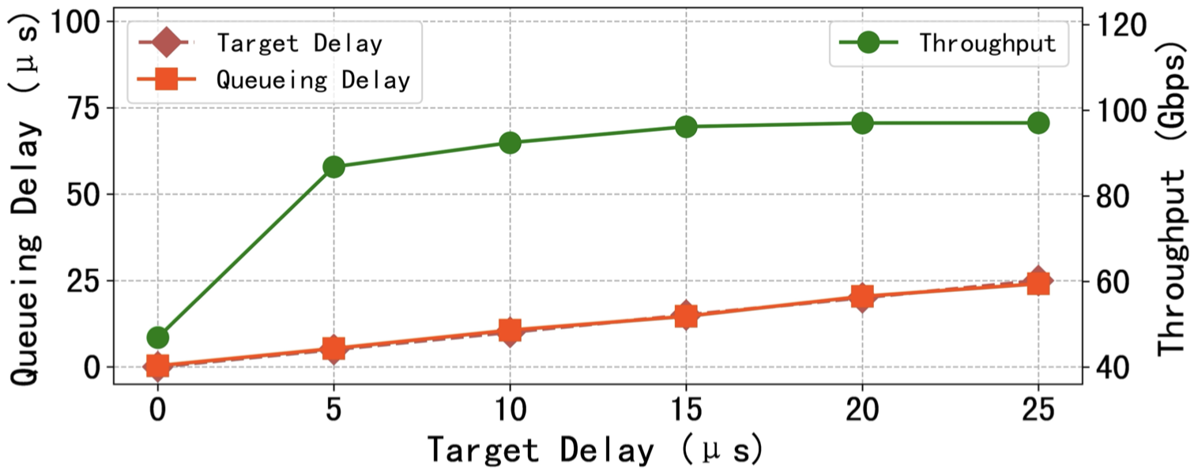
Motivation
Low target => Low bandwidth
High target => High latency
40 : 1 incast with different target

Slide 14
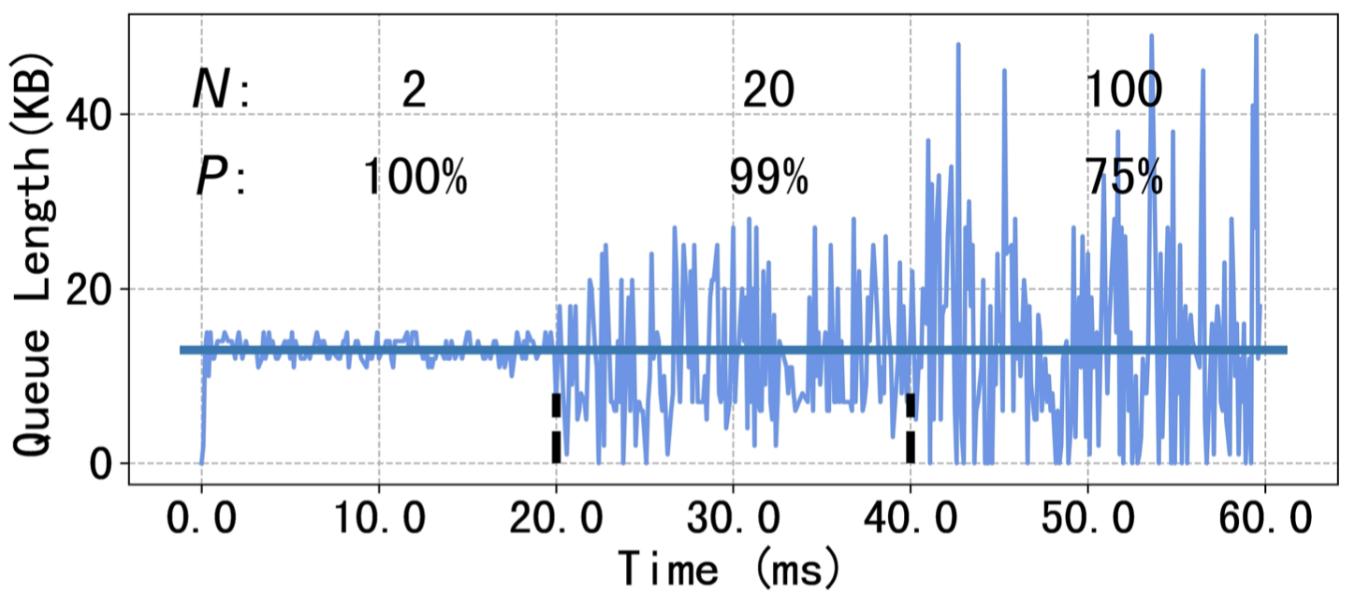
Motivation
Low target => Low bandwidth
High target => High latency
40 : 1 incast with different target
A static target does not apply
to all trafﬁc patterns !
2/20/100 : 1 incast with static target

Slide 15
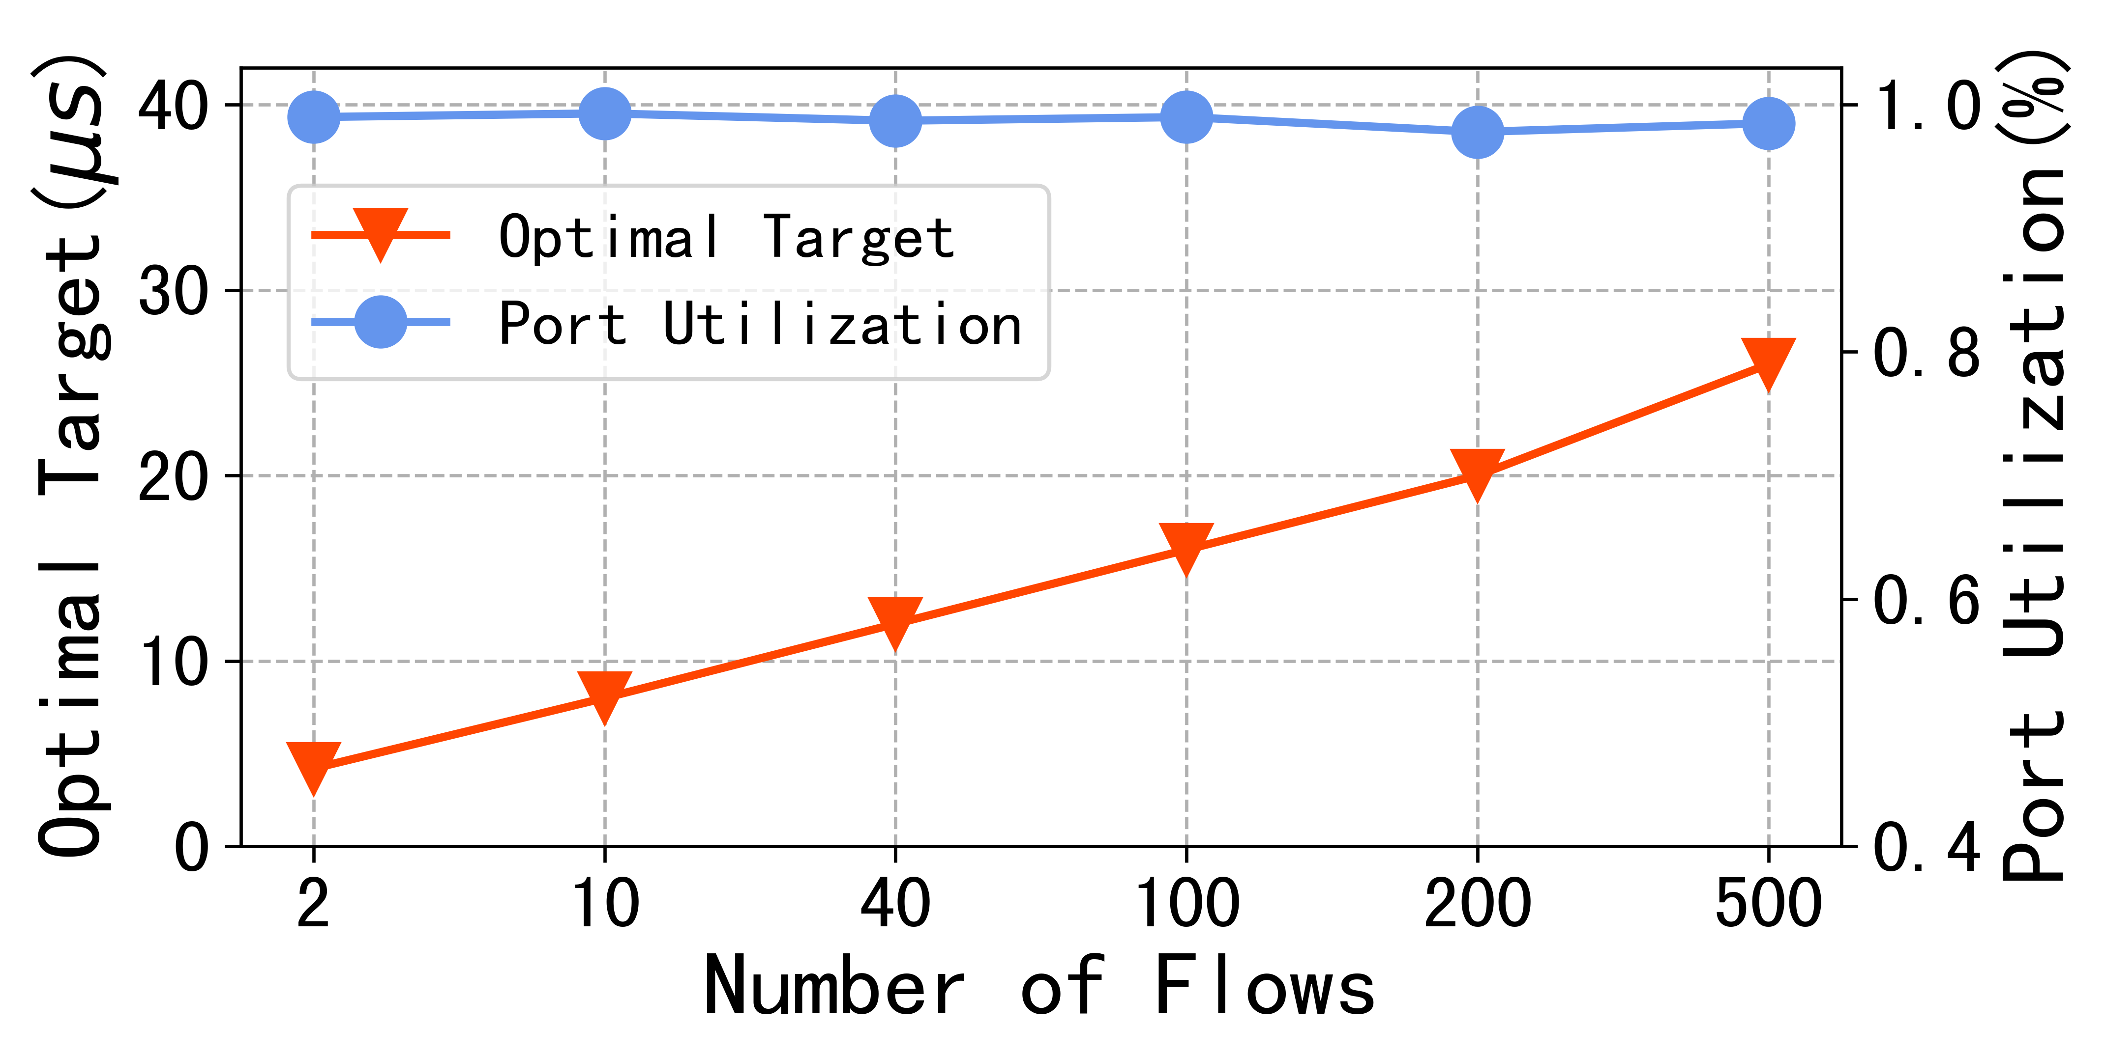
Motivation
Optimal target increases as the number of flows
More flows

Slide 16
Motivation
Optimal target increases as the number of flows
More flows
Complexity

Slide 17
Motivation
Optimal target increases as the number of flows
More flows
Complexity
Less queue stability

Slide 18
Motivation
Optimal target increases as the number of flows
More flows
Complexity
Less queue stability
Large target for more headroom

Slide 19
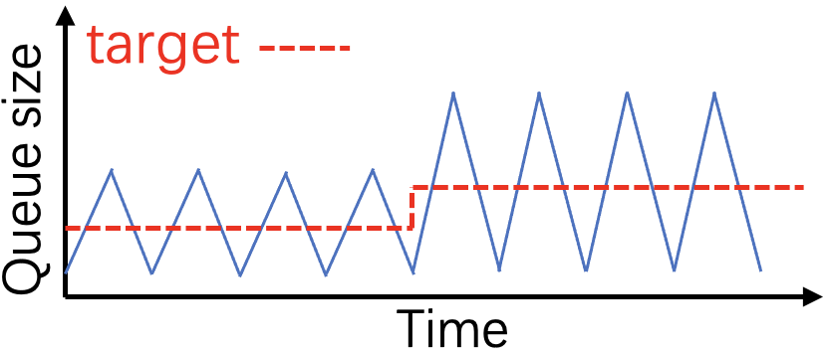
Goal
Accurate target value for RTT-based CC
Provide the lowest target with guaranteed bandwidth
Automatically update according to the traffic pattern
2. Easy to deploy
No switch modification needed
3. Easy to configure
Few & independent parameters

Slide 20
Observation
Port utilization keeps the same under different workloads!
Large Small Optimal
100% ~95% 95%~99%

Slide 21
Observation
Port utilization keeps the same under different workloads!
Large Small Optimal
100% ~95% 95%~99%
Instant port utilization is a good indicator

Slide 22


Solution
Update the target according to the queue status
Port Utilization > η: target
Port Utilization < η: target e.g. η=99%

Slide 23
Solution
Challenge #1 How to obtain the queue status?
Queue Length > 0 => ECN:1
Switch
Receiver
ECN mark ratio
No hardware modification
No complicated ECN parameter tunning problem

Slide 24


Solution
Challenge #2 Where to update the target?
Message
Sender
Target update
ACK & ECN marking ratio
Long Feedback Delay
Feedback are separated

Slide 25
Solution
Challenge #2 Where to update the target?
Queue Length > 0 => ECN:1
Switch
Receiver
ECN mark ratio
Target update
Target

Slide 26
Overall Design
Target generation module (TGM)
Sender (RP)
Window
Update
Message
Switch (CP)
ECN Flag
Message
Receiver (TGP)
Target
Update
Target
Target
Reaction Point (RP) : sending hosts
Congestion Point (CP) : congested switch
Target Generating Point (TGP) : receiving host

Slide 27
RET Congestion Control
Reaction Point (RP) based SWIFT Google 2020
AIMD controller based on whether the measured queuing delay exceeds target

Slide 28
RET Congestion Control
Reaction Point (RP) based SWIFT Google 2020
AIMD controller based on whether the measured queuing delay exceeds target
Congestion Point (CP)
Traditional ECN marking method with threshold “zero”

Slide 29
RET Congestion Control
Reaction Point (RP) based SWIFT Google 2020
AIMD controller based on whether the measured queuing delay exceeds target
Congestion Point (CP)
Traditional ECN marking method with threshold “zero”
Target Generation Point(TGP)
Switch ECN flag:
0: target + δ
1: target - (1- η) * δ e.g. η = 99%

Slide 30
RET Congestion Control
Queue size
Time
large target
high marking Ratio
target drops
marking ratio ≈ η

Slide 31
RET Congestion Control
Queue size
Queue size
Time
Time
large target
high marking Ratio
target drops
marking ratio ≈ η
small target
low marking ratio
target rises
marking ratio ≈ η

Slide 32

RET Congestion Control
RP algorithm optimization
Target Approach (Swift 2020)
Simple & Effective
Slow Reaction
(1)

Slide 33
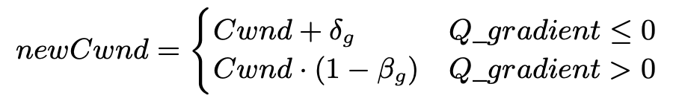
RET Congestion Control
RP algorithm optimization
Target Approach (Swift 2020)
Simple & Effective
Slow Reaction
(1)
Gradient Approach
(2)
Fast Reaction

Slide 34
RET Congestion Control
RP algorithm optimization
Target Approach (Swift 2020)
Simple & Effective
Slow Reaction
(1)
Gradient Approach
(2)
Fast Reaction
How to avoid gradient approach takes RTT spikes as congestion signal?

Slide 35
RET Congestion Control
RP algorithm optimization
ACK & Target
|Gradient| > target
Target Approach
Gradient Approach
Using target to filter the RTT noisy

Slide 36
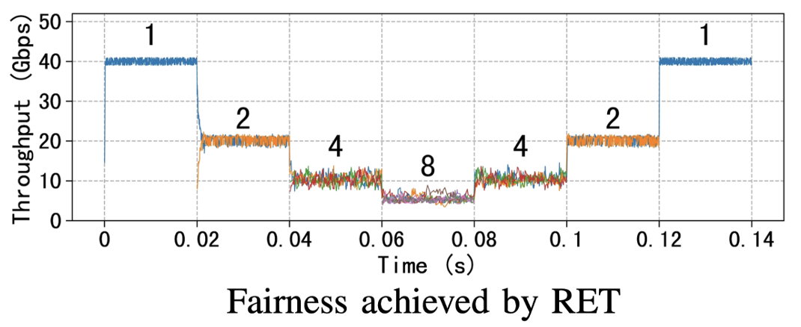
Evaluation
Multiple senders and one receiver
Change the number of flows every 20 ms
RET ensures fairness between different flows

Slide 37
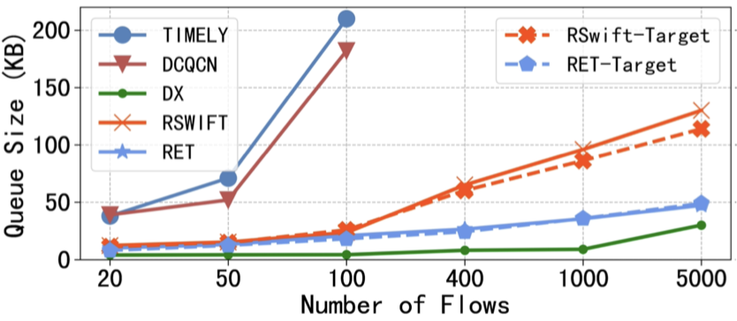
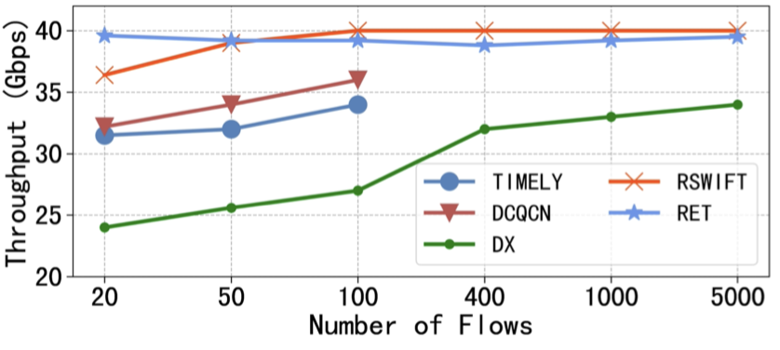
Experiment
63 sending hosts and one receiving host
Monitor queue size and system throughput for different incast ratio
RET provides better target for various traffic pattern
Timlely: 2015
DCQCN: 2015
DX: 2015
RDMA-SWIFT: 2020

Slide 38
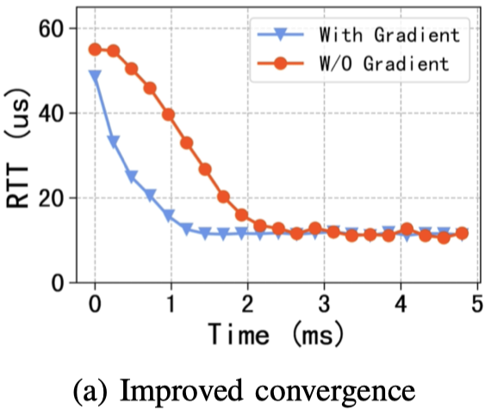
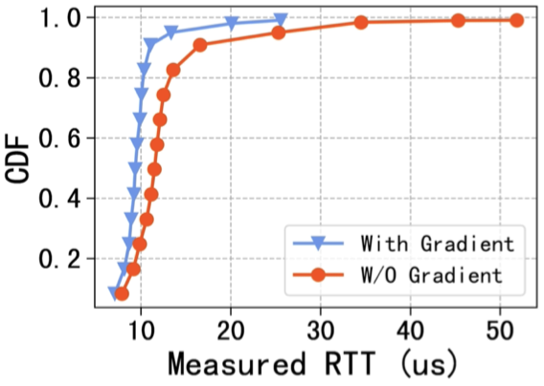

Experiment
Two sending hosts, each initiate 20 flows to the same receiving host at line rate
Gradient approach causes better stability and convergence

Slide 39
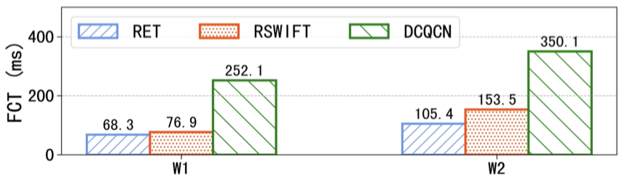
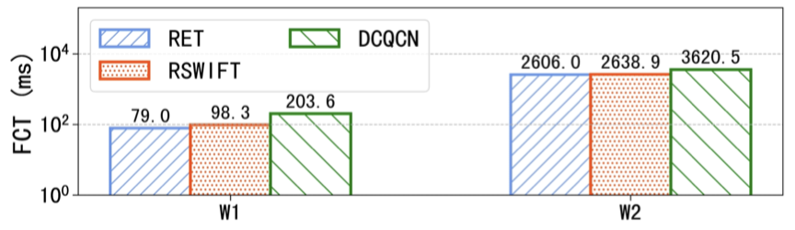


Experiment
Large-scale simulation
Leaf-spine: 288-hosts, 12 Leafs and 6 Spines
Web-server & Hadoop
RET provides shortest FCT among tested protocols

Slide 40
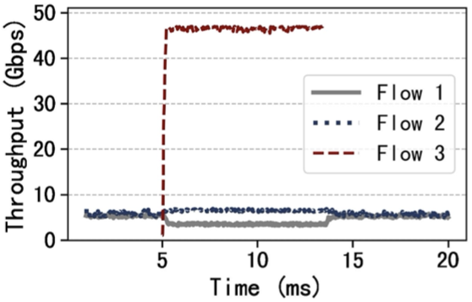
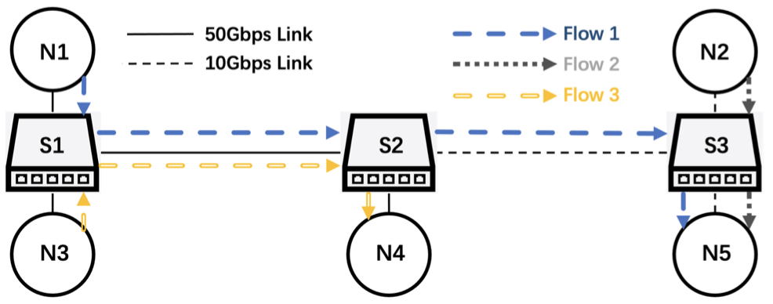
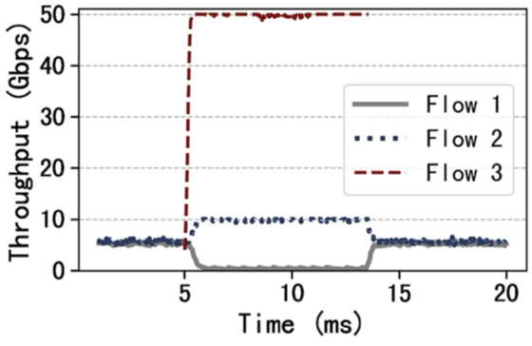
Limitation
Assumption: Congestion occurs primarily at host downlinks
CONGA (2014) MP-RDMA (2018) SRD (2020)

Slide 41
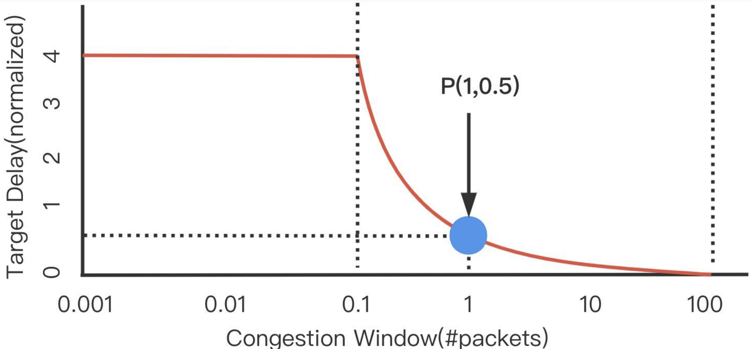
Related Work
Timely SIGCOMM2015
Unfairness, instability
DX/ ROGUE ATC 2015/SOCC 2018
Low throughput
DCQCN SIGCOMM2015
Complicated ECN parameter tunning
SWIFT SIGCOMM2020
Low throughput or High latency

Slide 42
Conclusion
The setting of target for RTT-based congestion control.
First effort targeting at achieving accurate target value in realtime.
Integrate our target generation module into SWIFT
Compared with tested protocols, RET provides better performance

Slide 43
THANKS & QUESTIONS ?
tangjian@smail.nju.edu.cn

