Slide 1
Chord Progression Recognition System
- Version 0.1

Slide 2
CPRS System

Slide 3
System Overview

Slide 4
CPRS – System Overview
Audio Input
Front-end
Note Salience Computation
Salience Gestalt Process
Bassline and onset filter
Harmonic Change Filter
Mid-end
Basegram and uppergram computation
Chordogram computation
Chordogram Gestalt Process
Chord boundaries
Back-end
Chord progression output

Slide 5
CPRS – Front End
Tone dictionary gen
Simple tone & Complex tone dictionary
STFT
Pre-salience calculation
Salience noise reduction
Audio
Spectrogram
Pre-salience
Noise reduced Pre-salience
“Gestaltize” process
“Gestaltize” process
Note salience matrix

Slide 6
CPRS – Mid End
Onset filter
Harmonic change vectors
Gestaltized salience matrix
Harmonic change filter
Bassline filter
Harmonic change moments
Compute basegram
basegram
Harmonic change vectors
Compute uppergram
uppergram

Slide 7
CPRS – Back End
basegram
bassgram
uppergram
Compute chordogram
treblegram
chordogram
Harmonic change moments
boundaries
bassgram
bassgram
treblegram
Combine same chords
Eliminate short chords
Merge similar chords
treblegram
chordogram
chordogram
Chordogram gestaltize process
boundaries
boundaries

Slide 8
CPRS – Feedback
Audio Input
Front-end
Mid-end
Feedback once
Back-end
Chord progression output

Slide 9
Evaluation

Slide 10
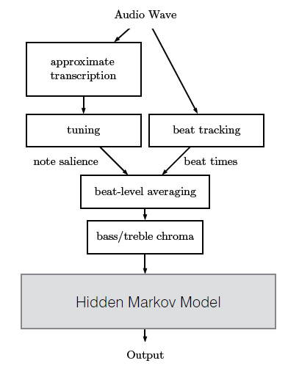
Chordino – my competitor

Slide 11
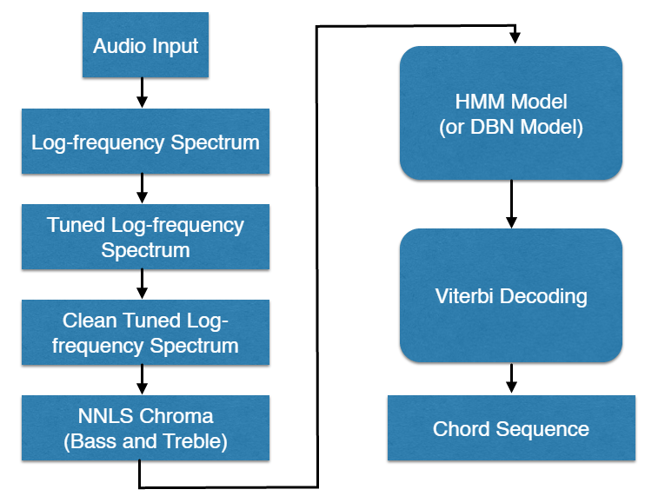
Chordino – my competitor

Slide 12
System design comparison
Key Tasks | Chordino | CPRS
Front-end | STFT, log-frequency spectrum, simple&complex tone dictionary, note salience matrix, noise reduction, tuning, nnls chroma, beat tracking | STFT, simple&complex tone dictionary, note salience matrix, noise reduction, gestalt process, onset filter, bassline filter, harmonic change filter
Mid-end | beat-level averaging, bass-chromagram and treble-chromagram | harmonic moment averaging, basegram and uppergram
Back-end | Hidden markov model, Viterbi decoding | Chordogram, chordogram gestalt process
Feedback | No | Yes

Slide 13
Process comparison
Key Tasks | Chordino | CPRS
spectrogram | Log-frequency spectrogram, similar to constant-Q | Only stft spectrogram
Noise reduction | Keep value larger than a certain running mean (slow) | keep peak values with certain prominence (fast)
Note salience computation | Solve an NNLS problem (deductive process, slow) | Cosine similarity between tone profiles and signal (additive process, fast)
Beat tracking | Use external beat tracking library | Beyond beat tracking, tracks harmonic change moments using bassline and onset information
Smoothing | Use inherit hmm or dbn smoothing capability, only happen in back-end | Use gestalt process, smooth in both front-end and back-end

Slide 14
Process comparison
Key Tasks | Chordino | CPRS
Mid-end output | Bass chromagram and treble chromagram (the bass are sometimes not the lowest pitch found in the front-end output) | Basegram and uppergram (the “base” always is the lowest pitch found in the front-end output)
Chord sequence decoding | Viterbi decoding (slow and not really necessary) | Template matching (fast and accurate because of the gestalt process in front-end)
Chord model | Triad, sixth, seventh, slash chords | Triads, sixth, seventh, sustain, slash chords…

Slide 15
Comparison Metrics
bass relative correct overlap (brco) =
# bass matching frames / total # of frames
treble relative correct overlap (trco) =
# treble matching frames / total # of frames
chord correct overlap (rco) =
# chord relative matching frames / total # of frames
segmentation quality (sq) =
# of correct boundaries / total # of boundaries

Slide 16
Comparison Methods
definition of correct bass matching:
Bass 0 matches nothing
other basses match the same basses pitch (note the "#" and "b")
definition of correct treble matching:
two treble matches if their types match
Treble ‘N’ matches all
definition of correct chord matching:
if both bass and treble match, they match
definition of correct boundary:
a detected boundary within 1/10 of the median of gt boundary-diffs

Slide 17
Testcases
Randomly choose 10 songs to represent a reasonable distribution of song styles:
Pop, Ballad, Folk, R&B, Rock
And to represent various kinds of music texture
From pure guitar accompaniment, pure piano accompaniment to full band arrangement
From broken chord texture to full block harmonic texture
And to represent different keys:
C, E, F, F#, G, Bb, B

Slide 18
Comparison results on testcases
Testcases | cdbrco | cdtrco | cdsq | cdrco | cpbrco | cptrco | cpsq | cprco
1984 | 0.7611 | 0.9598 | 0.7632 | 0.7611 | 0.8291 | 0.9382 | 0.8222 | 0.8165
anjing | 0.7971 | 0.9488 | 0.75 | 0.7923 | 0.8555 | 0.9841 | 0.9806 | 0.8555
dontbreakmyheart | 0.8938 | 0.9501 | 0.9279 | 0.8938 | 0.8787 | 0.9706 | 0.9314 | 0.8787
feijichangde1030 | 0.8083 | 0.982 | 0.7717 | 0.8016 | 0.8079 | 0.9591 | 0.9038 | 0.792
haoting | 0.6081 | 0.7651 | 0.6712 | 0.5882 | 0.8788 | 0.9826 | 0.9375 | 0.8788
putongpengyou | 0.8378 | 0.8996 | 0.7442 | 0.8086 | 0.8227 | 0.9476 | 0.8725 | 0.8201
shijiemori | 0.7782 | 0.8848 | 0.7813 | 0.7686 | 0.7998 | 0.9554 | 0.822 | 0.7968
tuihou | 0.7594 | 0.8826 | 0.6667 | 0.7519 | 0.8915 | 0.9735 | 0.9785 | 0.8843
woruciaini | 0.5678 | 0.7957 | 0.4832 | 0.5545 | 0.8196 | 0.959 | 0.7629 | 0.8092
xiaoxiaochong | 0.7966 | 0.9373 | 0.8087 | 0.7748 | 0.7687 | 0.9571 | 0.828 | 0.765
On Average | 0.76082 | 0.90058 | 0.73681 | 0.74954 | 0.83523 | 0.96272 | 0.88394 | 0.82969

Slide 19
Comparison results on testcases
Testcases | cdbrco | cdtrco | cdsq | cdrco | cpbrco | cptrco | cpsq | cprco
1984 | 1 | 1 | 1 | 1 | 1.089 | 0.977 | 1.077 | 1.073
anjing | 1 | 1 | 1 | 1 | 1.073 | 1.037 | 1.307 | 1.080
dontbreakmyheart | 1 | 1 | 1 | 1 | 0.983 | 1.022 | 1.004 | 0.983
feijichangde1030 | 1 | 1 | 1 | 1 | 1.000 | 0.977 | 1.171 | 0.988
haoting | 1 | 1 | 1 | 1 | 1.445 | 1.284 | 1.397 | 1.494
putongpengyou | 1 | 1 | 1 | 1 | 0.982 | 1.053 | 1.172 | 1.014
shijiemori | 1 | 1 | 1 | 1 | 1.028 | 1.080 | 1.052 | 1.037
tuihou | 1 | 1 | 1 | 1 | 1.174 | 1.103 | 1.468 | 1.176
woruciaini | 1 | 1 | 1 | 1 | 1.443 | 1.205 | 1.579 | 1.459
xiaoxiaochong | 1 | 1 | 1 | 1 | 0.965 | 1.021 | 1.024 | 0.987
On Average | 1 | 1 | 1 | 1 | 1.098 | 1.069 | 1.200 | 1.107

Slide 25
Thank you!!!

