Slide 1
Machine Learning for Materials Properties
Figures etc.
Robert Tang-Kong

Slide 2
Figure 1: Schematic ML Model Flow
Show data/information reduction pathway.
Identify what in/out is, what we have and what we want.
Identify where gaps used to be, or where Matminer fits in?
ability to produce large amounts of features quickly
Facilitates discussion of {dataset, features, and models}

Slide 3
Figure 2: Errors? Basic

Slide 4
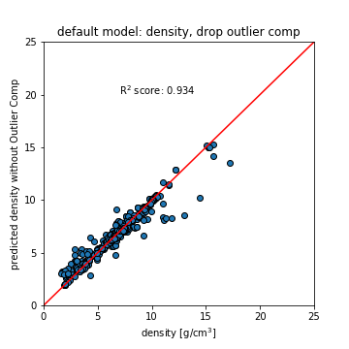
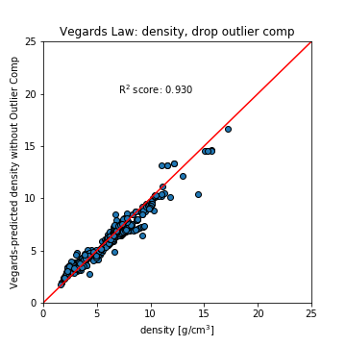
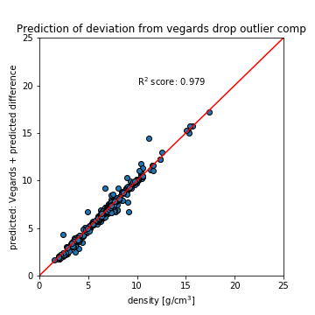
Figure 3: Performance of ML on predicting density of amorphous glasses vs Vegard’s Law
Show efficacy of pre-existing theory?
Why is this so effective? Acting as essentially hard spheres?
Seeing a perfect (almost) gradation between close packing structures
Look at the features involved, they are understandably tied to things like radii
Learning where we deviate from the agreed theory is notably more effective
Is essentially highly weighting our prior understanding and focusing the model on deviations from it.4
Also can reveal what elemental properties are relevant for improvements in learning.

Slide 5
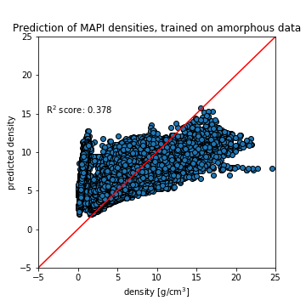
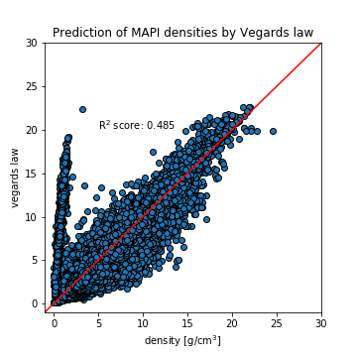
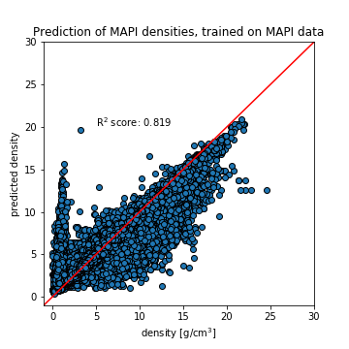
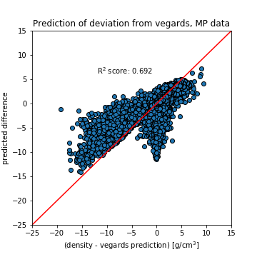
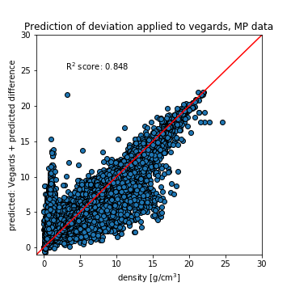
Figure 4: Performance of density predictions on MP dataset??
All Materials Project Data
(Trained on amorphous data) (Vegards law prediction) (Trained on MAPI data)
(Prediction of deviation from Vegards) (Prediction using deviation)
Need to work on:
outliers
Feature information
Notes:
Model trained on metallic glasses doesn’t do well, but this is very much to be expected.
What do features tell us? What’s different about this behavior?
Training on the crystalline dataset affords us some improvements, but not a huge amount.

Slide 7
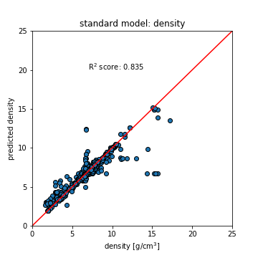
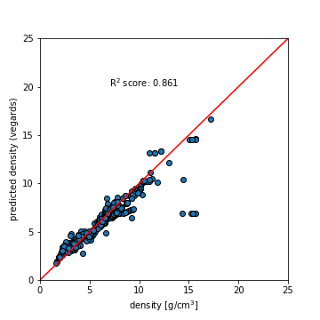
Initial models, density: Vegard’s law
We don’t beat the rule of mixtures quite yet…
Vegard’s law

Slide 8
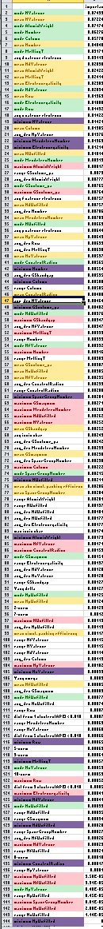
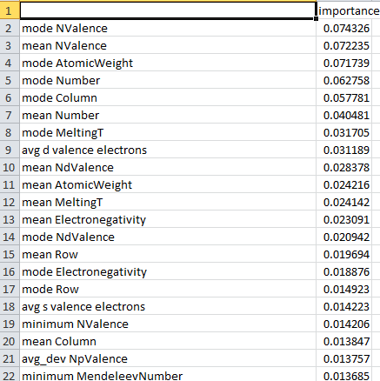
Feature Exploration: Density
Looking at density model features, ordered by importance
Mode, mean trend to the top, while min/max seem less important → Could justifiably leave out min/max
Near top, both mode and mean of same property appear together → may only need to choose one of mode/mean
These all come from cf.Stoichiometry(), which supplies 130 features…. Could cut down significantly
Green → mode
Yellow → Mean
Purple → Minimum
Red → Maximum

Slide 9
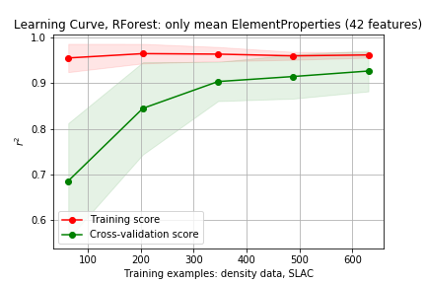
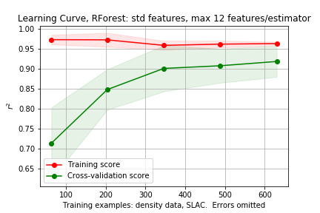
Fitting model with reduced feature set
Use only mean ElementProperty features
Not much of a change…
All 152 features

Slide 10
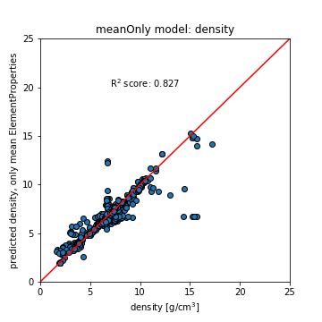
Fitting model with reduced feature set
Using only mean
Standard features

Slide 11
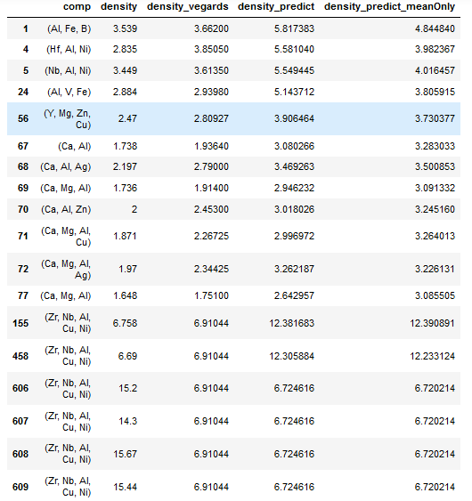
Outlier Data points
All highlighted compositions are:
Zr₅₇ Nb₅ Al₁₀ Cu_{15.4} Ni_{12.6}

Slide 12
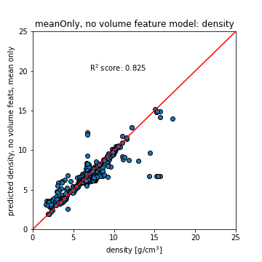
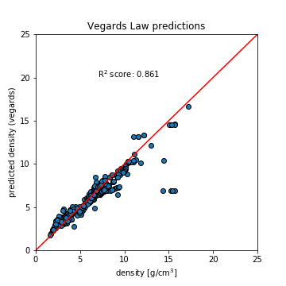
Dropping GSvolume, Covalent Radius

Slide 13
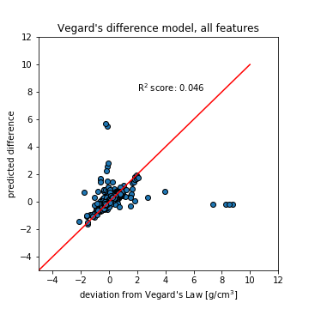
Model difference between real and Vegard’s law
Without outliers (same problem composition), r² = 0.479
Without outliers the original model gives up to r² = 0.913

Slide 15
Training Default Model without problem composition

Slide 16
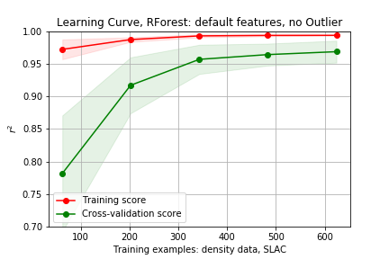
Learning curve without outlier composition
Seems to perform as good if not better than Vegard’s law without those compositions
(R² very sensitive to outliers)
Not much to learn/improve on here.

Slide 17
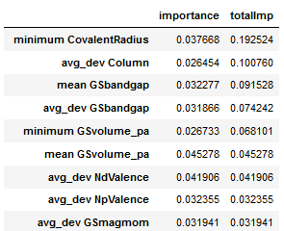
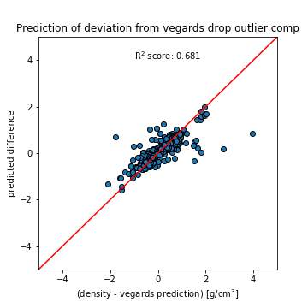
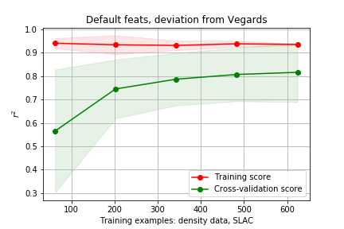
Can we learn where Vegard’s law is lacking?
Features gathered over 5 training splits (used to make scatter plot)

Slide 18
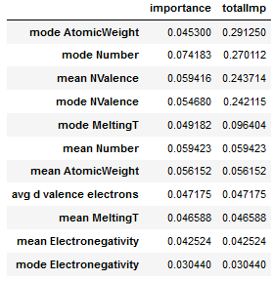
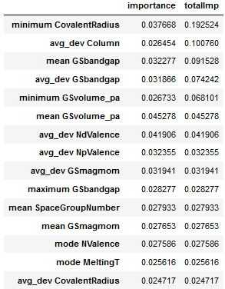
Investigating features used in models
Predicting Density deviation from Vegard’s law
Predicting Density
Notes:
Training performed 5 times, top 5 from each instance collected.
Duplicate features (across separate training instances) have their importances summed to give a sort of averaged importance
Only melting Temperature in common

Slide 19
Full Model vs Difference Model
Full Model | Importance | Rank in Diff Model
mode Number | 0.0605 | 38
mode AtomicWeight | 0.0603 | 39
mean NValence | 0.0566 | 36
mode NValence | 0.0538 | 7
mean Number | 0.0409 | 58
mean Electronegativity | 0.0304 | 19
mean AtomicWeight | 0.0302 | 61
mode Column | 0.0300 | 25
mode MeltingT | 0.0274 | 11
Difference Model | Importance | Rank in Full Model
avg_dev Column | 0.0330 | 86
minimum CovalentRadius | 0.0322 | 92
mean GSbandgap | 0.0294 | 34
avg_dev NpValence | 0.0257 | 35
avg_dev GSbandgap | 0.0251 | 23
mode NValence | 0.0233 | 5
minimum GSvolume_pa | 0.0218 | 93
mean GSmagmom | 0.0195 | 91
mean GSvolume_pa | 0.0191 | 57
Notes:
Train on Vegards data exactly
Look up feats
Look at next few feats
Youngs mod
MP API To check and see other comps, see how model compares to DFT

Slide 20
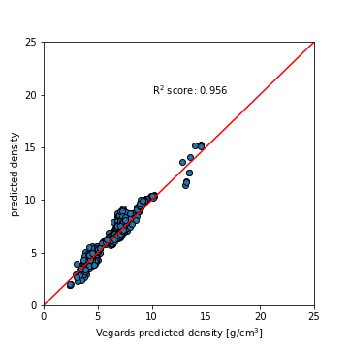
Vegards Model vs Difference Model
Vegards Prediction Model | Importance | Rank in Diff Model
mode AtomicWeight | 0.0676 | 39
mean NValence | 0.0587 | 36
mode Number | 0.0522 | 38
avg d valence electrons | 0.0446 | 51
mode NValence | 0.0441 | 7
mean NdValence | 0.0440 | 48
mean Number | 0.0397 | 58
mean AtomicWeight | 0.0352 | 61
mean Electronegativity | 0.0279 | 19
Difference Model | Importance | Rank in Full Model
avg_dev Column | 0.0330 | 86
minimum CovalentRadius | 0.0322 | 92
mean GSbandgap | 0.0294 | 34
avg_dev NpValence | 0.0257 | 35
avg_dev GSbandgap | 0.0251 | 23
mode NValence | 0.0233 | 5
minimum GSvolume_pa | 0.0218 | 93
mean GSmagmom | 0.0195 | 91
mean GSvolume_pa | 0.0191 | 57
Train model on vegards law predictions directly

Slide 21
Looking at improvement on Vegard’s Law Predictions
(0.93 → 0.979, 5.04% improvement, 70% of available improvement)
r² for difference predictions = 0.681
Notes:
V+diff > full RF model > Vegards law.
Why doesn’t RF model do as well? It has all the same features…
What do we learn from physics

Slide 22
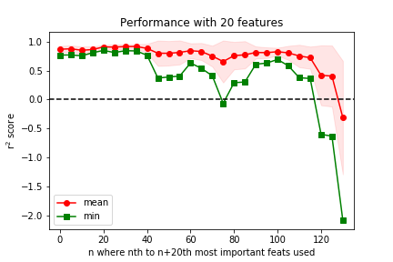
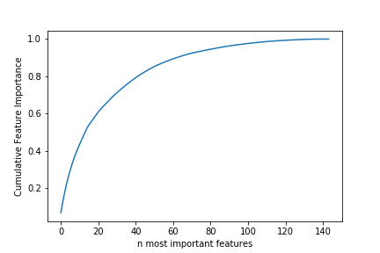
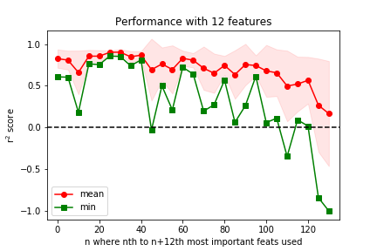
Feature Importances
Notes:
Our data is more monotonic, though not losing as much information as we might have initially expected.
For density it looks like we need far more than 12 features to capture say, 0.8 importance, and mean r2 performance tracks this (not getting close to 0.97 as we had before)

Slide 23
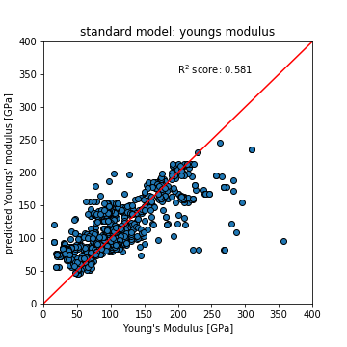
Young’s Modulus performs worse with standard model
Youngs Model | Importance
mean GSvolume_pa | 0.0576
minimum CovalentRadius | 0.0478
mean MeltingT | 0.0457
minimum GSvolume_pa | 0.0448
mean Electronegativity | 0.0399
mode GSvolume_pa | 0.0346
maximum MeltingT | 0.0323
mean GSmagmom | 0.0317
mode GSmagmom | 0.0269
avg_dev GSbandgap | 0.0251
mode MeltingT | 0.0189
avg_dev GSmagmom | 0.0179
mode Electronegativity | 0.0173

Slide 24
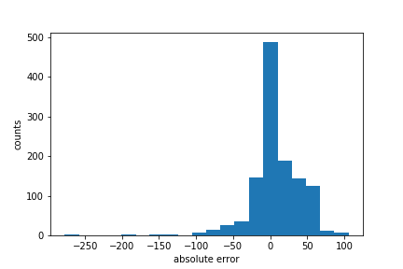
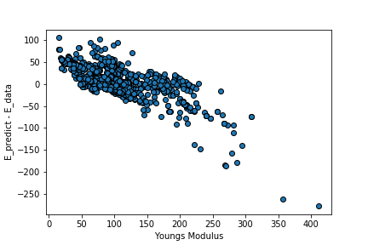

Slide 25
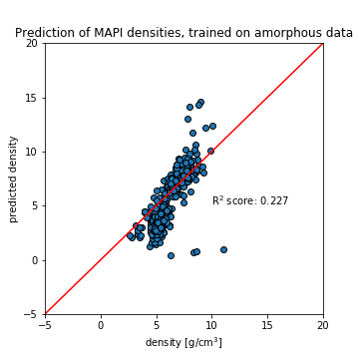
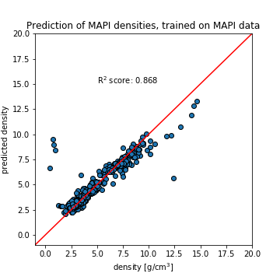
Materials Project Predictions (downsampled for speed)
Without 4 outliers: r²=0.9421

Slide 26
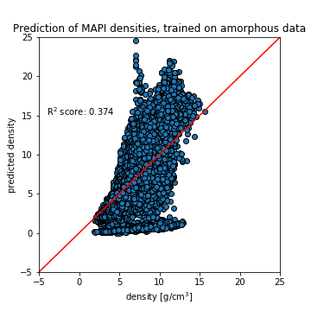
Materials Project Predictions
Crystalline data not predicted well by model trained on amorphous data. (as expected)

Slide 27
Vegard’s Law poorly predicts crystalline data

Slide 28
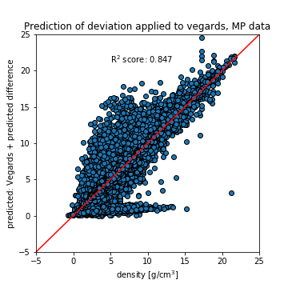
Comparison to Vegards Law
Prediction of deviation from Vegard’s law is roughly as good as amorphous case (r2 = 0.681),
Performance of (Vegard’s + deviation prediction) does not improve as much (0.819 → 0.847, 3.4% improvement, 15.5% of available improvement)

Slide 29
Materials Project Data
Full Model | Importance
mode Number | 0.0605
mode AtomicWeight | 0.0603
mean NValence | 0.0566
mode NValence | 0.0538
mean Number | 0.0409
mean Electronegativity | 0.0304
mean AtomicWeight | 0.0302
mode Column | 0.0300
mode MeltingT | 0.0274
Crystalline Model | Importance
mean AtomicWeight | 0.0772
mean Number | 0.0688
mean MeltingT | 0.0558
mean NdValence | 0.0497
mean Row | 0.0461
avg d valence electrons | 0.0390
mode MendeleevNumber | 0.0339
mode MeltingT | 0.0335
mean Electronegativity | 0.0305
mean CovalentRadius | 0.0202

Slide 30
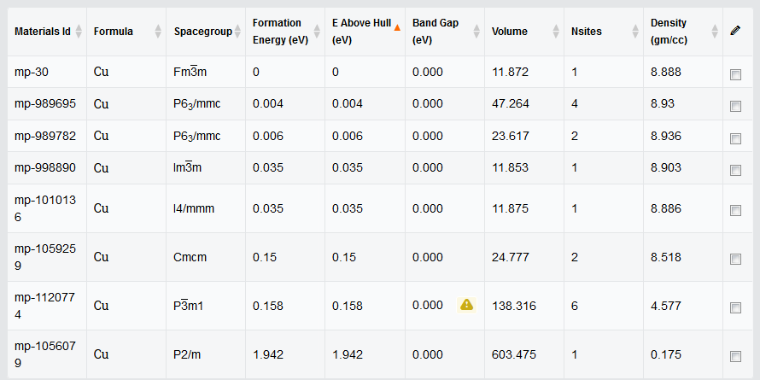
Outliers in MAPI data
Cu, Ta: one data point with extremely low density, 8 data points total (0.2 vs 8.8), (0.9 vs 15ish)
CeSe2: 45/176 abnormally low (2-3 vs 5-6)

