Slide 1
Mechanical Property Machine Learning Models
Summary of Results
Robert Tang-Kong

Slide 2
Figure 1: Schematic ML Model Flow
Show data/information reduction pathway.
Identify what in/out is, what we have and what we want.
Identify where gaps used to be, or where Matminer fits in?
ability to produce large amounts of features quickly
Facilitates discussion of {dataset, features, and models}

Slide 3
Figure A: All scatter plots for MG

Slide 4
Table A: R² for MG

Slide 5
Generation definitions
gen-0: No changes to data, raw model.
gen-1: outliers removed, model retrained
gen-2: features reduced, model retrained
gen-3: vegards + diff, model trained on deviation from vegards
Retrain at each Generation

Slide 6
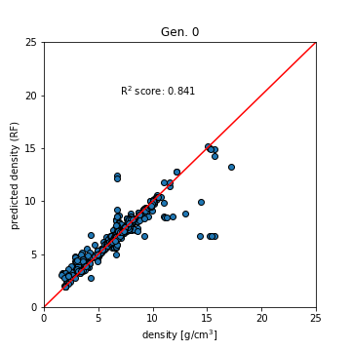
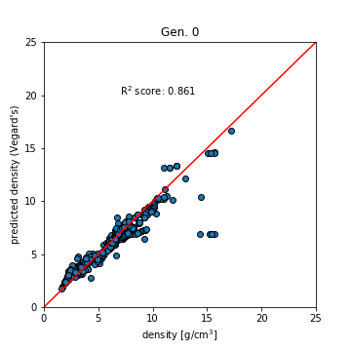
Raw Data (generation 0)

Slide 7
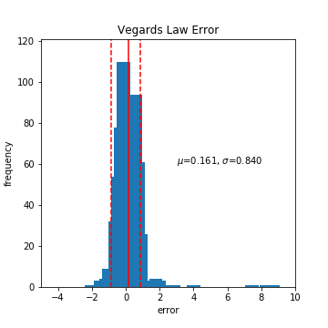
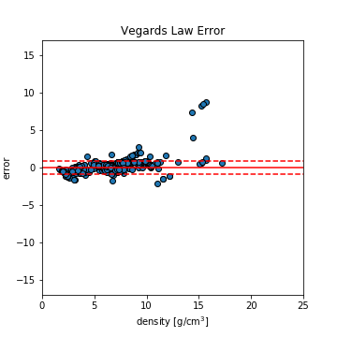
Data at gen-0 (before outlier removal)

Slide 8
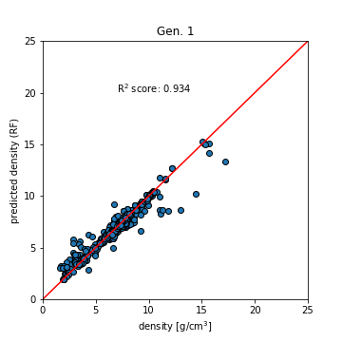

Removed outliers

Slide 9
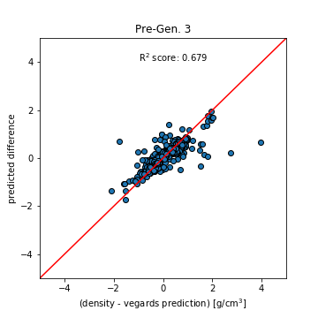
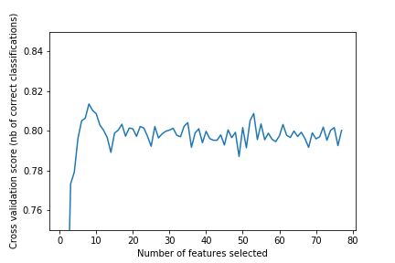
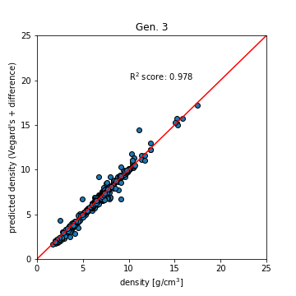
Methods for more mature ML models
Feature elimination/reduction
RFECV
Boosting using existing models
Notes:
Both can be used to reveal which features are most important in a given model
For a less interpretable model, local importances can be extracted with something like LIME.

Slide 10
Features, and what might be learned from them?

Slide 11
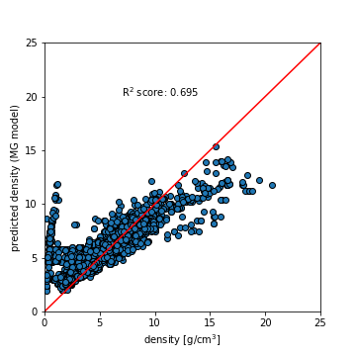
CR with MG model

Slide 12
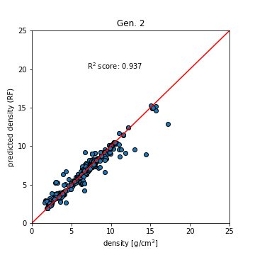

Figure 3: Performance of ML on predicting density of amorphous glasses vs Vegard’s Law
Show efficacy of pre-existing theory?
Why is this so effective? Acting as essentially hard spheres?
Seeing a perfect (almost) gradation between close packing structures
Look at the features involved, they are understandably tied to things like radii
Learning where we deviate from the agreed theory is notably more effective
Is essentially highly weighting our prior understanding and focusing the model on deviations from it.4
Also can reveal what elemental properties are relevant for improvements in learning.
R² Score | Gen. 0 | Gen. 1 | Gen. 2 | Gen. 3
RF | 0.841 | 0.934 | 0.937 | 0.974
Vegard’s | 0.861 | 0.930 | 0.930 | 0.930

Slide 13
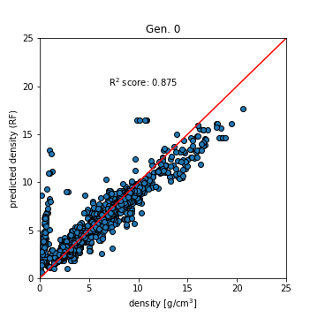
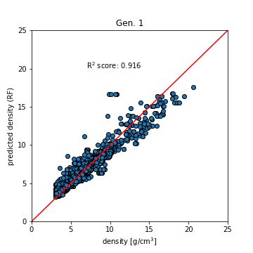

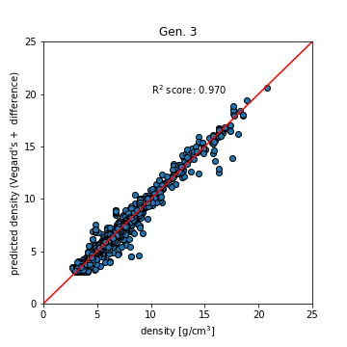
Figure 4: Performance of density predictions on MP dataset??
All Materials Project Data
(Trained on amorphous data) (Vegards law prediction) (Trained on MAPI data)
(Prediction of deviation from Vegards) (Prediction using deviation)
R² Score | Gen. 0 | Gen. 1 | Gen. 2 | Gen. 3
RF | 0.875 | 0.916 | 0.925 | 0.970
Vegard’s | 0.792 | 0.848 | 0.848 | 0.848
Notes:
Model trained on metallic glasses doesn’t do well, but this is very much to be expected.
What do features tell us? What’s different about this behavior?
Training on the crystalline dataset affords us some improvements, but not a huge amount.

Slide 14
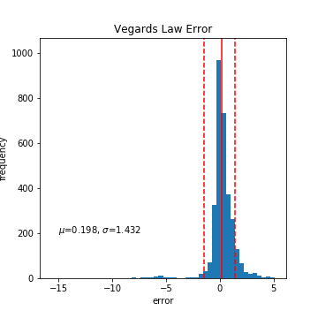
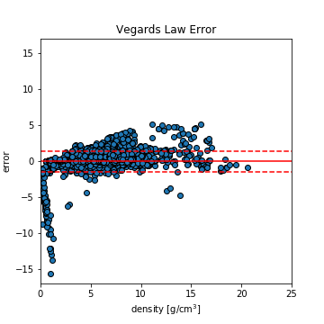

Slide 16
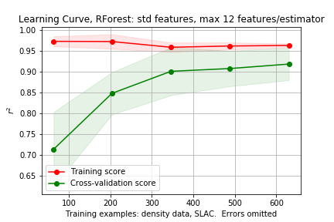
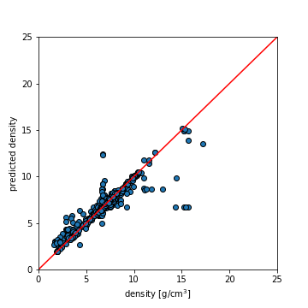
Initial models, density
Use density data as initial judge of model efficacy
Random Forest, 12 feat/estimator
Standard magpie features
Removing single elements and problem compositions
Thoughts
Model not generalizing well, but good accuracy

Slide 17
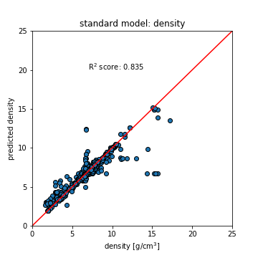
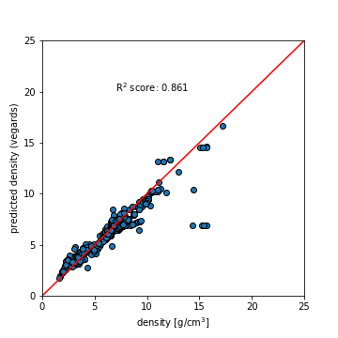
Initial models, density: Vegard’s law
We don’t beat the rule of mixtures quite yet…
Vegard’s law

Slide 18
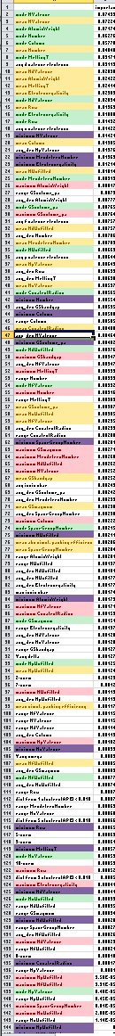
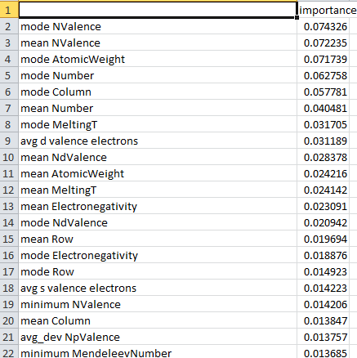
Feature Exploration: Density
Looking at density model features, ordered by importance
Mode, mean trend to the top, while min/max seem less important → Could justifiably leave out min/max
Near top, both mode and mean of same property appear together → may only need to choose one of mode/mean
These all come from cf.Stoichiometry(), which supplies 130 features…. Could cut down significantly
Green → mode
Yellow → Mean
Purple → Minimum
Red → Maximum

Slide 19
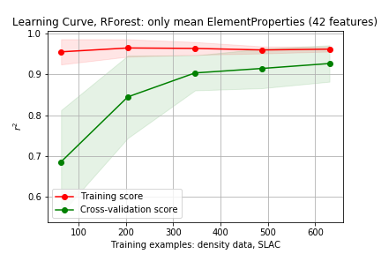
Fitting model with reduced feature set
Use only mean ElementProperty features
Not much of a change…
All 152 features

Slide 20
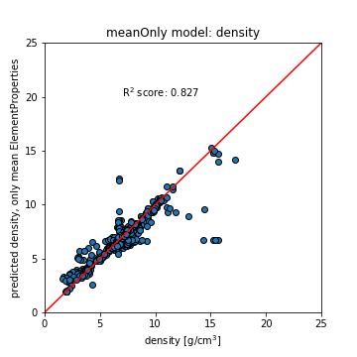
Fitting model with reduced feature set
Using only mean
Standard features

Slide 21
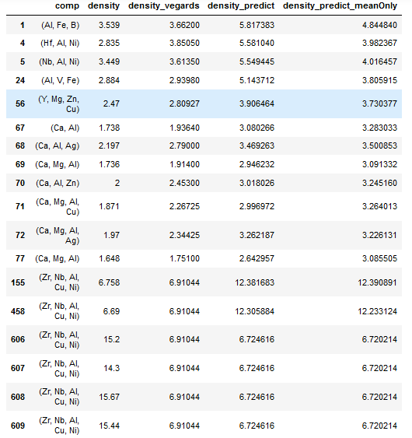
Outlier Data points
All highlighted compositions are:
Zr₅₇ Nb₅ Al₁₀ Cu_{15.4} Ni_{12.6}

Slide 22
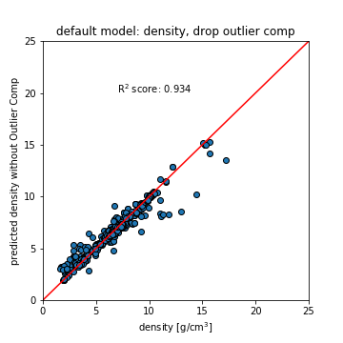
Outlier Data points: v2
Cu_{1.5}Si_{1.5}Ag_{0.3}B₄P₁₈Pt_{74.7}
Ta₂₁Co₁₁Ni₁₈
Hf₄₆Nb₂Al₁₃Cu_{29.25}Ni_{9.75}
Fe₉P₅Pt₆

Slide 23
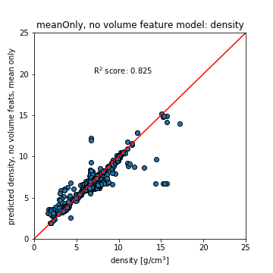
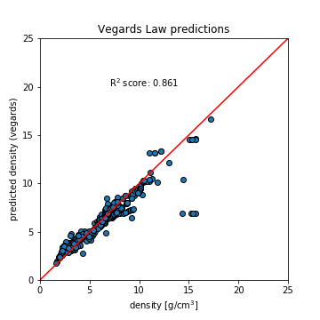
Dropping GSvolume, Covalent Radius

Slide 24
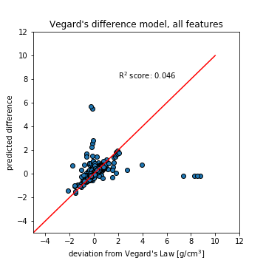
Model difference between real and Vegard’s law
Without outliers (same problem composition), r² = 0.479
Without outliers the original model gives up to r² = 0.913

Slide 26
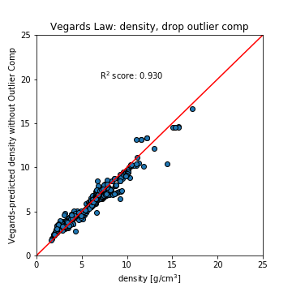
Training Default Model without problem composition

Slide 27
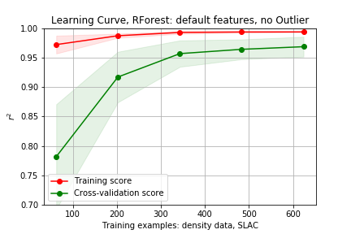
Learning curve without outlier composition
Seems to perform as good if not better than Vegard’s law without those compositions
(R² very sensitive to outliers)
Not much to learn/improve on here.

Slide 28
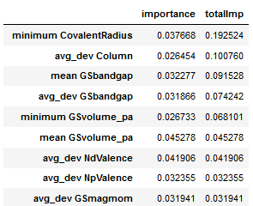
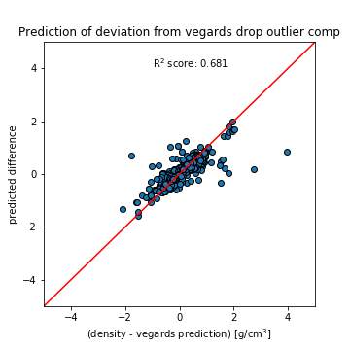
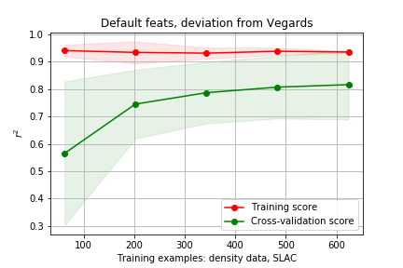
Can we learn where Vegard’s law is lacking?
Features gathered over 5 training splits (used to make scatter plot)

Slide 29
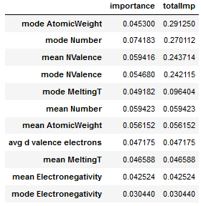
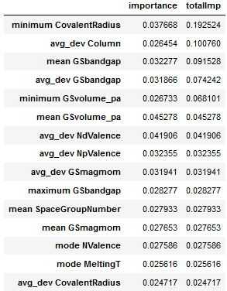
Investigating features used in models
Predicting Density deviation from Vegard’s law
Predicting Density
Notes:
Training performed 5 times, top 5 from each instance collected.
Duplicate features (across separate training instances) have their importances summed to give a sort of averaged importance
Only melting Temperature in common

Slide 30
Full Model vs Difference Model (pre rfecv)
Full Model | Importance | Rank in Diff Model
mode Number | 0.0605 | 38
mode AtomicWeight | 0.0603 | 39
mean NValence | 0.0566 | 36
mode NValence | 0.0538 | 7
mean Number | 0.0409 | 58
mean Electronegativity | 0.0304 | 19
mean AtomicWeight | 0.0302 | 61
mode Column | 0.0300 | 25
mode MeltingT | 0.0274 | 11
Difference Model | Importance | Rank in Full Model
avg_dev Column | 0.0330 | 86
minimum CovalentRadius | 0.0322 | 92
mean GSbandgap | 0.0294 | 34
avg_dev NpValence | 0.0257 | 35
avg_dev GSbandgap | 0.0251 | 23
mode NValence | 0.0233 | 5
minimum GSvolume_pa | 0.0218 | 93
mean GSmagmom | 0.0195 | 91
mean GSvolume_pa | 0.0191 | 57
Notes:
Train on Vegards data exactly
Look up feats
Look at next few feats
Youngs mod
MP API To check and see other comps, see how model compares to DFT

Slide 31
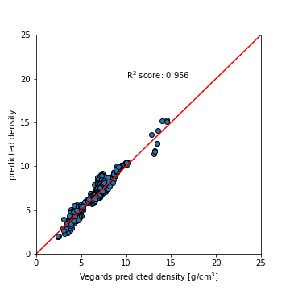
Vegards Model vs Difference Model
Vegards Prediction Model | Importance | Rank in Diff Model
mode AtomicWeight | 0.0676 | 39
mean NValence | 0.0587 | 36
mode Number | 0.0522 | 38
avg d valence electrons | 0.0446 | 51
mode NValence | 0.0441 | 7
mean NdValence | 0.0440 | 48
mean Number | 0.0397 | 58
mean AtomicWeight | 0.0352 | 61
mean Electronegativity | 0.0279 | 19
Difference Model | Importance | Rank in Full Model
avg_dev Column | 0.0330 | 86
minimum CovalentRadius | 0.0322 | 92
mean GSbandgap | 0.0294 | 34
avg_dev NpValence | 0.0257 | 35
avg_dev GSbandgap | 0.0251 | 23
mode NValence | 0.0233 | 5
minimum GSvolume_pa | 0.0218 | 93
mean GSmagmom | 0.0195 | 91
mean GSvolume_pa | 0.0191 | 57
Train model on vegards law predictions directly

Slide 32
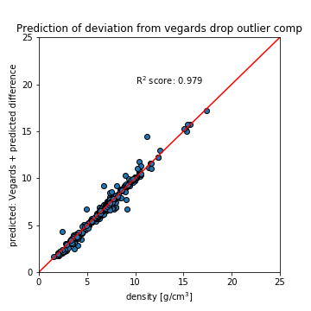
Looking at improvement on Vegard’s Law Predictions
(0.93 → 0.979, 5.04% improvement, 70% of available improvement)
r² for difference predictions = 0.681
Notes:
V+diff > full RF model > Vegards law.
Why doesn’t RF model do as well? It has all the same features…
What do we learn from physics

Slide 33
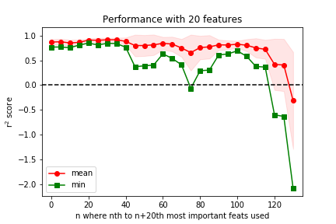
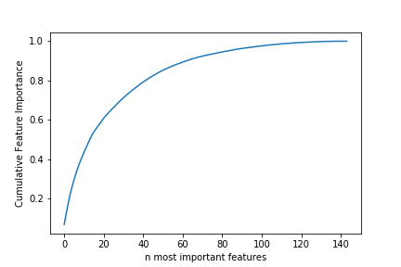
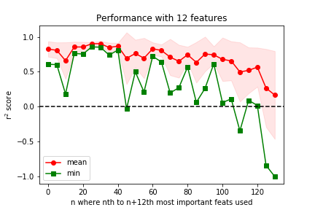
Feature Importances
Notes:
Our data is more monotonic, though not losing as much information as we might have initially expected.
For density it looks like we need far more than 12 features to capture say, 0.8 importance, and mean r2 performance tracks this (not getting close to 0.97 as we had before)

Slide 34
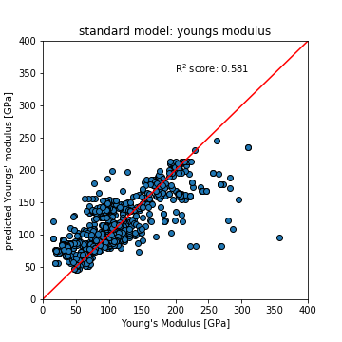
Young’s Modulus performs worse with standard model
Youngs Model | Importance
mean GSvolume_pa | 0.0576
minimum CovalentRadius | 0.0478
mean MeltingT | 0.0457
minimum GSvolume_pa | 0.0448
mean Electronegativity | 0.0399
mode GSvolume_pa | 0.0346
maximum MeltingT | 0.0323
mean GSmagmom | 0.0317
mode GSmagmom | 0.0269
avg_dev GSbandgap | 0.0251
mode MeltingT | 0.0189
avg_dev GSmagmom | 0.0179
mode Electronegativity | 0.0173

Slide 35
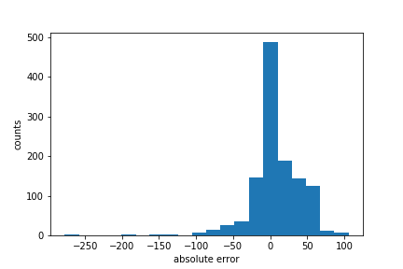
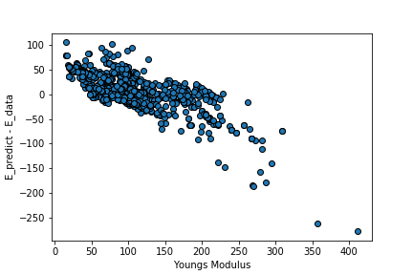

Slide 36
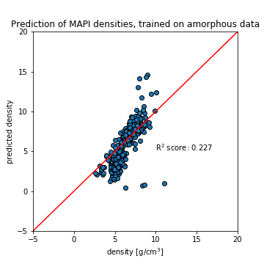
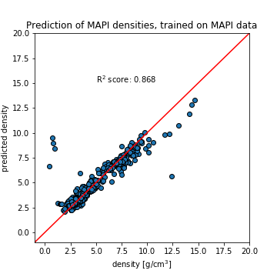
Materials Project Predictions (downsampled for speed)
Without 4 outliers: r²=0.9421

Slide 37
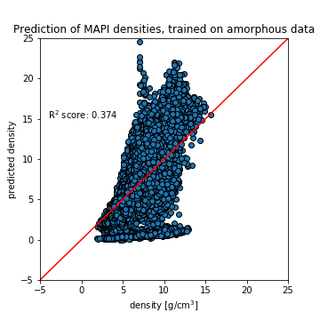
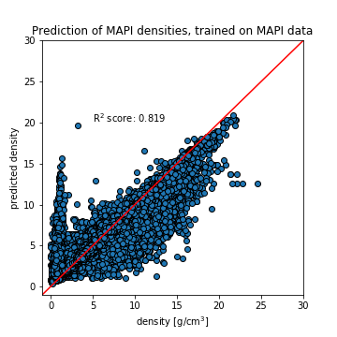
Materials Project Predictions
Crystalline data not predicted well by model trained on amorphous data. (as expected)
Notes:
Data is all materials project entries with density and <= 3 elements: ~50k data points
Taking only data within the same ternaries as own database: ~5k data points

Slide 38
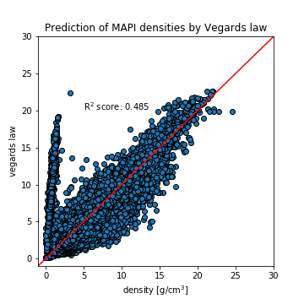
Vegard’s Law poorly predicts crystalline data

Slide 39
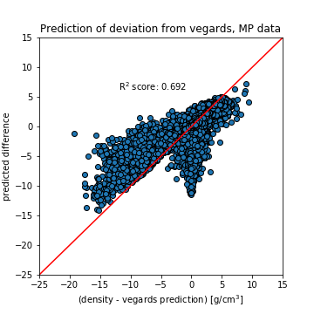
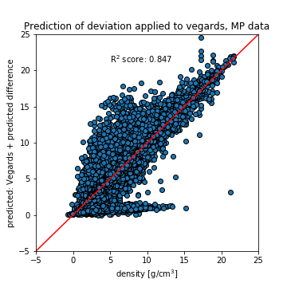
Comparison to Vegards Law
Prediction of deviation from Vegard’s law is roughly as good as amorphous case (r2 = 0.681),
Performance of (Vegard’s + deviation prediction) does not improve as much (0.819 → 0.847, 3.4% improvement, 15.5% of available improvement)

Slide 40
Materials Project Data
Full Model | Importance
mode Number | 0.0605
mode AtomicWeight | 0.0603
mean NValence | 0.0566
mode NValence | 0.0538
mean Number | 0.0409
mean Electronegativity | 0.0304
mean AtomicWeight | 0.0302
mode Column | 0.0300
mode MeltingT | 0.0274
Crystalline Model | Importance
mean AtomicWeight | 0.0772
mean Number | 0.0688
mean MeltingT | 0.0558
mean NdValence | 0.0497
mean Row | 0.0461
avg d valence electrons | 0.0390
mode MendeleevNumber | 0.0339
mode MeltingT | 0.0335
mean Electronegativity | 0.0305
mean CovalentRadius | 0.0202

Slide 41

Outliers in MAPI data
Cu, Ta: one data point with extremely low density, 8 data points total (0.2 vs 8.8), (0.9 vs 15ish)
CeSe2: 45/176 abnormally low (2-3 vs 5-6)

