Slide 1
Mechanical Property Machine Learning Models
Summary of Results
Robert Tang-Kong

Slide 2
Density Story: Failure
How do models fail?
Typographical errors
Modeling / physics errors
Can we beat simple models?
Can we learn from the deviation from these simple models?
Are we missing ensemble properties?

Slide 3
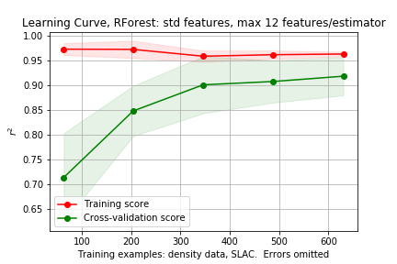
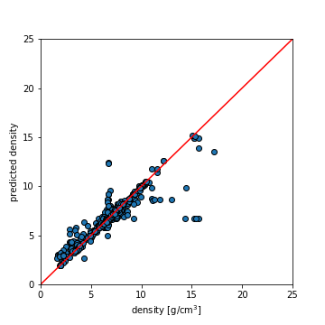
Initial models, density
Use density data as initial judge of model efficacy
Random Forest, 12 feat/estimator
Standard magpie features
Removing single elements and problem compositions
Thoughts
Model not generalizing well, but good accuracy

Slide 4
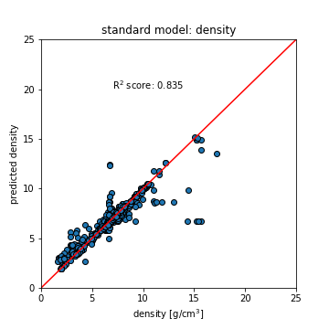
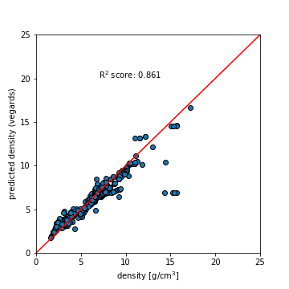
Initial models, density: Vegard’s law
We don’t beat the rule of mixtures quite yet…
Vegard’s law

Slide 5
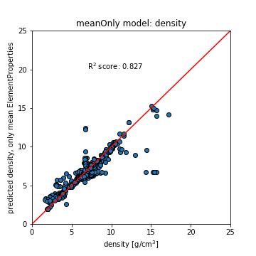
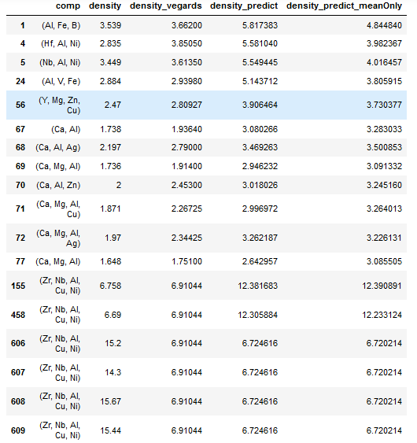
Outlier Data points
All highlighted compositions are:
Zr₅₇ Nb₅ Al₁₀ Cu_{15.4} Ni_{12.6}

Slide 6
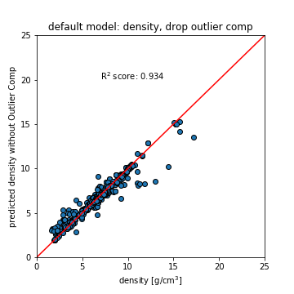
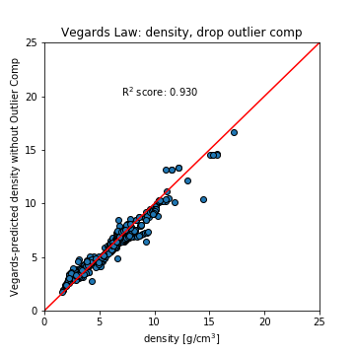
Training Default Model without problem composition

Slide 7
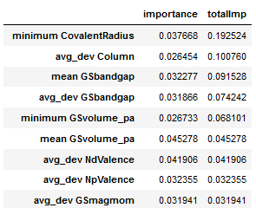
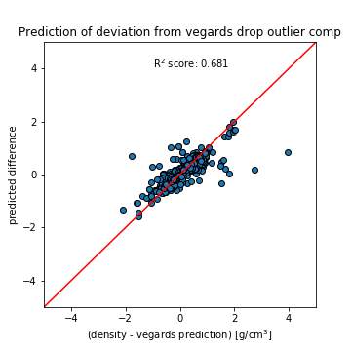
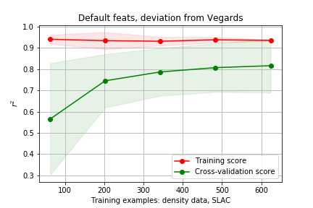
Can we learn where Vegard’s law is lacking?
Features gathered over 5 training splits (used to make scatter plot)

Slide 8
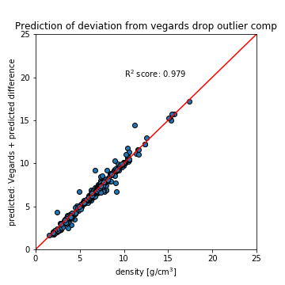
Looking at improvement on Vegard’s Law Predictions
(Vegards + predicted difference)
Notes:
V+diff > full RF model > Vegards law.
Why doesn’t RF model do as well? It has all the same features…
What do we learn from physics

Slide 9
Full Model vs Difference Model
Full Model | Importance | Rank in Diff Model
mode Number | 0.0605 | 38
mode AtomicWeight | 0.0603 | 39
mean NValence | 0.0566 | 36
mode NValence | 0.0538 | 7
mean Number | 0.0409 | 58
mean Electronegativity | 0.0304 | 19
mean AtomicWeight | 0.0302 | 61
mode Column | 0.0300 | 25
mode MeltingT | 0.0274 | 11
Difference Model | Importance | Rank in Full Model
avg_dev Column | 0.0330 | 86
minimum CovalentRadius | 0.0322 | 92
mean GSbandgap | 0.0294 | 34
avg_dev NpValence | 0.0257 | 35
avg_dev GSbandgap | 0.0251 | 23
mode NValence | 0.0233 | 5
minimum GSvolume_pa | 0.0218 | 93
mean GSmagmom | 0.0195 | 91
mean GSvolume_pa | 0.0191 | 57
Notes:
Train on Vegards data exactly
Look up feats
Look at next few feats
Youngs mod
MP API To check and see other comps, see how model compares to DFT

Slide 10
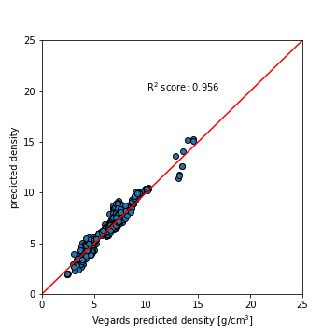
Vegards Model vs Difference Model
Vegards Prediction Model | Importance | Rank in Diff Model
mode AtomicWeight | 0.0676 | 39
mean NValence | 0.0587 | 36
mode Number | 0.0522 | 38
avg d valence electrons | 0.0446 | 51
mode NValence | 0.0441 | 7
mean NdValence | 0.0440 | 48
mean Number | 0.0397 | 58
mean AtomicWeight | 0.0352 | 61
mean Electronegativity | 0.0279 | 19
Difference Model | Importance | Rank in Full Model
avg_dev Column | 0.0330 | 86
minimum CovalentRadius | 0.0322 | 92
mean GSbandgap | 0.0294 | 34
avg_dev NpValence | 0.0257 | 35
avg_dev GSbandgap | 0.0251 | 23
mode NValence | 0.0233 | 5
minimum GSvolume_pa | 0.0218 | 93
mean GSmagmom | 0.0195 | 91
mean GSvolume_pa | 0.0191 | 57
Train model on vegards law predictions directly

Slide 11
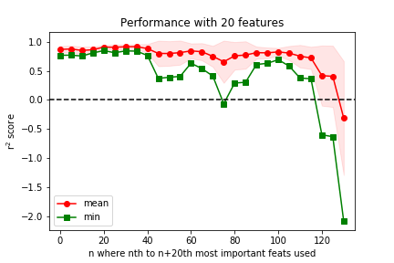
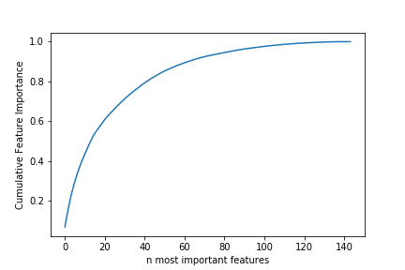
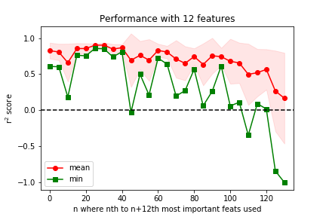
Feature Importances
Notes:
Our data is more monotonic, though not losing as much information as we might have initially expected.
For density it looks like we need far more than 12 features to capture say, 0.8 importance, and mean r2 performance tracks this (not getting close to 0.97 as we had before)

