Slide 1
Mechanical Property Machine Learning Models
Summary of Results
Robert Tang-Kong

Slide 2
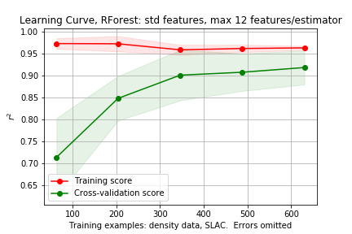
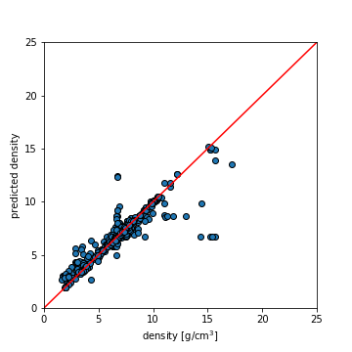
Initial models, density
Use density data as initial judge of model efficacy
Random Forest, 12 feat/estimator
Standard magpie features
Removing single elements and problem compositions
Thoughts
Model not generalizing well, but good accuracy

Slide 3
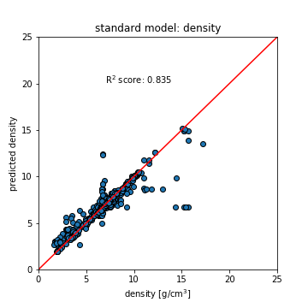
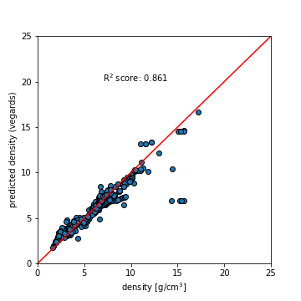
Initial models, density: Vegard’s law

Slide 4
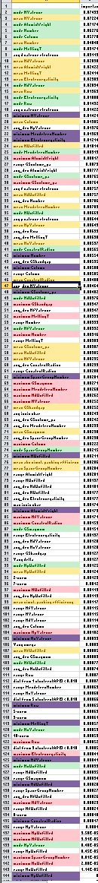
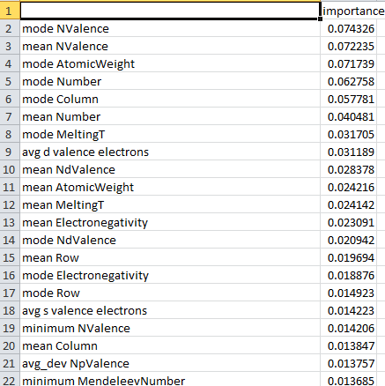
Feature Exploration: Density
Looking at density model features, ordered by importance
Mode, mean trend to the top, while min/max seem less important → Could justifiably leave out min/max
Near top, both mode and mean of same property appear together → may only need to choose one of mode/mean
These all come from cf.Stoichiometry(), which supplies 130 features…. Could cut down significantly for density specifically
Green → mode
Yellow → Mean
Purple → Minimum
Red → Maximum

Slide 5
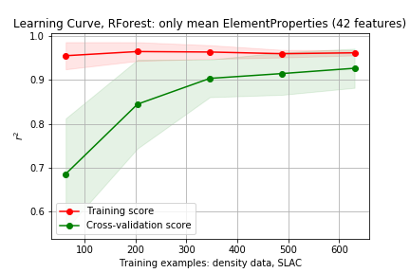
Fitting model with reduced feature set
Use only mean ElementProperty Feats
Not much of a change, actually

Slide 6
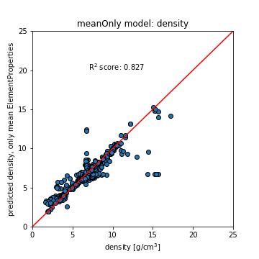
Fitting model with reduced feature set

Slide 7
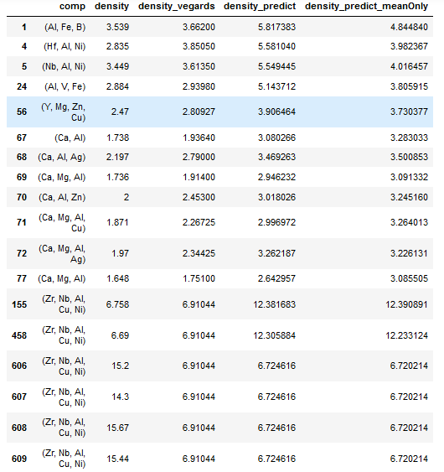
Outlier Data points
All highlighted compositions are:
Zr₅₇ Nb₅ Al₁₀ Cu_{15.4} Ni₁

