Slide 1
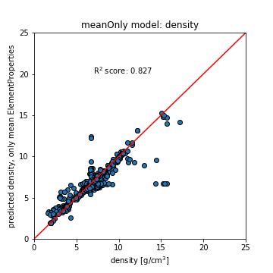
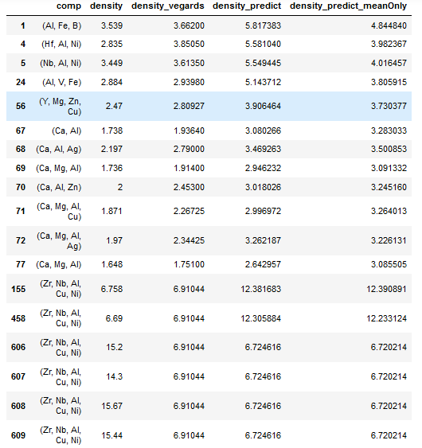
Outlier Data points
All highlighted compositions are:
Zr₅₇ Nb₅ Al₁₀ Cu_{15.4} Ni₁

