Slide 1
Hashing

Slide 2
Find pair with given sum in an array
Q: Given an unsorted integer array, find a pair with the given sum in it.
For example:
Input: array = [8, 7, 2, 5, 3, 1] target = 10 Output: Pair found (8, 2) or Pair found (7, 3)
Solution: We can use a hash table to solve this problem in linear time. The idea is to insert each array element nums[i] into a map.
We also check if difference (nums[i], target - nums[i]) already exists in the map or not.
If the difference is seen before, print the pair and return.

Slide 3
Find the duplicate element in a limited range array
Q: Given a limited range array of size n containing elements between 1 and n-1 with one element repeating, find the duplicate number in it without using any extra space.
Input: { 1, 2, 3, 4, 4 } Output: The duplicate element is 4
Solution: The idea is to use hashing to solve this problem. We can use a visited boolean array to mark if an element is seen before or not. If the element is already encountered before, the visited array will return true.

Slide 4
Find majority element
Q: Given an integer array containing duplicates, return the majority element if present. A majority element appears more than n/2 times, where n is the array size.
For example, the majority element is 2 in array {2, 8, 7, 2, 2, 5, 2, 3, 1, 2, 2}.
Solution: The idea is to store each element’s frequency in a map and return it if its frequency becomes more than n/2. If no such element is present, then the The majority element doesn’t exist in the array, and return -1.

Slide 5
Find all words that follow the same order of characters as given pattern
Q: Given a list of words and a pattern, find all words in the list that follows the same order of characters as that of the pattern.
Input: list = [leet, abcd, loot, geek, cool, for, peer, dear, seed, meet, noon, otto, mess, loss] pattern = moon (pattern is 4 digits with distinct character at first and last index, and same character at 1st and 2nd index) Output: [leet, loot, geek, cool, peer, seed, meet]

Slide 6
The idea is to use a map and associate each distinct character of the given word with the corresponding character in the pattern and store it.
For each character in both word and the pattern, if the character is seen before, it should only be mapped to the corresponding character in the pattern. Note that we also have to associate each character in the given pattern with the corresponding character in the given word and follow the same process.
Pattern: moon
Word: leet
Dic_1 = {‘l’:’m’,’e’:’o’,’t’:’n’}
Dic_2 = {‘m’:’l’,’o’:’e’,’n’:’t’}
Pattern: moon
Word: leat
Dic_1 = {‘l’:’m’,’e’:’o’,’a’:’o’,’t’:’n’}
Dic_2 = {‘m’:’l’,’o’:’e’,’n’:’t’}

Slide 7
Isomorphic Strings
Q: Given two strings, determine whether they are isomorphic. Two strings, X and Y, are called isomorphic if all occurrences of each character in X can be replaced with another character to get Y and vice-versa.
For example, consider strings ACAB and XCXY. They are isomorphic as we can map 'A' —> 'X', 'B' —> 'Y' and 'C' —> ‘C’.
Solution: The idea is to use hashing. The following solution uses a map to store a mapping from characters of string X to string Y and a set to store already mapped characters of string Y;

Slide 8
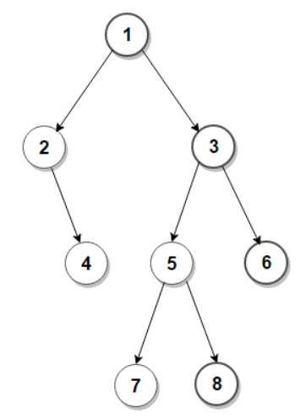
Print right view of a binary tree
Q: Given a binary tree, write an efficient algorithm to print its right view.
For example, the right view of the following binary tree is 1, 3, 6, 8
Solution: We can also solve this problem by using hashing. The idea is to traverse the tree in a preorder fashion and pass level information in function arguments. For every node encountered, insert the node and level information into the map. Finally, when all nodes are processed, traverse the map and print the right view.
Notes:
For example, the right view of the following binary tree is 1, 3, 6, 8

