Slide 1
Final Report
S(U)cheduler
Mengtao Tang, Le Sun

Slide 2
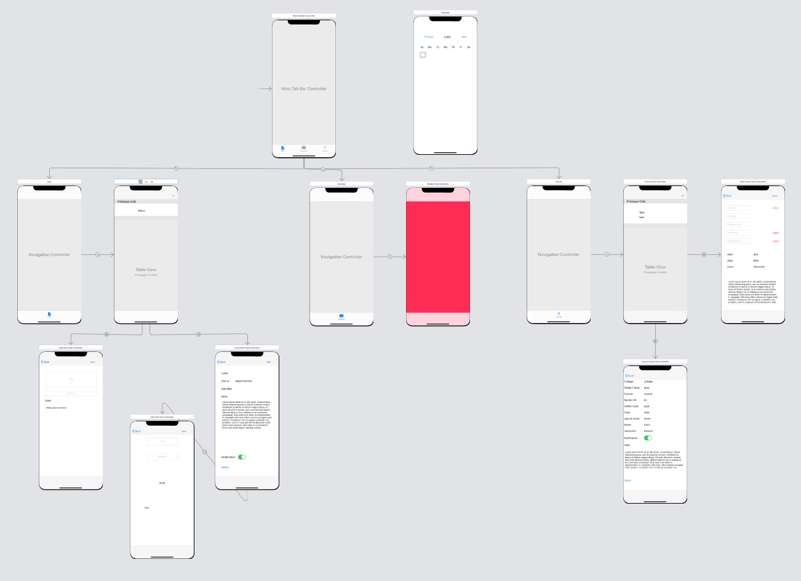
Overview

Slide 3
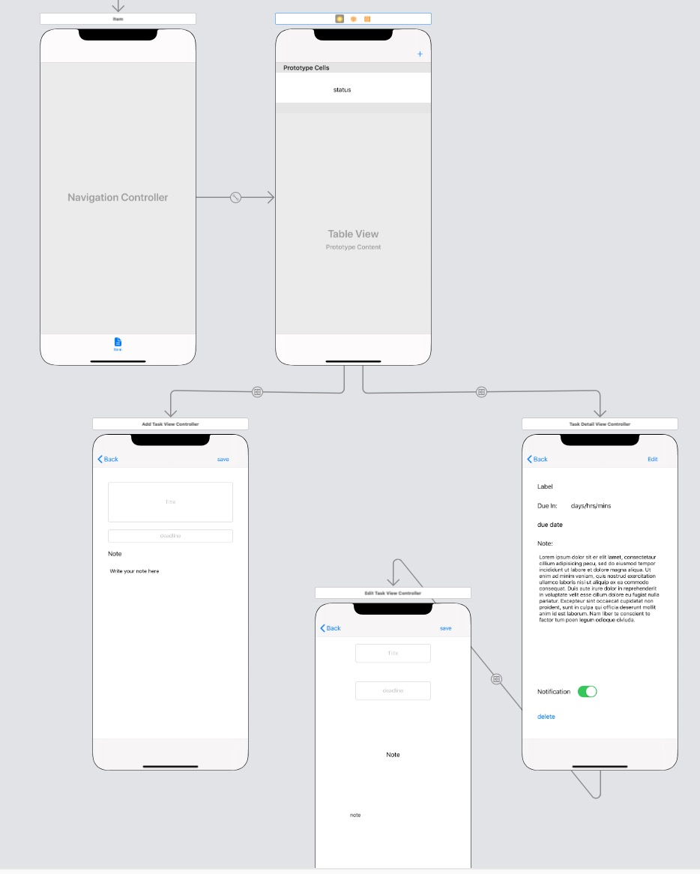
Task part

Slide 4
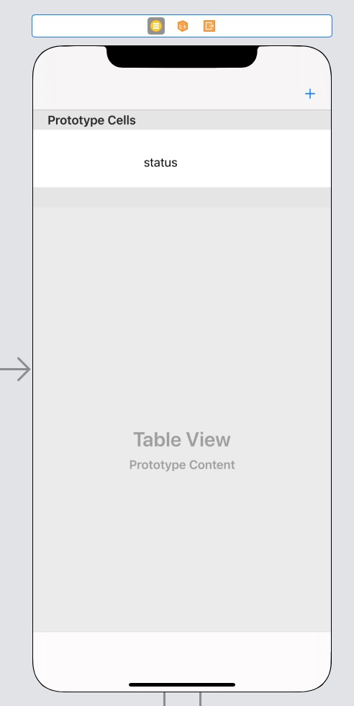
Task Table View Controller
AddTaskButton
TaskTitle_Label
TaskDLL_Label
TaskStatus_Label
AddTaskButton is a Navigation item, which will pop up the AddTaskView.
After we added a new task, we will call getTaskListByCategory() from the coredataRef and reload the tableView.
Then the tableViewCell will be updated, and show up all the tasks we have.
Clicking on a specific cell will pop up the TaskDetailView.
We will pass the current task: selectedObject and its id: selectedObjectID.

Slide 5
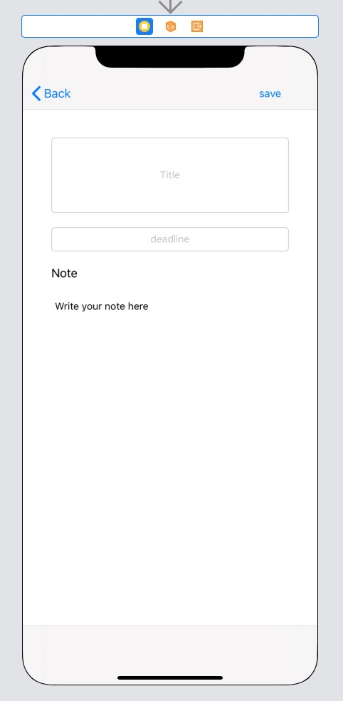
Add Task View Controller
Save_Button
TaskTitle_TextField
TaskDeadLine_TextField
Note_TextView
Inside of AddTaskViewController,
we created a coredata persistence to save this new task information in the local database.
let coredataRef = PersistenceManager.shared
createTask(): add task into core data
For the TaskDeadLine_TextField,
we created a DatePicker, so that user can select a date.
Clicking on Save_Button will go back to the TaskTableViewController.

Slide 6
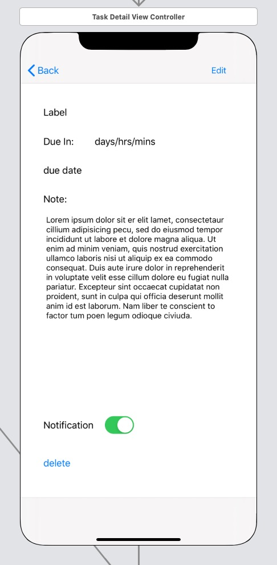
Task Detail View Controller
Edit_Button TaskTitle_Label
CountDown_Label DueDate_Label
Note_TextView Notification_Switch
Delete_Button
We will pass a selectedObject:Task? and a selectedObjectID: String from TaskTableViewController to the TaskDetailViewController.
We will load the data from the coredataRef using the selectedObjectID.
CountDown_Label will show up the time defference between the due date and today.
Notification_Switch will create a local notification request to the notification center.
We use the objectID as the identifier.
If Notification_Switch is off, then we remove the notification request by this identifier.
Clicking on Delete_Button will remove the current task object from coredataRef.
Clicking on Edit_button will pop up EditTaskView.
Still, we will pass the selectedObject.

Slide 7
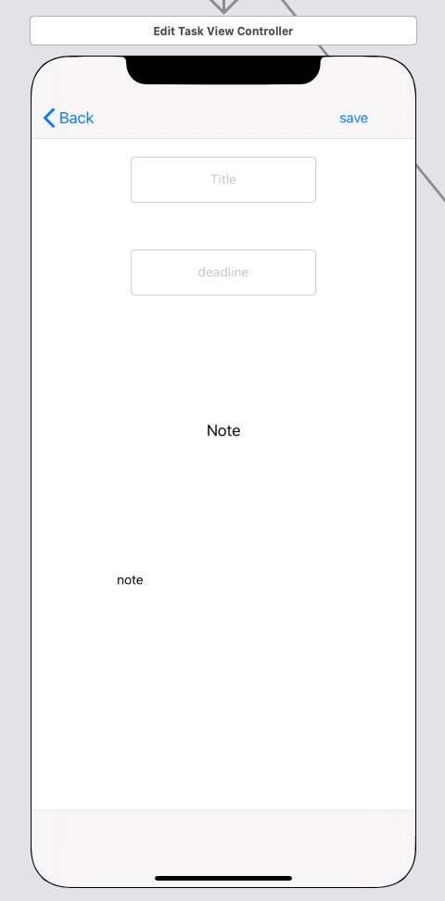
Edit Task View Controller
TaskTitle_TextField
TaskDDL_TextField
Note_TextView
Save_Button
This view is the same as the AddTaskView.
But first it will load the data from the selectedObject.
Then we just need to change fields and save it.
Clicking on Save_button will save all the fields into coredataRef.

Slide 8
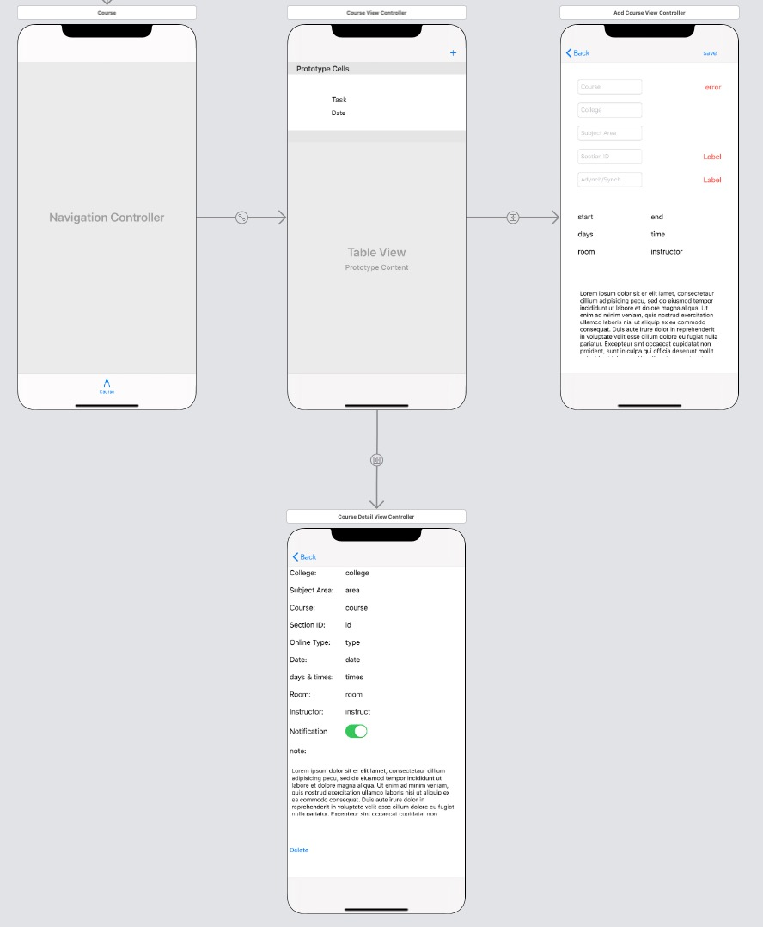
Course part

Slide 9
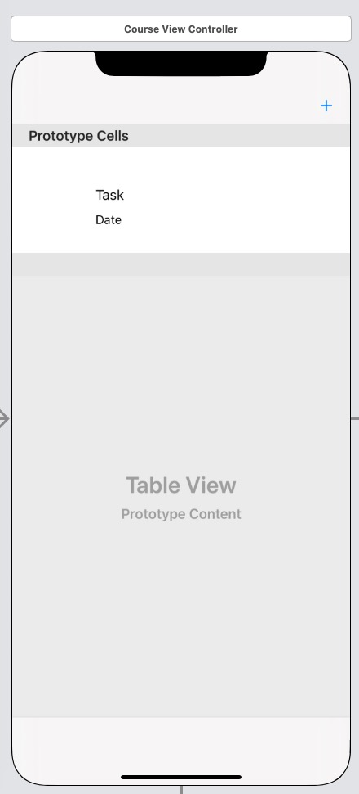
Course View Controller
CourseTableView
AddCourseButton
dateLabel
courseLabel
AddCourseButtonis a Navigation item, which will pop up the AddCourseView.
After we added a new course, we will call getCourseList() from the coredataRef and reload the tableView.
Then the tableViewCell will be updated, and show up all the courses we have.
Clicking on a specific cell will pop up the CourseDetailView.
We will pass the current course object.

Slide 10
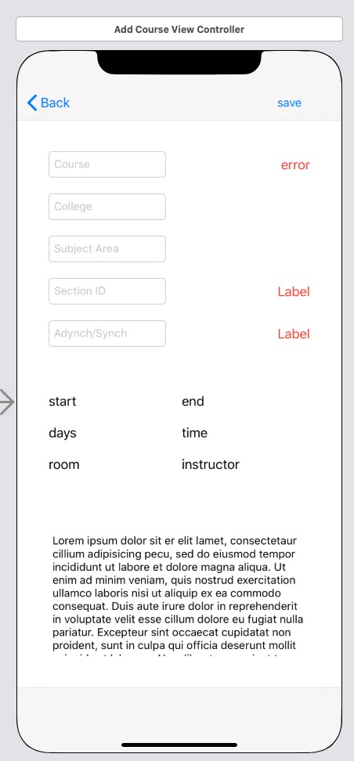
Add Course View Controller
Save_Button
5 TextField above
3 hided Label for showing error/remind
6 Label to show the course information
Description_TextView
We use Firebase to hold the database for the courses.
course code is used as the documentID, and each course has a sections subcollection with sectionID. Online course section will have a onlineType subcollection with either asynch or synch as the document id.
User only need to enter the course code and select sectionID & onlineType to get the whole course information.

Slide 11
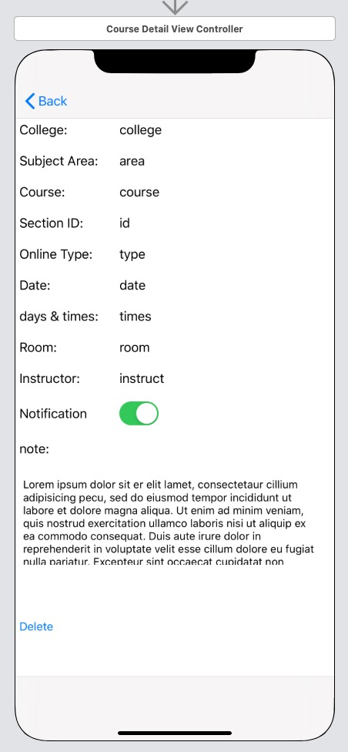
Course Detail View Controller
9 Label to show the course information
Notification_Switch
Note_TextView
Delete_Button
We will load the load from the courseObj passed by Course View Controller.
Notification_Switch will create several local notification requests to the notification center.
Since we want to set notification for the class in the whole semester, we will first get a dateList using this course's weekdays, startDate and endDate.
Then we use the objectID as the first identifier.
The identifier for the rest requests will be added by a count number.
This count number is from 0 to dateList.length.
So we have several notification requests for a single course.
If Notification_Switch is off, then we remove the notification request by a list of identifier.
Clicking on Delete_Button will remove the current course object from coredataRef.

Slide 12
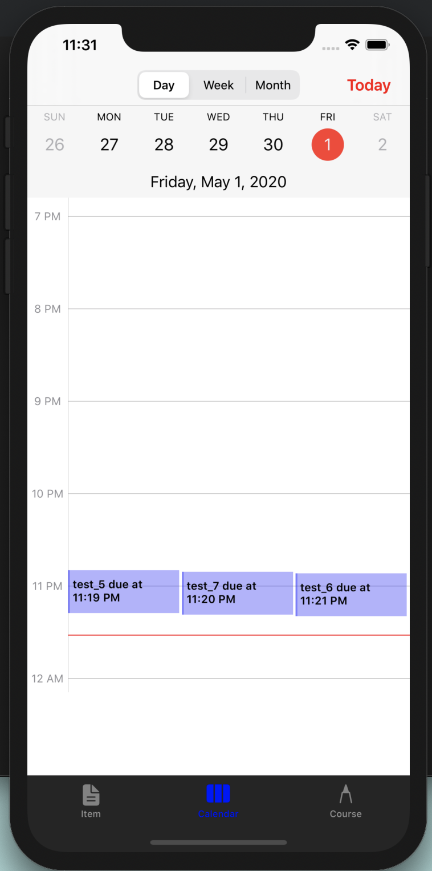
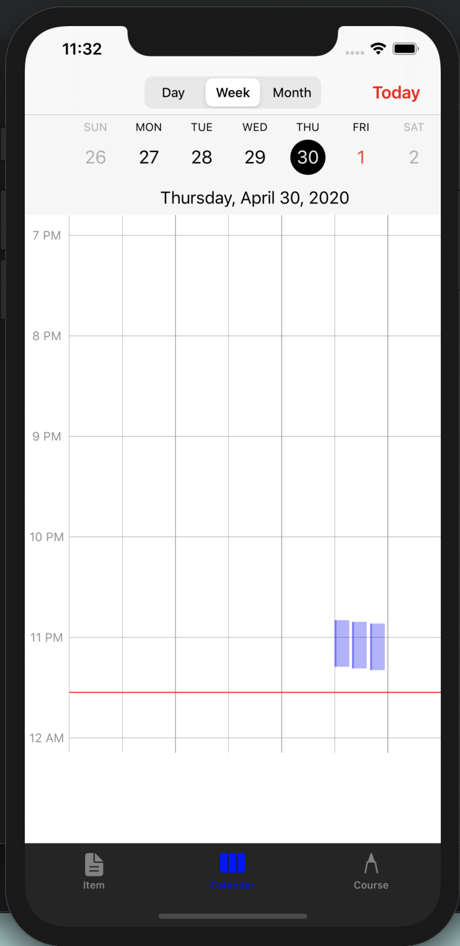
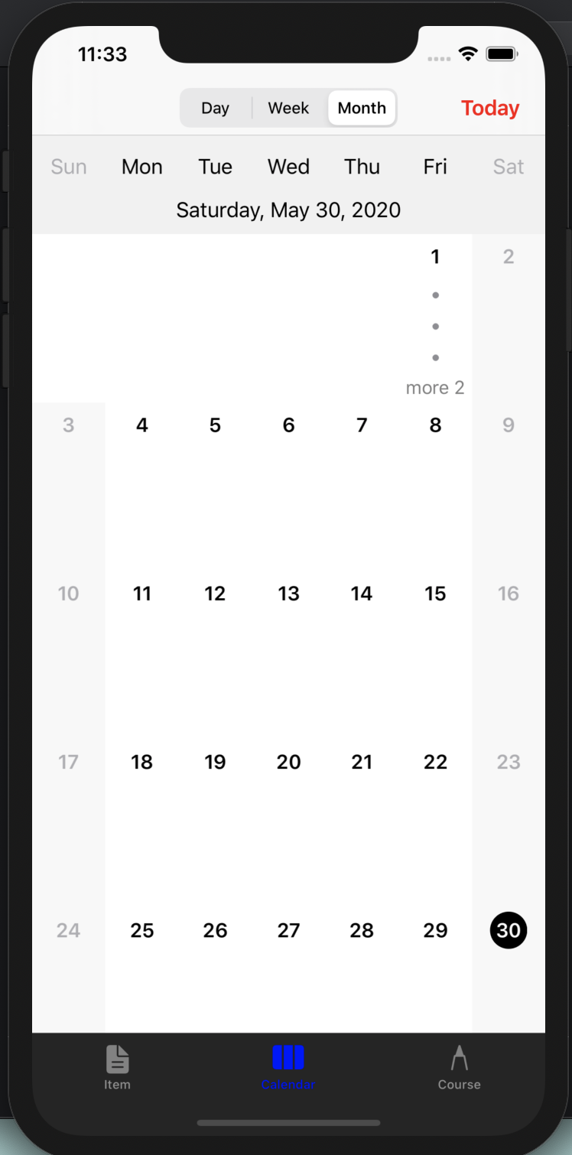
Calendar part
Segmented Controller
Day View - Scrollable UIView
Week View – Scrollable UIView
Month View – Collection View

Slide 13
Calendar
Day Header
Scrollable Collection View
Scrollable Collection View Cell
Today to Navigate
Timeline Bar
UIScrollView
Grid Biew
UIScrollView
Event Block
  Time Comparator
  Subview Drawing

Slide 14
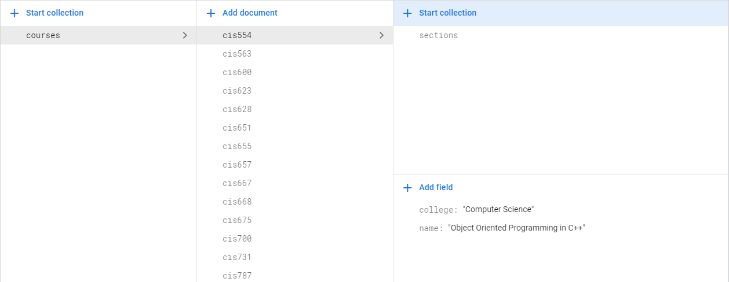
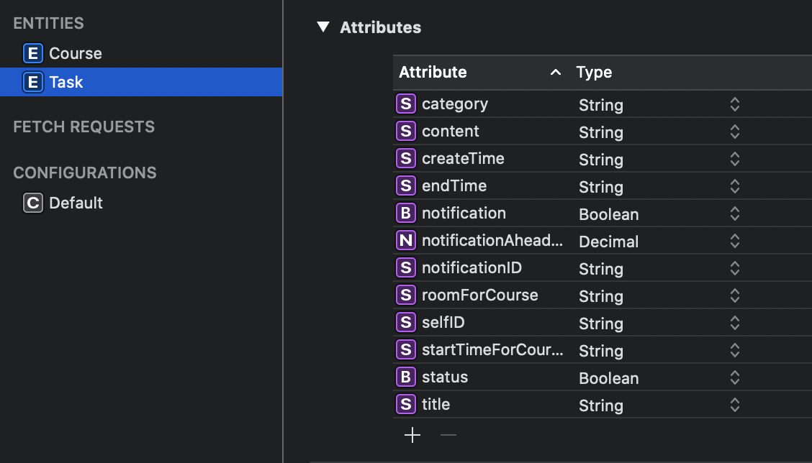
Database
Firebase Cloud Database
SU Course Information
Coredata Local Database
Scheduler Information
  Task Entity
  Course Entity

Slide 15
Thank you !

