Slide 1

Creating Your First Android Application
Hello World!
Notes:
Testing notes

Slide 2
Today's Agenda
Create an Android Project in Eclipse
Run the Android Application
Run your app from the command line
Notes:
Notes page 2

Slide 3
Create an Android Project in Eclipse
Click New in the toolbar or File → New → Android Application Project.
Fill in the form that appears:
Application Name
Project Name
Package Name
Minimum Required SDK
Target SDK
Compile With
Theme
Click Next.
Leave the default selections and click Next
Select BlankActivity and click Next.
Click Finish.

Slide 4
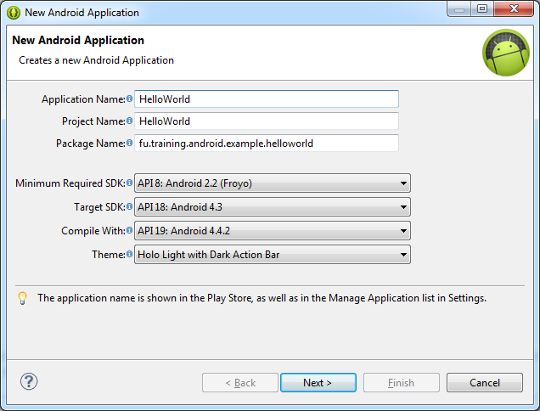
Create an Android Project in Eclipse

Slide 5
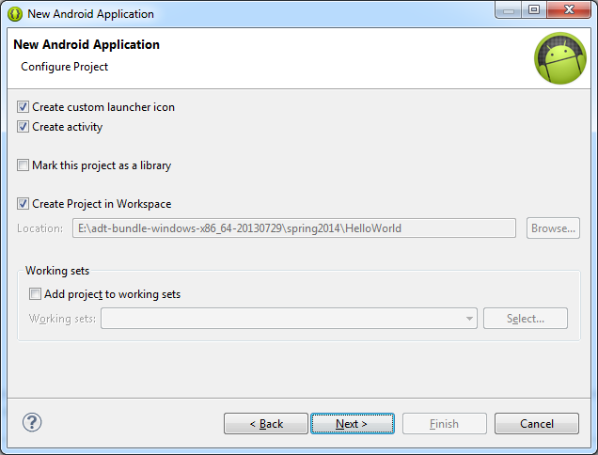
Create an Android Project in Eclipse

Slide 6
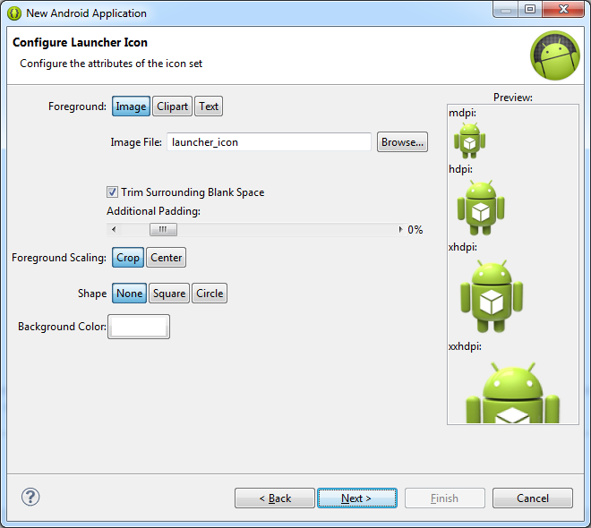
Create an Android Project in Eclipse

Slide 7
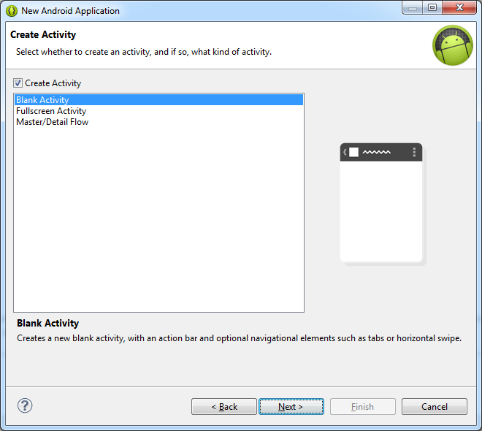
Create an Android Project in Eclipse

Slide 8
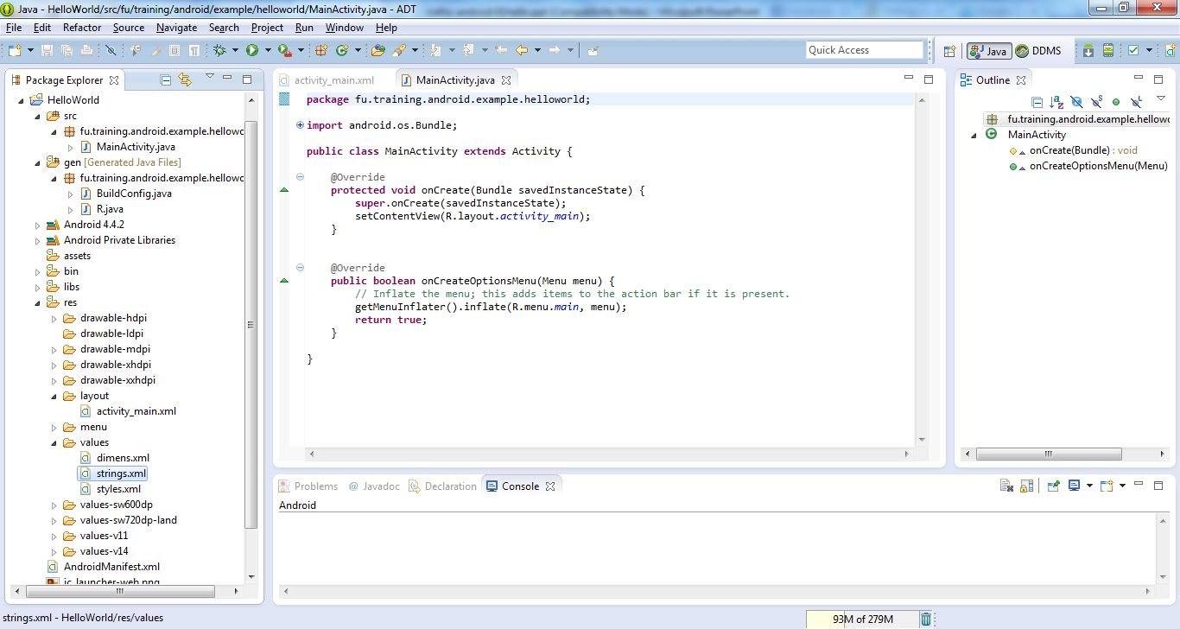
Create an Android Project in Eclipse

Slide 9
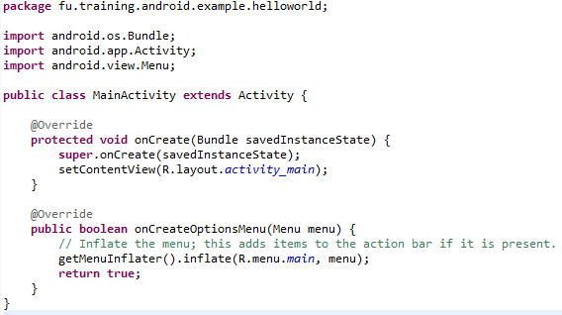
MainActivity.java

Slide 10
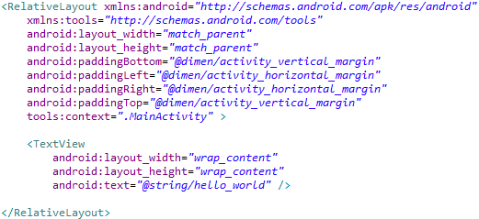
activity_main.xml

Slide 11
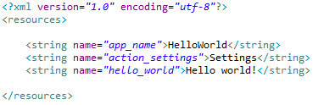
strings.xml

Slide 12
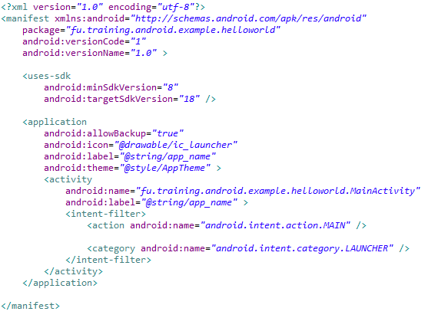
AndroidManifest.xml

Slide 13
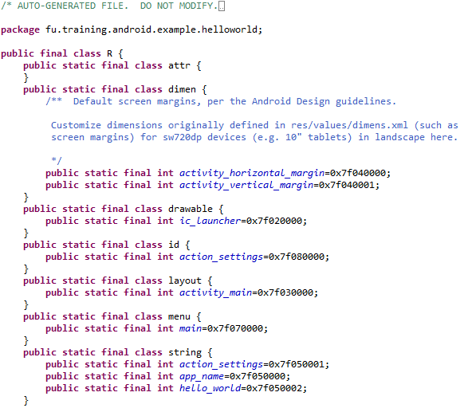
R.java

Slide 14
Run the Android Application
Run → Run (or click the “Run” button)
Select “Android Application”
The emulator may take a few minutes to start, so be patient!
You don't need to restart the emulator when you have a new version of your application

Slide 15
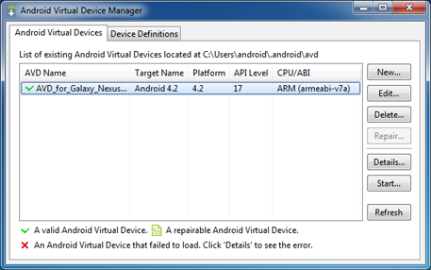
Run the Android Application

Slide 16
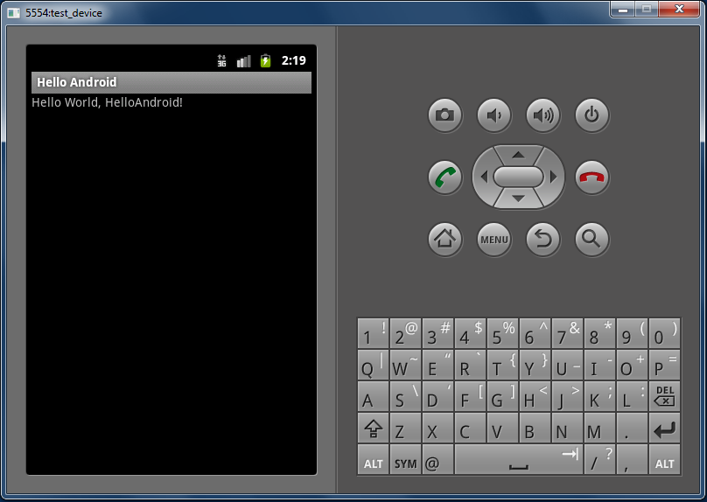
Run the Android Application

Slide 17
Run your app from the command line
Change directories to the root of your Android project and execute:
ant debug
Make sure the Android SDK platform-tools/ directory is included in your PATH environment variable, then execute:
adb install bin/HelloWorld-debug.apk
On the emulator, locate HelloWorld and open it.

Slide 18
Create a Project with CMD Tools
Run CMD tool
Change directories into the Android SDK’s tools/ path.
Execute:
android list targets
Execute:
android create project --target <target-id> --name MyFirstApp \
--path <path-to-workspace>/MyFirstApp
--activity MainActivity \ --package com.example.myfirstapp
Replace <target-id> with an id from the list of targets
Replace <path-to-workspace> with the location in which you want to save
Notes:
Replace <target-id> with an id from the list of targets (from the previous step) and replace <path-to-workspace> with the location in which you want to save your Android projects.
Tip: Add the platform-tools/ as well as the tools/ directory to your PATH environment variable.

