Slide 1

Understanding Activities
Android Life Cycle
Notes:
Testing notes

Slide 2
Today's Agenda
Life Cycle
Android Application Life Cycle
Activity
Activity Stack
Life Cycle States
Saving activity state
Notes:
Notes page 2

Slide 3
Life Cycle
The steps that an application goes through from starting to finishing.
Slightly different than normal Java life cycle due to:
The difference in the way Android application are defined
The limited resources of the Android hardware platform

Slide 4
Android Application Life Cycle
Each Android application runs inside its own instance of a Dalvik Virtual Machine (DVM).
At any point in time several parallel DVM instances could be active.
Unlike a common Windows or Unix process, an Android application does not completely controls the completion of its lifecycle.

Slide 5
Android Application Life Cycle
Occasionally hardware resources may become critically low and the OS could order early termination of any process. The decision considers factors such as:
Number and age of the application’s components currently running,
Relative importance of those components to the user, and
How much free memory is available in the system.

Slide 6
Core components
An Activity
A Service
A Broadcast Receiver
A Content Provider

Slide 7
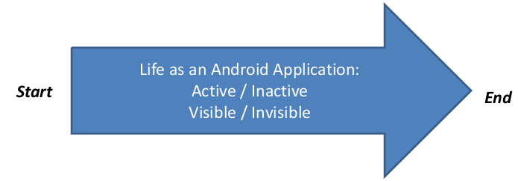
Android Component Life Cycle
All components execute according to a master plan that consists of:
A beginning - responding to a request to instantiate them
An end - when the instances are destroyed.
A sequence of in between states – components sometimes are active or inactive, or in the case of activities - visible or invisible.

Slide 8
Activity
An Activity is an application component that provides a screen with which users can interact in order to do something.
An application typically has multiple activities, and the user flips back and forth among them.
A typical Android application consists of one or more activities.
Only one activity (known as main) is chosen to be executed first when the application is launched.
An activity may transfer control and data to another activity through an interprocess communication protocol called intents.

Slide 9
Activity Stack
Activities in the system are scheduled using an activity stack.
When a new activity is started, it is placed on top of the stack to become the running activity.
The previous activity is pushed-down one level in the stack, and may come back to the foreground once the new activity finishes.
If the user presses the Back Button the current activity is terminated and the next activity on the stack moves up to become active.

Slide 10
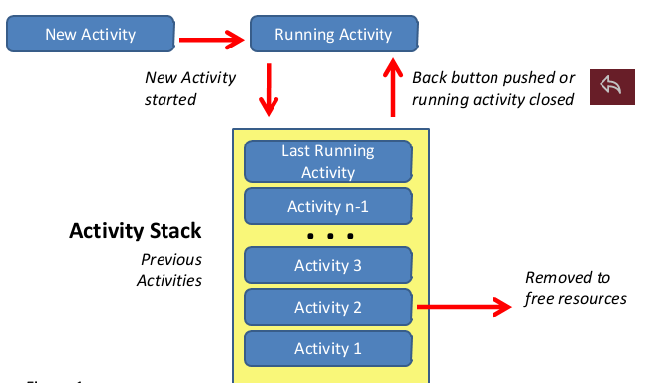
Activity Stack

Slide 11
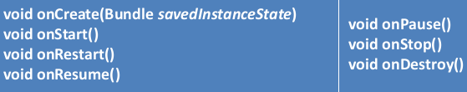
Life Cycle States
When progressing from one state to the other, the OS notifies the application of the changes by issuing calls to the following protected transition methods:

Slide 12
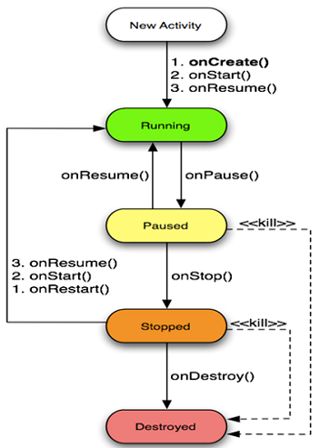
Life Cycle States

Slide 13
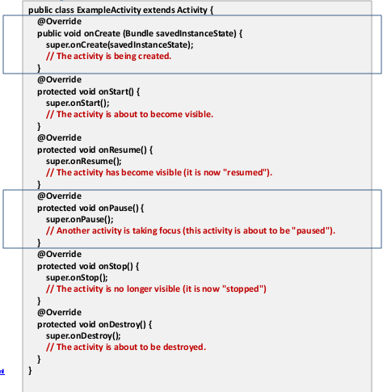
Life Cycle States

Slide 14
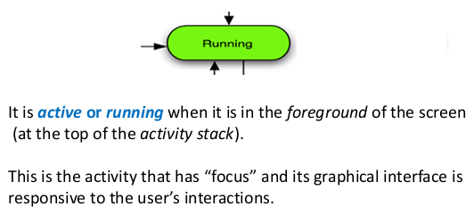
Life Cycle States

Slide 15
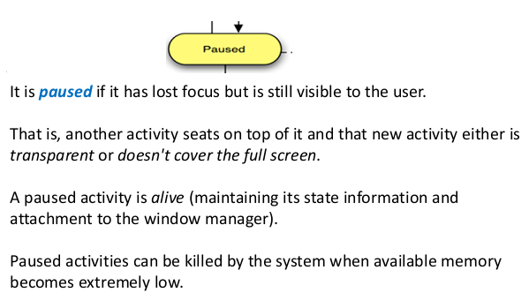
Life Cycle States

Slide 16
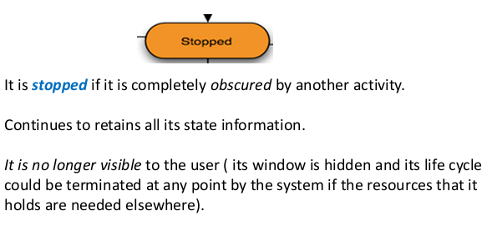
Life Cycle States

Slide 17
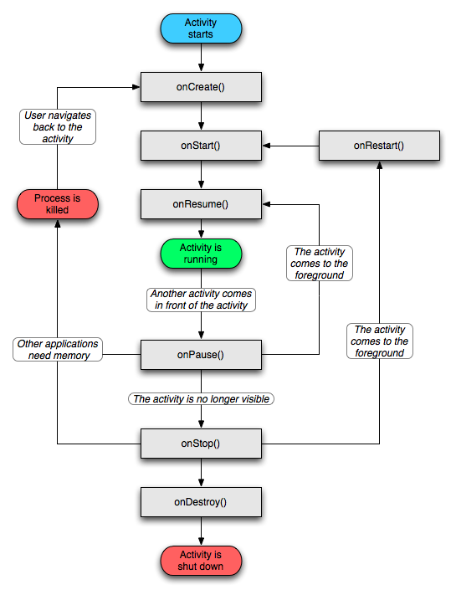

Slide 18
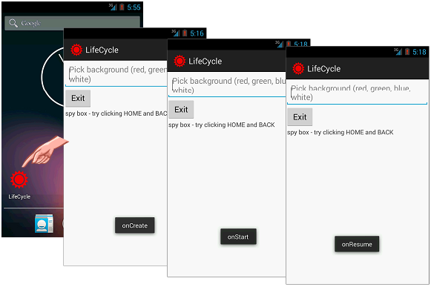

Slide 19
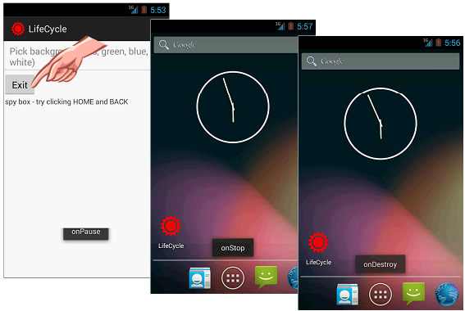

Slide 20
Saving activity state
The Activity object is still held in memory when it is paused or stopped.
When an activity is paused or stopped, the state of the activity is retained.
All information about its members and current state is still alive.
Thus, any changes the user made within the activity are retained so that when the activity returns to the foreground (when it "resumes"), those changes are still there.

Slide 21
Saving activity state
However, when the system destroys an activity in order to recover memory, the Activity object is destroyed, so the system cannot simply resume it with its state intact. Instead, the system must recreate the Activity object if the user navigates back to it.
The user is unaware that the system destroyed the activity and recreated it and, thus, probably expects the activity to be exactly as it was.
You can ensure that important information about the activity state is preserved by implementing an additional callback method that allows you to save information about the state of your activity: onSaveInstanceState().

Slide 22
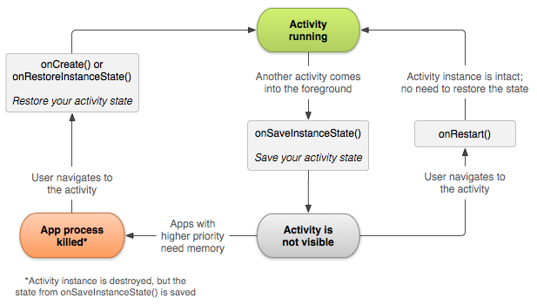
Saving activity state

Slide 23
Saving activity state
@Override
public void onSaveInstanceState(Bundle savedInstanceState) {
super.onSaveInstanceState(savedInstanceState);
// Save UI state changes to the savedInstanceState.
// This bundle will be passed to onCreate if the process is killed and restarted.
savedInstanceState.putBoolean("MyBoolean", true);
savedInstanceState.putDouble("myDouble", 1.9);
savedInstanceState.putInt("MyInt", 1);
savedInstanceState.putString("MyString", "Welcome back to Android");
// etc.
}

Slide 24
Saving activity state
@Override
public void onRestoreInstanceState(Bundle savedInstanceState) {
super.onRestoreInstanceState(savedInstanceState);
// Restore UI state from the savedInstanceState.
// This bundle has also been passed to onCreate.
boolean myBoolean = savedInstanceState.getBoolean("MyBoolean");
double myDouble = savedInstanceState.getDouble("myDouble");
int myInt = savedInstanceState.getInt("MyInt");
String myString = savedInstanceState.getString("MyString");
}

Slide 25
do exercises

