Slide 1
No API? No problem!
API mocking with WireMock
An open source workshop by …
Originally created by Bas Dijkstra – bas@ontestautomation.com – https://www.ontestautomation.com
Notes:
Please replace the … with your own name. I would really like it if you left the bottom line intact though, as a way of thanking me. That’s really all I’m asking for, the rest of the workshop is yours to butcher (erm, improve).
1

Slide 2
What are we going to do?
Stubbing, mocking and service virtualization
WireMock
Exercises, examples, …
Notes:
The workshop starts with a background on how stubbing, mocking and service virtualization can help you remove bottlenecks in your test environment. Then, we’re going to take a look at how WireMock enables you to write mocks in Java using a powerful and intuitive API. And of course, most importantly, the participants are going to do the hard work..
2

Slide 3
Preparation
Install JDK (Java 8 preferred)
Install IntelliJ IDEA (or any other IDE)
Download or clone project
Import Maven project in IDE
Notes:
Depending on the way you deliver this workshop, this sheet can be altered or even removed. When I delivered it, I had participants bring in their own laptop and asked them to follow installation instructions. I only provided them for Eclipse and mentioned that whenever they wanted to use a different IDE, they were allowed to do so. I wanted to keep things simple and therefore did not provide installation instructions for other IDEs.
3

Slide 4
Section 0: An introduction to service virtualization
Notes:
In the first 8 years of my career I wrote an awful lot of horrible automation

Slide 5
Problems in test environments
Systems are constructed out of of many different components
Not all of these components are always available for testing
Parallel development
No control over testdata
Fees required for using third party component
…

Slide 6
Problems in test environments
Mobile app
SaaS dependency
Under development
Access fees
System under test
No suitable test data
Limited access
Backend system
Mainframe

Slide 7
Simulation during test execution
Simulate dependency behaviour
Regain full control over test environment
Available on demand
Full control over test data (edge cases!)
No third party component usage fees
…

Slide 8
Problems in test environments
Mobile app
SaaS dependency
Under development
Access fees
System under test
No suitable test data
Limited access
Backend system
Mainframe

Slide 9
Simulation in test environments
Virtualized mobile app
Virtualized SaaS dependency
Unrestricted access
Unrestricted access
System under test
Unrestricted access
Unrestricted access
Virtualized backend system
Virtualized mainframe

Slide 10
API consumer
request
API provider
response
System
System
Notes:
In the first 8 years of my career I wrote an awful lot of horrible automation

Slide 11
Simulating APIs for more efficient testing and automation
request
Simulation
API consumer
API provider
response
System
Notes:
In the first 8 years of my career I wrote an awful lot of horrible automation

Slide 12

Our system under test
ParaBank
The world’s least safe
online bank
Request Loan process
Loan application is processed by 3rd party loan provider component
Notes:
Explain why this API was chosen (simple, lots of features, very ‘real’ data, something lots of people can relate to)
Mocks are included in the project to avoid the risk of the API being unavailable during the workshop (this actually happened to me once), feel free to remove it and test against the actual API
Alternatively, you can always use your own API of course!
12

Slide 13
ParaBank development team
3rd party development team
Frontend
/
API client
API
ParaBank middleware
API
Loan Processor service
Notes:
In the first 8 years of my career I wrote an awful lot of horrible automation

Slide 14
ParaBank development team
WireMock
Frontend
/
API client
API
ParaBank middleware
API
Simulated Loan Processor service
Notes:
In the first 8 years of my career I wrote an awful lot of horrible automation

Slide 15
What might we want to simulate?
Start testing against features under development
Easy setup of state for edge cases
Delays, fault status codes, malformatted responses, …
…

Slide 16
Section 1: Getting started with WireMock
Notes:
In the first 8 years of my career I wrote an awful lot of horrible automation

Slide 17
WireMock
http://wiremock.org
Java
HTTP mock server
only supports HTTP(S)
open source
developed and maintained by Tom Akehurst

Slide 18
Install WireMock
Maven
<dependency> <groupId>com.github.tomakehurst</groupId>
<artifactId>wiremock-jre8</artifactId>
<version>2.33.2</version>
<scope>test</test>
</dependency>

Slide 19
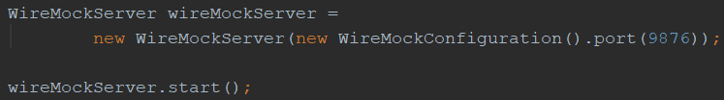
Starting WireMock (JUnit 4)
Via JUnit 4 @Rule
Without using JUnit 4 @Rule

Slide 20

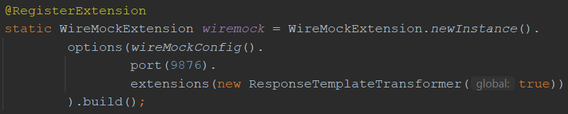
Starting WireMock (JUnit 5)
Uses the JUnit 5 Jupiter extension mechanism
Via @WireMockTest class annotation (basic configuration)
Programmatically using @RegisterExtension (full control)

Slide 21
Starting WireMock (standalone)
Useful for exploratory testing purposes
Allows you to share WireMock instances between teams
Long-running instances
Download the .jar first
java -jar wiremock-standalone-2.33.2.jar --port 9876

Slide 22
Configure responses
In (Java) code
Using JSON mapping files

Slide 23
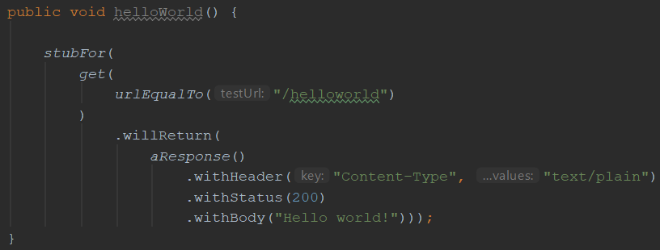
An example mock defined in Java

Slide 24
Some useful WireMock features
Verification
Verify that certain requests are sent by application under test
Record and playback
Generate mocks based on request-response pairs (traffic)
Fault simulation
…
Full documentation at http://wiremock.org/docs/

Slide 25
Now it’s your turn!
exercises > WireMockExercises1Test.java
Create a couple of basic mocks
Implement the responses as described in the comments
Verify your solution by running the tests in the same file
Answers are in answers > WireMockAnswers1Test.java
Examples are in examples > WireMockExamplesTest.java
Notes:
The answers to the JSON exercises can be found in src/test/resources/answers. Move the corresponding JSON files to the mappings folder for WireMock to pick them up

Slide 26
Section 2: Request matching strategies and fault simulation
Notes:
In the first 8 years of my career I wrote an awful lot of horrible automation

Slide 27
Request matching
Send a response only when certain properties in the request are matched
Options for request matching:
URL
HTTP method
Query parameters
Headers
Request body elements
…

Slide 28
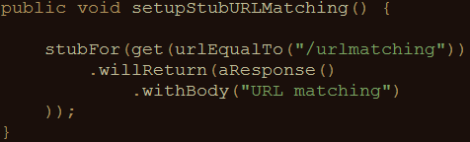
Example: URL matching (Java)
Other URL options:
urlPathEqualTo (using exact values)
urlMatching (using regular expressions)
urlPathMatching (using regular expressions)

Slide 29
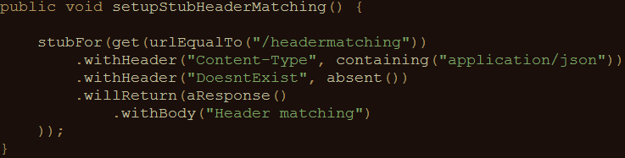
Example: header matching (Java)
absent(): check that parameter is not in request

Slide 30
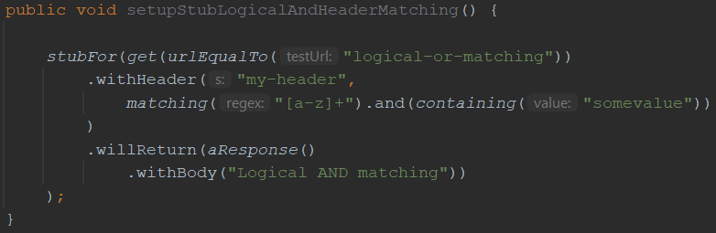
Example: using logical AND and OR
‘somevalue’ is matched
‘bananasomevaluebanana’ is matched
‘banana’ is not matched (does not contain ‘somevalue’)
‘123somevalue’ is not matched (contains numeric characters)

Slide 31
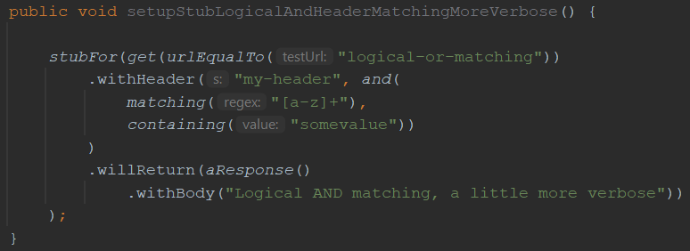
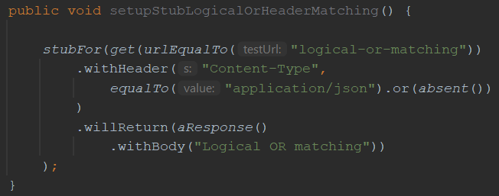
Some more examples…
Same behaviour as the previous example, using a slightly different syntax

Slide 32
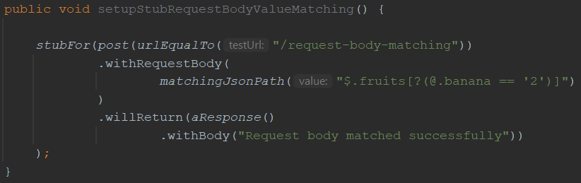
Matching on request body elements
Matching only those request bodies that have a root level element fruits with a child element banana with value 2
{“fruits”: {“banana”: 2, “apple”: 5} } ➔ MATCH
{“fruits”: {“apple”: “5”} } ➔ NO MATCH
{“fruits”: {“banana”: 3, “apple”: 5} } ➔ NO MATCH

Slide 33
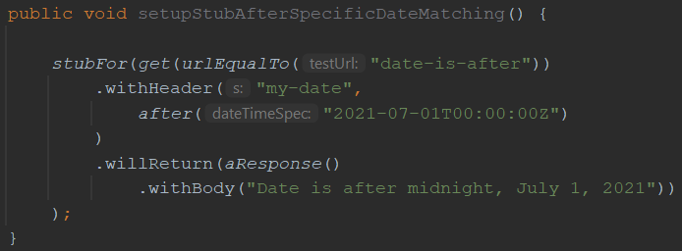
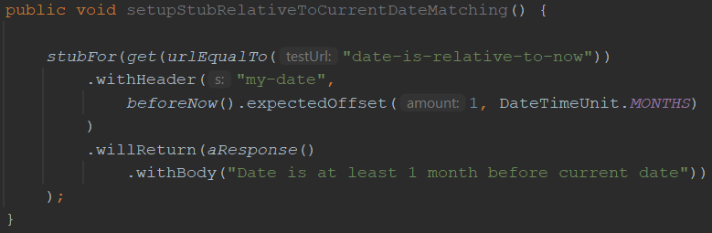
Matching using date/time properties
Matching all dates after midnight of July 1, 2021
Matching all dates at least 1 month before the current date

Slide 34
Other matching strategies
Authentication (Basic, OAuth(2))
Query parameters
Multipart/form-data
You can write your own matching logic, too

Slide 35
Fault simulation
Extend test coverage by simulating faults
Often hard to do in real systems
Easy to do using stubs or mocks
Used to test the exception handling of your application under test

Slide 36
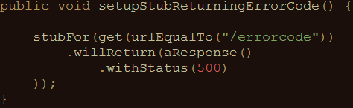
Example: HTTP status code (Java)
Some often used HTTP status codes:
Client error Server error
403 (Forbidden) 500 (Internal server error)
404 (Not found) 503 (Service unavailable)

Slide 37
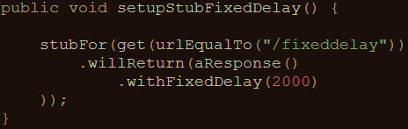
Example: timeout (Java)
Random delay can also be used
Uniform, lognormal, chunked dribble distribution options
Can be configured on a per-stub basis as well as globally

Slide 38
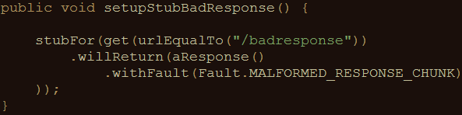
Example: bad responses (Java)
HTTP status code 200, but garbage in response body
Other options:
RANDOM_DATA_THEN_CLOSE (as above, without HTTP 200)
EMPTY_RESPONSE (does what it says on the tin)
CONNECTION_RESET_BY_PEER (close connection, no response)

Slide 39
Now it’s your turn!
exercises > WireMockExercises2Test.java
Practice fault simulation and different request matching strategies
Implement the responses as described in the comments
Verify your solution by running the tests in the same file
Answers are in answers > WireMockAnswers2Test.java
Examples are in examples > WireMockExamplesTest.java
Notes:
The answers to the JSON exercises can be found in src/test/resources/answers. Move the corresponding JSON files to the mappings folder for WireMock to pick them up

Slide 40
Section 3: Creating stateful mocks
Notes:
In the first 8 years of my career I wrote an awful lot of horrible automation

Slide 41
Statefulness
Sometimes, you want to simulate stateful behaviour
Shopping cart (empty / containing items)
Database (data present / not present)
Order in which requests arrive is significant

Slide 42
Stateful mocks in WireMock
Supported through the concept of a Scenario
Essentially a finite state machine (FSM)
States and state transitions
Combination of current state and incoming request determines the response being sent
Before now, it was only the incoming request

Slide 43
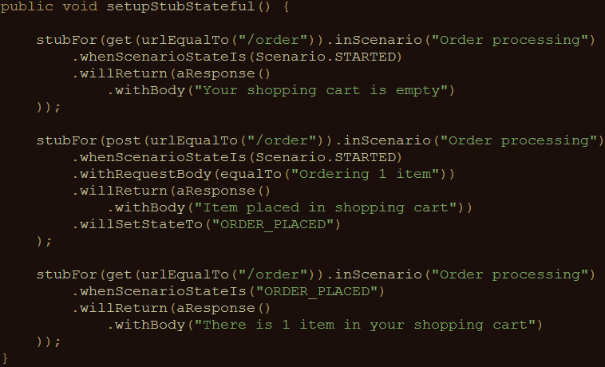
Stateful mocks: an example (Java)
Responses are grouped by scenario name
Response depends on both the incoming request as well as the current state
The initial state should always be Scenario.STARTED
Incoming requests can trigger state transitions
State names other than Scenario.STARTED are yours to define

Slide 44
Now it’s your turn!
exercises > WireMockExercises3Test.java
Create a stateful mock that exerts the described behaviour
Implement the responses as described in the comments
Verify your solution by running the tests in the same file
Answers are in answers > WireMockAnswers3Test.java
Examples are in examples > WireMockExamplesTest.java
Notes:
The answers to the JSON exercises can be found in src/test/resources/answers. Move the corresponding JSON files to the mappings folder for WireMock to pick them up

Slide 45
Section 4: Response templating
Notes:
In the first 8 years of my career I wrote an awful lot of horrible automation

Slide 46
Response templating
Often, you want to reuse elements from the request in the response
Request ID header
Unique body elements (client ID, etc.)
Cookie values
WireMock supports this through response templating

Slide 47
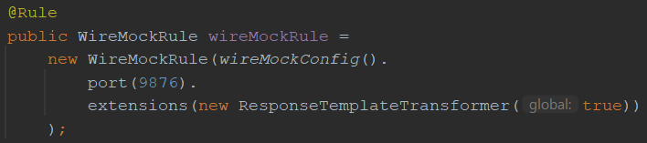
Setup response templating (JUnit4)
In code: through the JUnit @Rule
Global == false: response templating transformer has to be enabled for individual stubs

Slide 48
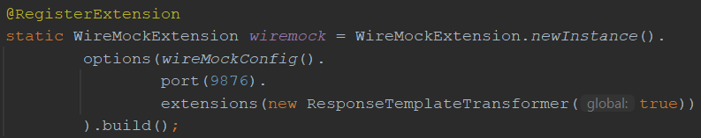
Setup response templating (JUnit5)
In code: through the Junit @RegisterExtension
Global == false: response templating transformer has to be enabled for individual stubs

Slide 49
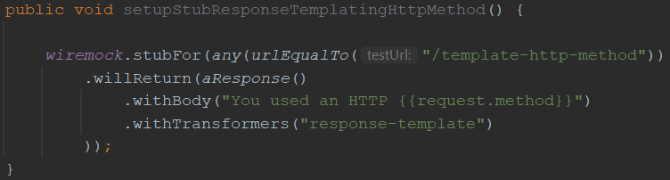
Enable/apply response templating
This template reads the HTTP request method (GET/POST/PUT/…) using {{request.method}} and returns it as the response body
This call to withTransformers() is only necessary when response templating isn’t activated globally

Slide 50
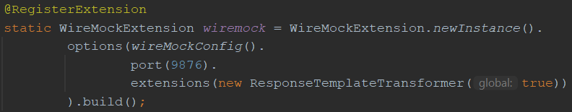
One thing to keep in mind…
Because we’re explicitly initializing a WireMock instance here…
… we need to explicitly assign our stub definition to that instance here, or else the stub definition will not be picked up!

Slide 51
Request attributes
Many different request attributes available for use
request.method : HTTP method (example)
request.pathSegments.[<n>] : n^{th} path segment
request.scheme : protocol (e.g. HTTPS)
…
All available attributes listed at
http://wiremock.org/docs/response-templating/

Slide 52
Request attributes (cont’d)
Extracting and reusing body elements
In case of a JSON request body:
{{jsonPath request.body ‘$.path.to.element’}}
In case of an XML request body:
{{xPath request.body ‘/path/to/element/text()’}}

Slide 53
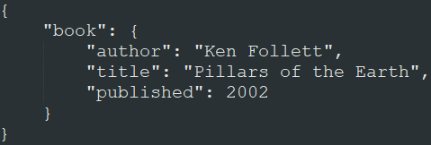
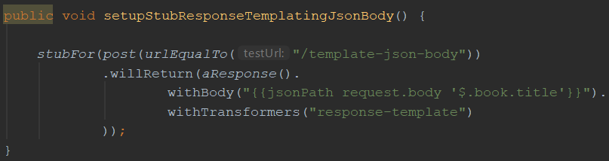
JSON extraction example
When sent this JSON
request body:
This stub returns a response with body “Pillars of the Earth”:
Again, this call to withTransformers() is only necessary when response templating isn’t activated globally

Slide 54
Now it’s your turn!
exercises > WireMockExercises4Test.java
Create mocks that use response templating
Implement the responses as described in the comments
Verify your solution by running the tests in the same file
Answers are in answers > WireMockAnswers4Test.java
Examples are in examples > WireMockExamplesTest.java
Notes:
The answers to the JSON exercises can be found in src/test/resources/answers. Move the corresponding JSON files to the mappings folder for WireMock to pick them up

Slide 55
Section 5: Verification
Notes:
In the first 8 years of my career I wrote an awful lot of horrible automation

Slide 56
Verifying incoming requests
Apart from returning responses, you might also want to verify that incoming requests have certain properties
Fail a test if these verifications aren’t met
You can do this with WireMock in a way very similar to mocking frameworks for unit tests (e.g., Mockito for Java)

Slide 57
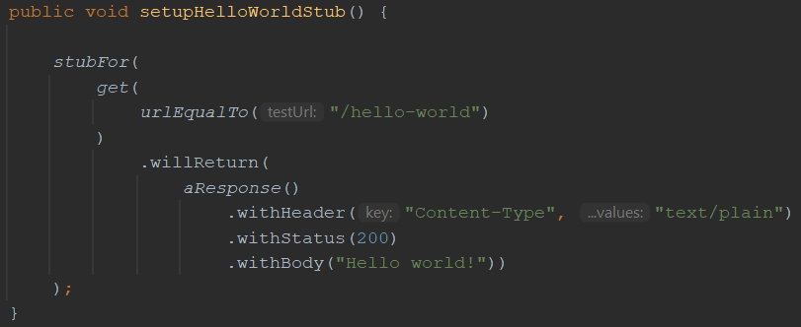
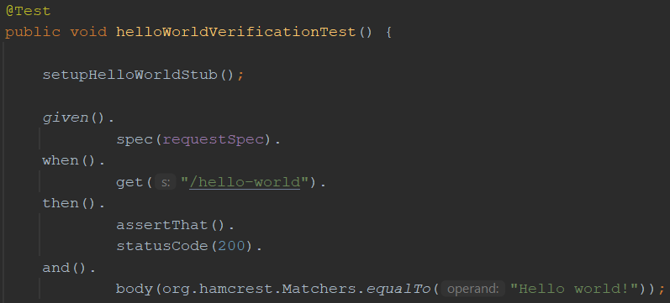
Verifying incoming requests
Given this simple ‘hello world’ stub
When we have this test that should invoke that stub exactly once
Then this verification can be added to the test to ensure that indeed, an HTTP GET to ‘/hello-world’ has been made exactly once

Slide 58
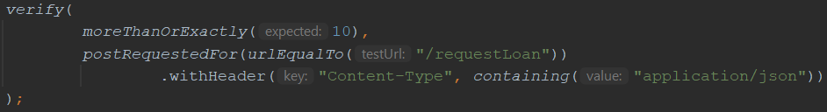
Some more verification examples
The same as the above, but less verbose
Verify that less than 5 HTTP POSTs were made to /requestLoan
Verify that 10 or more HTTP POSTs with a ‘Content-Type’ header value containing ‘application/json’ were made to /requestLoan

Slide 59
Now it’s your turn!
exercises > WireMockExercises5Test.java
Add WireMock verifications to the tests
Verify request properties as described in the comments
Verify your solution by running the tests
Answers are in answers > WireMockAnswers5Test.java
Examples are in examples > WireMockExamplesTest.java
Notes:
The answers to the JSON exercises can be found in src/test/resources/answers. Move the corresponding JSON files to the mappings folder for WireMock to pick them up

Slide 60
Section 6: Extending WireMock
Notes:
In the first 8 years of my career I wrote an awful lot of horrible automation

Slide 61
Extending WireMock
In some cases, the default WireMock feature set might not fit your needs
WireMock is open to extensions
Allows you to create even more powerful stubs
Several options available

Slide 62
Section 6.1: Filtering incoming requests
Notes:
In the first 8 years of my career I wrote an awful lot of horrible automation

Slide 63
Request filtering
Modify incoming requests (or halt processing)
This has a variety of use cases:
Checking authentication details
Request header injection
URL rewriting
Created by extending the StubRequestFilter class

Slide 64
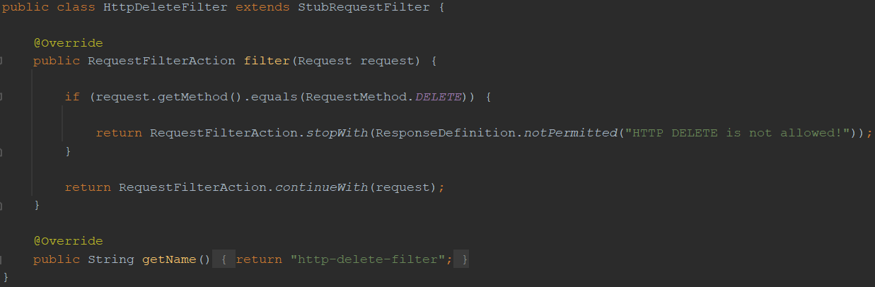
Request filtering – build
If the HTTP verb used equals DELETE…
Return an HTTP 403 and stop processing the request
Else continue processing the request

Slide 65
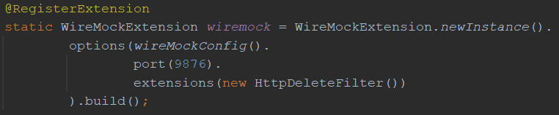
Request filtering – use
An extension can be registered using:
its class name (“com.example.HttpDeleteFilter”)
the class (HttpDeleteFilter.class)
an instance (new HttpDeleteFilter())

Slide 66
Now it’s your turn!
exercises > extensions > BasicAuthFilter.java
Implement a custom request filter that filters out all requests that do not have the proper basic authentication credentials
Verify your solution by running the tests in exercises > WireMockExercises6dot1Test.java
Answers are in answers > extensions > BasicAuthFilter.java
Examples are in examples > extensions > HttpDeleteFilter.java
Notes:
The answers to the JSON exercises can be found in src/test/resources/answers. Move the corresponding JSON files to the mappings folder for WireMock to pick them up

Slide 67
Section 6.2: Building a custom request matcher
Notes:
In the first 8 years of my career I wrote an awful lot of horrible automation

Slide 68
Custom request matchers
Add custom request matching logic to WireMock
Can be combined with existing standard matchers
Done by extending RequestMatcherExtension class

Slide 69
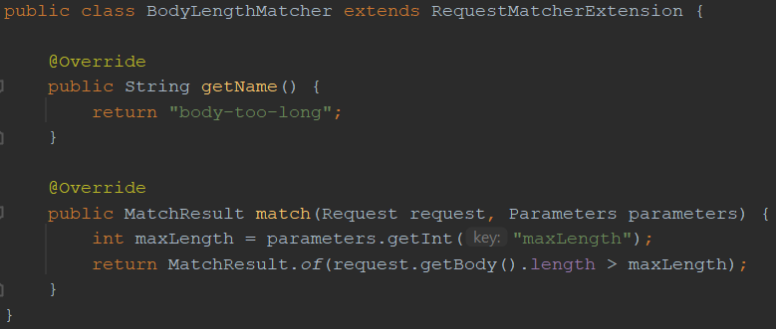
Custom request matcher – build
Get the value of the maxLength matcher parameter
Compare the request body length to the maxLength parameter value and return the result as a MatchResult

Slide 70
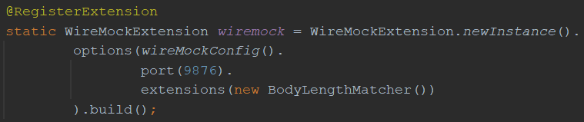
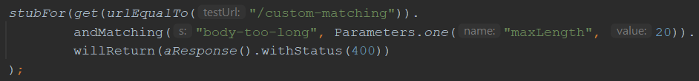
Custom request matcher – use
Register the extension
Use custom matcher in a stub definition using its name (can be combined with existing matchers)
Specify desired parameter value

Slide 71
Now it’s your turn!
exercises > extensions > RejectedHttpVerbsMatcher.java
Implement a custom matcher that reads a list of rejected HTTP verbs and matches the HTTP verb used in the incoming request against it
Verify your solution by running the tests in exercises > WireMockExercises6dot2Test.java
Answers are in answers > extensions > RejectedHttpVerbsMatcher.java
Examples are in examples > extensions > BodyLengthMatcher.java
Notes:
The answers to the JSON exercises can be found in src/test/resources/answers. Move the corresponding JSON files to the mappings folder for WireMock to pick them up

Slide 72
Section 6.3: Executing post-serve actions
Notes:
In the first 8 years of my career I wrote an awful lot of horrible automation

Slide 73
Post-serve actions
Perform specific actions after serving response
Logging, writing to database, …
Done by extending PostServeAction class

Slide 74
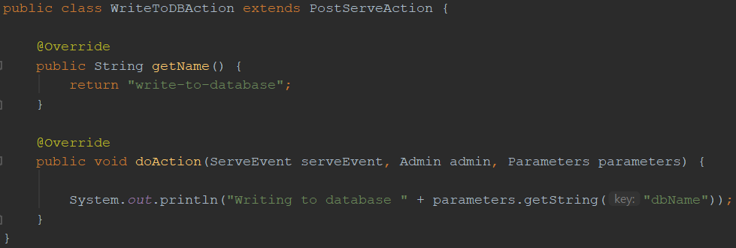
Post-serve action – build
This implements the post-serve action to execute after serving a response
Overriding doGlobalAction() automatically performs the action for all responses served by WireMock (no need to configure this on a per-stub basis anymore)

Slide 75
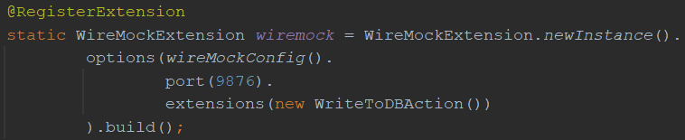
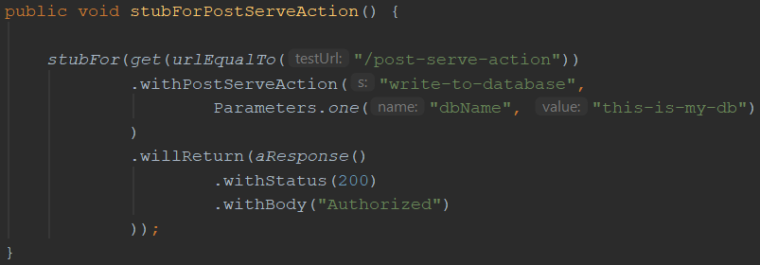
Post-serve action – use
Register the extension
Add the post-serve action to the stub definition and supply the desired parameter value

Slide 76
Now it’s your turn!
exercises > extensions > LogLoanRequestReceptionWithTimestamp.java
Implement a post-serve action that prints a log message containing the current date and time in the requested format to the console
Verify your solution by running the tests in exercises > WireMockExercises6dot3Test.java
Answers are in answers > extensions > LogLoanRequestReceptionWithTimestamp.java
Examples are in examples > extensions > WriteToDBAction.java
Notes:
The answers to the JSON exercises can be found in src/test/resources/answers. Move the corresponding JSON files to the mappings folder for WireMock to pick them up

Slide 77
Section 6.4: Transforming responses
Notes:
In the first 8 years of my career I wrote an awful lot of horrible automation

Slide 78
Response transformation
Create responses in a more dynamic and reusable fashion
Two types of use cases
Define characteristics of response definition
Add specific information to existing response
Done by extending ResponseDefinitionTransformer and ResponseTransformer class, respectively

Slide 79
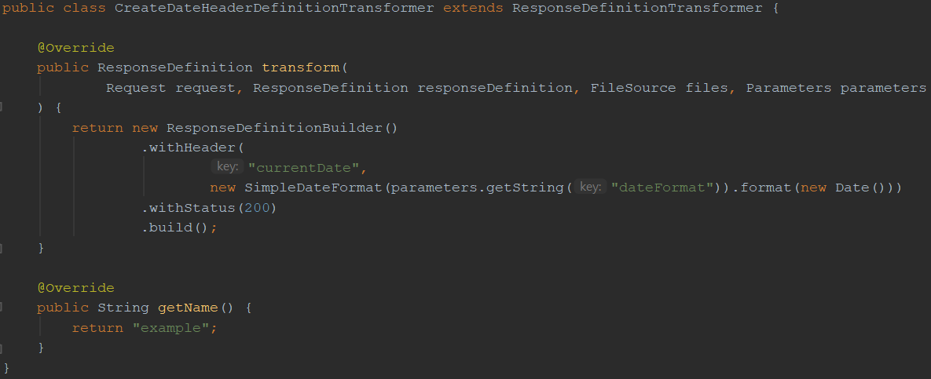
Response definition transformer – build
Use Builder pattern to construct response definition
Add header with value customized using parameter value
Add default status code

Slide 80
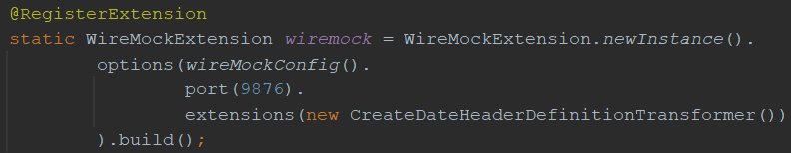
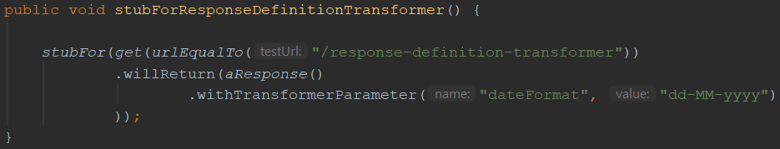
Response definition transformer – use
Register the extension
Specify response transformer parameter value to use for this response

Slide 81
You can transform the rendered Response, too…
Notes:
First: what is automated testing?

Slide 82
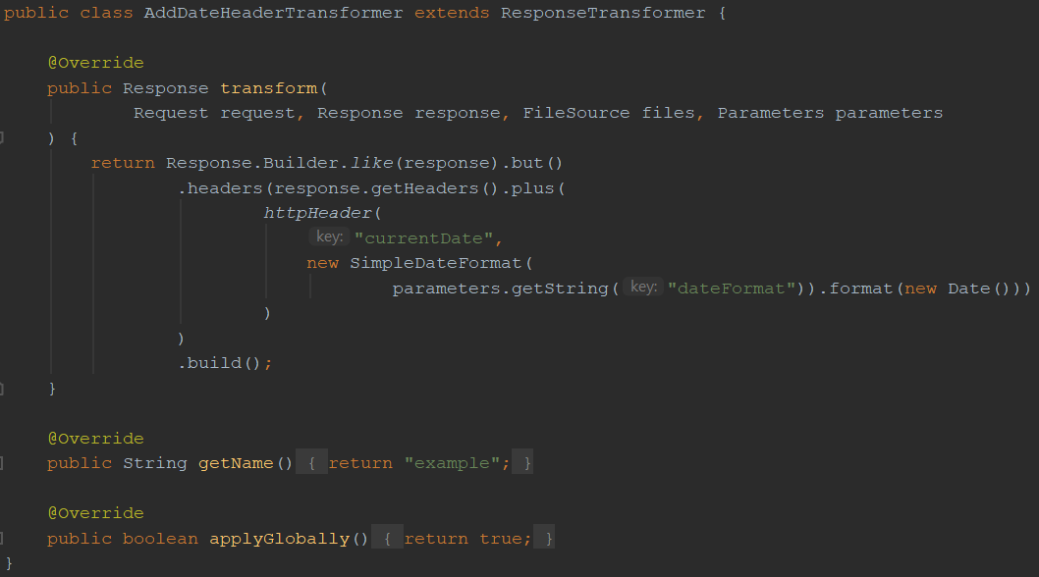
Response transformer – build
Use the defined response…
… but add a currentDate header after rendering it
By default, response transformers are applied globally, but this can switched off if desired

Slide 83
http://wiremock.org/docs /extending-wiremock/
Notes:
First: what is automated testing?

Slide 84
Now it’s your turn!
exercises > extensions > AddUuidHeaderTransformer.java
Implement a response definition transformer that adds the requested header to a response
Verify your solution by running the tests in exercises > WireMockExercises6dot4Test.java
Answers are in answers > extensions > AddUuidHeaderTransformer.java
Examples are in examples > extensions > CreateDateHeaderDefinitionTransformer.java
Notes:
The answers to the JSON exercises can be found in src/test/resources/answers. Move the corresponding JSON files to the mappings folder for WireMock to pick them up

Slide 85
Appendix A: JSON equivalents for the Java examples
Notes:
In the first 8 years of my career I wrote an awful lot of horrible automation

Slide 86
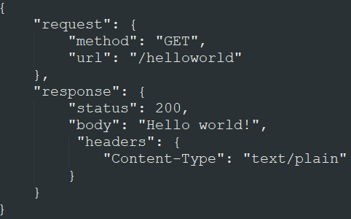
Our Hello world! mock

Slide 87
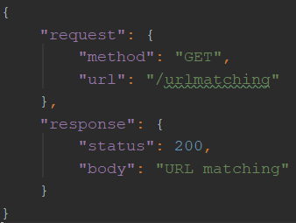
URL matching

Slide 88
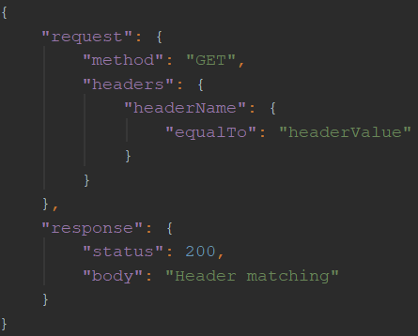
Request header matching

Slide 89
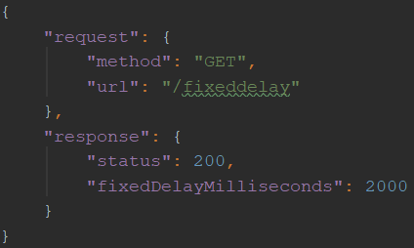
Simulating a delay

Slide 90
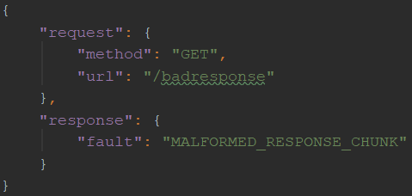
Returning a fault response

Slide 91
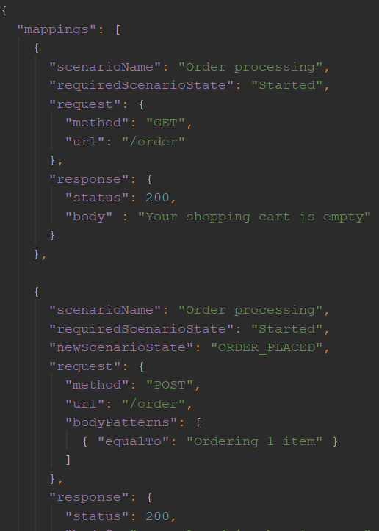
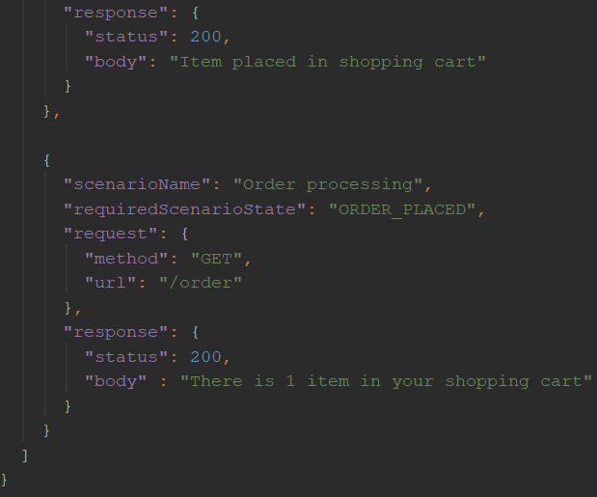
Creating a stateful mock

Slide 92
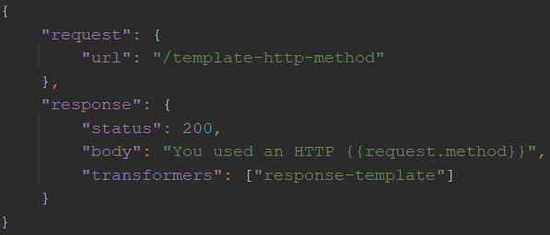
Use response templating

Slide 93
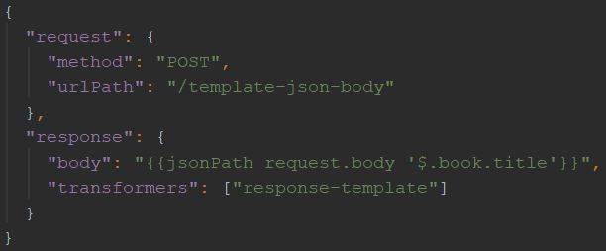
Use response templating
When sent this JSON
request body:
This stub returns a response with body “Pillars of the Earth”:

Slide 94
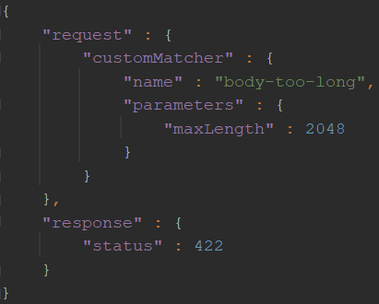
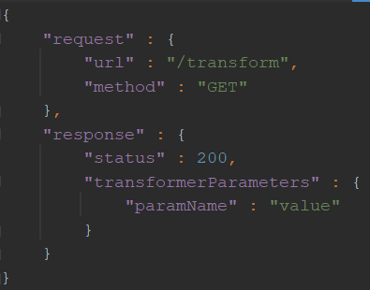
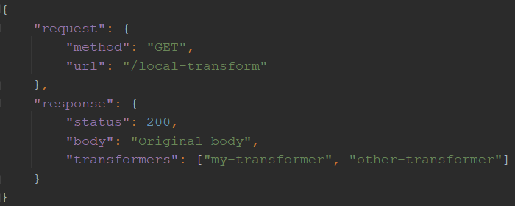
Using WireMock extensions
Using a custom matcher
Specifying transformer parameters
Registering a local transformer

Slide 95
?

