Slide 1

Switched Ethernet and IP
Soheil Abbasloo
Department of Computer Science
University of Toronto
Fall 2022

Slide 2
Last time: Broadcast Ethernet
Ethernet was invented as a broadcast technology
Each packet received by all attached hosts
CSMA/CD for media access control
Current Ethernets are “switched”
Point-to-point links between switches and to hosts
No (link) sharing, no CSMA/CD
Today: “Switched” Ethernet

Slide 3


Why Switched Ethernet?
B
Enables concurrent communication
Host A can talk to C, while B talks to D
No collisions → no need for CSMA, CD
No constraints on link lengths, etc.
A
C
Ethernet switch
D

Slide 4
The evolution of Ethernet
From the shared media coax cables to dedicated links
From 3 Mbps experimental Ethernet to 400 Gbps
From electrical signaling to optical
Changed almost everything except the frame format
Lesson: the right interface can accommodate many changes
Evolve the implementation while maintaining the interface (backward compatibility)

Slide 5
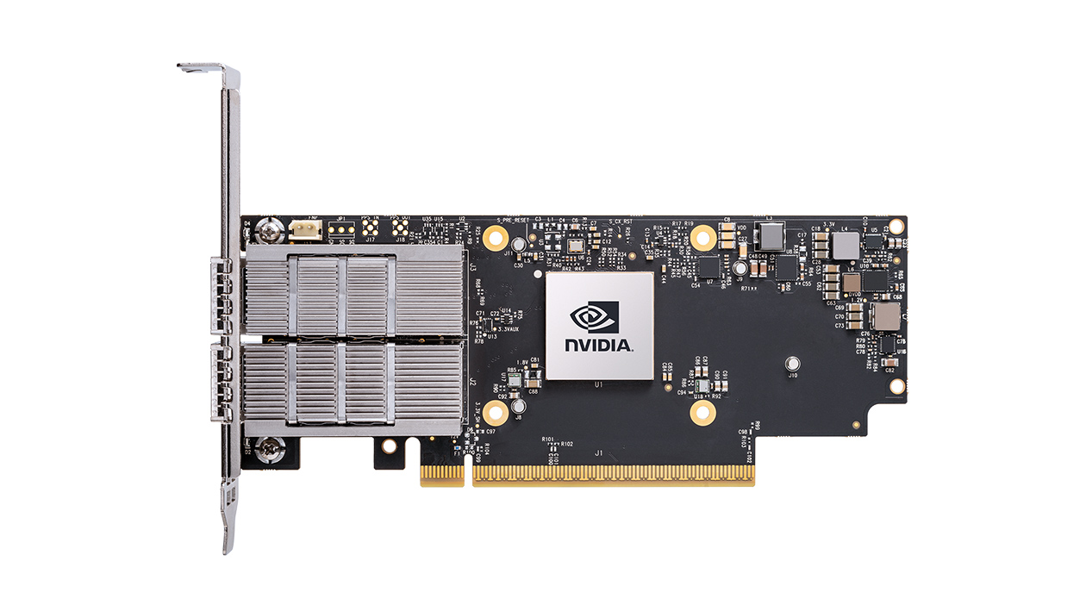
As of Aug 2022,
State-of-the-art Ethernet adaptors clock at 400 Gbps
https://www.nvidia.com/en-us/networking/ethernet/connectx-6/

Slide 6
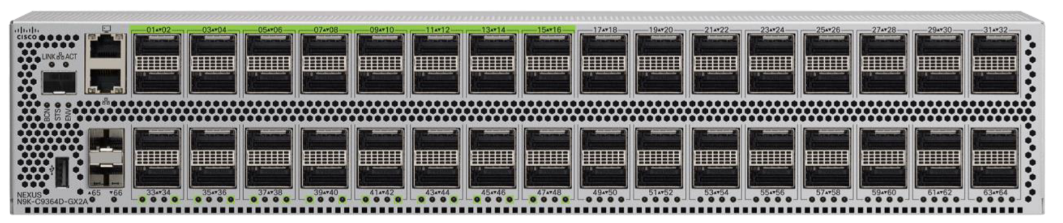
400 Gbps Ethernet switches
Cisco Nexus 9364D-GX2A switch
64 x 400GbE ports!
https://www.cisco.com/c/en/us/products/collateral/switches/nexus-9000-series-switches/datasheet-c78-743854.html

Slide 7
Outline
Routing in switched Ethernet
Forwarding in switched Ethernet
IP

Slide 8
Routing with Switched Ethernet?
A_{MAC}
B_{MAC}
C_{MAC}
D_{MAC}
F_{MAC}
E_{MAC}

Slide 9
“Routing” with broadcast Ethernet
A_{MAC}
B_{MAC}
C_{MAC}
D_{MAC}
E_{MAC}
F_{MAC}
Sender transmits frame onto broadcast link
Frame contains destination MAC address
Each receiver’s link layer passes the frame to the network layer:
If destination address matches the receiver’s MAC address
Or if the destination addr. is the broadcast MAC address (ff:ff:ff:ff:ff:ff)

Slide 10
“Routing” with broadcast Ethernet
A_{MAC}
B_{MAC}
C_{MAC}
D_{MAC}
E_{MAC}
F_{MAC}
Ethernet is `plug-n-play’
A new host plugs into the Ethernet and is good to go
No configuration by users or network operators

Slide 11
Routing in “Extended LANs”
Local-Area Network (LAN)
Bridges relay broadcasts from one LAN to the other

Slide 12

The “Broadcast Storm” Problem
Radia Perlman
Perlman’s idea: eliminate loops in the topology

Slide 13
Easiest Way to Avoid Loops
Use a topology where loops are impossible!
Take arbitrary topology
Build spanning tree
Sub-graph that includes all vertices but contains no cycles
Links not in the spanning tree are not used to forward frames
Only one path to destinations on spanning trees
So don’t have to worry about loops!

Slide 14
Consider graph

Slide 15
A Spanning Tree

Slide 16
Another Spanning Tree

Slide 17
Yet Another Spanning Tree

Slide 18
Spanning Tree Protocol (Perlman‘85)
Protocol by which bridges construct a spanning tree
Nice properties
Zero configuration (by operators or users)
Self healing
Still used today

Slide 19
From Extended LANs to Switched Ethernet

Slide 20
Switched Ethernet
Constraints (for backward compatibility)
No changes to end-hosts
Maintain plug-n-play aspect
Earlier Ethernet achieved plug-n-play by leveraging a broadcast medium
Can we do the same in a switched topology?

Slide 21
Flooding (still) leads to loops
Example: A wants to broadcast a message
A sends packet to 1
1 Floods to 2 and 4
2 Floods to B and 3
4 Floods to D and 3
3 Floods packet from 2 to C and 4
3 Floods packet from 4 to C and 2
4 Floods packet from 3 to D and 1
2 Floods packet from 3 to B and 1
1 Floods packet from 2 to A and 4
1 Floods packet from 4 to B and 2
….
A “broadcast storm” if the network contains a cycle of switches
A
1
B
2
4
D
3
C

Slide 22
A Rejected Solution
Example: A wants to broadcast a message
A sends packet to 1
1 Floods to 2 and 4
2 Floods to B and 3
4 Floods to D and 3
3 Floods packet from 2 to C and 4
3 Floods packet from 4 to C and 2
done!
A
1
B
2
4
D
3
C
Can we have 3 remember that it has already received and flooded the message?

Slide 23
Spanning Tree Approach
Take arbitrary topology
Pick subset of links that form a spanning tree

Slide 24
You: Design a Spanning Tree Algorithm
Take 5 minutes, design with your neighbors, report back
Goals
Distributed
Self-configuring
Must adapt when failures occur
But don’t worry about that on first try…

Slide 25
Algorithm Has Two Aspects
Pick a root:
Destination to which shortest paths go
Pick the one with the smallest identifier (MAC addr.)
Compute shortest paths to the root
No shortest path can have a cycle
Only keep the links on shortest-paths
Break ties in some way (so we only keep one shortest path from each node)
Ethernet’s spanning tree construction does both with a single algorithm

Slide 26
Breaking Ties
When there are multiple shortest paths to the root, choose the path that uses the neighbor switch with the lower ID.
One could use any tiebreaking system, but this is an easy one to remember and implement

Slide 27
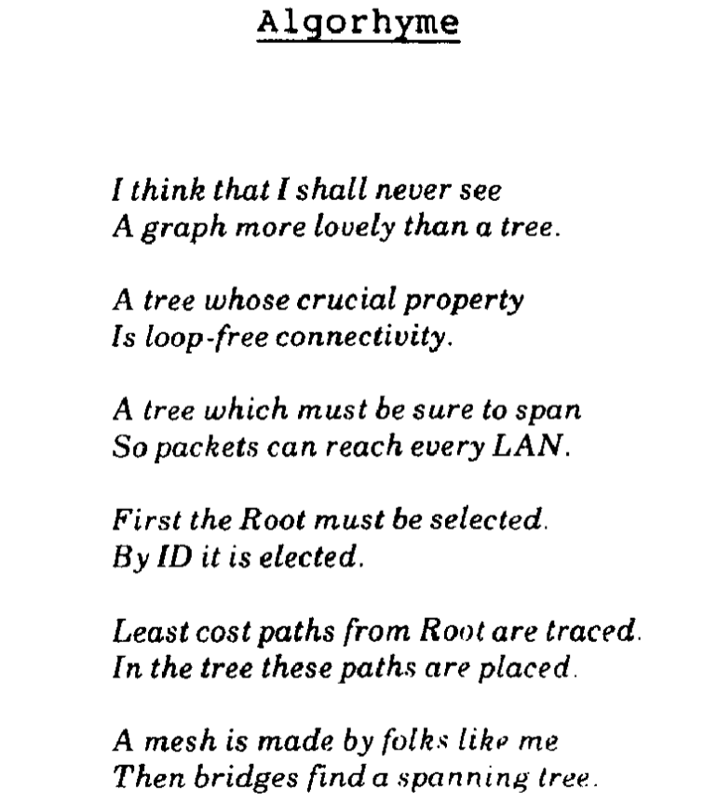
Perlman’s description of her algorithm in her SIGCOMM’85 paper:

Slide 28
Constructing a Spanning Tree
Messages (Y, d, X)
From node X
Proposing Y as the root
And advertising a distance d to Y
Switches elect the node with smallest identifier (MAC address) as root
Y in the messages
Each switch determines if a link is on its shortest path to the root; excludes it from the tree if not
d to Y in the message

Slide 29
Steps in Spanning Tree Algorithm
Initially, each switch proposes itself as the root
I.e., switch X announces (X, 0, X) to its neighbors
Switches update their view of the root
Upon receiving message (Y, d, Z) from Z, check Y’s id
If Y’s id < current root: set root = Y
Switches compute their distance from the root
Add 1 to the shortest distance received from a neighbor
If root or shortest distance to it changed, send neighbors updated message (Y, d+1, X)

Slide 30
Example (root, dist, from)
(1,0,1)
(1,0,1)
1
1
(1,1,3)
(1,1,5)
(3,0,3)
(5,0,5)
3
5
3
5
(2,0,2)
(2,0,2)
2
2
(2,1,4)
(4,0,4)
4
4
6
6
7
(1,1,6)
7
(6,0,6)
(2,1,7)
(7,0,7)
1
(1,0,1)
1
(1,0,1)
(1,1,3)
(1,1,5)
(1,1,3)
(1,1,5)
3
5
3
5
(1,2,3)
✗
(1,2,2)
(1,3,4)
2
(2,1,4)
2
4
✗
✗
6
4
7
6
(1,3,7)
(1,1,6)
(2,1,7)
7
(1,1,6)

Slide 31
Example From Switch #4’s Viewpoint
Switch #4 thinks it is the root
Sends (4, 0, 4) message to 2 and 7
Then, switch #4 hears from #2
Receives (2, 0, 2) message from 2
… and thinks that #2 is the root
And realizes it is just one hop away
Then, switch #4 hears from #7
Receives (2, 1, 7) from 7
And realizes this is a longer path
So, prefers its own one-hop path
And removes 4-7 link from the tree
1
3
5
2
4
6
7

Slide 32
Example From Switch #4’s Viewpoint
Switch #2 hears about switch #1
Switch 2 hears (1, 1, 3) from 3
Switch 2 starts treating 1 as root
And sends (1, 2, 2) to neighbors
Switch #4 hears from switch #2
Switch 4 starts treating 1 as root
And sends (1, 3, 4) to neighbors
Switch #4 hears from switch #7
Switch 4 receives (1, 3, 7) from 7
And realizes this is a longer path
So, prefers its own three-hop path
And removes 4-7 Iink from the tree
1
3
5
2
4
6
7

Slide 33
Links on spanning tree
3-1
5-1
6-1
2-3
4-2
7-2
1
3
5
2
4
6
7

Slide 34
Now which ones are on the spanning tree?
2 is new root
3-2
6-2
4-2
7-2
5-6
3
5
2
4
6
7

Slide 35
Robust Spanning Tree Algorithm
Algorithm must react to failures
Failure of the root node
Failure of other switches and links
How?
Root switch sends periodic root announcement messages
Other switches continue forwarding messages
Detecting failures through timeout (soft state)
If no word from root, time out and claim to be the root!

Slide 36
Outline
Routing in switched Ethernet
Forwarding in switched Ethernet
IP

Slide 37
Flooding on a Spanning Tree
Switches flood using the following rule:
(Ignoring all ports not on spanning tree!)
Originating switch sends packet out all ports
When a packet arrives on one incoming port, send it out all ports other than the incoming port

Slide 38
Flooding on Spanning Tree

Slide 39
Flooding on Spanning Tree

Slide 40
But isn’t flooding wasteful?
Yes, but we can use it to bootstrap more efficient forwarding
Idea:
watch the packets going by, and learn from them
If node S sees a packet from node A come in on a particular port, it knows what port to use to reach A!
Works because there’s only one path to A
P
From A
S
3
3
A
1
1
2
2

Slide 41
Nodes can “learn” routes
Switch learns how to reach nodes by remembering where flooding packets came from
If flood packet from Node A entered switch on port 4, then switch uses port 4 to send to Node A

Slide 42
General Approach
Flood first packet to node you are trying to reach
All switches learn where you are
When destination responds, some switches learn where it is…
Why not all?

Slide 43
Learning from Flood Packets
Node A can be reached
through this port
Node A can be reached
through this port
Node B
Node A
Once a node has sent a flood message, all other switches know how to reach it….

Slide 44
Node B Responds
Node B can be reached
through this port
Node B can be reached
through this port
Node B can be reached
through this port
Node B can be reached
through this port
Node B
Node A
When a node responds, some of the switches learn where it is

Slide 45
Ethernet switches are “self learning”
When a packet arrives:
Inspect source MAC address, associate with incoming port
Store mapping in the switch table
Use time-to-live field to eventually forget mapping
Packet tells switch how to reach A.
B
A
C
D

Slide 46
Self Learning: Handling Misses
When packet arrives with unfamiliar destination
Forward packet out all other ports
Response may teach switch about that destination
B
A
C
D

Slide 47
Hence: Forwarding Rule
When switch receives a packet:
index the switch table using destination MAC
if entry found for destination {
if dst on port from which packet arrived then drop packet
else forward packet on port indicated
}
else flood
Why do this?
forward on all but the port
on which the frame arrived

Slide 48
Summary of Learning Approach
Avoids loop by restricting to spanning tree
This makes flooding possible
Flooding allows packet to reach destination
And in the process switches learn how to reach source of flood
No route “computation”
Forwarding entries a consequence of traffic pattern

Slide 49
Strengths of Ethernet’s Approach?
Plug-n-Play: zero-configuration / self-*
Simple
Cheap (?)

Slide 50
Weaknesses of This Approach?
Much of the network bandwidth goes unused
Forwarding is only over the spanning tree
Delay in reestablishing spanning tree
Network is “down” until spanning tree rebuilt
And rebuilt spanning tree may be quite different
Slow to react to host movement
Entries must time out
Poor predictability
Location of root and traffic pattern determines forwarding efficiency

Slide 51
Outline
Routing in switched Ethernet
Forwarding in switched Ethernet
IP

Slide 52
Local vs. global delivery
Application
Network IP Addresses
IP Packet Forwarding
IP Packet Format
Best-Effort Global Delivery
Transport
Network
L3
L2
Data link
Physical
Best-Effort Local Delivery

Slide 53
IP Address (IPv4)
A unique 32-bit number
Identifies an interface (on a host, on a router, …)
Represented in dotted-quad notation
.
.
.
128
100
20
20
10000000
01100100
00010100
00010100

Slide 54
Grouping Related Hosts
The Internet is an “inter-net(work)”
Used to connect networks together, not hosts
Need to address a network (i.e., group of hosts)
host
host
...
host
host
host
...
host
LAN 1
LAN 2
router
router
router
WAN
WAN
LAN = Local Area Network
WAN = Wide Area Network

Slide 55
Scalability Challenge
Suppose hosts had arbitrary addresses
Then every router would need a lot of information
…to know how to direct packets toward every host
1.2.3.4
5.6.7.8
2.4.6.8
1.2.3.5
5.6.7.9
2.4.6.9
host
host
...
host
host
host
...
host
LAN 1
LAN 2
router
router
router
WAN
WAN
1.2.3.4
1.2.3.5
forwarding table

Slide 56
A key trick in computer science . . .
When more scalability is needed . . .
A hierarchical structure can be used

Slide 57
A familiar hierarchical addressing
M5S 2E4

Slide 58
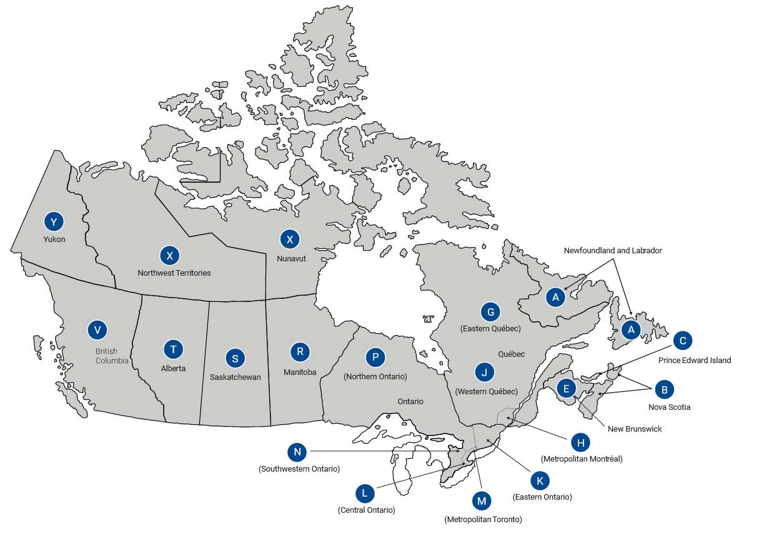
A familiar hierarchical addressing
M5S 2E4
Notes:
Is the mail destined to Ontario or BC?
Bring it to Ontario office

Slide 59
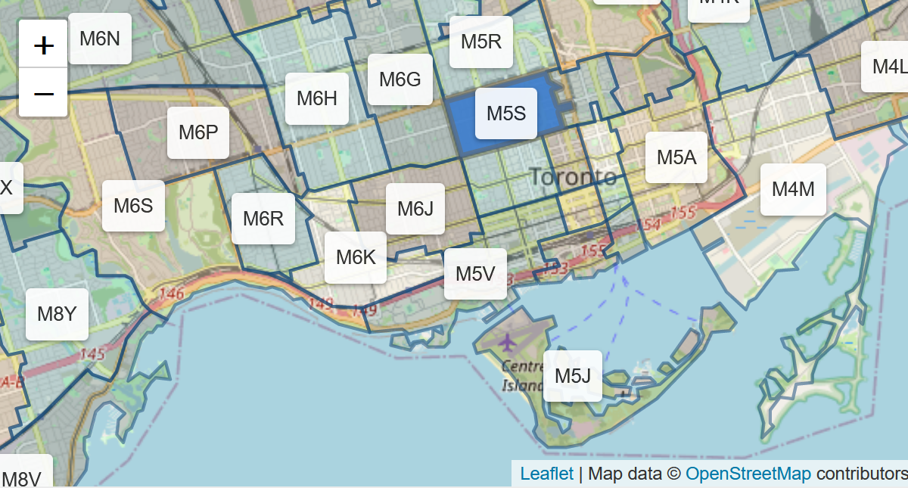
A familiar hierarchical addressing
M5S 2E4
Notes:
Is the mail destined to downtown or uptown?
Bring it to Downtown office
. . .

Slide 60
A familiar hierarchical addressing
M5S 2E4
Forward Sortation Area
Local Delivery Unit
We use the same approach for network addresses

Slide 61
Hierarchical Addressing: IP Prefixes
Network and host portions (left and right)
128.100.20.0/24 is a 24-bit prefix with 2⁸ addresses
.
.
.
128
100
20
20
10000000
01100100
00010100
00010100
Network (24 bits)
Host (8 bits)

Slide 62
IP Address and 24-bit Subnet Mask
.
.
.
Address
128
100
20
20
10000000
01100100
00010100
00010100
11111111
11111111
11111111
00000000
Mask
255
255
255
0

Slide 63
Scalability Improved
Number related hosts from a common subnet
1.2.3.0/24 on the left LAN
5.6.7.0/24 on the right LAN
1.2.3.4
1.2.3.7
1.2.3.156
5.6.7.8
5.6.7.9
5.6.7.212
host
host
...
host
host
host
...
host
LAN 1
LAN 2
router
router
router
WAN
WAN
1.2.3.0/24
5.6.7.0/24
forwarding table

Slide 64
Easy to Add New Hosts
No need to update the routers
E.g., adding a new host 5.6.7.213 on the right
Doesn’t require adding a new forwarding-table entry
1.2.3.4
1.2.3.7
1.2.3.156
5.6.7.8
5.6.7.9
5.6.7.212
host
host
...
host
host
host
...
host
LAN 1
LAN 2
router
router
router
host
WAN
WAN
5.6.7.213
1.2.3.0/24
5.6.7.0/24
forwarding table

Slide 65
A bit of History!

Slide 66
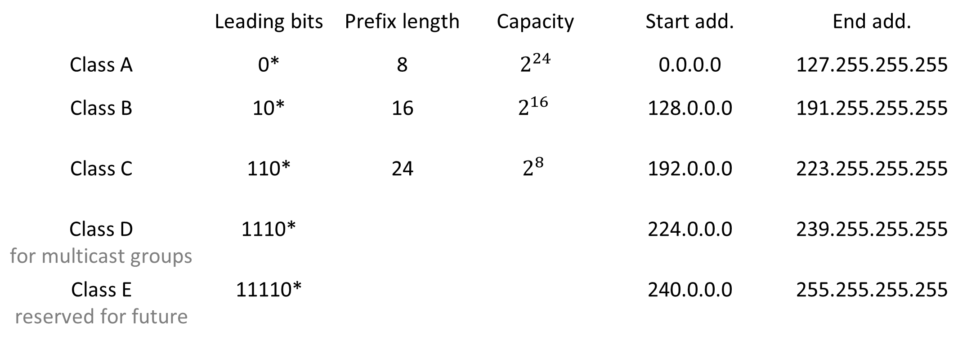
Classful Addressing
In the olden days, there were only 5 fixed allocation sizes (or classes)
 | Leading bits | Prefix length | Capacity | Start add. | End add.
Class A | 0* | 8 | $2^{24}$ | 0.0.0.0 | 127.255.255.255
Class B | 10* | 16 | $$2^{16}$$ | 128.0.0.0 | 191.255.255.255
Class C | 110* | 24 | $$2^{8}$$ | 192.0.0.0 | 223.255.255.255
Class D for multicast groups | 1110* |  |  | 224.0.0.0 | 239.255.255.255
Class E reserved for future | 11110* |  |  | 240.0.0.0 | 255.255.255.255
UofT has 128.100.0.0/16!

Slide 67
Classful networking was quite wasteful leading to IP address exhaustion
Issue Class C was too small, so everybody requested class B but class B is too big, which led to wasted space
Solution Classless Inter-Domain Routing (CIDR) introduced in 1993

Slide 68
Classless Inter-Domain Routing (CIDR)
Use two 32-bit numbers to represent a network
Network number = IP address + Mask
IP Address : 12.4.0.0 IP Mask: 255.254.0.0
Address
00001100
00000100
00000000
00000000
Mask
11111111
11111110
00000000
00000000
Network Prefix
for hosts
Written as 12.4.0.0/15

Slide 69
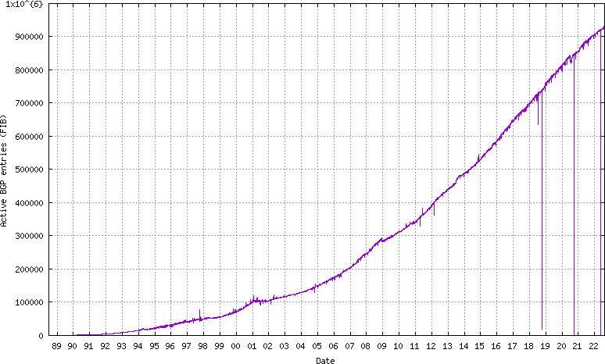
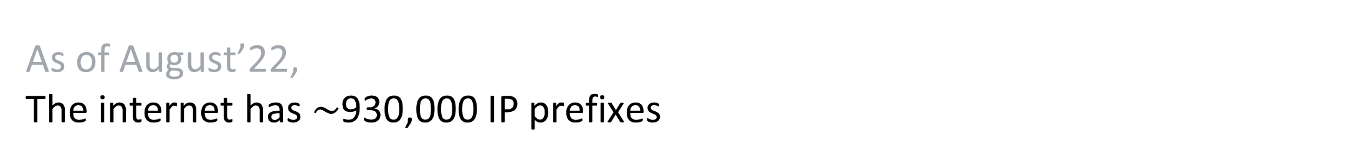
As of August’22, The internet has $\sim$930,000 IP prefixes
https://bgp.potaroo.net/as2.0/bgp-active.html

Slide 70
How IP address allocation happens?
Again, there is a hierarchy

Slide 71

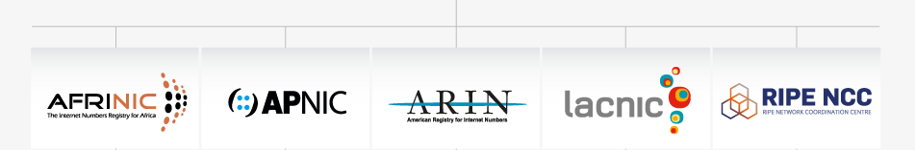

Internet Corporation for Assigned Names and Numbers (ICANN)
Allocates large prefixes blocks to Regional Internet Registries (RIRs)
Africa Asia-Pacific America Latin America Europe
RIRs allocates parts of these prefixes blocks to
Internet Service Providers (ISPs) and large institutions

Slide 72
IP Packet Forwarding

Slide 73
IP Router
Control Plane
Implementing routing protocols,
computing routing tables
Processor
Switching
Fabric
Data Plane
Adapter
Adapter
Forwarding actual packets
Adapter
Adapter
Adapter
Adapter

Slide 74
Hop-by-Hop Packet Forwarding
Each router has a forwarding table
Maps destination address to outgoing interface
Upon receiving a packet
Inspect the destination address in the header
Index into the table
Determine the outgoing interface
Forward the packet out that interface
Then, the next router in the path repeats

Slide 75
Separate Forwarding Entry Per Prefix
Prefix-based forwarding
Map the destination address to matching prefix
Forward to the outgoing interface
1.2.3.4
1.2.3.7
1.2.3.156
5.6.7.8
5.6.7.9
5.6.7.212
host
host
...
host
host
host
...
host
LAN 1
LAN
router
router
router
WAN
WAN
1.2.3.0/24
5.6.7.0/24
forwarding table

Slide 76
CIDR Makes Packet Forwarding Harder
Provider 1’s Forwarding table
Forwarding table may have many matches
Assume a packet destined to 128.100.20.20 comes at Provider 1
IP Prefix | Output
128.100.0.0/16 | Port #1
128.200.10.0/24 | Port #1
128.1.0.0/16 | Port #1
128.100.20.0/24 | Port #2
128.0.0.0/8
Port #1
Provider 2
Provider 1
128.100.20.20
Port #2
128.100.17.0/24
128.100.18.0/24
128.100.19.0/24
128.100.20.0/24

Slide 77
CIDR Makes Packet Forwarding Harder
Provider 1’s Forwarding table
Forwarding table may have many matches
Assume a packet destined to 128.100.20.20 comes at Provider 1
IP Prefix | Output
128.100.0.0/16 | Port #1
128.200.10.0/24 | Port #1
128.1.0.0/16 | Port #1
128.100.20.0/24 | Port #2
???
128.0.0.0/8
Port #1
Provider 2
Provider 1
128.100.20.20
Port #2
128.100.17.0/24
128.100.18.0/24
128.100.19.0/24
128.100.20.0/24

Slide 78
Longest Prefix Match Forwarding
Provider 1’s Forwarding table
Destination-based forwarding
Packet has a destination address
Router identifies longest-matching prefix
IP Prefix | Output
128.100.0.0/16 | Port #1
128.200.10.0/24 | Port #1
128.1.0.0/16 | Port #1
128.100.20.0/24 | Port #2
128.0.0.0/8
Port #1
Provider 2
Provider 1
128.100.20.20
Port #2
128.100.17.0/24
128.100.18.0/24
128.100.19.0/24
128.100.20.0/24

Slide 79
Creating a Forwarding Table
Entries can be statically configured
“map 128.100.20.0/24 to Port #2”
But, this doesn’t adapt
To failures
To new equipment
To the need to balance load
That is where the control plane comes in
Routing protocols (next lecture)

Slide 80
IP Packet Format

Slide 81
IP Packet Structure
4 bits
version | header length | Type of service (TOS) | Total Length
Identification |  |  | Flags | Fragment offset
Time to Live |  | Protocol | Header Checksum
Source IP Address
Destination IP Address
Options (if any)
Payload

Slide 82
The version number tells us what other fields to expect, typically it is set to “4” for IPv4, or “6” for IPv6
4 bits
version | header length | Type of service (TOS) | Total Length
Identification |  |  | Flags | Fragment offset
Time to Live |  | Protocol | Header Checksum
Source IP Address
Destination IP Address
Options (if any)
Payload

Slide 83
The number of 32-bit words in the header, typically set to 5 (20 bytes header) Can be more when “IP options” are used
4 bits
version | header length | Type of service (TOS) | Total Length
Identification |  |  | Flags | Fragment offset
Time to Live |  | Protocol | Header Checksum
Source IP Address
Destination IP Address
Options (if any)
Payload

Slide 84
Allows different packets to be treated differently, e.g., low delay for voice, high bandwidth for video
4 bits
version | header length | Type of service (TOS) | Total Length
Identification |  |  | Flags | Fragment offset
Time to Live |  | Protocol | Header Checksum
Source IP Address
Destination IP Address
Options (if any)
Payload

Slide 85
# of bytes in the entire packet, with a maximum of 65 535 bytes
4 bits
version | header length | Type of service (TOS) | Total Length
Identification |  |  | Flags | Fragment offset
Time to Live |  | Protocol | Header Checksum
Source IP Address
Destination IP Address
Options (if any)
Payload

Slide 86
Supports dividing a large IP packet into fragments … in case a link cannot handle a large IP packet
4 bits
version | header length | Type of service (TOS) | Total Length
Identification |  |  | Flags | Fragment offset
Time to Live |  | Protocol | Header Checksum
Source IP Address
Destination IP Address
Options (if any)
Payload

Slide 87
Used to identify packets trapped in a loop, and eventually discard them
4 bits
version | header length | Type of service (TOS) | Total Length
Identification |  |  | Flags | Fragment offset
Time to Live |  | Protocol | Header Checksum
Source IP Address
Destination IP Address
Options (if any)
Payload

Slide 88
The upper-level protocol carried in the packet, “6” for TCP, “17” for UDP
4 bits
version | header length | Type of service (TOS) | Total Length
Identification |  |  | Flags | Fragment offset
Time to Live |  | Protocol | Header Checksum
Source IP Address
Destination IP Address
Options (if any)
Payload

Slide 89
The sum of all the 16-bit words in the header (does not protect the payload) If header bits are corrupted, checksum won’t match, and receiver discards corrupted packets
4 bits
version | header length | Type of service (TOS) | Total Length
Identification |  |  | Flags | Fragment offset
Time to Live |  | Protocol | Header Checksum
Source IP Address
Destination IP Address
Options (if any)
Payload

Slide 90
Uniquely identify the source and destination host Why do we need source IP?!
4 bits
version | header length | Type of service (TOS) | Total Length
Identification |  |  | Flags | Fragment offset
Time to Live |  | Protocol | Header Checksum
Source IP Address
Destination IP Address
Options (if any)
Payload

Slide 91
IP Header: To and From Addresses
Destination IP address (32 bits)
Unique identifier for the receiving host
Allows each node to make forwarding decisions
Source IP address (32 bits)
Unique identifier for the sending host
Recipient can decide whether to accept packet
Enables recipient to send a reply back to source

Slide 92
MAC Address vs. IP Address
MAC addresses
Hard-coded when adapter is built
Flat name space of 48 bits (e.g., 00-0E-9B-6E-49-76)
Like a social insurance number
Portable, and will stay the same as the host moves
Used to get packet between interfaces on same network
IP addresses
Configured, or learned dynamically
Hierarchical name space of 32 bits (e.g., 12.178.66.9)
Like a postal mailing address
Not portable, and depends on where the host is attached
Used to get a packet to destination IP subnet

Slide 93
Contrast
IP
Packets forwarded on all links
Aggregatable addresses
Routing protocol computes loop-free paths
Forwarding table computed by routing protocol
Ethernet
Packets forwarded on subset of links (spanning tree)
Flat addresses
“Routing” protocol computes loop-free topology
Forwarding table derived from data packets^{(+SPT for floods)}

