Slide 1

The Routing Concept & Algorithms
Soheil Abbasloo
Department of Computer Science
University of Toronto
Fall 2022

Slide 2
Last Time …
Network IP Addresses
IP Packet Forwarding
IP Packet Format
Routing Concept & Algorithms
(Today)
Application
Best-Effort Global Delivery
Transport
Network
L3
L2
Data link
Physical
Best-Effort Local Delivery
Ethernet pkt forwarding
Spanning Tree & Flooding
Why not simply use the layer 2 flooding mechanism to avoid doing routing in the Internet?!

Slide 3
to UBC
to UofT
router#4
router#2
Forwarding Table
111010010
UofT
Destination | Next Hop
UBC | router#4
UW | router#5
UofT | router#2
NYU | router#3
router#5
to UW
to NYU
router#3

Slide 4
Forwarding
Local router process that determines the output link (a.k.a “next hop”) for each packet
How
read address from packet’s network layer header
search forwarding table

Slide 5
to UBC
to UofT
router#4
router#2
111010010
UofT
Forwarding Table
Destination | Next Hop
UBC | router#4
UW | router#5
UofT | router#2
NYU | router#3
router#1
router#5
to UW
to NYU
router#3

Slide 6
Routing
Network-wide process that determines the content of forwarding tables
determines the end-to-end path for each destination

Slide 7
Destination | Next Hop
UBC | router#1
UW | router#1
UofT | router#6
NYU | router#1
to UBC
to UofT
router#4
router#2
111010010
UofT
Destination | Next Hop
UBC | router#4
UW | router#5
UofT | router#2
NYU | router#3
Destination | Next Hop
UBC | router#1
UW | router#1
UofT | router#1
NYU | router#1
router#1
Forwarding Table
to UW
router#5
to NYU
router#3

Slide 8
Routing
Network-wide process that determines the content of forwarding tables
determines the end-to-end path for each destination
How?
coming up soon

Slide 9

Forwarding vs. Routing
Forwarding: “data plane”
Directing one data packet
Each router using local routing state
Routing: “control plane”
Computing the forwarding tables that guide packets
Jointly computed by routers using a distributed algorithm
Very different timescales!
Control Plane
Processor
Switching
Fabric
Adapter
Adapter
Adapter
Adapter
Adapter
Adapter
Data Plane

Slide 10
Routing Fundamentals
Validity of routing state

Slide 11
Goal of Routing (v1)
Find a path to a given destination
How do we know that the state contained in forwarding tables meets our goal?
This is what “validity” of routing state tells us
[this is non-standard terminology]

Slide 12
Local vs. Global View of State
Local routing state is the forwarding table in a single router
By itself, the state in a single router can’t be evaluated
It must be evaluated in terms of the global context

Slide 13
Destination | Next Hop
UBC | router#1
UW | router#1
UofT | router#1
NYU | router#1
to UBC
to UofT
router#4
router#2
111010010
UofT
Destination | Next Hop
UBC | router#4
UW | router#5
UofT | router#2
NYU | router#3
Destination | Next Hop
UBC | router#1
UW | router#1
UofT | router#1
NYU | router#1
router#1
to UW
router#5
to NYU
router#3

Slide 14
Local vs. Global View of State
Local routing state is the forwarding table in a single router
By itself, the state in a single router can’t be evaluated
It must be evaluated in terms of the global context
Global state refers to the collection of forwarding tables in each of the routers
Global state determines which paths packets take
(Will discuss later where this routing state comes from)

Slide 15
“Valid” Routing State
Global state is “valid” if it produces forwarding decisions that always deliver packets to their destinations
Goal of routing protocols: compute valid state
But how can you tell if routing state if valid?
Need a succinct correctness condition for routing
Suggestions?
Notes:
What could go wrong?

Slide 16
Necessary and Sufficient Condition
Global routing state is valid if and only if:
There are no dead ends (other than destination)
There are no loops
A dead end is when there is no outgoing link (next-hop)
A packet arrives, but the forwarding decision does not yield any outgoing link
A loop is when a packet cycles around the same set of nodes forever

Slide 17
Destination | Next Hop
UBC | router#1
UW | router#1
UofT | router#1
NYU | router#1
Loop!
to UBC
to UofT
router#4
router#2
111010010
UofT
Destination | Next Hop
UBC | router#4
UW | router#5
UofT | router#2
NYU | router#3
Destination | Next Hop
UBC | router#1
UW | router#1
UofT | router#1
NYU | router#1
router#1
to UW
router#5
to NYU
router#3

Slide 18
Destination | Next Hop
UBC | router#1
UW | router#1
UofT | router#1
NYU | router#1
Deadend (to UofT)
to UBC
to UofT
router#4
router#2
111010010
UofT
Destination | Next Hop
UBC | router#4
UW | router#5
NYU | router#3
Destination | Next Hop
UBC | router#1
UW | router#1
UofT | router#1
NYU | router#1
router#1
to UW
router#5
to NYU
router#3

Slide 19
Necessary and Sufficient Condition
Global routing state is valid if and only if:
There are no dead ends (other than destination)
There are no loops

Slide 20
Necessary (“only if”): Easy
If you run into a deadend before hitting destination, you’ll never reach the destination
If you run into a loop, you’ll never reach destination

Slide 21
Sufficient (“if”):
Assume no deadends, no loops
Packet must keep wandering, but without repeating
If ever enter same router from same link, will loop
Only a finite number of possible links for it to visit
It cannot keep wandering forever without looping
Must eventually hit destination
Notes:
Destination is only safe deadend

Slide 22
Checking Validity of Routing State
Focus only on a single destination
Ignore all other routing state
Mark outgoing link (“next hop”) with arrow
There is only one at each node
Eliminate all links with no arrows
Look at what’s left….

Slide 23
Example 1

Slide 24
Pick Destination

Slide 25
Put arrows on outgoing links (to green dot)

Slide 26
Remove Unused Links
Leaves Spanning Tree: Valid

Slide 27
Second Example

Slide 28
Second Example
Is this valid?

Slide 29
Lesson….
Very easy to check validity of routing state for a particular destination
Deadends are obvious
Node without outgoing arrow
Loops are obvious
Disconnected from rest of graph

Slide 30
Goal (for routing)
v1: Find a path to a given destination
v2: Find a least cost path to a given destination

Slide 31
next hop
dest.
z
?
u
?
next hop
next hop
dest.
dest.
z
?
u
?
v
?
v
v
?
1
2
u
4
z
could represent:
-- propagation delay
-- load
-- cost
link costs
Notes:
(First example, link costs.)
Let’s suppose that there are only 3 routers in the entire Internet,
and they are all directly connected to each other in this triangle.
For each router, we will decide how it should reach every other router.
For example, router u can reach router z directly,
or it can reach router z indirectly, through router v.
Which of the two routes (paths) is better?
In other words, for each source router,
we will decide which is the best next hop to every destination router.
How will we decide? We will rely on these 3 clicks things called click “link costs”.
Each link is associated with a link cost.
The lower the link cost, the better the quality of the link.
So, link costs could represent, for example,
click the propagation delay of the link,
or its click current load.

Slide 32
next hop
dest.
z
z
u
u
next hop
next hop
dest.
dest.
z
v
u
v
v
v
v
v
v
1
2
u
4
z
least-cost path from u to z:
u v z
least cost path from u to v:
u v
Notes:
(Least-cost routing.)
For each pair of routers, we will find the path that has the least total cost.
For example, from source router click u to destination router z,
- there is the click direct path, which has cost 4;
- and the click indirect one, through v, which has cost 1 + 2 = 3.
So, the click indirect one is the best path.
Now, let’s fill in the forwarding table of router u:
- the best next hop to destination router z is click router v.
click
Similarly, from click source router u to destination router v,
- there is a click direct path, of cost 1;
- and an click indirect one, through z, of cost 4 + 2 = 6.
So, the best path is the direct one.
Now, let’s fill in the forwarding table of router u:
- the best next hop to destination router v is click router v itself.
click
In a similar manner, we can fill in the forwarding tables of routers 2 clicks z and 2 clicks v.

Slide 33
Least-cost path routing
Given: router graph & link costs
Goal: find least-cost path
from each source router
to each destination router
how do we compute these?

Slide 34
Routing Algorithms

Slide 35
“Least Cost” Routes
“Least cost” routes an easy way to avoid loops
No sensible cost metric is minimized by traversing a loop
Least cost routes are also “destination-based”
i.e., do not depend on the source
Why is this?
Least-cost paths form a spanning tree

Slide 36
Least-cost path routing
Approach 1: link-state routing
Approach 2: distance-vector routing

Slide 37
dest.
next hop
cost
z
v
v
1
2
*
4
u
z

Slide 38

dest.
next hop
cost
z
z
4
v
v
1
v
1
2
*
4
u
z

Slide 39


dest.
next hop
cost
z
z
v
4
3
v
v
1
v
1
2
*
4
u
z

Slide 40
dest.
next hop
cost
z
v
x
v
1
3
*
u
2
z
2
1
x

Slide 41

dest.
next hop
cost
z
-
-
v
v
1
x
x
2
v
1
3
*
u
2
z
2
1
x

Slide 42

dest.
next hop
cost
z
-
-
v
4
v
v
1
x
x
2
v
1
3
*
u
2
z
2
1
x

Slide 43

dest.
next hop
cost
z
-
-
v
x
4
3
v
v
1
x
x
2
v
1
3
*
u
2
z
2
1
x

Slide 44
dest.
next hop
cost
z
w
y
v
x
5
3
v
w
2
5
*
u
2
3
1
z
1
2
x
y
1

Slide 45



dest.
next hop
cost
z
-
-
w
w
5
y
-
-
v
v
2
x
x
1
5
v
3
w
2
5
*
u
2
3
1
z
1
2
x
y
1

Slide 46


dest.
next hop
cost
z
-
-
w
w
x
5
4
y
-
x
-
2
v
v
2
x
x
1
5
v
3
w
2
5
*
u
2
3
1
z
1
2
x
y
1

Slide 47
dest.
next hop
cost
z
-
-
w
w
x
5
4
y
-
x
-
2
v
v
2
x
x
1
5
v
3
w
2
5
*
u
2
3
1
z
1
2
x
y
1

Slide 48
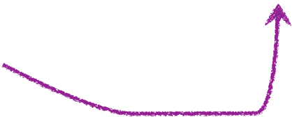

dest.
next hop
cost
z
-
x
-
4
w
w
x
5
4
3
y
-
x
-
2
v
v
2
x
x
1
5
3
v
w
2
5
*
u
2
3
1
z
1
2
x
y
1

Slide 49
dest.
next hop
cost
z
-
x
-
4
w
w
x
5
4
3
y
-
x
-
2
v
v
2
x
x
1
5
3
v
w
2
5
*
u
2
3
1
z
1
2
x
y
1

Slide 50
dest.
next hop
cost
z
-
x
-
4
w
w
x
5
4
3
y
-
x
-
2
v
v
2
x
x
1
5
3
v
w
2
5
*
u
2
3
1
z
1
2
x
y
1
Notes:
(Nothing.)

Slide 51
Routing algorithm for source u
Input: router graph & link costs
Output: least-cost path
from source router u
to every other router

Slide 52
Dijkstra’s algorithm
Source router considers every other router
starting from next “closest” neighbor
Checks whether it can improve current paths
by using that router as an intermediate point
Ends when all intermediaries have been considered
See text for exact algorithm

Slide 53
From routing algorithm to protocol
Note: Dijkstra’s is a local computation!
computed by one node given complete network graph
Possibilities:
Option#1: a separate machine runs the algorithm
Option#2: every router runs the algorithm
Currently Option#2 is used …

Slide 54
Link State Routing
Network-wide Distributed Problem
A local Non-Distributed Problem

Slide 55
Link State Routing
Every router knows its local “link state”
router u: “(u,v) with cost=2; (u,x) with cost=1”
A router floods its link state to all other routers
does so periodically or when its link state changes
How to know which link state is the new one?
Hence, every router learns the entire network graph
runs Dijkstra’s locally to compute its forwarding table
OSPF is a link-state protocol (IETF RFC 2328 or 5340)

Slide 56
Link State Routing
Are loops possible?
B
5
C
B
C
5
5
A
5
3
F
A
F
1
1
5
D
E
D
E
1
A and D think that this is the path to C
E thinks that this is the path to C

Slide 57
Convergence
All routers have consistent routing information
E.g., all nodes having the same link-state database
Forwarding is consistent after convergence
All nodes have the same link-state database
All nodes forward packets on same paths

Slide 58
Convergence Delay
Time to achieve convergence
Sources of convergence delay?
time to detect failure
time to flood link-state information
time to re-compute forwarding tables
Performance during convergence period?
lost packets due to blackholes
looping packets
out-of-order packets reaching the destination

Slide 59
Link State Routing
Are loops possible?
yes, until convergence
Scalability?
O(NE) messages
O(N²) computation time
O(network diameter) convergence time
O(N) entries in forwarding table
Do we have to use Dijkstra’s?

Slide 60
Least-cost path routing
Approach 1: link-state routing
Approach 2: distance-vector routing

Slide 61
Experiment
Your job: find the youngest person in the room
Ground Rules
You may not leave your seat, nor shout loudly across the class
You may talk with your immediate neighbors (hint: “exchange updates” with them)
At the end of 5 minutes, I will pick a victim and ask:
who is the youngest person in the room? (name , date)
which one of your neighbors first told you this information?

Slide 62
Go!

Slide 63
Example of Distributed Computation
I am three hops away
I am two hops away
I am one hop away
I am two hops away
I am two hops away
I am three hops away
I am one hop away
Destination
I am three hops away
I am one hop away
I am two hops away

Slide 64
x
y
z
This is y’s “distance vector”
x
-
-
-
y
2
0
1
z
-
-
-
y
2
1
7
x
z
to
x
y
z
x
y
z
x
0
2
7
x
-
-
-
from
y
-
-
-
y
-
-
-
z
-
-
-
z
7
1
0

Slide 65
x
y
z
x
0
2
7
y
2
0
1
2
0
1
z
7
1
0
y
2
1
7
x
z
to
x
y
z
x
y
z
x
0
2
7
x
0
2
7
from
y
y
2
0
1
z
z
7
1
0
7
1
0

Slide 66
x
y
z
x
0
2
7
y
2
0
1
z
7
1
0
y
2
1
7
x
z
to
x
y
z
x
y
z
x
0
2
3
x
0
2
7
from
y
2
0
1
y
2
0
1
z
7
1
0
z
7
1
0

Slide 67
x
y
z
x
0
2
7
y
2
0
1
z
7
1
0
y
2
1
7
x
z
to
x
y
z
x
y
z
x
0
2
3
x
0
2
7
from
y
2
0
1
y
2
0
1
z
7
1
0
z
3
1
0

Slide 68
x
y
z
x
0
2
3
y
2
0
1
z
3
1
0
y
2
1
7
x
z
to
x
y
z
x
y
z
x
0
2
3
x
0
2
3
from
y
2
0
1
y
2
0
1
z
3
1
0
z
3
1
0

Slide 69
x
y
v
z
x
-
-
-
-
z
x
y
v
y
1
0
-
3
y
-
-
-
-
z
-
-
-
-
v
-
-
-
-
y
z
-
3
1
0
1
3
x
z
2
1
to
x
y
v
z
v
x
y
v
z
x
0
1
2
-
from
y
-
-
-
-
x
-
-
-
-
v
-
-
-
-
v
2
-
0
1
z
-
-
-
-

Slide 70
x
y
v
z
x
0
1
2
-
z
x
y
v
y
1
0
-
3
y
1
0
-
3
z
-
3
1
0
v
2
-
0
1
y
z
-
3
1
0
1
3
x
z
2
1
to
x
y
v
z
v
x
y
v
z
x
0
1
2
-
from
y
1
0
-
3
x
0
1
2
-
v
2
-
0
1
v
2
-
0
1
z
-
3
1
0

Slide 71
x
y
v
z
x
0
1
2
-
z
x
y
v
y
1
0
-
3
y
1
0
-
3
z
-
3
1
0
v
2
-
0
1
y
z
-
3
1
0
1
3
x
z
2
1
to
x
y
v
z
v
x
y
v
z
x
0
1
2
3
from
y
1
0
-
3
x
0
1
2
-
v
2
-
0
1
v
2
-
0
1
z
-
3
1
0

Slide 72
x
y
v
z
x
0
1
2
-
z
x
y
v
y
1
0
-
3
y
1
0
-
3
z
-
3
1
0
v
2
-
0
1
y
z
3
3
1
0
1
3
x
z
2
1
to
x
y
v
z
v
x
y
v
z
x
0
1
2
3
from
y
1
0
-
3
x
0
1
2
-
v
2
-
0
1
v
2
-
0
1
z
-
3
1
0

Slide 73
x
y
v
z
x
0
1
2
-
z
x
y
v
y
1
0
3
3
y
1
0
-
3
z
-
3
1
0
v
2
-
0
1
y
z
3
3
1
0
1
3
x
z
2
1
to
x
y
v
z
v
x
y
v
z
x
0
1
2
3
from
y
1
0
-
3
x
0
1
2
-
v
2
-
0
1
v
2
-
0
1
z
-
3
1
0
Notes:
Router y:
Adds route to router v, through router x.

Slide 74
x
y
v
z
x
0
1
2
-
z
x
y
v
y
1
0
3
3
y
1
0
-
3
z
-
3
1
0
v
2
-
0
1
y
z
3
3
1
0
1
3
x
z
2
1
to
x
y
v
z
v
x
y
v
z
x
0
1
2
3
from
y
1
0
-
3
x
0
1
2
-
v
2
-
0
1
v
2
3
0
1
z
-
3
1
0
Notes:
Router v:
Adds route to router y, through x.

Slide 75
x
y
v
z
x
0
1
2
3
z
x
y
v
y
1
0
3
3
y
1
0
3
3
z
3
3
1
0
v
2
3
0
1
y
z
3
3
1
0
1
3
x
z
2
1
to
x
y
v
z
v
x
y
v
z
x
0
1
2
3
from
y
1
0
3
3
x
0
1
2
3
v
2
3
0
1
v
2
3
0
1
z
3
3
1
0

Slide 76
Distance-vector routing
Input to each router: local link costs & neighbor messages (DVs)
Output of each router: least-cost path to every other router

Slide 77
Distance-vector routing
Distributed algorithm
All routers run it “together”
each router runs its own instance
neighbors exchange and react to each other’s messages

Slide 78
Bellman-Ford algorithm
All neighbors exchange information
Each router checks whether it can improve current paths by leveraging the new information
Ends when no improvement is possible

Slide 79
to
x
y
z
x
0
2
7
from
y
2
0
1
z
7
1
0
y
2
1
7
x
z
dx(z) =
min{
cost(x,z),
cost(x,y) + dy(z)
}

Slide 80
y
2
7
x
u
z
1
w
dx(z) =
min{
cost(x,y) + dy(z),
cost(x,u) + du(z),
cost(x,w) + dw(z)
}

Slide 81
y
2
7
x
u
z
1
w
dx(z) =
minn{
cost(x,n) + dn(z)
}
for all neighbors n
Bellman-Ford equation
Notes:
... which is called the Bellman-Ford equation.

Slide 82
Bellman-Ford equation
Formalizes the following decision:
pick as the next hop for destination z
the neighbor that results in the least-cost path to z.

Slide 83
x
y
z
y
2
0
1
z
3
1
0
2
y
1
7
x
z
x
y
z
y
2
0
1
z
3
1
0

Slide 84
x
y
z
y
4
0
1
z
3
1
0
routing loop!
y
1
7
x
z
x
y
z
y
2
0
1
z
3
1
0

Slide 85
x
y
z
y
4
0
1
z
3
1
0
routing loop!
y
1
7
x
z
x
y
z
y
4
0
1
z
3
1
0

Slide 86
x
y
z
y
4
0
1
z
3
1
0
routing loop!
y
1
7
x
z
x
y
z
y
4
0
1
z
5
1
0

Slide 87
x
y
z
y
4
0
1
z
5
1
0
routing loop!
y
1
7
x
z
x
y
z
y
4
0
1
z
5
1
0

Slide 88
x
y
z
y
6
0
1
z
5
1
0
routing loop!
y
1
7
x
z
x
y
z
y
4
0
1
z
5
1
0

Slide 89
x
y
z
y
6
0
1
z
5
1
0
routing loop!
y
1
7
x
z
x
y
z
y
6
0
1
z
5
1
0

Slide 90
x
y
z
y
6
0
1
z
5
1
0
routing loop!
y
1
7
x
z
x
y
z
y
6
0
1
z
7
1
0
Notes:
.

Slide 91
x
y
z
y
6
0
1
z
7
1
0
routing loop!
y
1
7
x
z
x
y
z
y
6
0
1
z
7
1
0

Slide 92
x
y
z
y
8
0
1
z
7
1
0
routing loop!
y
1
7
x
z
x
y
z
y
6
0
1
z
7
1
0

Slide 93
x
y
z
y
8
0
1
z
7
1
0
routing loop!
y
1
7
x
z
x
y
z
y
8
0
1
z
7
1
0

Slide 94
x
y
z
y
8
0
1
z
7
1
0
routing loop!
y
1
7
x
z
x
y
z
count-to-infinity scenario
y
8
0
1
z
7
1
0

Slide 95
Problems with Bellman-Ford
Routing loops
z routes through y, y routes through x
y loses connectivity to x
y decides to route through z
Can take a very long time to resolve
Count-to-infinity scenario

Slide 96
x
y
z
y
2
0
1
z
∞
poisoned reverse
3
1
0
2
y
1
7
x
z
x
y
z
y
2
0
1
z
3
1
0
Notes:
Z will not advertise 3 to y, instead it goes with infinity (poison-reverse)
The case that z will not share info back to a node that it has received the info from is called split-horizon advertisement

Slide 97
x
y
z
y
∞
0
1
poisoned reverse
z
∞
1
0
y
1
7
x
z
x
y
z
y
2
0
1
z
3
1
0

Slide 98
x
y
z
y
∞
0
1
poisoned reverse
z
∞
1
0
y
1
7
x
z
x
y
z
y
∞
0
1
z
3
1
0

Slide 99
x
y
z
y
∞
0
1
poisoned reverse
z
∞
1
0
y
1
7
x
z
x
y
z
y
∞
0
1
z
7
1
0

Slide 100
x
y
z
y
∞
0
1
poisoned reverse
z
7
1
0
y
1
7
x
z
x
y
z
y
∞
0
1
z
7
1
0

Slide 101
x
y
z
y
8
0
1
z
7
1
0
y
1
7
x
z
x
y
z
poisoned reverse
y
∞
0
1
z
7
1
0

Slide 102
Solution
Poisoned reverse
If z routes to x through y, z advertises to y that its cost to x is infinite
y never decides to route to x through z
Often avoids the count-to-infinity problem

Slide 103
Distance Vector Routing
Are loops possible?
yes, until convergence
convergence slower than in Link-State
Scalability?
requires fewer messages than Link-State
O(N) update time on arrival of a new DV from neighbor
O(network diameter) convergence time
O(N) entries in forwarding table
RIP is a protocol that implements DV (IETF RFC 2080)
Notes:
RIP: Routing Information Protocol

Slide 104
Does Poison-Reverse Completely Solve the Count-to-Infinity Problem?
D
100
1
∞
4
B
∞
4
100
1
100
1
1
1
6
3
∞
∞
2
2
∞
5
A
1
C
How can we mitigate this?
Notes:
Blue numbers -> advertised info regarding destination D (with poison-reverse)
Finish by replacing 100s with infinity on one side, 5 on the other, and then updating C

Slide 105
Summary
Least-cost path routing
link-state routing
Each node knows the entire map of network
Each node calculates the routes to all destinations by itself
distance-vector routing
Each node only knows its neighbors and their distance to destinations
Calculations happen in a distributed fashion
Slow convergence

Slide 106
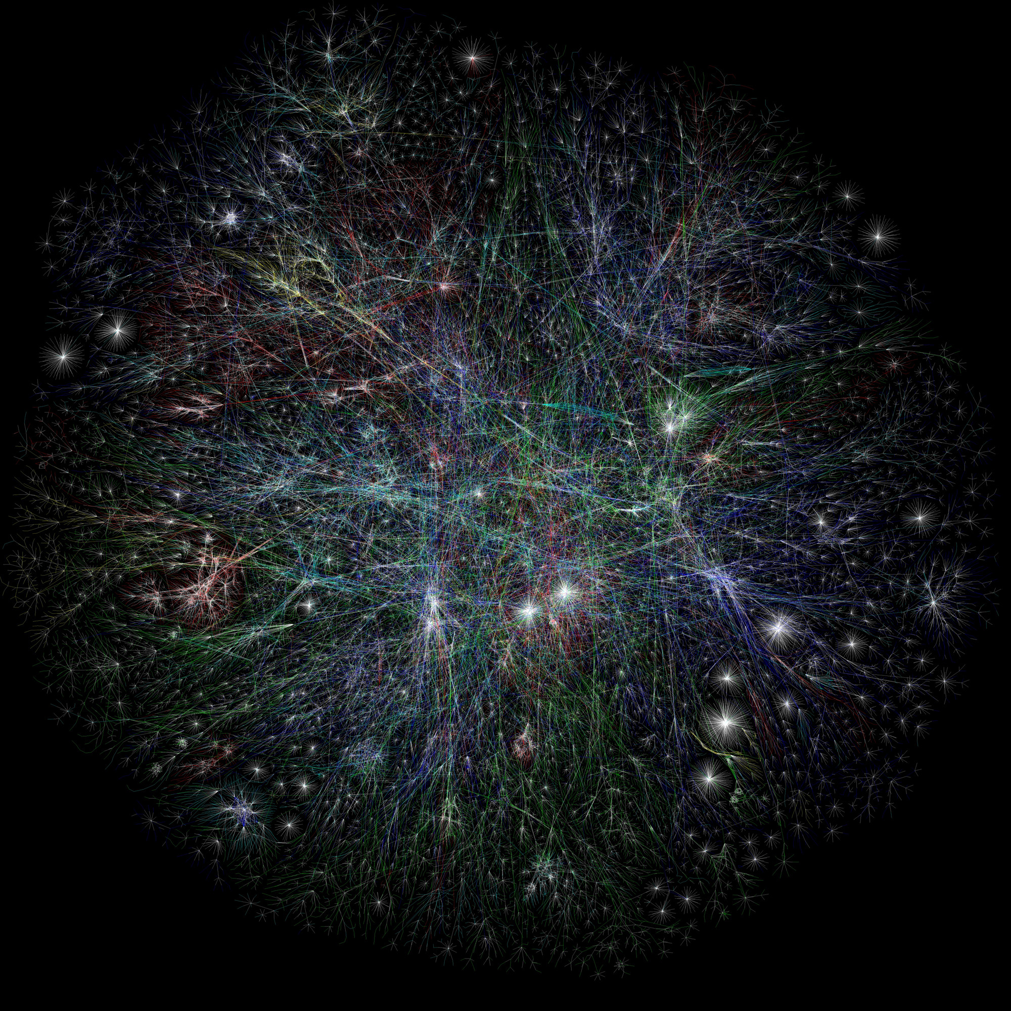
Which one do you think is a better choice for this network?
Routing in the Internet (next time)

