Slide 1
Distribution Models and Portfolio Risk Management
Evidence from Technology and Energy Stocks
Tianxudong Tang
Nov 2026
1
Erdos Institute Quant Finance Boot Camp

Slide 2
Research question
• Does a better fit to historical returns improve risk forecasts?
• Does VaR-based position sizing improve investment outcomes?
• What is the opportunity cost of reducing market exposure?
2

Slide 3
Data and research design
• 20 stocks: 10 technology-related and 10 energy
• Training: 2021–2023 | Out-of-sample: 2024–2025 (502 days)
• Fit Normal, Student-t, and two-component Gaussian mixture (GMM)
• Evaluate BIC, portfolio VaR / ES, and position-sizing performance
3

Slide 4
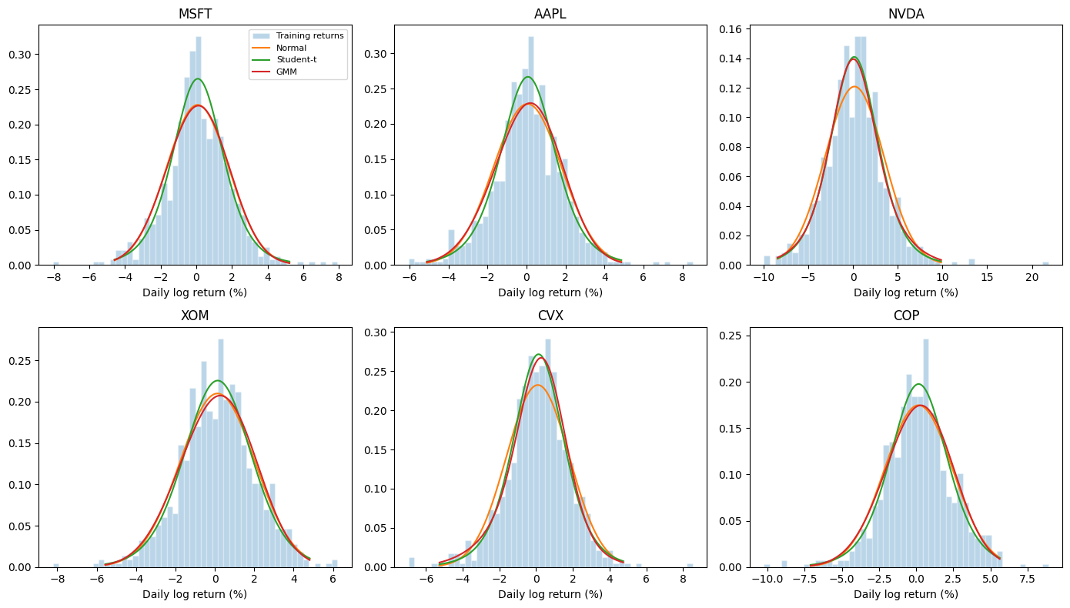
Historical fit: Student-t wins all 20 stocks
Student-t has the lowest BIC for all 20 stocks.
Better fit does not necessarily mean better financial decisions.
4

Slide 5
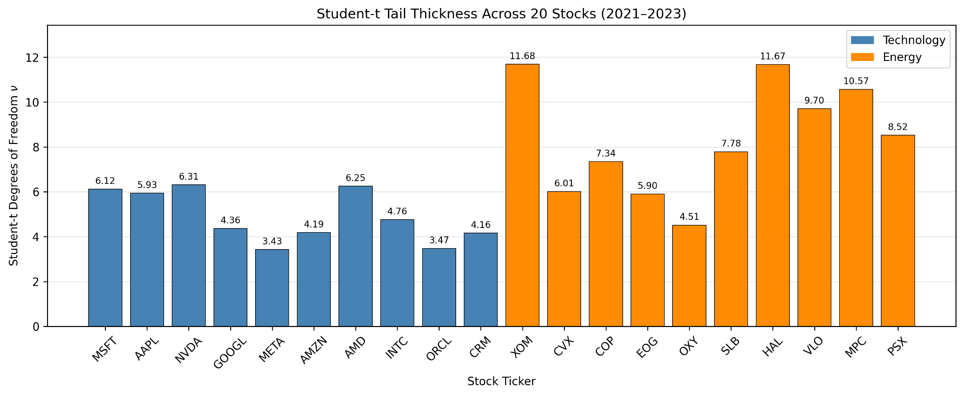
Tail thickness differs across stocks
Mean fitted ν:
Technology 4.90
Energy 8.37
Lower ν means heavier fitted tails.
5

Slide 6
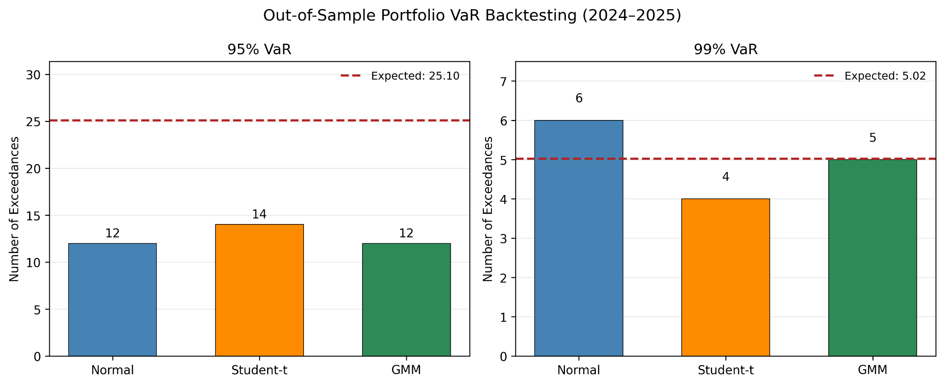
Out-of-sample VaR: no consistent winner
99% VaR exceedances:
Normal: 6
Student-t: 4
GMM: 5
Expected: 5.02
Few extreme days limit strong rankings.
6

Slide 7
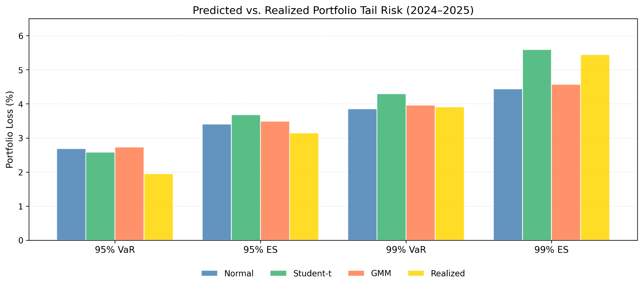
VaR and expected shortfall comparison
Different models are closest on different risk measures.
7

Slide 8
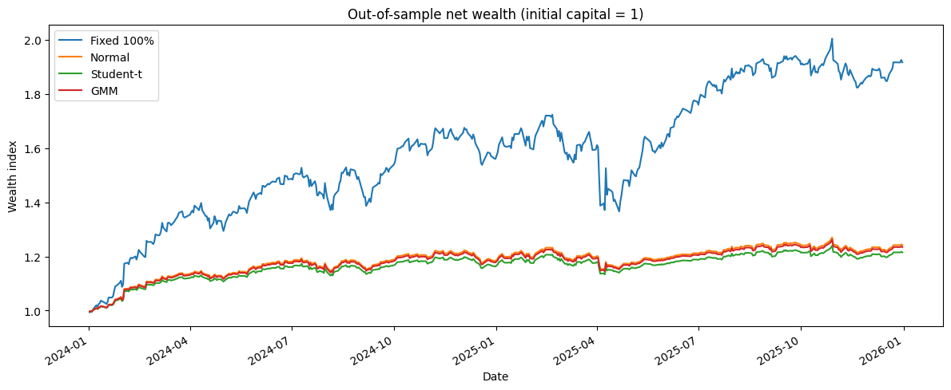
Investment test: risk reduction vs. growth
Cumulative return:
Fully invested: 91.60%
Normal VaR: 24.17%
Student-t VaR: 21.49%
GMM VaR: 23.45%
Cash earns zero.
8

Slide 9
What did the investor give up?
Backtest results, 2024–2025
Strategy | Return | Max drawdown | Sharpe | Avg. exposure
Fully invested | 91.60% | −20.72% | 1.548 | 100%
Normal VaR | 24.17% | −6.78% | 1.399 | 36.98%
Student-t VaR | 21.49% | −6.09% | 1.399 | 33.15%
GMM VaR | 23.45% | −6.60% | 1.399 | 35.96%
The VaR overlays reduced drawdown, but did not improve observed Sharpe ratios.
9

Slide 10
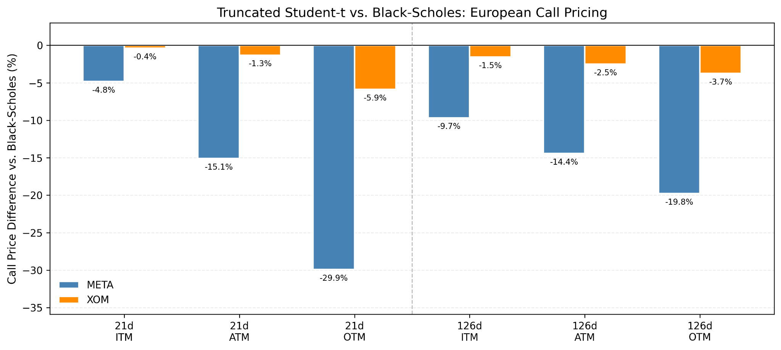
Supplementary result: theoretical call pricing
Truncated Student-t prices differ more from Black–Scholes for META than for XOM.
No market option quotes were used.
10

Slide 11
Conclusion: protection has an opportunity cost
• Student-t wins on historical BIC, not consistently on out-of-sample risk metrics.
• VaR sizing cut drawdowns, but gave up 67–70% of cumulative return.
• All three risk-controlled Sharpe ratios were ~1.40, below 1.55 for the benchmark.
• A risk overlay should be judged by both protection gained and upside surrendered,
i.e. no risk no gain！
11

