Slide 1



Income Prediction & Workforce Analytics
Group 3
2026.06.30

Slide 2
01
Introduction

Slide 3
Introduction
Predicting whether income exceeds $50K and analyzing workforce-related income patterns.
Why it matters
• Supports data-driven workforce planning
• Highlights factors linked with income
• Raises fairness questions around demographic disparities
Project workflow
Data
→
Cleaning
→
EDA
→
Modeling
→
Deployment

Slide 4
02
Dataset Overview

Slide 5
Dataset Overview
UCI Adult Income Dataset · cleaned modeling table
32,534
12
2
24.1%
cleaned records
predictor features
target classes
>50K class rate
Main features
Demographic
age, race, sex, native_country
Education & Work
education, occupation, workclass
Target variable:
whether annual income exceeds $50K.
Household
marital_status, relationship
Employment Signals
hours_per_week, capital gain/loss flags

Slide 6
03
Data Cleaning and Feature Engineering
Transforming raw census data into reliable, modeling-ready features

Slide 7
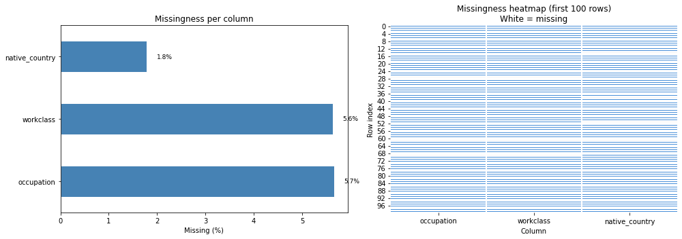
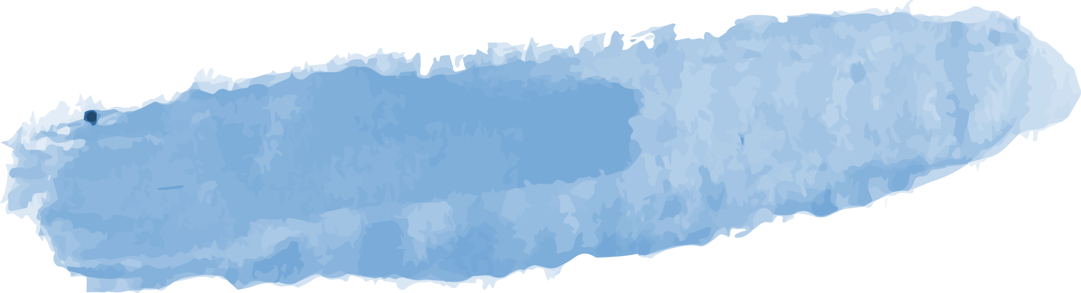

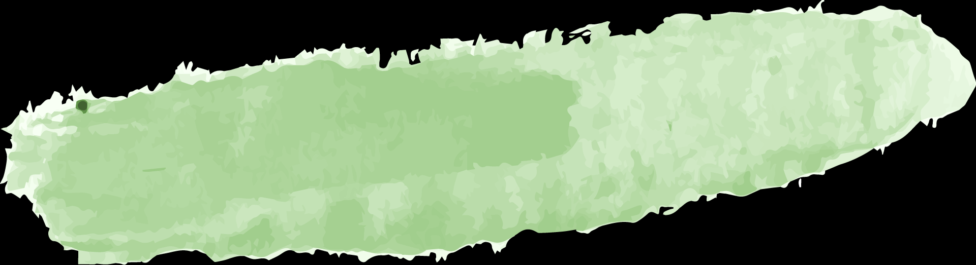
Data Quality Assessment
5.7% Missing
5.6% Missing
Occupation contained the highest proportion of missing values
Missing values in workclass required categorical imputation
1.8% Missing
Native country had limited missingness
32,561 rows · 15 variables · 27 exact duplicates
Overall missingness was low and concentrated in categorical features.

Slide 8
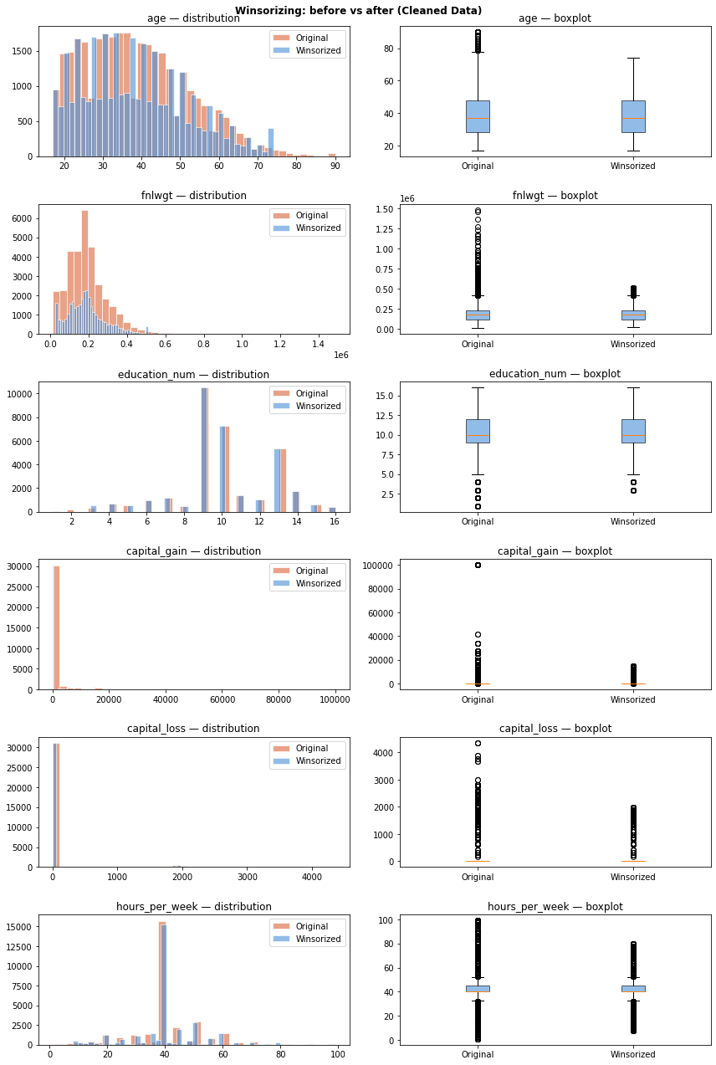



Data Cleaning Pipeline
Missing Values
Outliers & Duplicates
Formatting
Mode imputation preserved the full sample and avoided unnecessary row deletion.
Extreme numeric values were winsorized, and 27 exact duplicate rows were removed.
Spaces were removed, labels were standardized to lowercase, and data types were corrected.

Slide 9
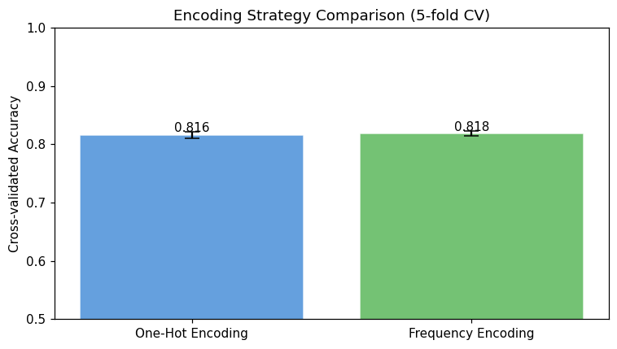
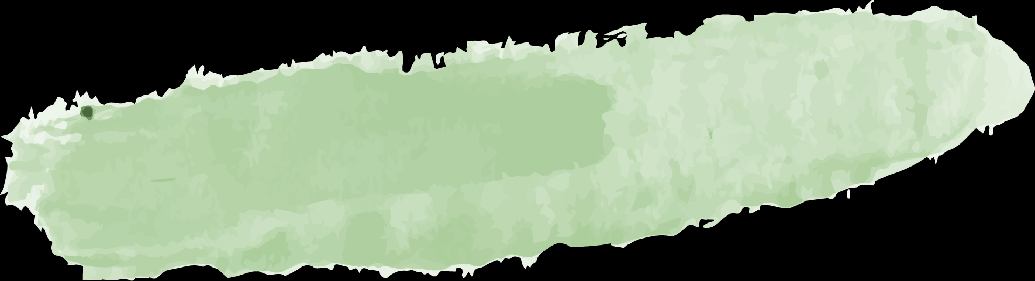
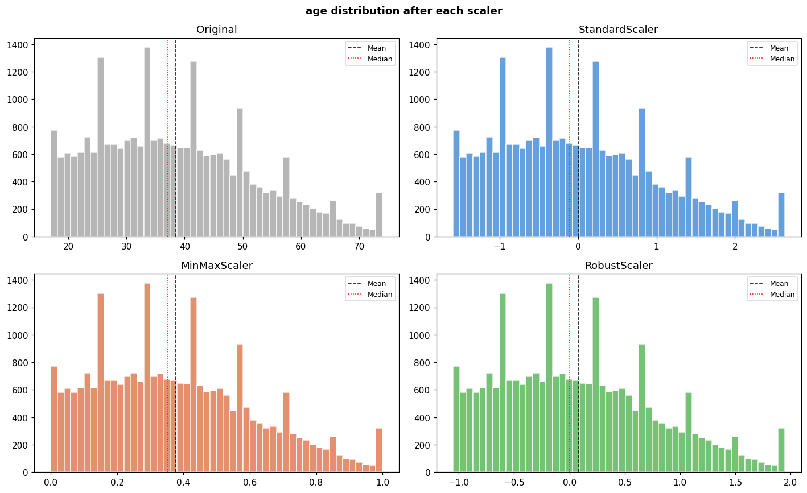

Feature Engineering
Categorical Encoding
Capital Indicators
Grouped Features
Feature Scaling
Evaluated one-hot and frequency encoding for categorical variables.
Created capital_gain_flag and capital_loss_flag to capture whether capital activity existed.
Created age and work-hour groups to capture nonlinear and interpretable patterns.
Applied StandardScaler to continuous features using training data only.

Slide 10


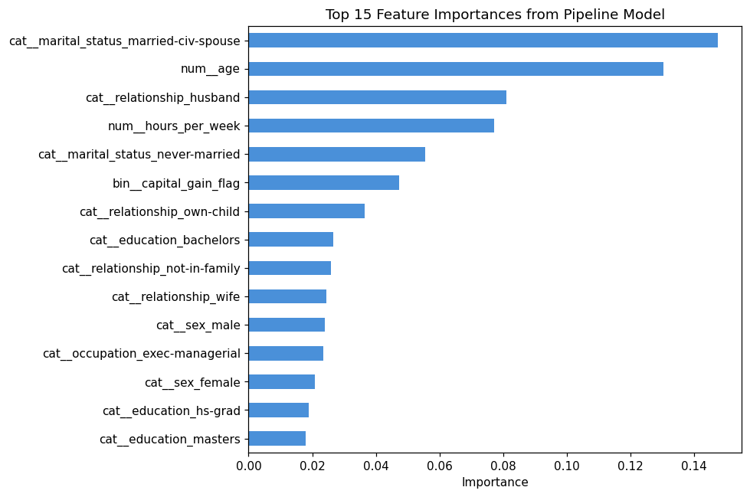
Final Modeling-Ready Dataset
age | workclass | education | occupation | hours/week | gain flag | loss flag | income
39 | state-gov | bachelors | adm-clerical | 40 | 1 | 0 | ≤50K
50 | self-emp-not-inc | bachelors | exec-managerial | 13 | 0 | 0 | ≤50K
38 | private | hs-grad | handlers-cleaners | 40 | 0 | 0 | ≤50K
53 | private | 11th | handlers-cleaners | 40 | 0 | 0 | ≤50K
28 | private | bachelors | prof-specialty | 40 | 0 | 0 | ≤50K
Cleaning Outcomes
32,534 complete, unique records
No missing values or duplicates
Standardized labels and data types
Reduced the impact of extreme values
Final Feature Set
8 categorical features
2 numerical features
2 engineered binary features
12 predictors → 103 encoded features

Slide 11
04
Exploratory Data Analysis

Slide 12


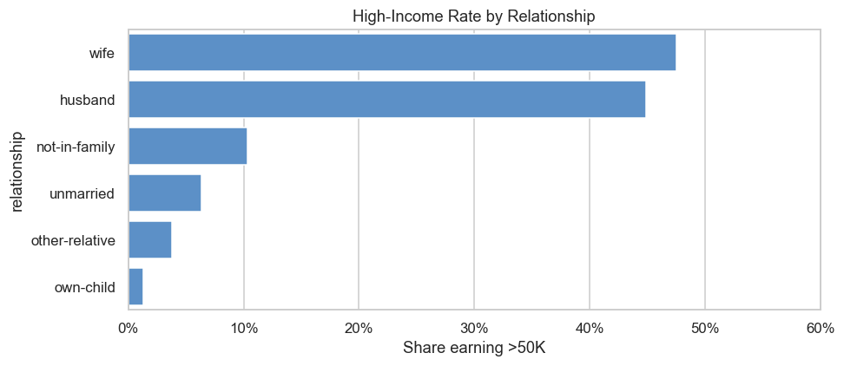
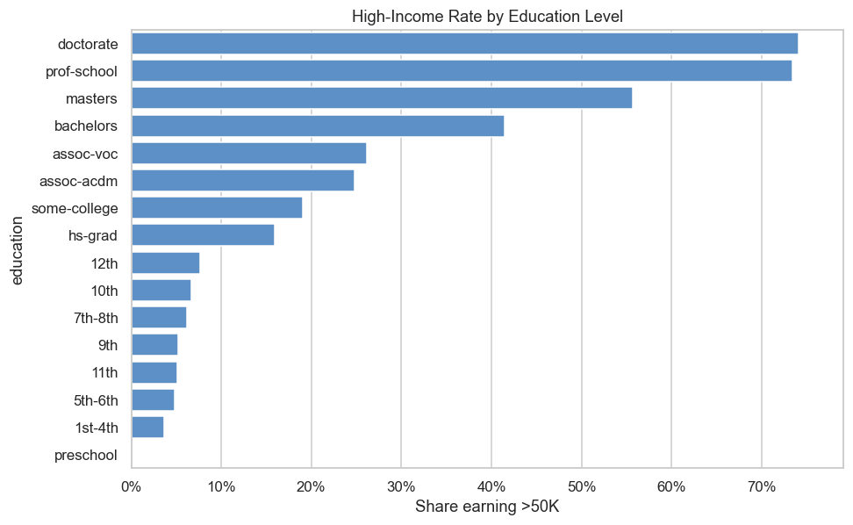
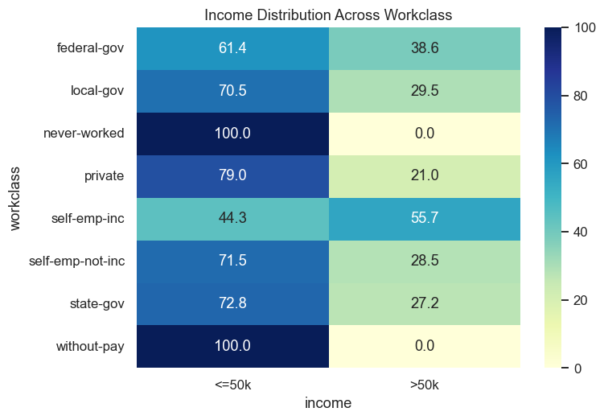
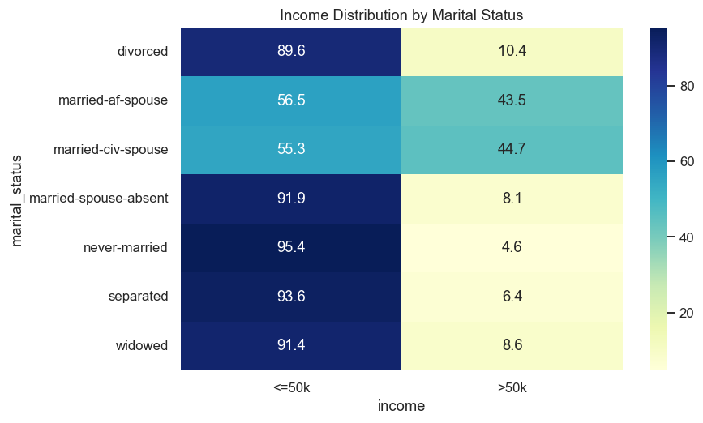
Exploratory Data Analysis
Education
Workclass
Family Structure
Higher education levels show higher >50K rates.
Bachelors, Masters, Doctorate groups stand out.
Marital status and relationship show clear income differences.
Household structure is strongly associated with income.
Self-employed incorporated workers have the highest >50K rate, followed by government workers, while private-sector workers have a relatively lower >50K rate.

Slide 13
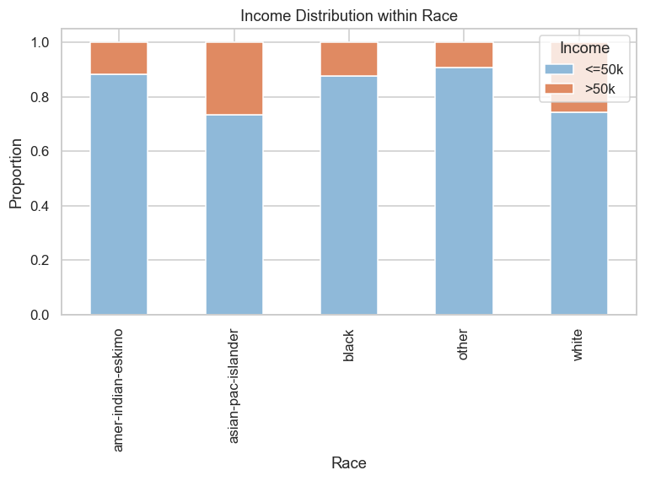
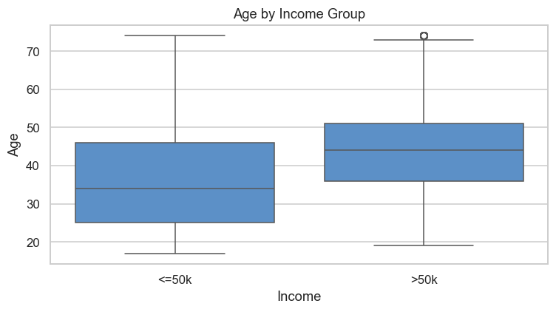
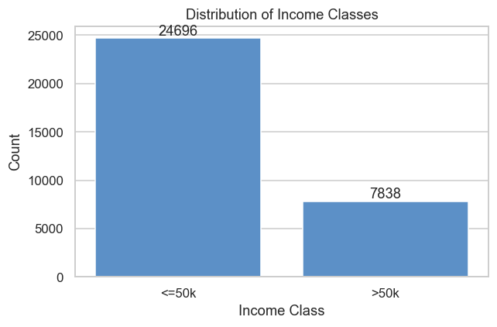
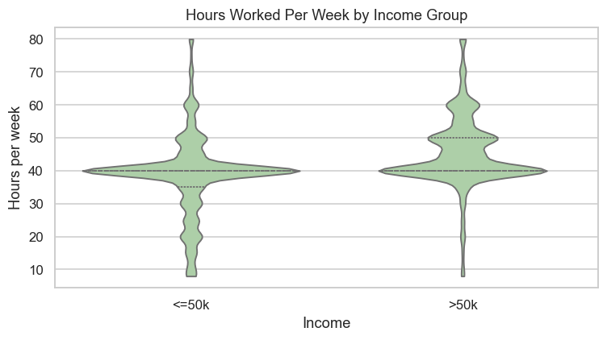
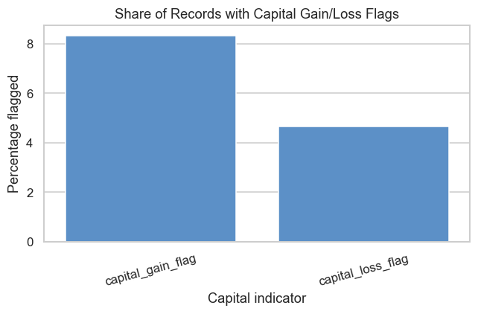
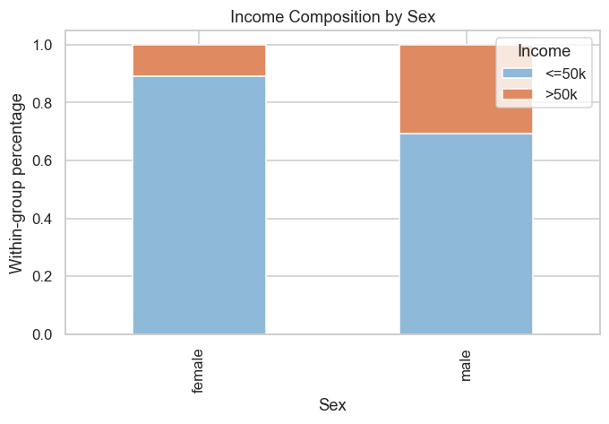
Exploratory Data Analysis
Age & Working Hours
Data Quality Notes
Race & Sex
Asian-Pacific-Islander and White groups show relatively higher >50K proportions, while Female groups show a lower >50K proportion than Male groups.
Older individuals and longer working hours are more likely linked with >50K.
But neither variable is strong enough alone.
Target class is imbalanced.
Rare categories need cautious interpretation.
Capital gain/loss flags are sparse but useful.

Slide 14
05
Modeling

Slide 15
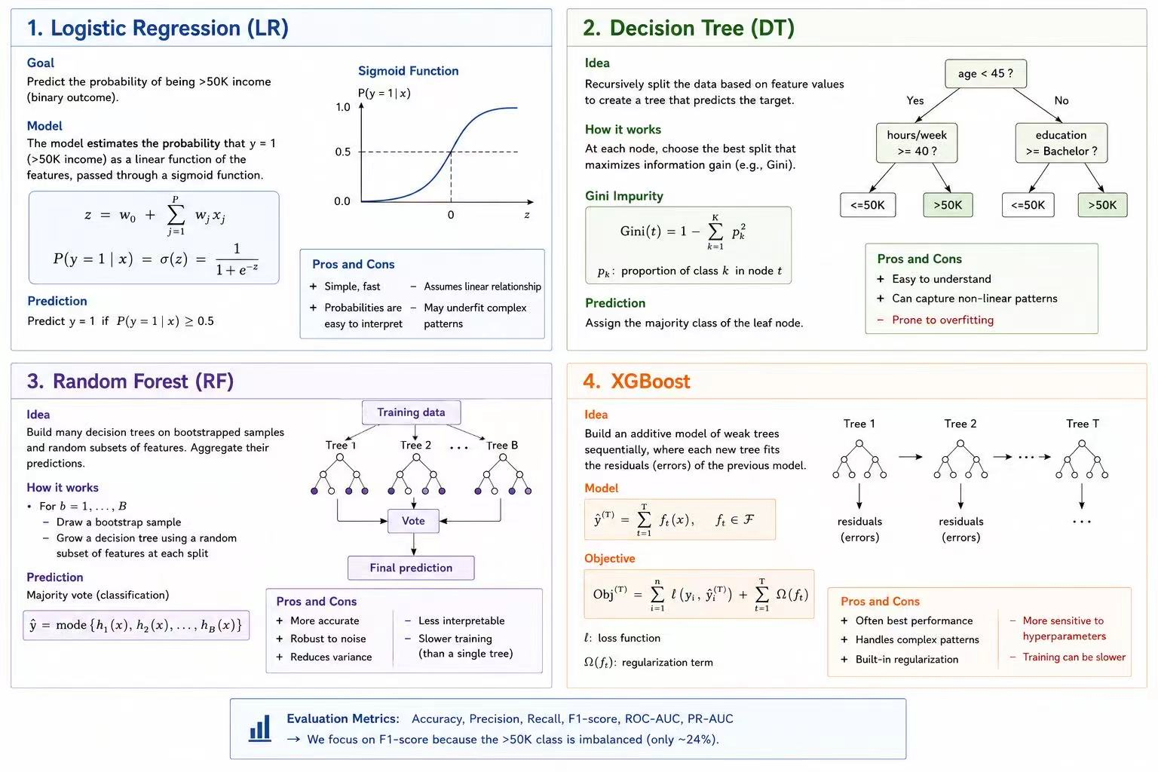
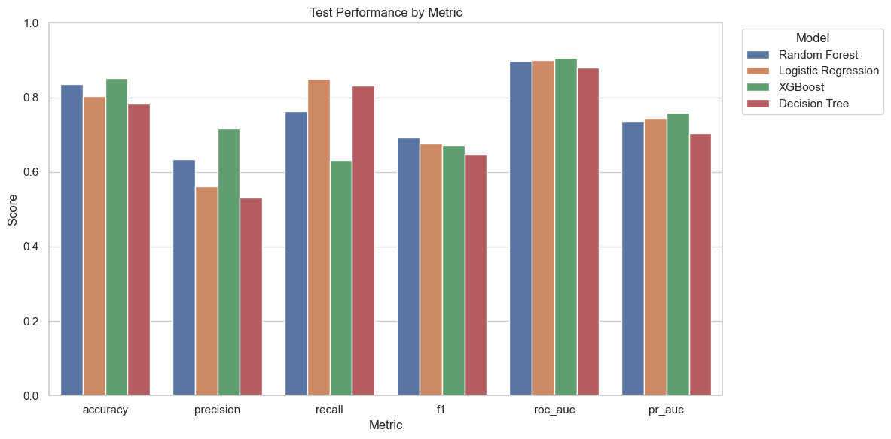
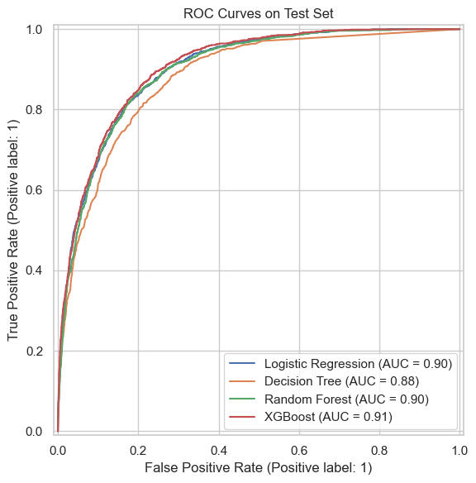
Modeling
05
Four classifiers were evaluated using the same preprocessing pipeline and independent test set.
Model Performance Comparison
Model
Acc.
Prec.
Recall
F1
ROC
PR
Random Forest
0.836
0.633
0.762
0.692
0.898
0.736
Logistic Reg.
0.803
0.560
0.850
0.675
0.901
0.745
XGBoost
0.851
0.717
0.633
0.672
0.906
0.759
Decision Tree
0.783
0.532
0.831
0.649
0.880
0.705
Selected final model
Best F1-score
Random Forest
0.6916
Best ROC-AUC
Best Recall
0.9063
0.8501
Evaluation metrics
Accuracy, Precision, Recall, F1-score, ROC-AUC, and PR-AUC were used because the >50K class is imbalanced.

Slide 16
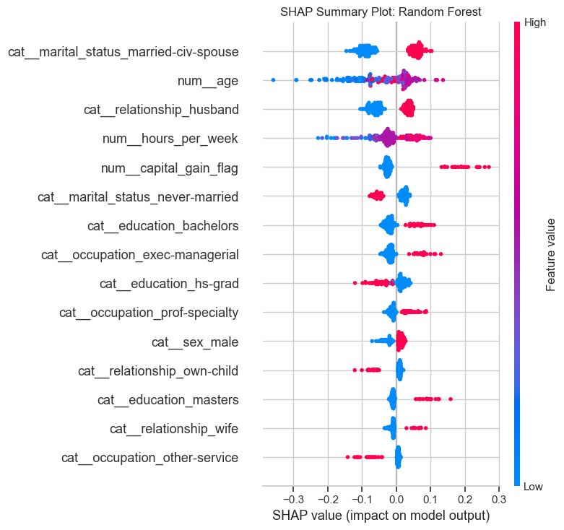
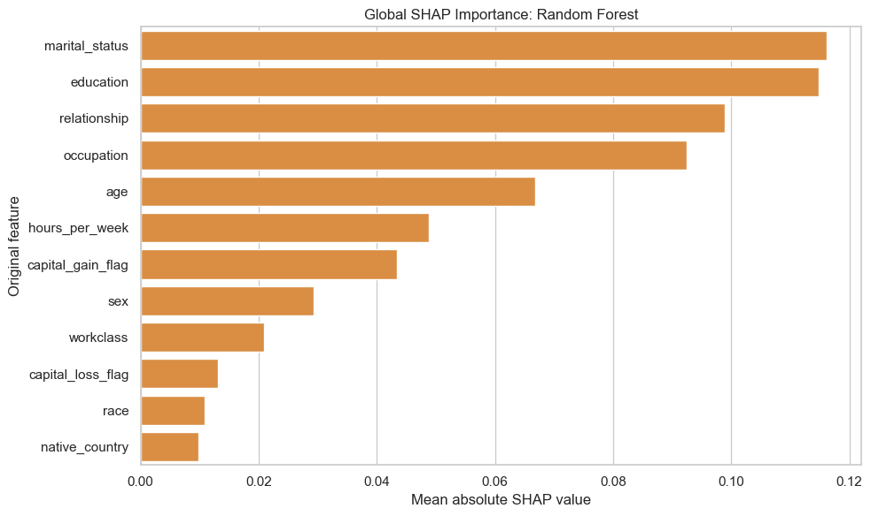
SHAP Explanations: Global View
10
SHAP explains both feature importance and the direction of each contribution.
SHAP confirms that marital status, education, relationship, occupation, and age have the largest average effects on predictions.

Slide 17
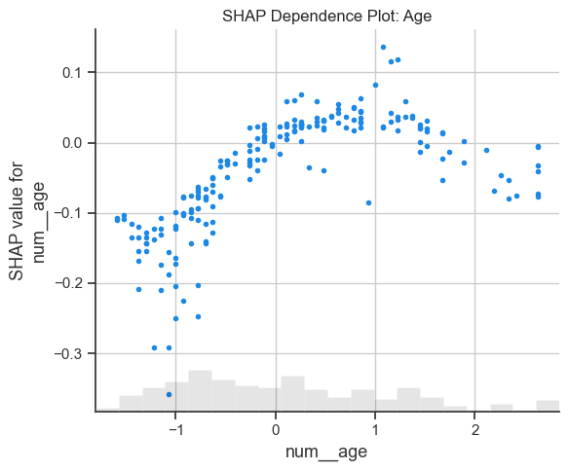
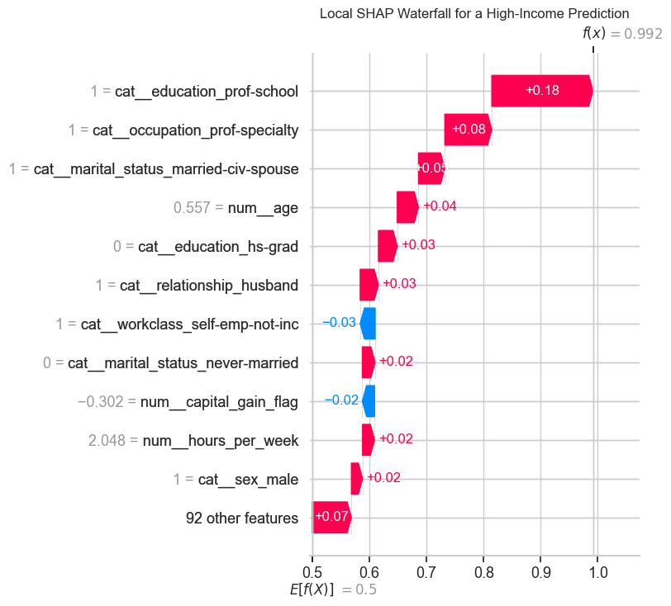
SHAP Explanations: Local and Non-linear Effects
11
Local explanations show why one prediction is high or low; dependence plots show feature response patterns.
Age effect
Individual explanation
Age has a non-linear relationship with the predicted probability of earning more than $50K.
The waterfall plot decomposes one prediction into positive and negative feature contributions.

Slide 18
06
Streamlit Web App Deployment

Slide 19
Streamlit Web App Deployment
06
The app turns the trained income model into an interactive analytics and prediction demo.
App pages
Demo functions
01
Dataset Explorer
Individual prediction
Batch prediction
Explore distributions and workforce-related income patterns.
Manual feature inputs return class, probability, and confidence.
CSV upload produces predictions and downloadable results.
02
Prediction Center
Run individual or batch predictions with model comparison.
Threshold adjustment
Model comparison
Sliders show precision/recall trade-offs at different cutoffs.
Users can compare Logistic Regression, Decision Tree, Random Forest, and XGBoost.
03
What-if Analysis
Modify profile features and observe probability changes.
Prediction explanation
What-if simulation
04
Model Performance Dashboard
Local contribution chart explains key feature drivers.
Scenario changes show how income probability responds.
Review metrics, thresholds, ROC/PR curves, and confusion matrices.
users can explore the data, adjust assumptions, compare models, and understand predictions in one Streamlit interface.

Slide 20
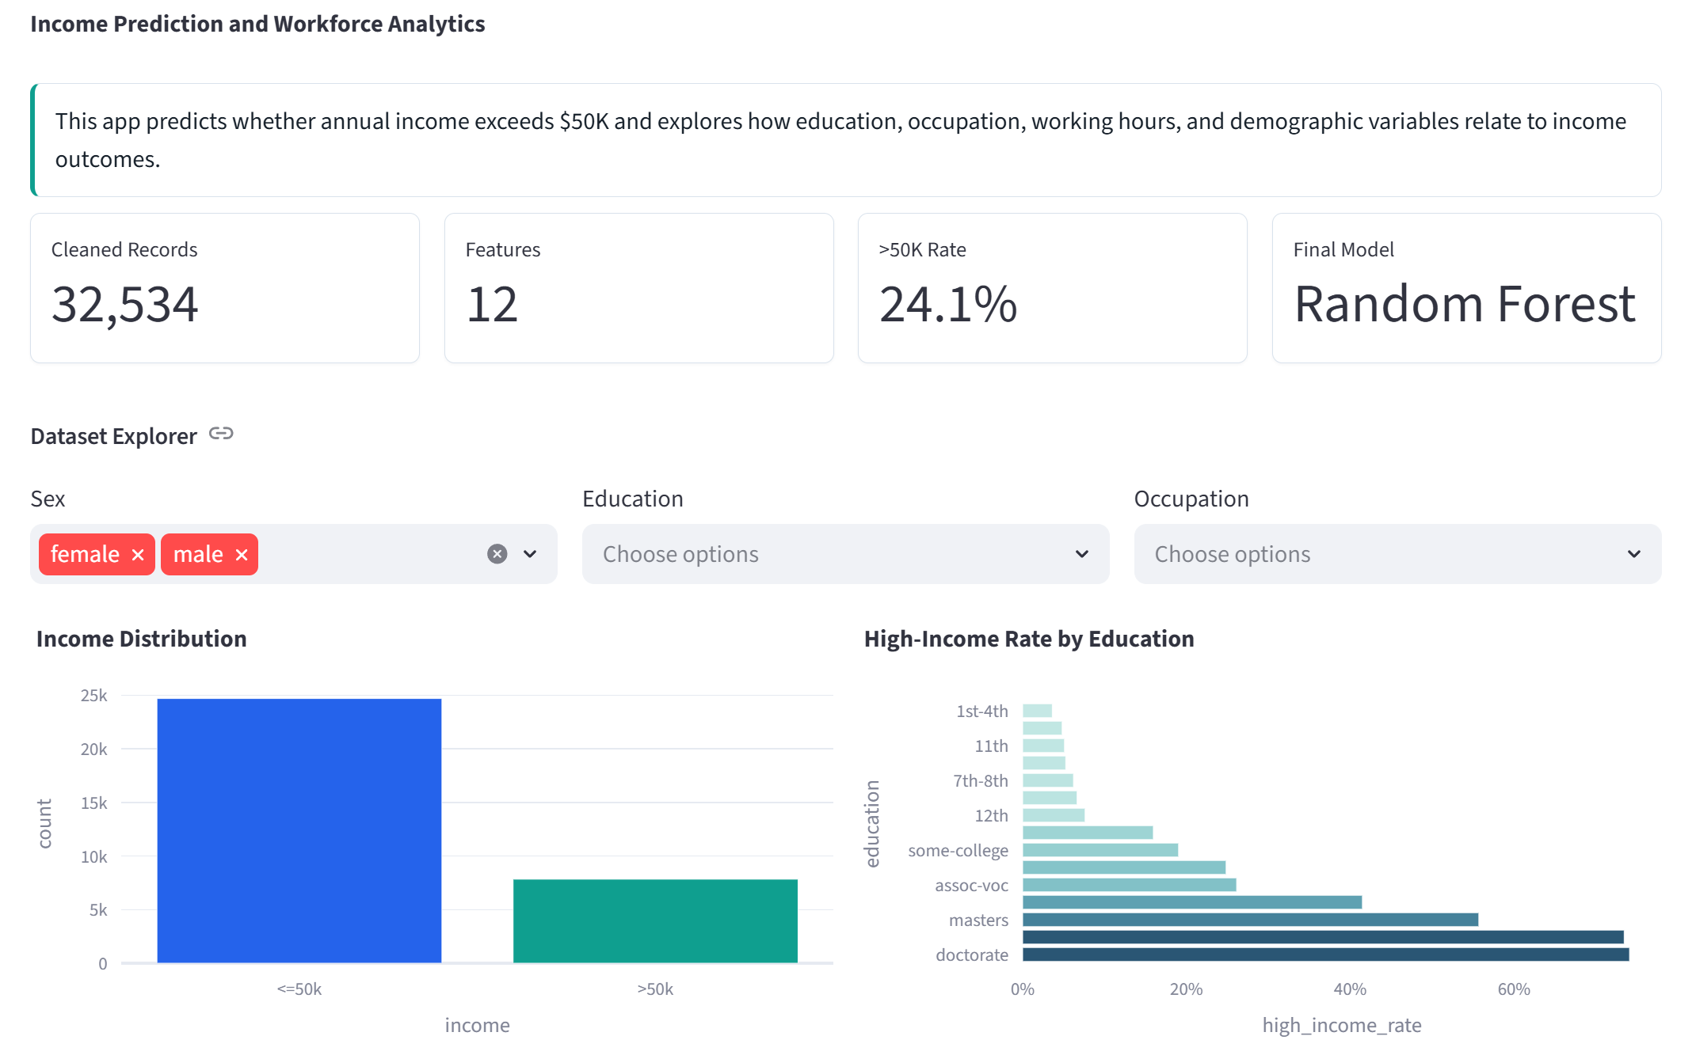
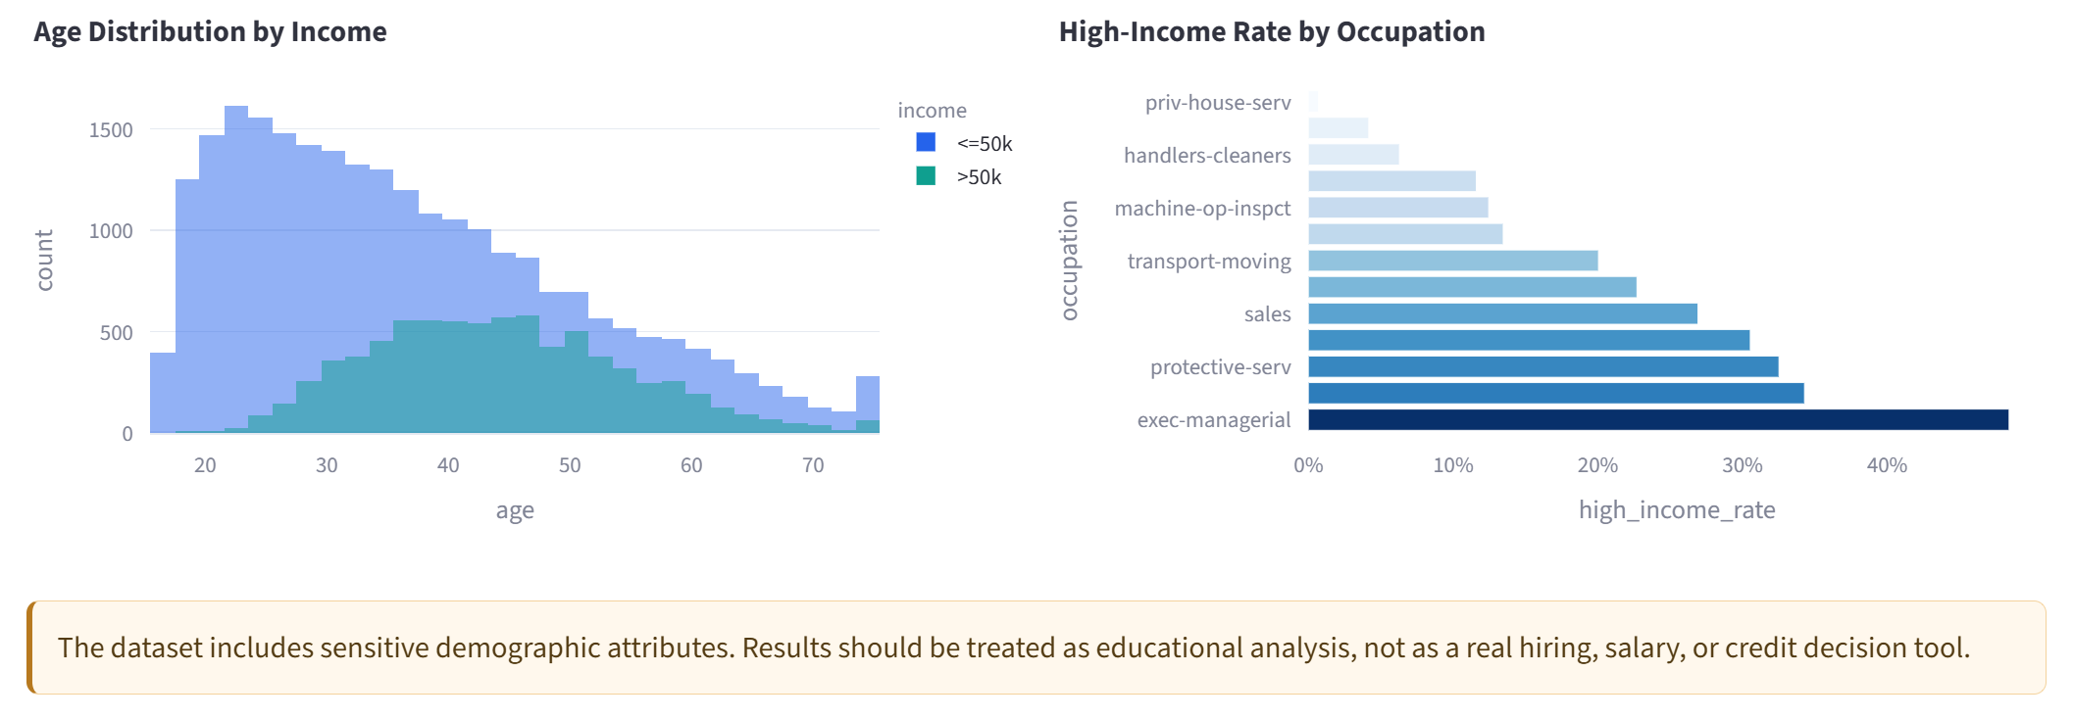
Deployment Demo: Dataset Explorer
07
Explore distributions and workforce-related income patterns.

Slide 21
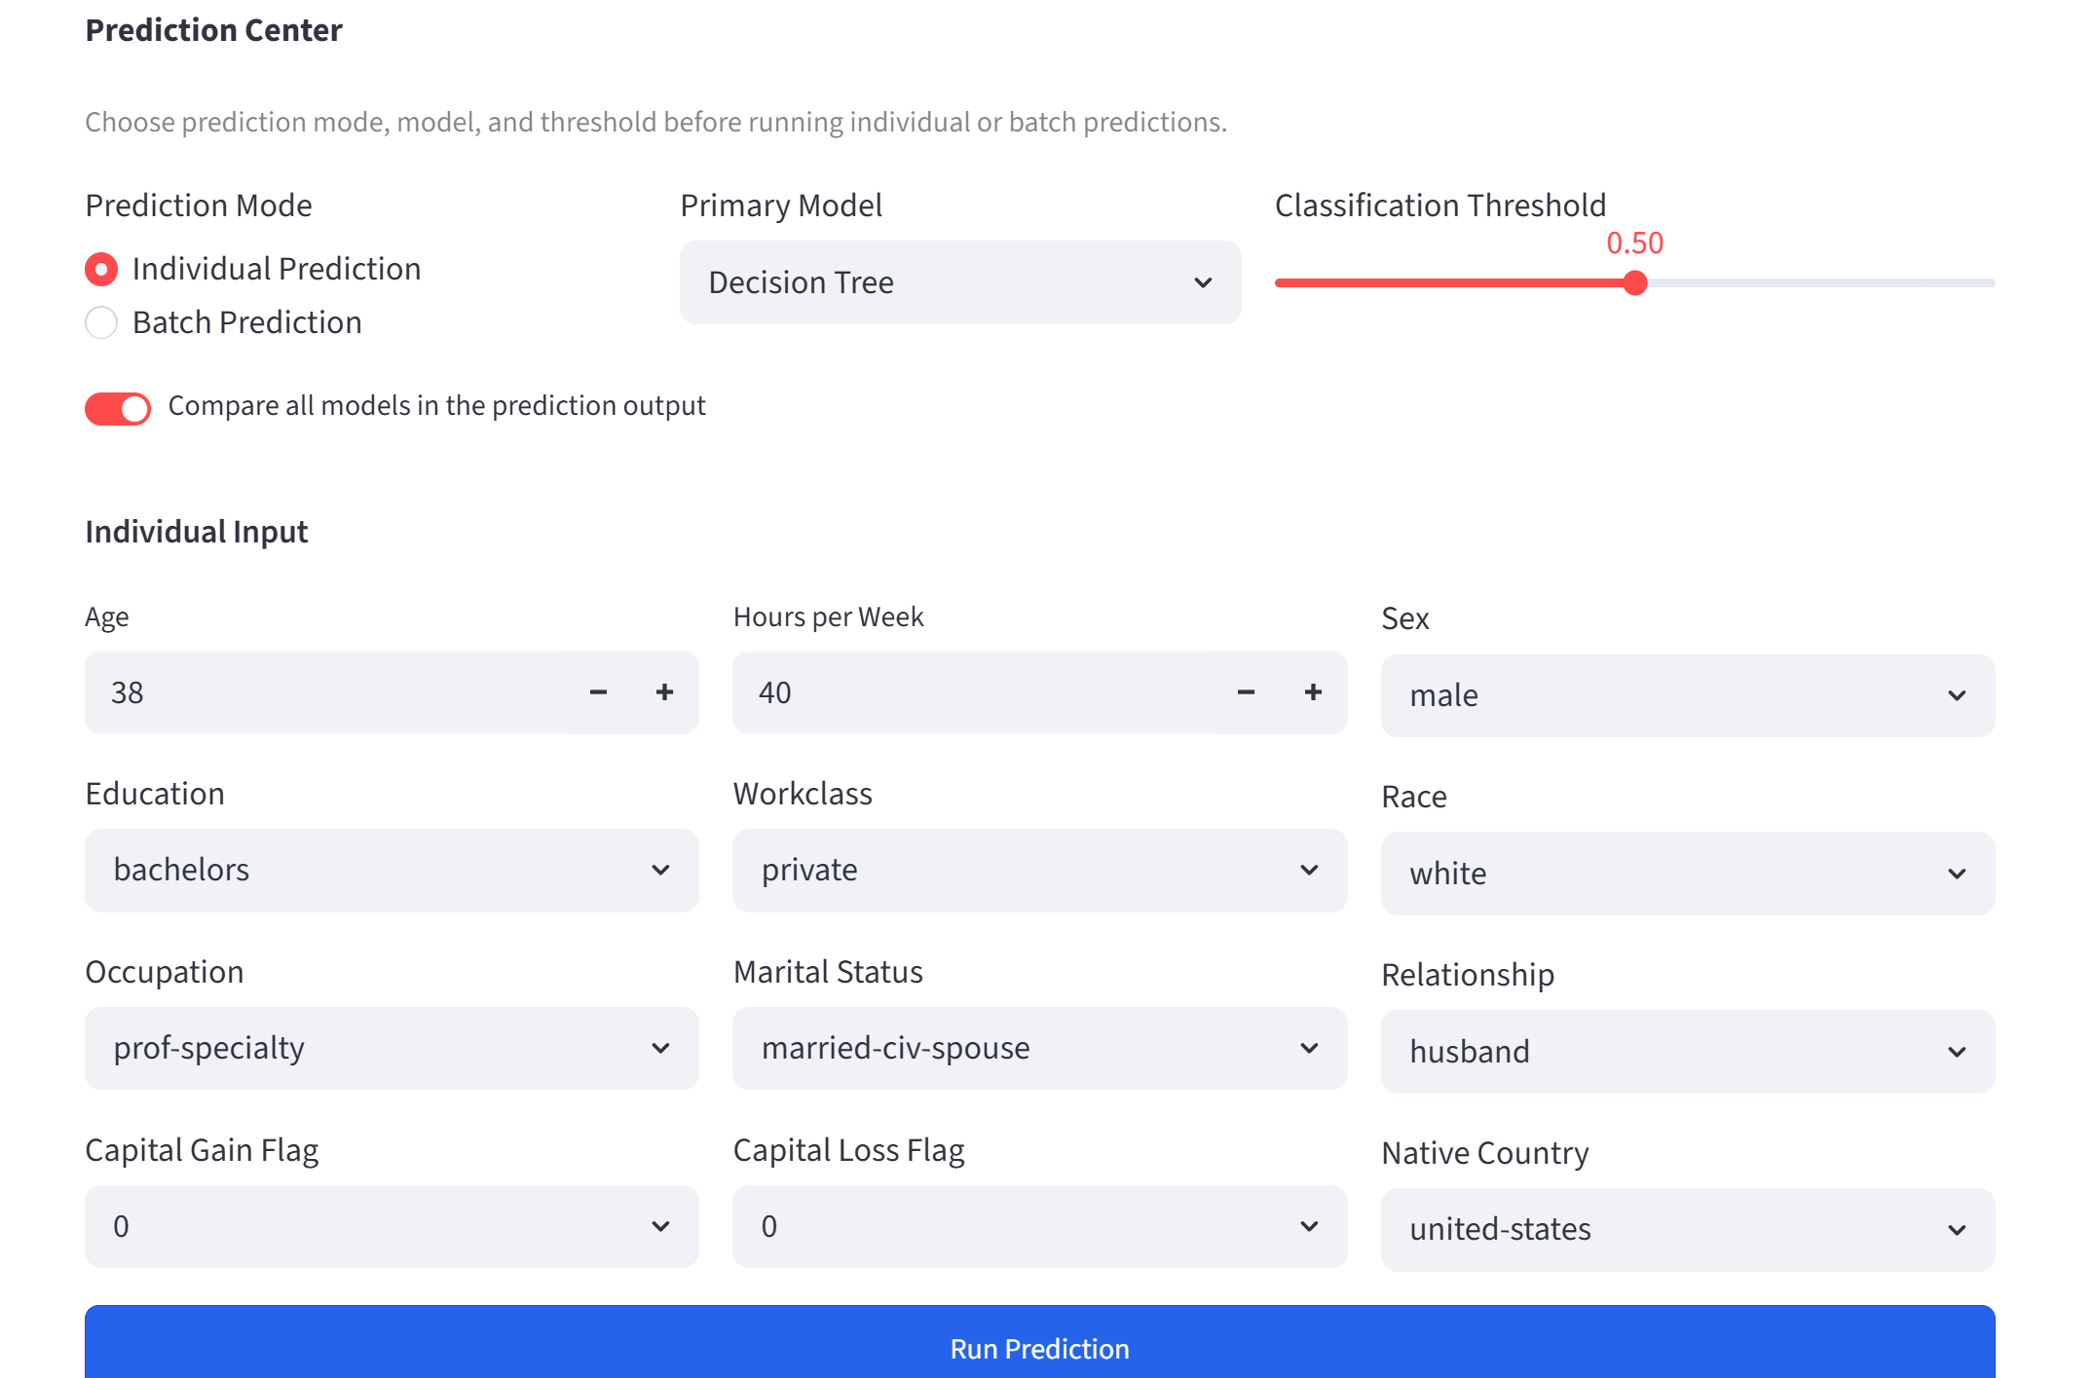
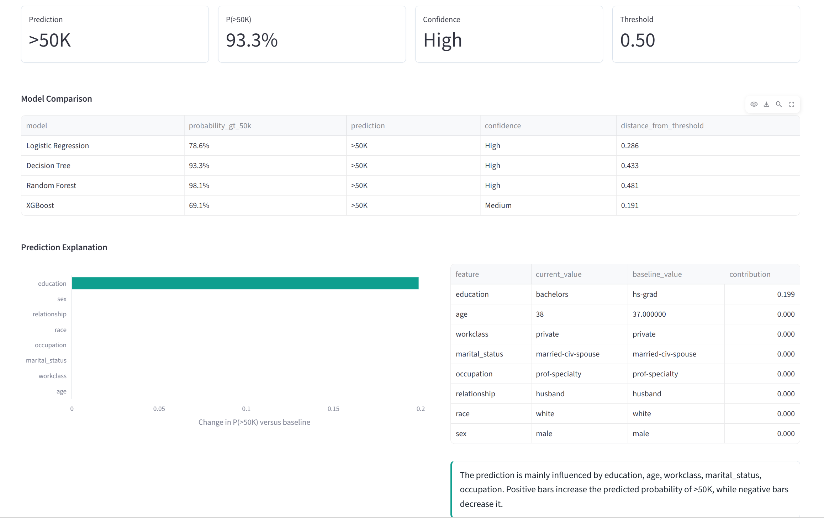
Deployment Demo: Prediction Center
07
Run individual or batch predictions with model comparison.

Slide 22
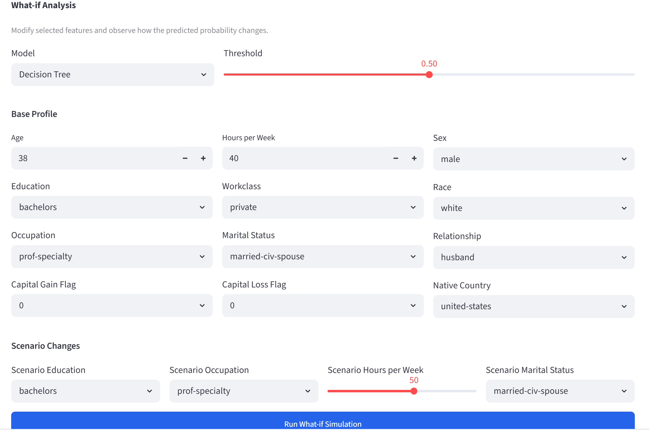
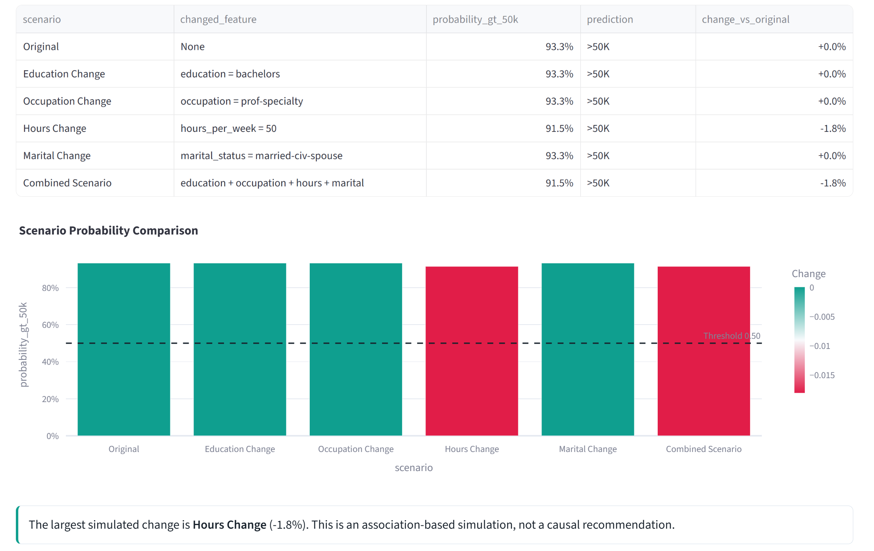
Deployment Demo: What-if Analysis
08
Modify profile features and observe probability changes.

Slide 23
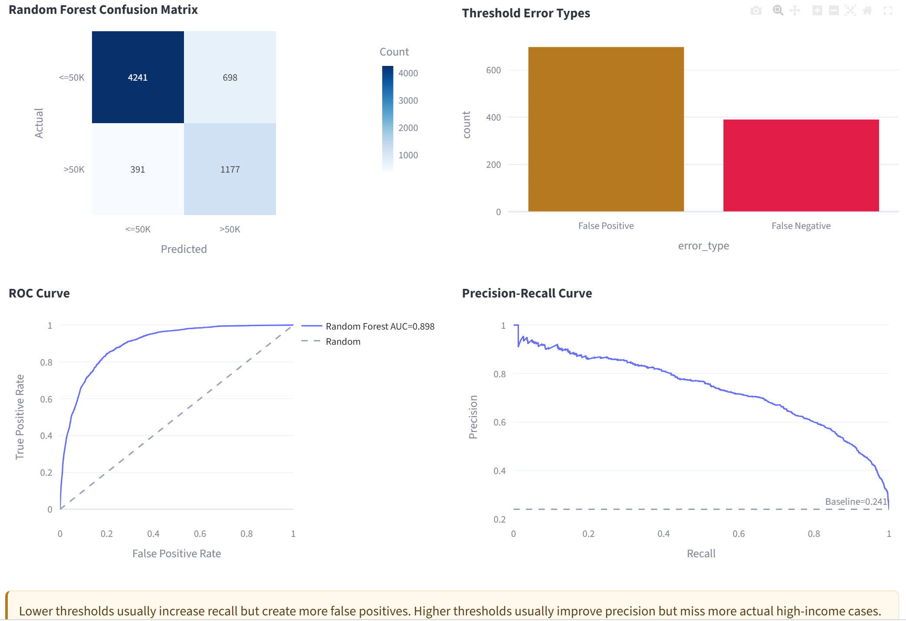
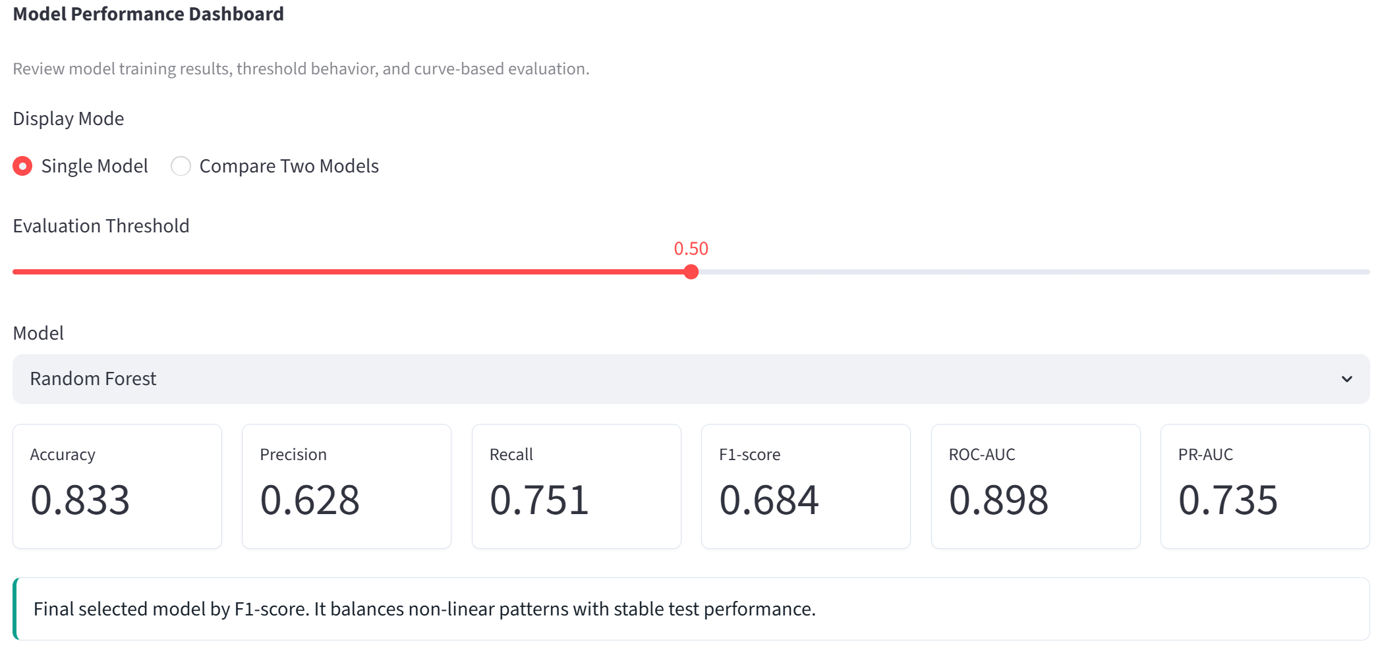
Deployment Demo: Model Performance
08
Review metrics, thresholds, ROC/PR curves, and confusion matrices.

Slide 24
07
Limitations & Failure Modes

Slide 25
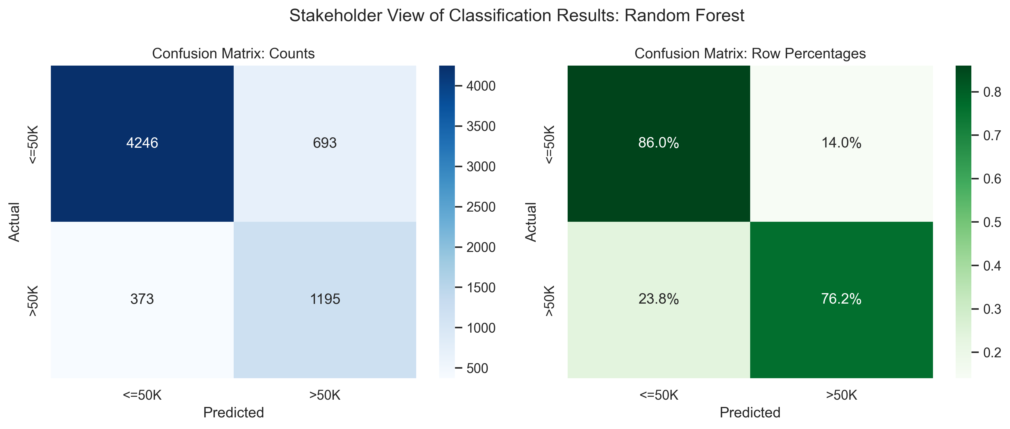
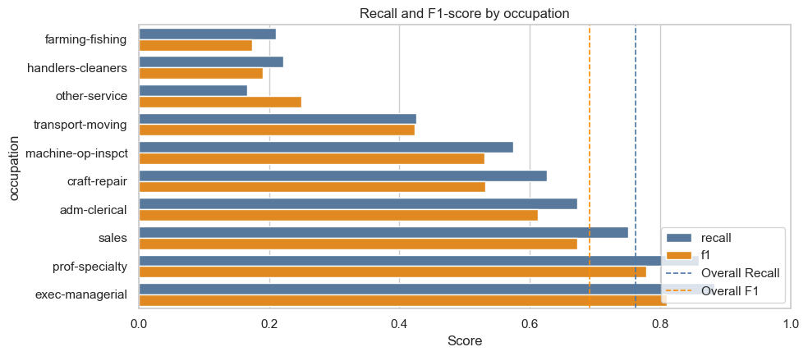
Prediction Errors
Subgroup Gaps
Limitations & Failure Modes
Fairness Risk
Data Limitations
Limitations & Failure Modes
False negatives miss actual >50K cases.
False positives overestimate some <=50K cases.
Recall and F1 vary by sex, education, race, and occupation.
Small groups have less stable results.
Demographic variables may reflect historical inequality.
Results show association, not causation.
>50K is the minority class.
Dataset is from the 1994 U.S. Census.
$50K threshold is outdated.

Slide 26
08
Conclusion

Slide 27
Conclusion
What we learned from modeling and deployment
Income can be predicted reasonably well
Employment and demographic features provide useful predictive signal.
Next Steps
Newer Data: Use recent labor-market datasets and update the $50K threshold.The target variable is imbalanced
More Model Comparison: Add new model, such as LightGBM, CatBoost, and calibrated Logistic Regression.
Add model monitoring and maintenance: Monitor prediction rates, average predicted probability, and subgroup performance over time.
Key factors are consistent with hypotheses
Education, occupation, marital status, age, and working hours are important.
Deployment makes the analysis usable
The Streamlit app supports prediction, comparison, threshold tuning, and what-if analysis.

Slide 28
Thank You for Listening!
Group 3
2026.06.30

